Slide 1
ITEC 715
Foundations of Instructional Multimedia
Week 1

Slide 2
ITEC 715
Class = E-learning Company!
Treat this class like an e-learning company
Each of you will take the role of:
  Instructional Designer
  Developer
Each of you will produce either:
  A complete short e-learning course, or
  A single module of a larger e-learning course
ITEC 715
E-learning Agency
And
Treat this class like an
e-learning company
You will take the role of Instructional Designer
You will take the role of Developer
Each of you will produce either:
  A complete short e-learning course, or
  A single module of a larger e-learning course

Slide 3
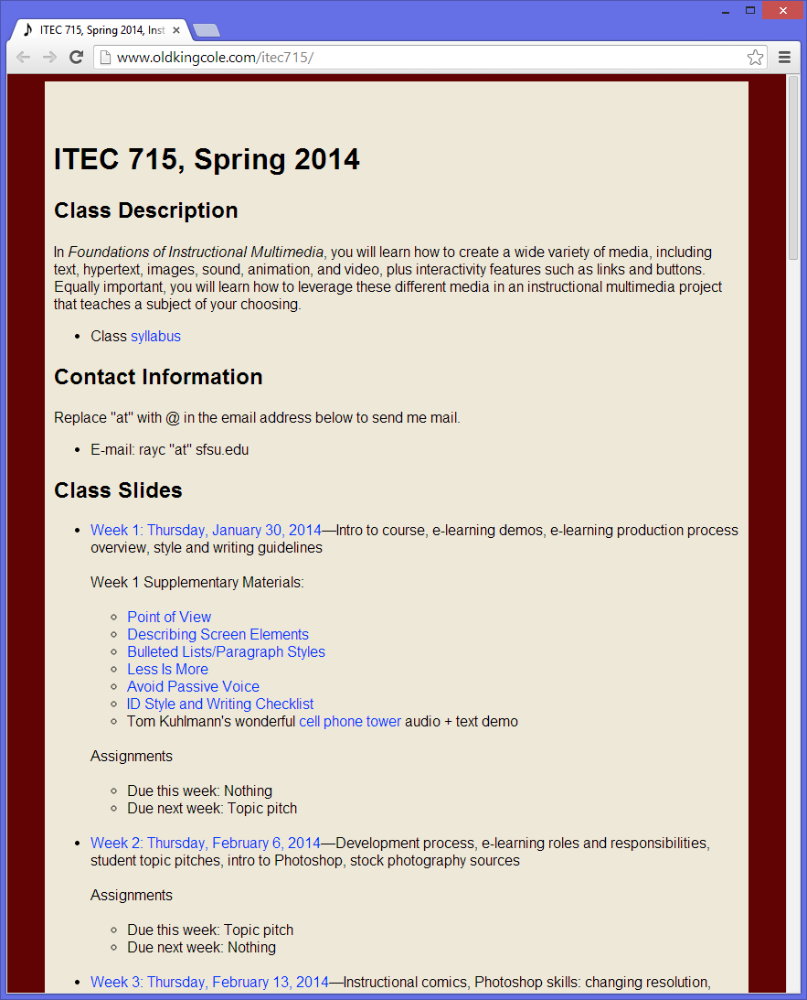
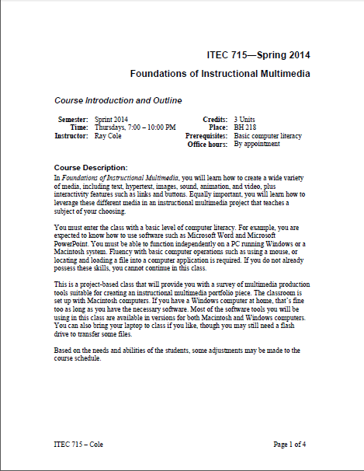
ITEC 715
Syllabus
http://www.oldkingcole.com/itec715
Notes:
Review Syllabus
Required Entry Skills
Grading
Overview of Projects
Academic Honesty

Slide 4
ITEC 715
Introductions
Each person, introduce yourself
  Your name
  How far along are you in your studies?
  Any prior ID experience?
  Any prior multimedia experience?
  Any particular areas of interest?

Slide 5






ITEC 715
Who Am I?
Instructor: Ray Cole
Some companies where I’ve helped to create e-learning:

Slide 6
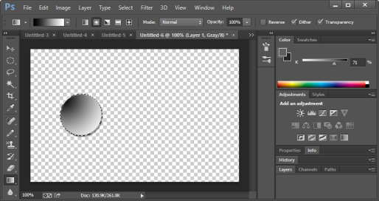
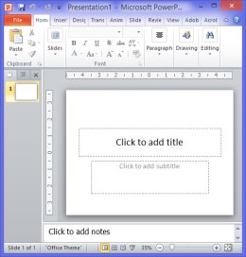
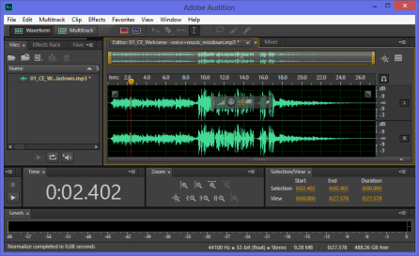
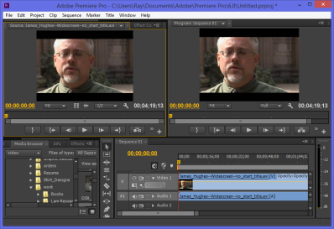
Software
In this class, you’ll learn a little bit of lots of different software packages, including:
  Adobe Photoshop
  Microsoft PowerPoint
  Adobe Audition and/or Audacity
  Apple Garage Band and/or Adobe Audition
  Adobe Premiere
  Optionally: Adobe Presenter, Adobe Media Encoder
The best way to get this software is to subscribe to it for a year. Academic price: ~$30/month with a 1-year contract gets you Photoshop, Audition, Media Encoder, and Premiere (plus tons more: Dreamweaver, Flash, Acrobat, Illustrator, InDesign, and more)
You won’t need Presenter until near the end of the semester, so you can wait until then and then download the 30-day free trial. (PC only)
Adobe Photoshop
PowerPoint
Adobe Audition
Adobe Premiere
Optional: GarageBand, Audacity, Adobe Media Encoder, Adobe Presenter
Subscribe to the Adobe Creative Cloud to get all Adobe Software used in ITEC 715 except Adobe Presenter. http://www.adobe.com/products/creativecloud.html
We won’t need Adobe Presenter until near the end of the semester, so you can wait until then, and then download the free 30-day trial. Adobe Presenter works only on Windows (no Mac version, sorry). http://www.adobe.com/products/presenter.html

Slide 7
What Is Multimedia?

Slide 8
Multimedia Components
Text
Hypertext/Hypermedia
Graphics
Sound
Video
Animation

Slide 9
What Is E-learning?

Slide 10
E-learning
Traditional Classroom
E-learning
Classroom learning requires learners to be together in the same place (in the classroom) at the same time (during class)
E-learning allows either the time or the place to be different for learners

Slide 11
Two Types of E-learning
Same Time, Different Place (live)
  Webinars
  MOOCs
Different Time, Different Place (on-demand)
  Web-based Training (WBT)
  CD-Rom
  Other Computer-based Training (CBT)
  Lecture Videos (e.g., Lynda.com, Khan Academy)

Slide 12
Attributes of Ideal Learning
What makes for an ideal learning intervention?

Slide 13
Attributes of Ideal Learning
What makes for an ideal learning intervention?
  Clarity
  Relevance
  Practice opportunities
  Feedback

Slide 14
Attributes of Ideal Learning
Good training is not about telling the learner what he or she needs to know!
Good training is about what the learner should do with that knowledge!
  Good training is not about the content.
  Good training is about the learner.
➔Good training is experience engineering!

Slide 15
Understanding the
Production Process

Slide 16

E-learning Production Process
Phases:
Sales / Proposal
Discovery
Interaction Design
Content Design
Scripting
Build
Alpha Delivery
Beta / Final Delivery
A factory for e-learning? Yes!

Slide 17

E-learning Production Process
Phases:
Sales / Proposal
Discovery
Interaction Design
Content Design
Scripting
Build
Alpha Delivery
Beta / Final Delivery
Convince client that you can meet their
  Schedule
  Budget
  Educational needs

Slide 18

E-learning Production Process
Phases:
Sales / Proposal
Discovery
Interaction Design
Content Design
Scripting
Build
Alpha Delivery
Beta / Final Delivery
Audience and Needs analysis
Identify SMEs
Roles and responsibilities
Collect source materials

Slide 19

E-learning Production Process
Phases:
Sales / Proposal
Discovery
Interaction Design
Content Design
Scripting
Build
Alpha Delivery
Beta / Final Delivery
Reach agreement about:
All presentation layouts
All interactivity layouts
All other look and feel issues
Notes:
Other look and feel issues might include:
Colors
Navigation
Branding
Accessibility issues (Section 508, or just “We have a lot of older employees who won’t be able to read such small font.”)

Slide 20
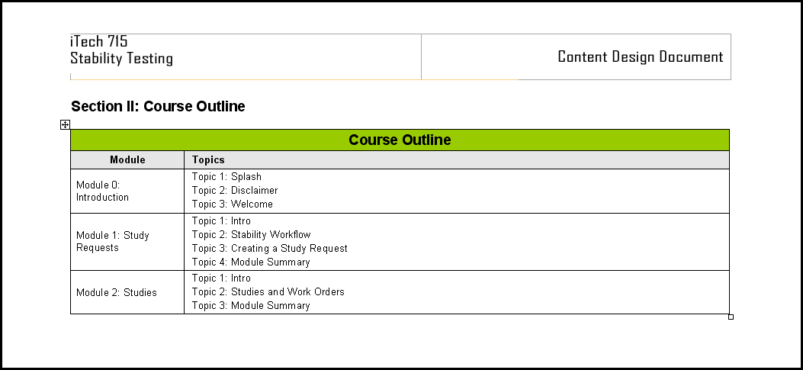
E-learning Production Process
Phases:
Sales / Proposal
Discovery
Interaction Design
Content Design
Scripting
Build
Alpha Delivery
Beta / Final Delivery
State course- and module-level learning objectives
Identify how many assessment questions will be used to test mastery of the learning objectives
Organize content into Modules, Topics, and Pages

Slide 21
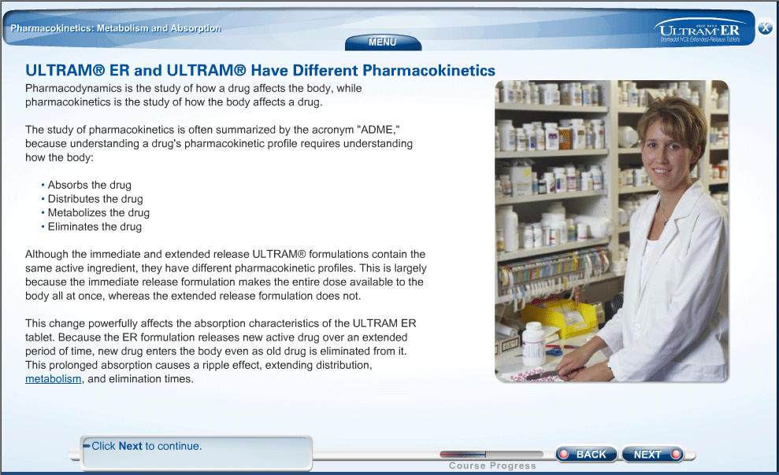
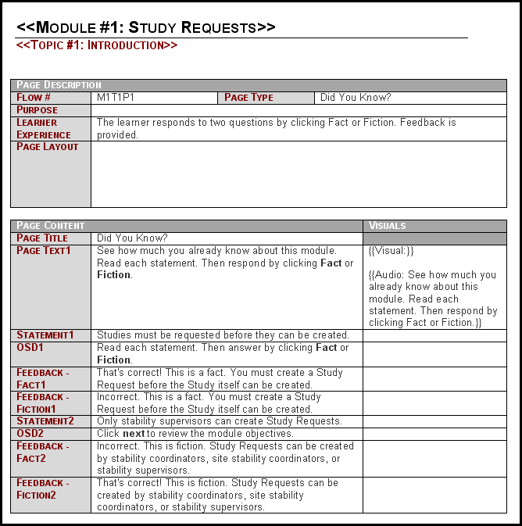
E-learning Production Process
Phases:
Sales / Proposal
Discovery
Interaction Design
Content Design
Scripting
Build
Alpha Delivery
Beta / Final Delivery
Write all on-screen text
Write activities
Write all voice-over narration, character dialog, and other spoken audio
Specify graphics, animations, video
Notes:
At some (many?) companies, scripting is done in a “structured” file, often a Microsoft Word document consisting of a series of multi-column tables.
You won’t be writing this kind of script for this class. Instead, you’ll be working directly in PowerPoint, where you can see more clearly how your pages will look.

Slide 22

E-learning Production Process
Phases:
Sales / Proposal
Discovery
Interaction Design
Content Design
Scripting
Build
Alpha Delivery
Beta / Final Delivery
Developers code all interactivity
Graphic artists, animators, videographers create and edit any needed media
Recording engineers record voice actors, edit and encode audio

Slide 23

E-learning Production Process
Phases:
Sales / Proposal
Discovery
Interaction Design
Content Design
Scripting
Build
Alpha Delivery
Beta / Final Delivery
Deliver built course to client
Client reviews course, notes bugs
IDs and Developers fix bugs and address client change requests
Rebuild course, incorporating client-requested changes

Slide 24

E-learning Production Process
Phases:
Sales / Proposal
Discovery
Interaction Design
Content Design
Scripting
Build
Alpha Delivery
Beta / Final Delivery
Deliver bug-free course to client for final approval
Collect money for a job well done!

Slide 25
E-learning Production Process
This class will primarily be concerned with the following production phases:
Dev
Discovery
Int. Design
Build
Roles
IDs
////////////////
Content Design
Scripting
PMs
Production Phases
Note: Roles not shown → Sales, Copyeditors, Internal Content Reviewers, Voice Actors, etc.

Slide 26
E-learning Production Process
Sample Interaction Deck—Approved
Start
Script—Approved
Yes
Client Approves?
Alpha Build
Meet w/ Client
No
Yes
Review and Report Bugs
E-learning Design Document
Sample Interaction Deck
Client Approves?
Meet w/ SMEs
No
Accept/Reject changes
Fix Bugs
Fix Bugs
Script
No
E-learning Design Doc—Approved
Bug-Fixed Alpha Build
Yes
Script
Copy Edit
Client Approves?
Continued on next slide
ID
Creative Designer
Client
Copy Editor or Proofreader
Developer

Slide 27
E-learning Production Process
From last slide
No
Client Approves?
Done
Yes
Yes
Record Audio
Client Approves?
No
Find out why
No
Yes
Replace Temp Audio with final audio
Release Candidate 1 (aka “Beta” Release)
Release Candidate 2+
Client Approves?
Recording Engineer
Client
Project Manager

Slide 28
Writing for E-learning
Style Guidelines:
Why Do We Need Them?

Slide 29
Benefits of Style Guidelines
Helps all team members write with a consistent voice
Improves the quality of on-screen text by raising awareness of common punctuation and grammar errors
Enables a formal or semi-formal copy edit phase in the development cycle
Captures some evidence-based instructional design best practices (e.g., using second-person POV)

Slide 30
Writing for E-learning
General Guidelines

Slide 31

Use the Chicago Manual of Style
As a baseline, you’ll use the Chicago Manual of Style. You will then supplement these guidelines with some additional guidelines covering situations specific to e-learning

Slide 32
Capitalization
Guideline: Whenever a term can be interpreted either as a proper name for something, or a generic term, favor the generic term interpretation and do not capitalize it.
Example:
  “Mary sent out the employee engagement survey to all employees last week.”
  “Employee engagement” could be interpreted as the name of the survey, in which case it should be capitalized. Or, it could be interpreted as a generic adjective describing the survey, not its proper name. In this latter case, “employee engagement” would not be capitalized. Since either interpretation is possible, the guidelines say to favor the non-capitalized interpretation.
In general, this guideline boils down to: “Try to minimize the use of capitalization.”
NOTE: It’s extremely easy to fall into the habit of capitalizing Important Words (sic) even when there is no grammatical justification for doing so, so following this guideline requires some vigilance.

Slide 33
Things to Avoid
Guideline: Minimize your use of “utilize.”
“Utilize” is a word that you should seldom utilize. Often, “utilize” is just a pretentious substitute for “use.” Unless you are writing dialog for an officious bureaucrat, “use” is usually more appropriate.
Guideline: Don’t use “their” as a gender-neutral singular pronoun.
Don’t write | Do Write
The manager must ask their direct reports. | Managers must ask their direct reports.
Note how changing the subject to plural often solves this problem. Use “his or her” if you must maintain a singular subject.

Slide 34
Things to Avoid
Guideline: Use italics for emphasis, not underlines.
The early years of the World Wide Web have caused nearly everyone to associate underlined text with hyperlinks. If you underline on-screen text, someone will most likely try to click it. So don’t use underlines for emphasis. Instead, use italics.
Don’t write | Do Write
Remember, you must do this before you enter the vault. | Remember, you must do this before you enter the vault.

Slide 35
Writing for E-learning
A Look at Some Learning Research

Slide 36
Two Similar Courses Compared
Researchers at the University of California, Santa Barbara studied* two versions of an instructional biology module (structured as a game)
  Formal language
  Personalized language
Example:
  Formal Version:
  “This program is about what type of plants survive on different planets. For each planet, a plant will be designed. The goal is to learn what type of roots, stem, and leaves allow the plant to survive in each environment. Some hints are provided throughout the program.”
  Personalized Version:
  “You are about to start a journey where you will be visiting different planets. For each planet, you will need to design a plant. Your mission is to learn what type of roots, stem, and leaves will allow your plant to survive in each environment. I will be guiding you throughout by giving out some hints.”
  *Moreno, R., and Mayer, R.E. (2000). Engaging Students in Active Learning: The Case for Personalized Multimedia Messages. Journal of Educational Psychology, 93, 724-733 (as reported in Ruth Clark and Richard Mayer’s book E-Learning and the Science of Instruction, page 137)

Slide 37
Results?
Four other similar studies surveyed¹
Clark & Mayer report²:
  “In five out of five studies, students who learned with personalized text performed better on subsequent transfer tests than students who learned with formal text” [p. 136-7]
  “Overall, participants in the personalized group produced between 20 and 46 per cent more solutions to transfer problems than the formal group.” [p. 137]
¹Moreno, R., and Mayer, R.E. (2000). Engaging Students in Active Learning: The Case for Personalized Multimedia Messages. Journal of Educational Psychology, 93, 724-733 (available, as of 2/7/2011, at http://ldt.stanford.edu/~educ39105/paul/articles_2006/Engaging%20students%20in%20active%20learning-The%20case%20for%20personalizaed%20multimedia%20messages.pdf )
²Ruth Clark and Richard Mayer, E-Learning and the Science of Instruction, 2002

Slide 38
Formal vs. Personalized
There is no important difference in content
Differences exist primarily in voice and point of view
Formal Version:
“This program is about what type of plants survive on different planets. For each planet, a plant will be designed. The goal is to learn what type of roots, stem, and leaves allow the plant to survive in each environment. Some hints are provided throughout the program.”
  Personalized Version:
“You are about to start a journey where you will be visiting different planets. For each planet, you will need to design a plant. Your mission is to learn what type of roots, stem, and leaves will allow your plant to survive in each environment. I will be guiding you throughout by giving out some hints.”
Formal:
Passive voice
Third person
Personalized:
Active voice
Second Person (mostly)
Guideline: Use active voice
Guideline: Use second person point of view

Slide 39
Voice
Passive Voice vs. Active Voice

Slide 40
Voice: Passive and Active
In active voice, the subject comes before the verb in the sentence:
  Joe purchased the software.
In passive voice, the subject comes after the verb in the sentence:
  The software was purchased by Joe.
Note that a passive voice sentence is grammatically correct, even if you omit the subject:
  The software was purchased.
Instructionally, passive voice is bad for a number of reasons:
  Leaving out the subject can hide the fact that you don’t know who performed the action
  Passive voice sentences tend to be longer than the equivalent active voice sentences
  Passages that rely heavily on passive voice sound more formal, stuffy, and boring
  Passages that rely heavily on passive voice can be harder to read and understand

Slide 41
Passive vs. Active Voice
Here are two versions of the same paragraph, adapted from page 101 of Isaac Asimov’s 1962 book, The Genetic Code:
Passive Voice | Active Voice
In 1952, a crucial experiment on bacteriophage (bak-tee’-ree-oh-fayj), a variety of virus that infests bacterial cells, was performed by two biochemists, Alfred D. Hershey and M. Chase. A cell is entered by one, multiplication occurs so that the viruses become numerous, and finally the cell is killed by them. The cell membrane is burst and, where the cell had been entered by one virus, emergence is done by many. | In 1952, two biochemists, Alfred D. Hershey and M. Chase, performed a crucial experiment on bacteriophage (bak-tee’-ree-oh-fayj), a variety of virus that infests bacterial cells. They enter a cell, multiply and become numerous, and finally kill the cell. The cell membrane bursts and, where one virus had entered, many emerge.
Which passage is easier to read?
(NOTE: Asimov’s version is the one in the “Active Voice” column)
Read: http://www.winthrop.edu/wcenter/handoutsandlinks/passive.htm to learn more.

Slide 42
Passive vs. Active Voice Exercise
Click Go ➔Connect to Server
Enter afp://coe.sfsu.edu if it (or coe) is not already present in the location bar.
Click Classroom, then navigate through the following folders:
  ITEC715
  2014_Spring
  Week01
  In-Class
There you will find seven word documents. Copy the one with your assigned number by dragging it to your desktop.
Then, double-click your desktop copy to open it.
When you are done, write your file back to the class server by saving it in the In-Class_Student_Work folder (located inside the In-Class folder).

Slide 43
Point of View
First Person, Second Person, and Third Person Points of View

Slide 44
First and Third Person POV
Most novelists and short story authors write their tales in one of two common points of view: first person singular, or various flavors of third person.
Point of View | Comments | Example
First Person Singular | In the first person singular point of view, the story is narrated by a single individual, who refers to himself or herself as “I” throughout the narrative. | I first knew something was wrong when I discovered Clelland Nostropolis was missing. I’d been expecting him to meet me at his hotel room, but when I got there, I could see that the door had been forced open and Clelland was nowhere to be found.
Third Person | Third person narratives are told by a narrator who is outside the story itself. | Veronika first knew something was wrong when she discovered Clelland Nostropolis was missing. She’d been expecting him to meet her at his hotel room, but when she got there, she could see that the door had been forced open and Clelland was nowhere to be found.

Slide 45
Second Person POV
To leverage the research findings, favor the second person point of view
Point of View | Comments | Example
Second Person | Second person narration is seldom used in normal literature. Notice that in second person narration, the reader is the main character! | You first knew something was wrong when you discovered Clelland Nostropolis was missing. You’d been expecting him to meet you at his hotel room, but when you got there, you could see that the door had been forced open and Clelland was nowhere to be found.
Which point of view seems the most dispassionate?
Which is the most involving? Why?

Slide 46
1st Person vs. 2nd Person Plural
If you are a classroom instructor, you may be used to saying “we” a lot: “This afternoon, we’ll cover that in more detail.”
“We” is not second-person—it’s first person plural. Don’t use “we” if you can use “you” instead:
In a corporate training setting, “we” is appropriate when you are referring to the whole company: “Because XYZ Corp. established a warehouse on our Dubai and Shanghai premises in 2011, we expect to save over a million dollars on shipping costs we would otherwise have incurred.”
Don’t write | Do Write
In this course, we will cover… | In this course, you will learn

Slide 47
POV Guidelines
Guideline: Do not use “we” to refer to the e-learning narrator and the learner; instead use “you” to speak directly to the learner and leave the narrator out of it
Guideline: Use “we” when referring to the company as a whole
NOTE: “Us” and “our” are also first-person plural, so sentences like “Let’s turn our attention to the second point…” are also a violation of the class writing style guidelines. In this case, “Next, consider the second point…” or “Now turn your attention to the second point…” would be within guidelines.

Slide 48
Writing Onscreen Directions
How to Refer to Screen Literals

Slide 49
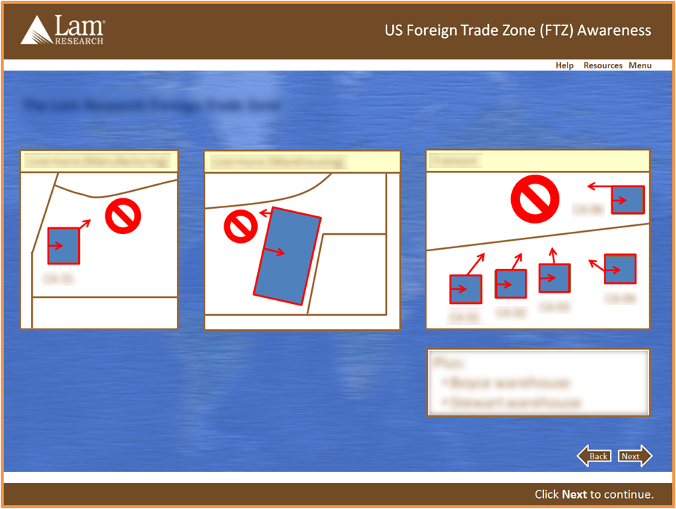
Referring to Screen Literals
“Screen Literals” are objects such as buttons or links that are literally on the screen, for example:
Menu
Resources
Help
Back
Next

Slide 50


Referring to Screen Literals
Note: Not all screen literals have names:
Two ways to deal with unnamed buttons:
  Refer to the button by its shape (“Click the Forward arrow to continue.”)
  Use the help screen(s) to associate a name with the button; then refer to it by name
Named | Unnamed

Slide 51
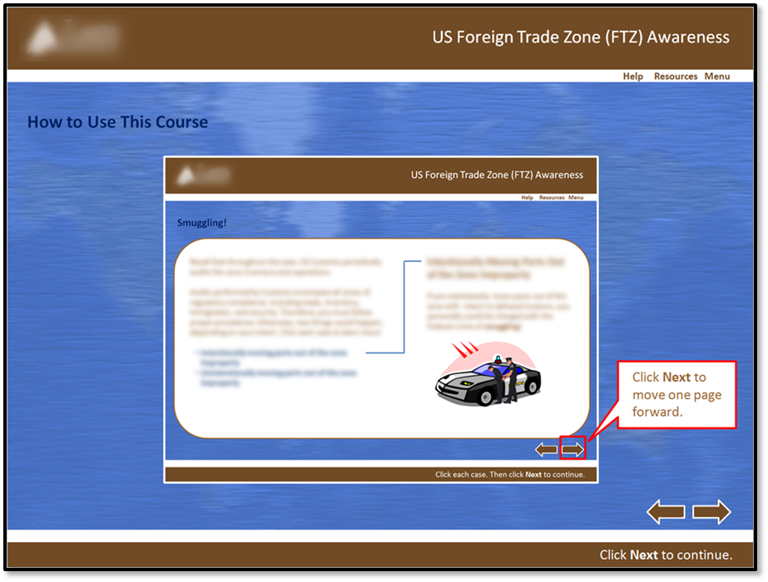
Associating Names with Buttons
One way to associate a name with an unnamed/unlabeled screen element, is to use the help screen(s):

Slide 52
Referring to Screen Literals
Guideline: When referring to named screen literals, refer to them by name and use boldfaced font.
Guideline: If you have given an unnamed screen literal a name in the help screen(s), then treat that literal as though it were named (i.e., follow the guideline for named literals, above):
Guideline: If you have not associated a name with an unnamed screen literal somewhere (like the help screen(s)) early in the course, then refer to the literal by its shape and function, boldfacing
the function:
Don’t write | Do Write
Click “Next” to continue. Click Next to continue. | Click Next to continue.
Click Next to continue.
Click the Forward arrow to continue.

Slide 53
Writing Onscreen Directions
How to Refer to Mouse Operations

Slide 54
Clicks and Drags
Guideline: Never “click on”; just “click”
Guideline: Never “click and drag”; just “drag”
Don’t write | Do Write
Click on Next to continue. Click on the Next button to continue. | Click Next to continue.
Don’t write | Do Write
Click and drag the slider to explore the relationship between supply and demand. | Drag the slider to explore the relationship between supply and demand.

Slide 55
Writing Onscreen Directions
Other Guidelines

Slide 56
Use Clear, Simple Language
Guideline: Avoid “techy” terms like “cursor,” “access,” and “interface.”
Guideline: Favor the present tense.
Don’t write | Do Write
In this module you will learn how to access the course interface. | In this module, you will learn how to use the course controls.
Roll your cursor over the More Info button for more information. | Roll your mouse pointer over the More Info button for more information.
Don’t write | Do Write
The current module will be highlighted in the menu. | The current lesson is highlighted in the menu.

Slide 57
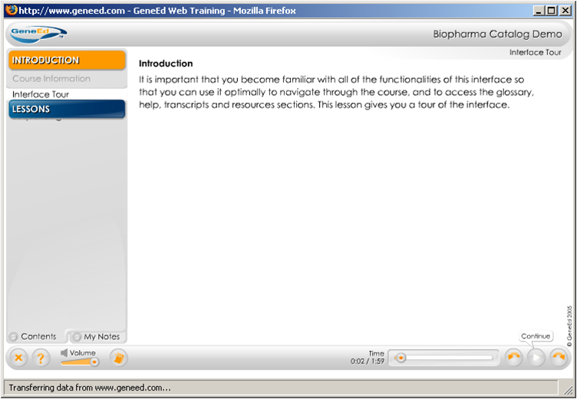
Use Clear, Simple Language
Avoid “Empty” Phrases
Don’t write | Do Write
It is important to remember that you should never leave your laptop unattended. | Never leave your laptop unattended.
It is important that you become familiar with all of the functionalities of this interface so that you can use it optimally to navigate through the course, and to access the glossary, help, transcripts and resources sections. This lesson gives you a tour of the interface. | In this lesson, you will learn how to use the course controls.

Slide 58
Writing Multiple Choice Questions

Slide 59
Multiple Choice: Needed?
Traditional multiple choice questions are probably overused
They are not always the best way to assess a learner’s knowledge
They can be used in more creative ways, but often aren’t
That being said, if you do want to write traditional multiple choice questions, this section presents some guidelines.

Slide 60
Question-Writing Terminology
Select the best choice: Proofreading your resume is important because:
  Reading about your own accomplishments raises your
  confidence level
  Errors in your resume reflect badly on your attention to detail
  Most employers fire people for making typos
  A lot of HR professionals have English degrees
The question itself, or the incomplete sentence that the learner must complete, is called a “stem.”
The correct answer choice is called the “key” (or just “the correct answer” ☺)
The incorrect answer choices are called “distractors.”

Slide 61
Use Positively-Worded Stems
Research has shown* that questions with positively worded stems lead to better assessment tests.
Don’t write | Do Write
Select the best choice: Which of the following is not correct? Laughing is harmful to your health Laughing can be contagious Laughing can make it hard to breath Laughing at someone can hurt his or her feelings | Select the best choice: Which of the following is correct? Laughing is harmful to your health Laughing can be contagious Laughing causes neuron loss Laughing has negative physiological side effects
*Barnette, J. Jackson; Effects of Stem and Likert Response Option Reversals on Survey Internal Consistency: If You Feel the Need, There is a Better Alternative to Using those Negatively Worded Stems; Educational and Psychological Measurement, June 2000, Vol. 60, No. 3, 361-370

Slide 62
Introducing Your MC Question
There are two kinds of multiple choice questions:
  Only one answer choice is correct
  Multiple answer choices may be correct
Guideline: When only one answer choice is correct, introduce your multiple choice questions with the italicized phrase: Select the best choice:
Guideline: When more than one answer choice may be correct, introduce your multiple choice question with the italicized phrase: Select all that apply:
Guideline: Introduce your true/false questions with the italicized phrase: True or false:

Slide 63
Ordering Your Answer Choices
Guideline: “True” always precedes “False” in the answer choices for a True/False question:
  True or false: Mr. Spock has pointed ears.
    True
    False
Guideline: When your answer choices are numeric, list them in either ascending or descending order:
  Select the best choice: 2 + 3 * 4⁵ = ?
    62
    137
    3074
    5120

Slide 64
How Many Answer Choices?
Guideline: Your multiple choice questions should present four answer choices.
Guideline: Minimize the use of “All of the above”/”None of the above”-type answer choices
  Instead, favor plausible distractors that reflect common mistakes people make. That way, the feedback can clarify and directly address those common errors.
  Also avoid “joke” distractors. They can be entertaining, but they usually have little or no instructional value.
Guideline: Match quiz questions to learning objectives for the course. Don’t ask trivia questions!

Slide 65
Labeling Feedback
Guideline: Don’t use exclamation points in the headers or titles that introduce feedback to incorrect answers.
Note: It’s OK to use exclamation points in the headers that introduce feedback to correct answers.
Don’t write | Do Write
Incorrect! | Incorrect.

Slide 66
Feedback
Two kinds of feedback:
  Extrinsic
  Intrinsic
Michael Allen* distinguishes between three kinds of feedback: judgments, explanations, and consequences. Of these, consequences are the most effective. Both judgments (“That’s incorrect.”) and explanations (“Actually, most textile conservators recommend wearing gloves when handling textiles, because otherwise the oils from your hands can dirty the fabric.”) are extrinsic feedback. Consequences are intrinsic feedback.
Allen, Michael W., Successful e-Learning Interface: Making Technology Polite, Effective, and Fun; Pfiefer; 2011

Slide 67
Extrinsic Feedback
Extrinsic Feedback:
  An (often anonymous) authority tells you if you are right or wrong
    Examples: “That’s correct!” or “No, that’s incorrect. Please try again.”
  In most e-learning, this kind of feedback predominates
  Strengths: Easy to implement
  Weaknesses: Learner may not learn why the answer is correct or incorrect

Slide 68
Intrinsic Feedback
Intrinsic Feedback
  Direct consequence of learner action
    Examples: Learner miscommunicates during a simulated sales call and loses the account; learner solves a customer problem and gets praise from her boss
  Strengths: Rich context; learner sees directly why actions are good or bad, understands consequences
  Weaknesses: A bit harder to write (but usually worth it)

Slide 69
Other Feedback Strategies
Delayed feedback:
  Don’t tell learners right away whether their actions are right or wrong; instead, let them continue, seeing the consequences as they move forward
  Often paired with intrinsic feedback
  Strengths: Gives learners a chance to discover their errors, back up and correct them
  Weaknesses: Don’t let learners go too long without feedback, otherwise the learning association between the action and the feedback can be lost

Slide 70
Other Feedback Strategies
Asking “Why?”
  Another strategy is to ask learners to justify their answer choices before telling them if they were right or wrong
  Can be a guard against random guessing and helps ensure learners really do know why correct answers are correct and why incorrect answers are incorrect
  Uncommon, but can be effective

Slide 71
Bullet Lists
Formatting and Punctuation Guidelines

Slide 72
Bullet Lists
Guideline: Bullet lists begin with an introductory phrase.
Example:
In this session, you will learn how to:
  Apply research findings to draft instructional writing that improves learner retention
  Explain the differences between first person, second person, and third person points of view, and why these differences matter
  Refer to on-screen elements and course interactions such as mouse clicks and drags in a consistent way
  Write clear and effective multiple choice questions
  Explain the differences between extrinsic feedback and intrinsic feedback

Slide 73
Bullet Lists
Example:
In this session, you will learn how to:
  Apply research findings to draft instructional writing that improves learner retention
  Explain the differences between first person, second person, and third person points of view, and why these differences matter
  Refer to on-screen elements and course interactions such as mouse clicks and drags in a consistent way
  Write clear and effective multiple choice questions
  Explain the differences between extrinsic feedback and intrinsic feedback
  Guideline: Each bullet list item begins with a capital letter.

Slide 74
Bullet Lists
Example:
In this session, you will learn how to:
  Apply research findings to draft instructional writing that improves learner retention
  Explain the differences between first person, second person, and third person points of view, and why these differences matter
  Refer to on-screen elements and course interactions such as mouse clicks and drags in a consistent way
  Write clear and effective multiple choice questions
  Explain the differences between extrinsic feedback and intrinsic feedback
  Guideline: Multi-line bullet list items begin their second and subsequent lines aligned with the first letter of the first line, not with the bullet.

Slide 75
Bullet Lists
Example:
In this session, you will learn how to:
  Apply research findings to draft instructional writing that improves learner retention
  Explain the differences between first person, second person, and third person points of view, and why these differences matter
  Refer to on-screen elements and course interactions such as mouse clicks and drags in a consistent way
  Write clear and effective multiple choice questions
  Explain the differences between extrinsic feedback and intrinsic feedback
  Guideline: Bullet list items have no terminal punctuation unless any item in the list is a complete sentence, in which case all items in the list get terminal punctuation.

Slide 76
Bullet Lists
  Guideline: Try to avoid full-sentences in bullet lists and instead favor short phrases as bullet list items whenever possible.

Slide 77
Bullet Lists
Guideline: Each list item must follow grammatically from the introductory phrase.
Example:
In this course, you will learn how to attach one sheet of paper to another by:
  Gluing their sides together
  Stapling their corners together
  Taping their edges together
  When none of the above are possible, call your manager for help
  For each list item:
    Introductory phrase + list item = grammatically correct sentence
    Note: This applies to multiple choice questions too!

Slide 78
Handouts/Job Aids

Slide 79
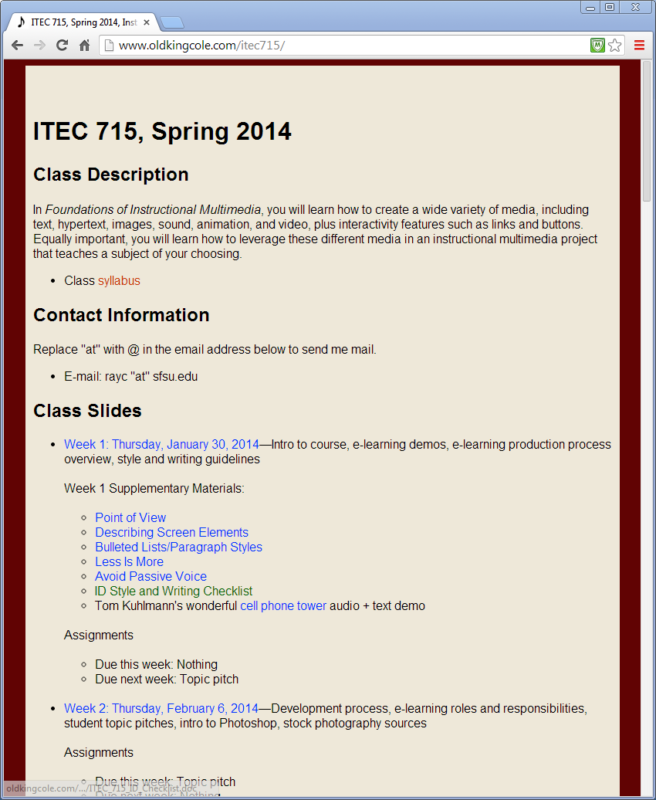
ITEC 715
Writing Handouts
Handouts at the class website: (Listed under Week 1)
  Point of View
  Describing Screen Elements
  Bullet Lists/Paragraph Styles
  Less Is More
  Avoid Passive Voice
  ID Style and Writing Checklist
  …and more…

Slide 80
ITEC 715
More on Writing Style
Also standardize:
  Fonts
  Introduction of new terms
  Introduction of new acronyms

Slide 81
Multimedia Considerations

Slide 82
ITEC 715
Onscreen Text with Audio
When your screen has text that the learner must read, and simultaneously, audio narration that the learner must listen to, there are a few choices, but none that are good:
  Text and audio present different information
  Text and audio present same information, but use different words
  Text and audio match exactly
Tom Kuhlmann’s demo: http://www.articulate.com/community/blogdemo/celltower03/player.html
Cathy Moore* puts it this way:
  Visuals + audio = persuasion
  Text + silence = learner control
  Also, “Narration narrows cultural appeal”
*http://blog.cathy-moore.com/2007/11/addicted-to-audio/

Slide 83
ITEC 715
Describing Graphics
Learning researcher Ruth Clark has written*:
“In multimedia learning, the modality principle prescribes that graphic examples are best explained by words presented in an auditory rather than a visual mode (Clark & Mayer, 2002; Mayer & Moreno, 1998). Applying the modality principle maximizes working memory resources by sending separate inputs to the visual and auditory centers in working memory rather than two inputs into the visual center, as would be the case with a graphic explained with text. By using the two storage areas in working memory, cognitive load is minimized.”
* Performance Improvement, August 2002, ISPI, article retrieved from http://www.clarktraining.com/content/articles/newISD.pdf, August 25, 2007

Slide 84
ITEC 715
For Next Week
Prepare your topic pitch. Choose your topic and prepare a pitch to the class. List a primary objective. Consider how you might incorporate graphics, sound, and video. What kind of interactivity will be appropriate for this topic?
Read the handouts posted to the class website under Week 1 Supplementary Materials
Download and read the Week 2 slides and come to class ready to discuss (download from: http://www.oldkingcole.com/itec715/)
Optionally, activate your Lynda account: http://www.lynda.com/edu-media/studentlogin.asp (class code: TBD) Note: I will email you the proper code—watch your inbox
Optionally, get started with the Lynda Photoshop online training to be ready for next week’s intro to Photoshop
Next week: Intro to Photoshop!

