Slide 1
ITEC 715
The Design of Multimedia Learning
Week 3

Slide 2
ITEC 715
From Last Week: Making a Comic Strip
Notes:
An example of a comic strip used as an opening vignette to motivate why the topic is important. Storytelling can be an effective way to engage learner emotions and motivation. A good story is also memorable.

Slide 3
ITEC 715
Making a Comic Strip, cont.
Course: Basic Accounting
Comic’s purpose: Introduce topic
Specifications:
Script:
Panel 1 (pile of money): They say money is the root of all evil…
Panel 2 (factory): …but industry couldn’t survive without it…
Panel 3 (woman with groceries): …and neither could individuals.
Panel 4 (businessman/CPA): Hi. I’m Tony Nichols, certified public accountant. In this course, you will learn basic accounting.

Slide 4
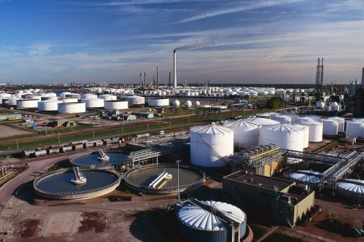
ITEC 715
Making a Comic Strip, cont.
Course: Basic Accounting
Comic’s purpose: Introduce topic
Specifications:
Images:

Slide 5
ITEC 715
Making a Comic Strip, cont.
Course: Basic Accounting
Comic’s purpose: Introduce topic
Specifications:
Rough Mockup
They say that money is the root of all evil…
I’m Tony Nichols, certified public accountant. In this
course you will learn basic accounting
…but industry can’t survive without it…
… and neither can individuals.

Slide 6
ITEC 715
Making a Comic Strip, cont.
Strategy:
Conceive idea
Find images, write rough script
Create rough mockup
Figure out the layout
Size and crop images appropriately
Add captions and word balloons
Put panels together to create final comic strip

Slide 7
ITEC 715
Making a Comic Strip, cont.
1. Conceive the idea:
Sometimes stock photos give you ideas
2. Find images, write rough script
Image sources include
Take your own with a digital (or film or polaroid) camera
Use stock photography images. Some sources (free, and for pay) include:
Clipart from MS Powerpoint and MS Office Online
iStockPhoto
GettyImages
CanStockPhoto
BigStockPhoto
ThinkStockPhotos
WikiMedia
Design Comics
Draw images in Photoshop, or on paper and then scan them in

Slide 8
ITEC 715
Making a Comic Strip, cont.
3. Create rough mockup
You can do this in Photoshop, or in PowerPoint
4. Figure out the layout
How big do you want the final comic strip to be? Think about how much screen real estate you want it to occupy. This determines the height of your panels
Don’t forget to account for the gutter space between the panels

Slide 9
ITEC 715
Making a Comic Strip, cont.
4. The layout specs for our comic are:
Size: 650 x 150 px Gutter width: 15 px
Panel 1 height: 150 px
Panel 1 yellow caption box height: 25 px over top of Panel 1
Panel 2 height: 125 px
Panel 2 yellow caption box height: 25 px underneath Panel 2
Panel 3 height: 150 px
Panel 3 yellow caption box height: 25 px over bottom of Panel 3
Panel 4 height: 125 px
Panel 4 white word balloon height: 25 px above Panel 4
Panel 4 word balloon funnel: Liquify brush size 17, density 50, pressure 100

Slide 10
ITEC 715
Making a Comic Strip, cont.
5. Check Resolution; then size and crop
Make sure all images are at the same resolution—“Image→Image Size→Resolution” (use 72 pix/inch)
Photoshop’s “Image → Resize Image”, “Image → Resize Canvas”, and “Image → Crop” features
6. Add captions and word balloons
Photoshop’s marquee, color, and text tools
7. Put completed panels together
Photoshop layers, layer effects, layer visibility

Slide 11
ITEC 715
Making a Comic Strip, cont.
Other resources, if you want to dig deeper into the theory of comics:
Understanding Comics by Scott McCloud*
Making Comics by Scott McCloud
Comics and Sequential Art by Will Eisner
Graphic Storytelling by Will Eisner
How to Draw Comics the Marvel Way by Stan Lee and John Buscema
* Scott McCloud’s book, Understanding Comics, gets Ray’s highest recommendation!

Slide 12
ITEC 715
Photoshop Image Setup
Image Mode → RGB
Resolution for screen → 72 pixels per inch
Image formats:
Traditionally (in the olden days):
GIF or PNG if you need transparency
GIF or PNG for images with few colors
JPG for photographic images
Now:
24-bit PNG for highest quality + supports transparency

Slide 13
ITEC 715
Photoshop Image Setup
Photoshop tool palettes:
Marquee tool → select, move (with arrows), select inverse, crop, fill
Layers* → new layer, select layer, delete layer, merge layers, layer effects
*Don’t forget to name your layers!

Slide 14
ITEC 715
For Next Week
Create a comic that could be used in your final project. It does not have to use the dimensions of the example in-class comic. It must be at least 4 panels long, and it must contain at least one word balloon.
Download and read the Week 4 slides and come to class ready to discuss.
Next week: More Photoshop!

