Slide 1
ITEC 715
The Design of Multimedia Learning
Week 4

Slide 2
ITEC 715
Tonight’s Agenda
Review highlights from last week’s Photoshop and comic construction intro
Critique our comics
Take a look at some ways you could take the comic format further
Then, turn attention to functional and look-&-feel issues as we design the common elements of our e-learning screens
Finally, some additional Photoshop techniques that may help you with the assignment for next week

Slide 3
ITEC 715
From Last Week: Making a Comic Strip
Notes:
An example of a comic strip used as an opening vignette to motivate why the topic is important. Storytelling can be an effective way to engage learner emotions and motivation.

Slide 4
ITEC 715
Photoshop Image Setup
Image Mode → RGB
Resolution for screen → 72 dpi
Image formats:
PSD for your layered, editable source
24-bit PNG for delivery in your course
Photoshop tool palettes:
Marquee tool → select, move (with arrows), fill, stroke
Layers → new layer, select layer, delete layer, merge layers, layer effects

Slide 5
Etiquette of In-class Critiques

Slide 6
ITEC 715
In-class Critiques
Focus on the work, not the person
Try to be specific and constructive
What’s working, what’s not?
Are there categorical problems, or just random mistakes?
Ask questions
Notes:
If something’s not working, clearly identify the problem
If you have a suggestion for improvement, offer it
It’s useful to know what is working too, so point out the good as well as the bad
If a problem covers a broad category – e.g., overuse of passive voice – you can state the category of the problem and cite an example or two if necessary to clarify. It’s not necessary to itemize each infraction!
Ask questions to lead the designer to think about things he or she might not have considered

Slide 7
Review/Critique of Student Comics

Slide 8
ITEC 715
Making a Comic Strip
Other resources, if you want to dig deeper into the theory of comics:
Understanding Comics by Scott McCloud*
Making Comics by Scott McCloud
Comics and Sequential Art by Will Eisner
Graphic Storytelling by Will Eisner
How to Draw Comics the Marvel Way by Stan Lee and John Buscema
* Scott McCloud’s book, Understanding Comics, gets Ray’s highest recommendation!

Slide 9
ITEC 715
Taking the Idea Further
Comic-centric e-learning examples:
Broken Coworker (Workplace Harassment)
Connect with Haji Kamal (Cultural Communication)

Slide 10
Elements of Good Screen Design

Slide 11
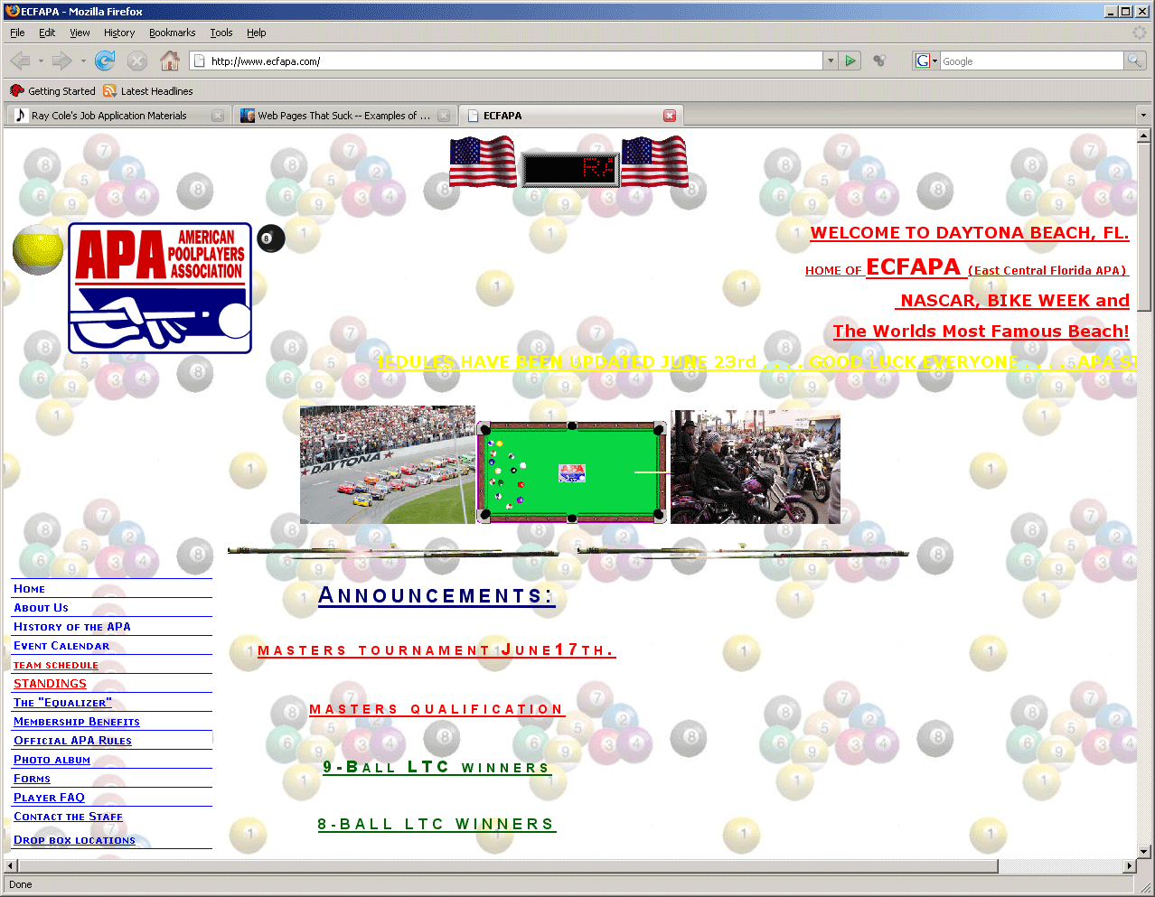
Bad Screen Design #1
What’s Wrong With This Screen?
Source: http://www.ecfapa.com/
Notes:
Source: http://www.ecfapa.com/

Slide 12
Bad Screen Design #1
What’s Wrong With This Screen?
Wasted space at top
Distracting background image
Insufficient contrast between yellow text and white background
What’s clickable?
What’s primary content?
Where is my eye supposed to start? How is it supposed to traverse this screen?
Etc…
Source: http://www.ecfapa.com/
Notes:
Source: http://www.ecfapa.com/

Slide 13
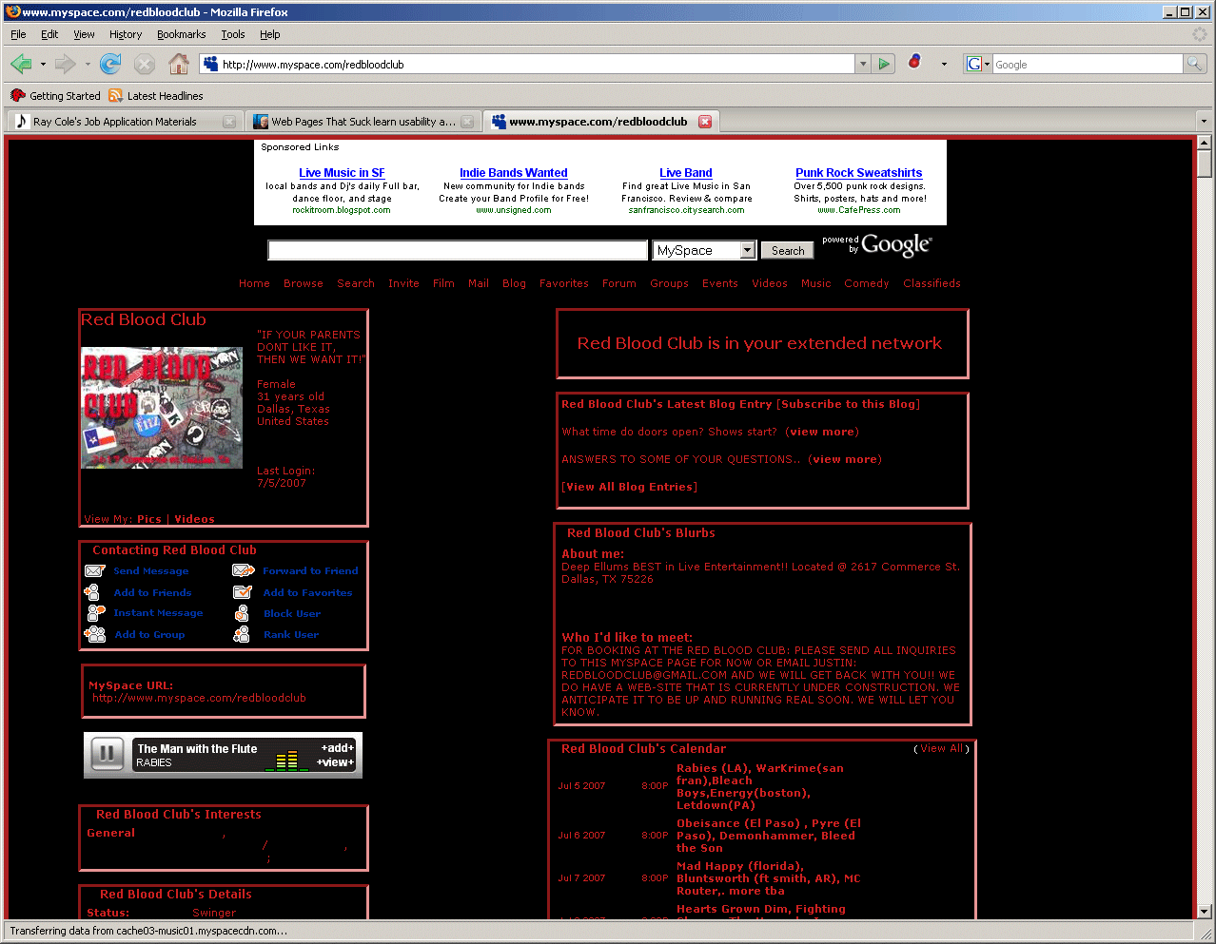
Bad Screen Design #2
What’s Wrong With This Screen?
Source: http://www.myspace.com/redbloodclub

Slide 14
Bad Screen Design #2
What’s Wrong With This Screen?
Busy—too many links
Text-heavy—poor use of images/lack of images
Insufficient contrast between red text and black background
What’s primary content?
Etc…
Source: http://www.myspace.com/redbloodclub

Slide 15
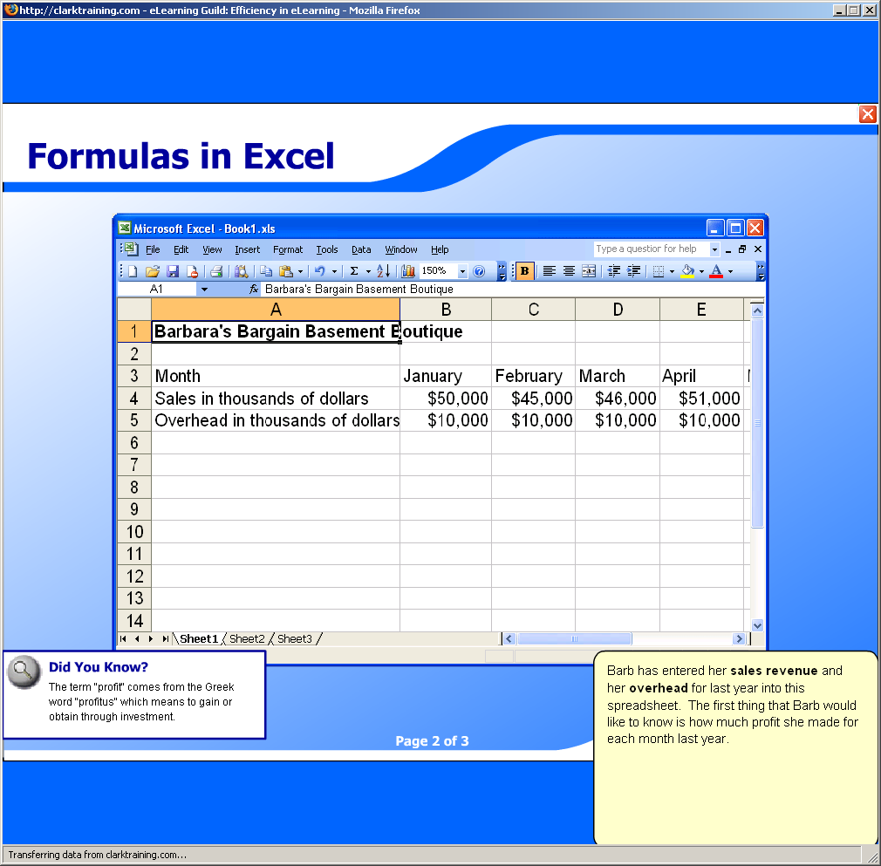
Multimedia Design Example
Is This Design Good or Bad? Why?
Source: http://www.clarktraining.com/mtest

Slide 16
Multimedia Design Example
Is This Design Good or Bad? Why?
Music and voice compete for attention
The “Did You Know?” box and the yellow text box compete for attention with the main spreadsheet screen and the voice and music!
With so many things to focus on simultaneously, the learner is likely to retain none of it due to cognitive overload
Source: http://www.clarktraining.com/mtest

Slide 17
Better Screen Design #1
What’s Working Here?
Source: http://www.geneed.com/g2/individual/demo.php

Slide 18
Better Screen Design #1
What’s Working Here?
Navigation (“Lessons”) links listed clearly in left column
Primary content is clear
Forward/Back buttons grouped together
Current location listed at top
Additional, less-often-used controls at the lower left
Clean look with good contrast between text and background
Repeated elements such as rounded rectangles tabs, and circular buttons
Source: http://www.geneed.com/g2/individual/demo.php

Slide 19
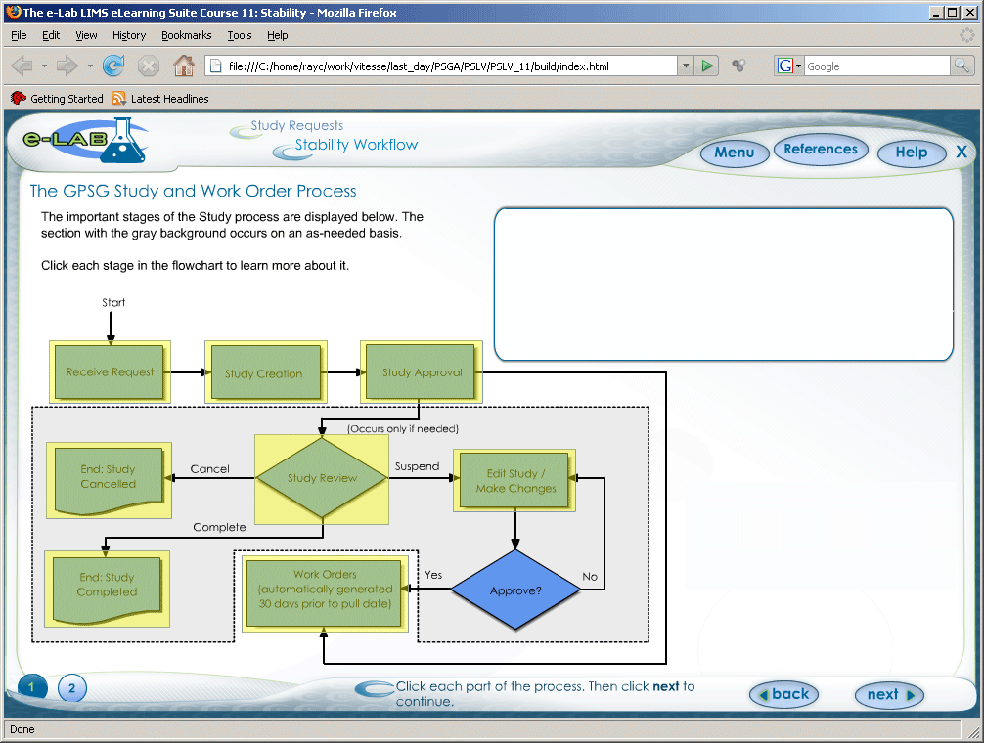
Better Screen Design #2
What’s Working Here?

Slide 20
Better Screen Design #2
What’s Working Here?
Navigation recallable from “Menu” button at top; leaves more screen area available for content
Reasonable eye-path: Start at upper left. Read directions, then move to lower left to perform actions, then look to upper right for results
Forward/Back buttons grouped together
Current location listed at top
Repeated elements

Slide 21
Better Screen Design #3
What’s Working Here?
Source: http://www.asklearning.com/web/defaultflash.cfm. → E-Learning Portfolio → The New Standard Deal

Slide 22
Better Screen Design #3
What’s Working Here?
Navigation recallable from “Show Index” button at lower left; leaves more screen area available for content
Eye is drawn directly to primary content
Forward/Back buttons grouped together
Current location listed at top
Progress indicator at lower left
Graphics support “story” context
Source: http://www.asklearning.com/web/defaultflash.cfm. → E-Learning Portfolio → The New Standard Deal

Slide 23
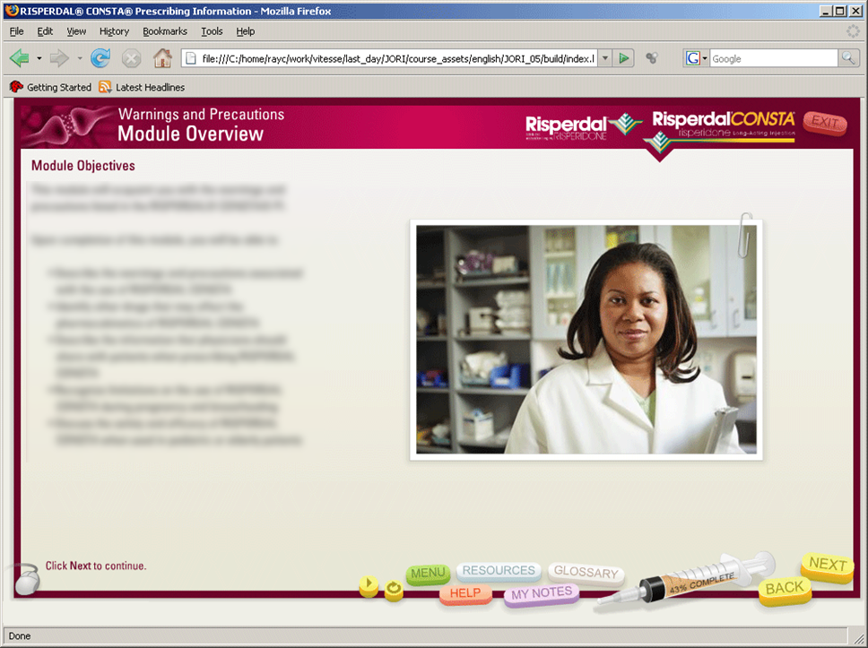
Better Screen Design #4
What’s Working Here?

Slide 24
Better Screen Design #4
What’s Working Here?
Navigation recallable from “Menu” button at lower center; leaves more screen area available for content
Primary content is clear
Buttons grouped together
Current location listed at top
Syringe is progress indicator
Control graphics are thematically appropriate (a syringe and pills)

Slide 25
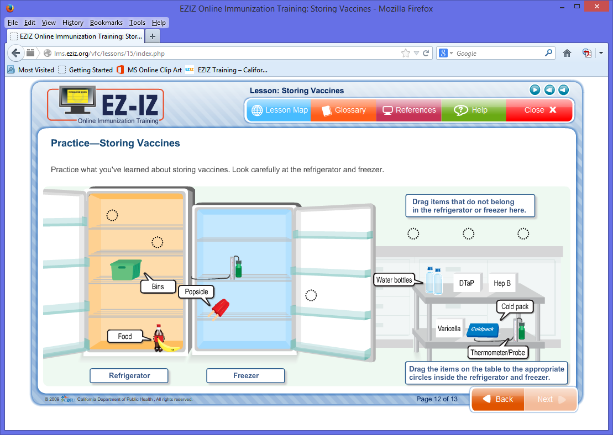
Better Screen Design #5
What’s Working Here?
Source: http://lms.eziz.org/vfc/lessons/15/index.php

Slide 26
Better Screen Design #5
What’s Working Here?
Contrast: dark font on light background; objects the learner must manipulate are darker than background to draw the learner’s eye
Repetition of design elements such as button shapes, label boxes, callout shapes, and target circles
Clean alignment of elements
Elements with similar functions are in close proximity to each other
Source: http://lms.eziz.org/vfc/lessons/15/index.php

Slide 27
General Principles Layout

Slide 28
General Principles: Layout
Screen Design: General Layout Principles
Placement
Along the edges of the screen:
Navigation
Titling
Progress indicator
On-screen directions
Middle of screen:
Reserved for course content
Allocation of Space
Try to maximize the area reserved for course content
Make edges as thin as practical without making the elements contained there unreadably small
Source: http://lms.eziz.org/vfc/lessons/15/index.php

Slide 29
Screen Design Principles
“CRAP”—Contrast, Repetition, Alignment, Proximity
Contrast
Good
Not as good
Repetition
Good
Not as good
Alignment
Proximity
Good
Not as good
Good
Not as good

Slide 30
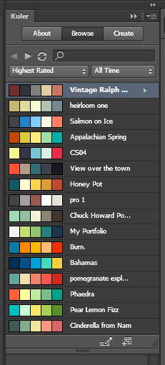
Colors
Colors/Palette
If you’re not sure what colors go with each other, hunt down some online visual art, screen capture it, then use Photoshop’s Eye-dropper tool to select some colors from the artist’s palette
Visit a paint store and get some color combination cards
Visit the Color Combos website for more ideas: http://www.colorcombos.com/combolibrary.html
Use the Kuler panel in Photoshop: Window ➔ Extensions ➔Kuler

Slide 31
General Principles Navigation

Slide 32
Screen Design Principles
Navigation Principles
Learner should have a good idea of what will happen when clicking any button
Learner should be able to easily move around in the course—at least forward/back one page and to the start of any topic.
Group like controls together.
Place navigation controls in the same place on every screen; don’t let forward/back or other navigation buttons “jump” around from screen to screen
Avoid hub-and-spoke navigation schemes
Resist the urge to remove navigation controls in order to force the learner through one particular path; when you must make a button or control unavailable, grey it out rather than removing it from the screen
Notes:
Layout Principles:
“CRAP”—Contrast, Repetition, Alignment, Proximity. See http://www.thinkvitamin.com/features/design/how-crap-is-your-site-design
Colors—If you’re not sure what colors go with each other, hunt down some online visual art, screen capture it, then use Photoshop’s Eye-dropper tool to select some colors from the artist’s pallete. Or, visit a paint store and get some color combination cards. Or, visit the Color Combos website for more ideas: http://www.colorcombos.com/combolibrary.html
Navigation Principles:
Learner should have a good idea of what will happen when clicking any button or link.
Learner should be able to easily move around in the course—at least forward/back one page and to the start of any topic.
Group like controls together.
Place navigation controls in the same place on every screen; don’t let forward/back or other navigation buttons “jump” around from screen to screen.

Slide 33
More Photoshop: Magic Wand, Eye Dropper, Select Inverse, Crop, Cut, Bevel, Shapes, Gradient Effects, Layer Effects, and Layer Opacity

Slide 34
ITEC 715
For Next Week
Mock up three variations of the frame and navigation layout you will use for your final e-learning project. Content (in the center) is not required for this assignment. You can leave the center blank.
Use a canvas size of 1440 x 1080 for your screen designs.
Download and read the Screen Designs assignment sheet for the full list of required elements to include in your designs. Available on the class website.
Next week: Effective use of graphics!

