Slide 1
ITEC 715
Computer Foundations for Instructional Multimedia
Week 6

Slide 2
Image Sources
Recall from Last Week

Slide 3
Royalty Free Image Sources
Stock Photography | Clipart
iStock Photo (http://www.istockphoto.com) | Microsoft Office Online (http://office.microsoft.com/en-us/images)
Getty Images (http://www.gettyimages.com) | Open Clip Art Library (http://www.openclipart.org)
Corbis Images (http://www.corbisimages.com) | Design Comics (http://designcomics.org)
And Powerpoint…

Slide 4
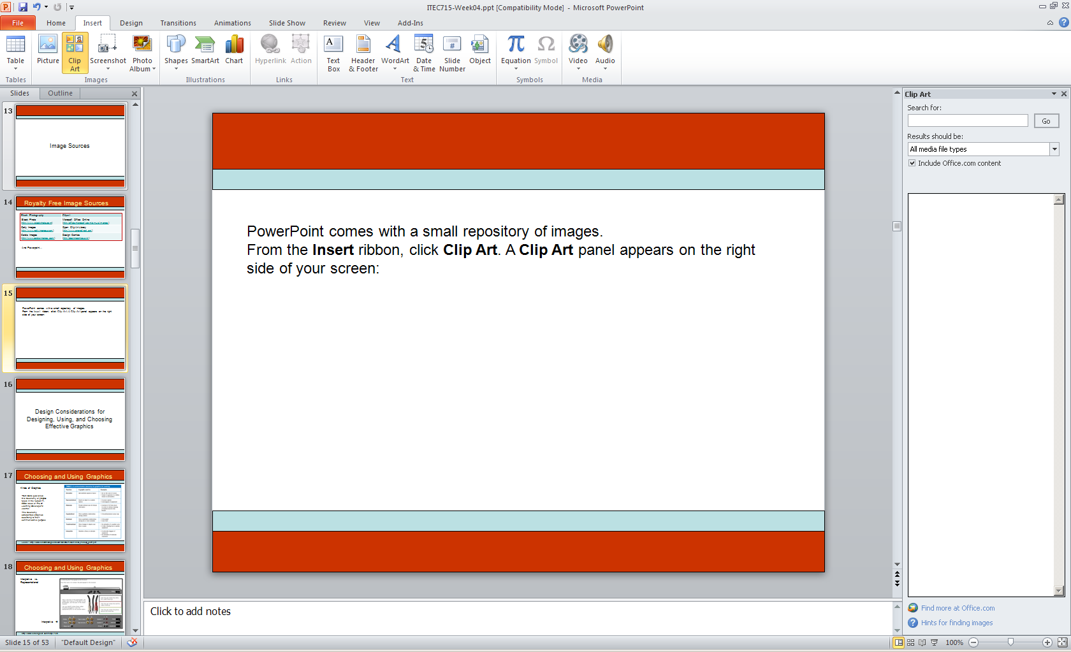
PowerPoint Clip Art
PowerPoint comes with a small repository of images.
From the Insert ribbon, click Clip Art. A Clip Art panel appears on the right side of your screen:

Slide 5
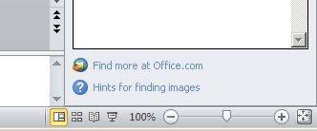
PowerPoint Clip Art
PowerPoint comes with a small repository of images.
From the Insert ribbon, click Clip Art. A Clip Art panel appears on the right side of your screen:

Slide 6
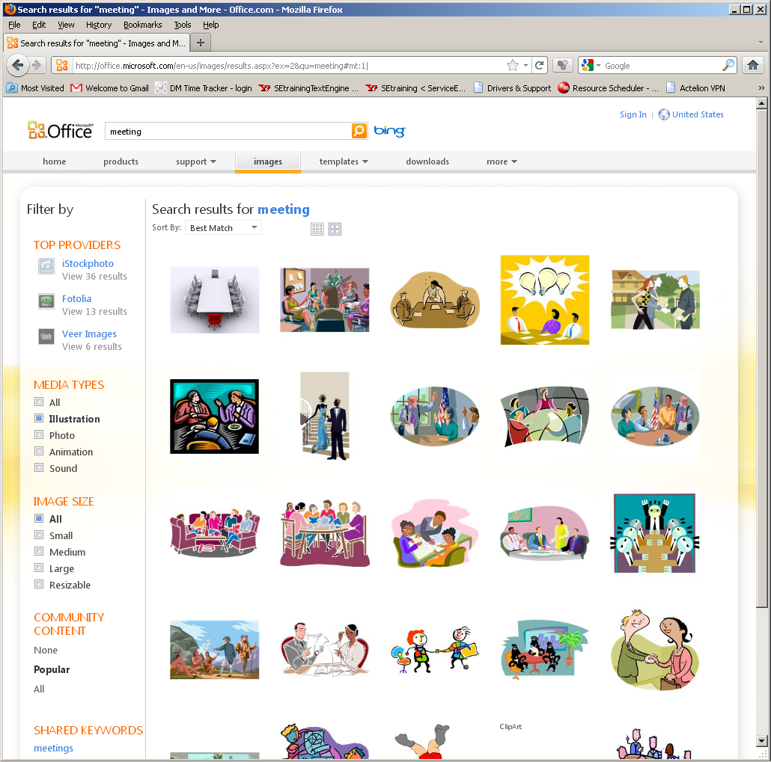
Searching
Enter your search term(s).
Use filters to restrict your search by media type or image size.

Slide 7
Style Numbers
Suppose you like this image. What other clip art is available that is drawn in this style?

Slide 8
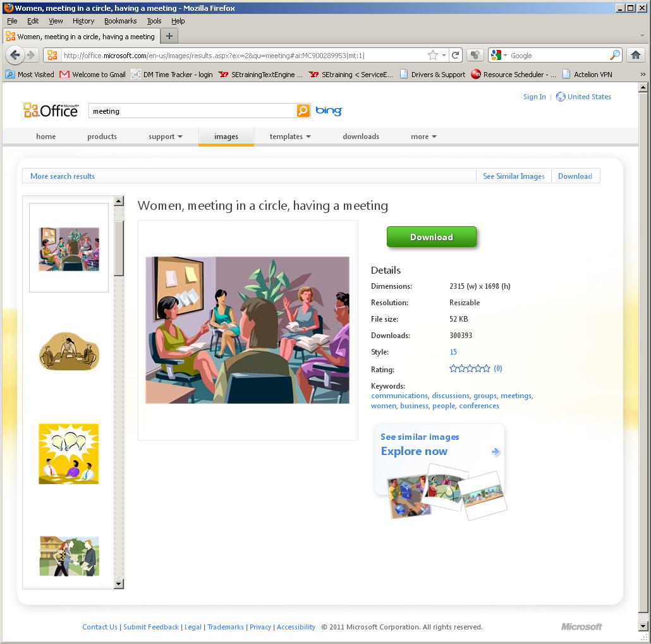
Style Numbers
Click the image you like
to view its details.
Many illustrated images have a Style number associated with them.
This number is an active link. Click it to reveal the other images in the repository that are drawn in the same style!

Slide 9
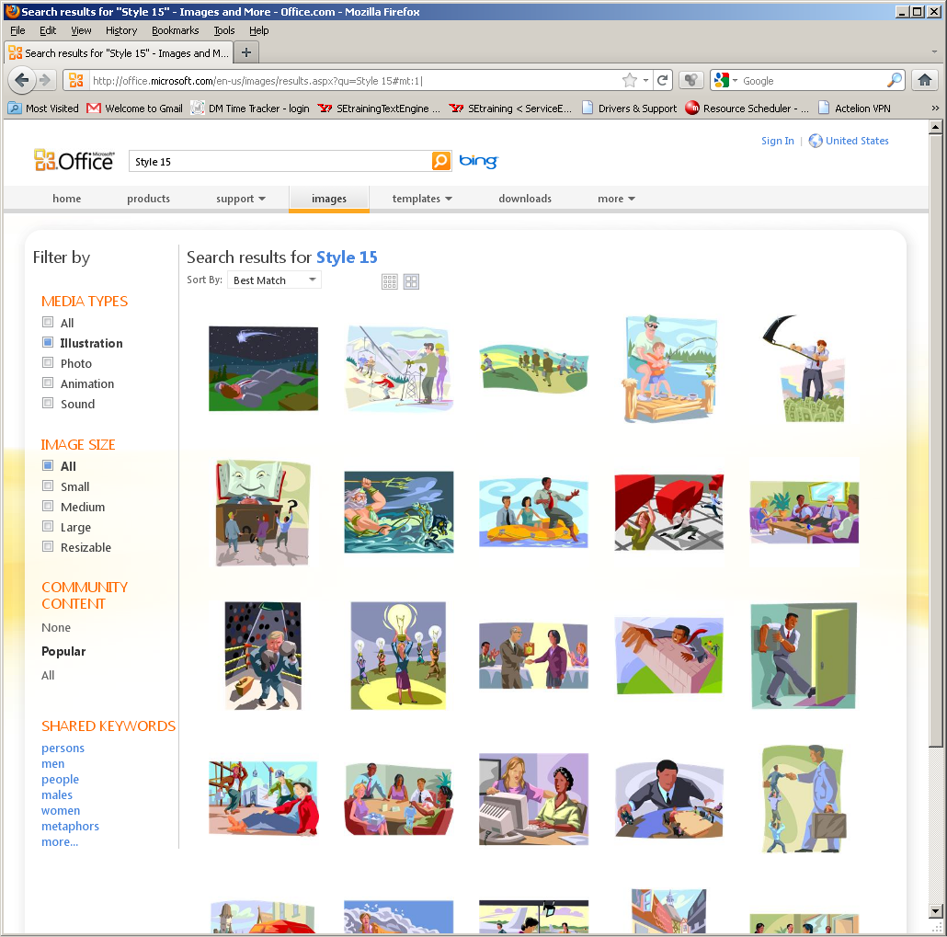
Like-Styled Images

Slide 10
Visual Unity

Slide 11

Hodge-Podge Look w/ Photos
Some images in color
Some images in B&W
Some images sharp
Some images blurred
VISUAL DISUNITY!

Slide 12

Visual Unity w/ Photos
All images in color
All images sharp
VISUAL UNITY!
Note: The slide now has good visual unity, but it has poor ethnic diversity.

Slide 13
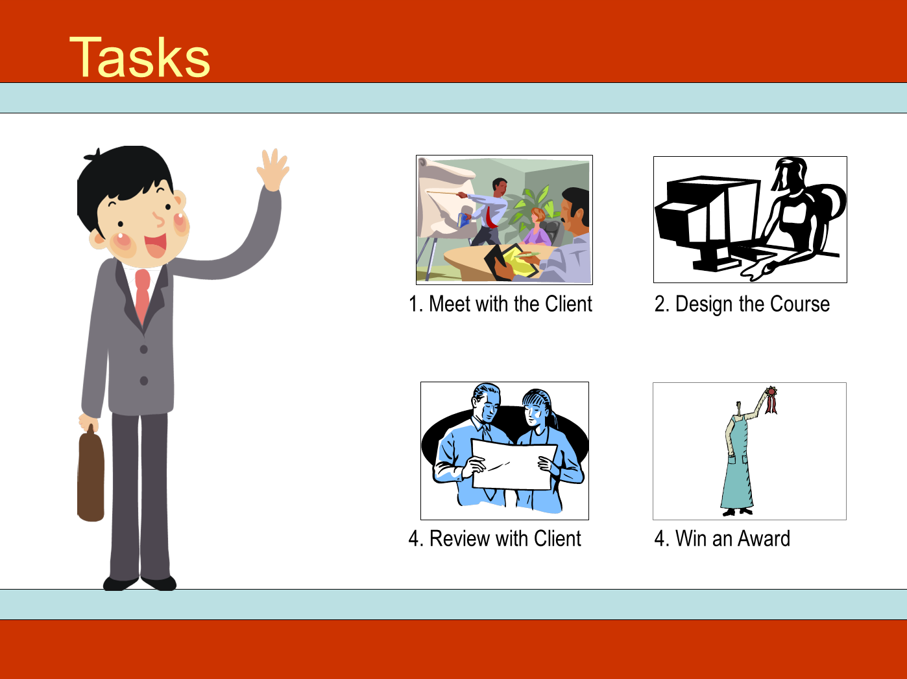
Visual Disunity w/ Illustrations
Some images in color
Some images in B&W
Some images in monotone
Every image in a different style
VISUAL DISUNITY!

Slide 14
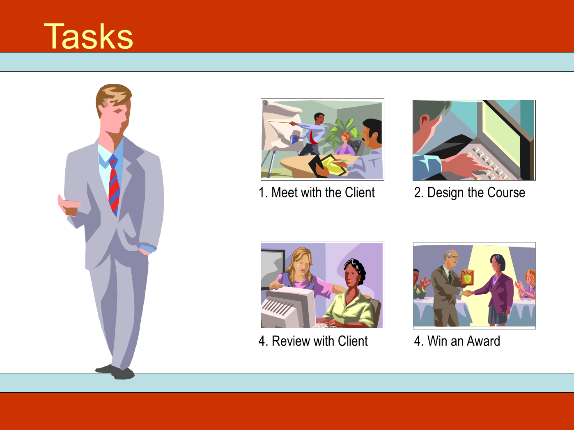
Visual Unity w/ Illustrations
All images in color
All images in same style (15)
VISUAL UNITY!

Slide 15
Working with Clip Art Illustrations

Slide 16
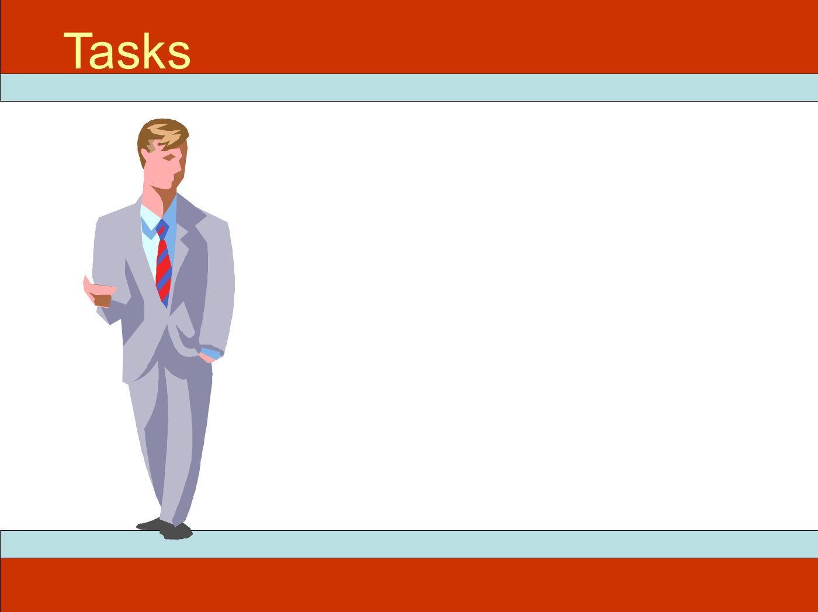
Deconstructing Clip Art
The image of the man originally came from this clip art image.

Slide 17
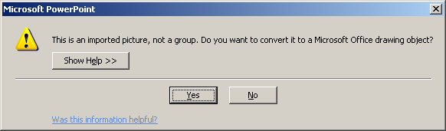
Deconstructing Clip Art
A lot of the illustrational clip art on the Microsoft Office Online image repository consists of many small shapes grouped together.
Right click (PC) or control-click (Mac) and choose Group→Ungroup. You’ll be presented with this dialog.
Click Group→Ungroup a second time to complete the ungrouping process.

Slide 18
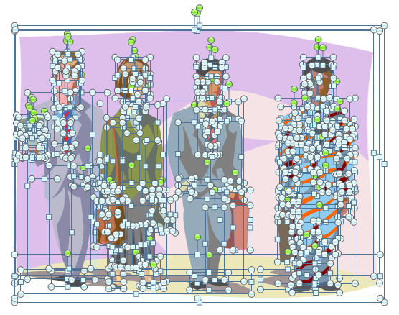
Deconstructing Clip Art
Click somewhere neutral to clear the selections. Then drag across the portions of the image you want to delete.

Slide 19

Deconstructing Clip Art
To delete the selected parts of the image, press the Delete key.
You may have to go back and re-select elements that didn’t get selected the first time, but eventually, you should be able to remove everything except the image of the man on the left.

Slide 20
Deconstructing Clip Art
The newspaper he’s holding is also constructed out of smaller shapes.
Click each part of the newspaper and press Delete. Continue until you have removed the newspaper completely.
But be careful not to delete his hand!

Slide 21
Deconstructing Clip Art
Finally, drag your mouse across the man to select all his parts, and then click Group→Group to group them all back together again.
After you’ve grouped the remaining parts, you can copy, paste, and resize the man as-needed and place him on your page.

Slide 22
Reconstructing Clip Art
Note that prior to regrouping, you could replace elements from this image with elements from other ungrouped clip art images.
For example, you could give the man a different tie, different hair style, etc.
You can also recolor elements to change skin tone, clothing color, etc.
Before
After

Slide 23
Combining Photographs

Slide 24

Background

Slide 25

Background + Foreground
Unfortunately, the foreground image of the man has its own (white) background that ruins the illusion that the man is in the office environment. What to do?

Slide 26
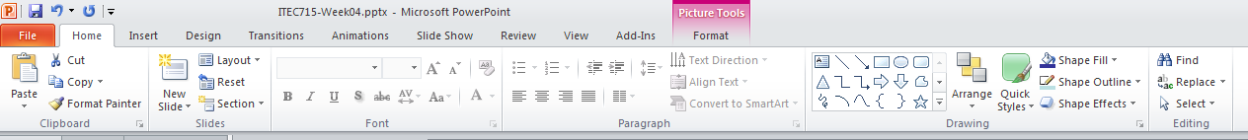
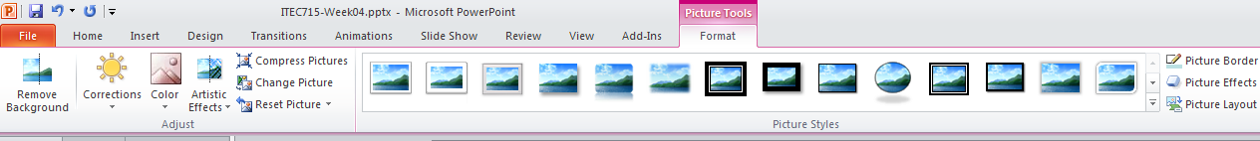
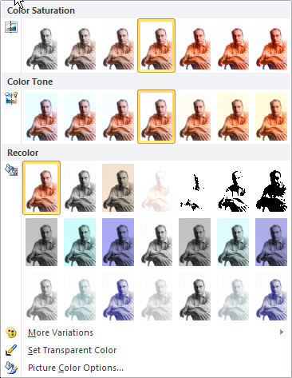
Remove the White Background
1. Click the photo of the man. Then, click Picture Tools in the ribbon.
2. Next, click Color → Set Transparent Color.
3. Finally, click the white background in the photo of the man to make it transparent.
Note: in PP2007, click Color→Recolor→Set Transparent Color

Slide 27
Background + Foreground
Now it looks like I’m in the office environment, ready to offer advice to your learners…
Unfortunately, the foreground image of the man has its own (white) background that ruins the illusion that the man is in the office environment. What to do?

Slide 28
Design Considerations for Designing, Using, and Choosing Effective Graphics

Slide 29
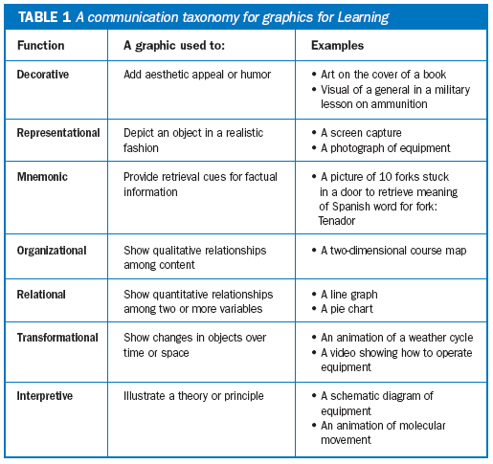
Choosing and Using Graphics
Kinds of Graphics
Ruth Clark published this taxonomy of graphics types in the August 11, 2003 issue of The E-Learning Developer’s Journal.
The taxonomy categorizes graphics according to their communicative purpose
Source: http://www.clarktraining.com/content/articles/MoreThanEyeCandy_part1.pdf

Slide 30
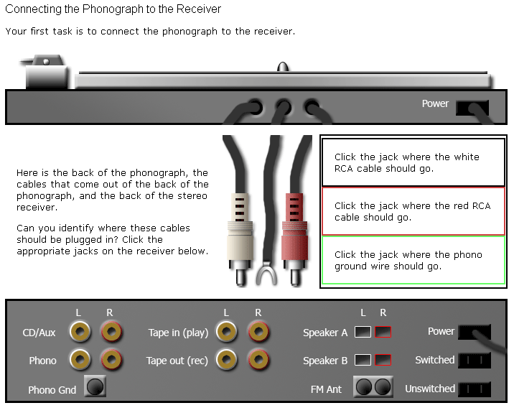
Choosing and Using Graphics
Interpretive vs. Representational
Interpretive →
http://www.oldkingcole.com/simple-sim/

Slide 31

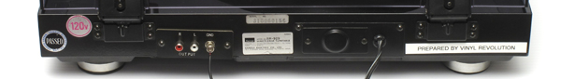
Choosing and Using Graphics
Interpretive vs. Representational
Is the representational image more effective or less?
Is there a theoretical basis for making a choice between representational and interpretive images?
Representational →
http://www.oldkingcole.com/simple-sim/photorealistic.html

Slide 32
Choosing and Using Graphics
Images with high visual fidelity represent a specific person or thing
As fidelity decreases, the images represent larger classes of people or things
Images with low visual fidelity can represent the fundamental essentials of people or things
This high visual fidelity image is a good choice when you want learners to understand how to connect cables to this specific audio receiver.
This low visual fidelity image is a good choice when you want learners to understand how to connect cables to any audio receiver, regardless of brand or specific model.

Slide 33
Choosing and Using Graphics
Perpendicular Continuums
Representational
Case Studies and Historical Accounts
Device and Application Emulations
In general, as things move from left to right across the scenario/simulation axis, they become more interactive
As things move from top to bottom on the realistic/abstract axis, they represent general concepts more than specific instances. Scott McCloud talks about this in his book, Understanding Comics. There, he points out that a photograph of a face represents one specific person. A drawing of a man’s face might represent any man. A genderless “smiley face” can represent any person, and so on
Text-based environments like “Zork”
Interpretive
Allegories and Fables
Scenario
Simulation
A similar, but slightly different take on these ideas is at Scott McCloud’s website here: http://www.scottmccloud.com/4-inventions/triangle/index.html
Notes:
Note: In Ruth Clark’s taxonomy, what I’ve called “Realistic” images, she would call “Representational.” What I’ve called “Abstract”, she calls “Interpretive.”

Slide 34
Images of People
Diversity, Attire, Setting, and Abstraction

Slide 35




Diversity
How would you rate the diversity of these images?
Age diversity: Good
Gender diversity: Poor
Racial diversity: Poor
Age diversity: Fair (Poor?)
Gender diversity: Good
Racial diversity: Poor
Age diversity: Fair/Poor
Gender diversity: Good
Racial diversity: Poor
Age diversity: Fair (Poor?)
Gender diversity: Good
Racial diversity: Good

Slide 36



Diversity
Are age, gender, and race the only important diversity categories?
Not necessarily. If you want your images to signal an inclusive workplace, you may need to consciously choose images of people in other minority classes.
Disability status
Pregnancy status
Sexual orientation

Slide 37




Attire & Setting
Do the people in your e-learning course look like the people in your school, company, or institution?
Attire:
Setting:

Slide 38
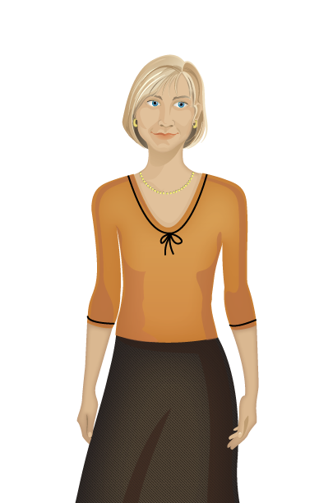


Abstraction
A specific woman
No specific woman
Representational
Interpretive

Slide 39
This Week:
A Divide and Conquer Approach to E-learning Design and Production

Slide 40
A Challenge to E-learning Designers
Common reactions to e-learning:
“Overcoming my boredom is the hardest part of most e-learning I take.”
“I typically read e-mail or do other tasks while the voice of the e-learning narrator drones on.”
“At the quiz, I guess randomly until I get the right answer.”
“After taking a typical e-learning course, I haven’t learned much, and I retain even less.”
What can we do to avoid creating courses that generate responses like these?

Slide 41
Why Design Internactions?
Driving Principles (Instructional)
Improve learner engagement because bored learners tune out
Learners retain more when they work with the material
Driving Principles (Economic)
Don’t reinvent the wheel
Breaking a complex task into smaller chunks makes designing easier (and faster)
Time is money

Slide 42
Interaction Design
Page Types
  Definition: A “page type” is a formalized templated combination of page layout and interactivity.
  Page layout = how elements are arranged on the page
  Interactivity = how the learner interacts with the page
  NOTE: Basic navigation doesn’t count as interactivity!

Slide 43
Page Type Examples

Slide 44

ITEC 715
Text With Graphic
The Company Helpdesk
You can reach the company helpdesk at any time, day or night, by calling x1700. Please have the following information ready when you call the helpdesk:
Your employee number
Your location (campus and building)
Your computer’s asset number (located on a sticker the underside of most laptops)
Whether this is a new issue or an existing issue. If it’s an existing issue, please have the ticket number available.
Call x1700 to reach the helpdesk at any time
Click Next to continue.
Back
Menu
Next

Slide 45
ITEC 715
Text Explore
The Company Business Process
There are four major steps to the company business process. Click each step to learn more about it:
Research the competitive landscape
Estimate costs required to “beat the best”
Estimate the return on investment (ROI)
Make a “build vs. buy” decision
Click each process step. Then click Next to continue.
Back
Menu
Next

Slide 46
ITEC 715
Text Explore
The Company Business Process
There are four major steps to the company business process. Click each step to learn more about it:
Research the competitive landscape
Estimate costs required to “beat the best”
Estimate the return on investment (ROI)
Make a “build vs. buy” decision
Research the Competitive Landscape
In this step, you must determine if there are any competitors who are already engaged in the new business opportunity you see for your company. If so, you need to identify which competitor is doing the best in this market.
“Best” can be a tricky concept. Sometimes it means earning the largest gross margins. Sometimes is means capturing the largest share of the market. Be careful how you define “best” at this stage!
Click each process step. Then click Next to continue.
Back
Menu
Next

Slide 47
ITEC 715
Text Explore
The Company Business Process
There are four major steps to the company business process. Click each step to learn more about it:
Research the competitive landscape
Estimate costs required to “beat the best”
Estimate the return on investment (ROI)
Make a “build vs. buy” decision
Estimate Costs Required to “Beat the Best”
Having identified the competitor who is doing best in this market, you next need to figure out how much it will cost your company to enter the market and beat the best player.
Some factors to consider:
Existing brand loyalties you may have to overcome
Marketing costs
Any import duties on parts or subcomponents
Taxes and other fees
Click each process step. Then click Next to continue.
Back
Menu
Next

Slide 48
ITEC 715
Text Explore
The Company Business Process
There are four major steps to the company business process. Click each step to learn more about it:
Research the competitive landscape
Estimate costs required to “beat the best”
Estimate the return on investment (ROI)
Make a “build vs. buy” decision
Estimate the Return on Investment (ROI)
To compute the ROI, <blah blah blah etc. etc. etc.>
Click each process step. Then click Next to continue.
Back
Menu
Next

Slide 49
ITEC 715
Text Explore
The Company Business Process
There are four major steps to the company business process. Click each step to learn more about it:
Research the competitive landscape
Estimate costs required to “beat the best”
Estimate the return on investment (ROI)
Make a “build vs. buy” decision
Make a “Build vs. Buy” Decision
Factors to consider in making this decision include:
Blah
Blah
Blah
Yadda
Yadda
Yadda
Click each process step. Then click Next to continue.
Back
Menu
Next

Slide 50
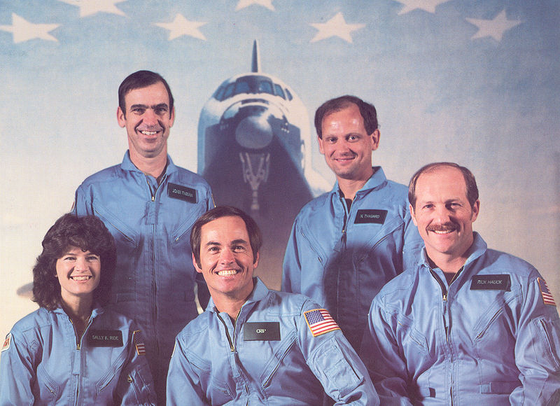
ITEC 715
Graphic Explore
Sally Ride’s Crewmates on STS-7
In 1983, Sally Ride became the first American woman to enter space when she flew on the space shuttle Challenger’s STS-7 mission. At the time, she was also the youngest American to enter space. Can you identify her crewmates? Click each astronaut to see if you are right.
Click each astronaut. Then click Next to continue.
Back
Menu
Next

Slide 51

ITEC 715
Graphic Explore
Sally Ride’s Crewmates on STS-7
In 1983, Sally Ride became the first American woman to enter space when she flew on the space shuttle Challenger’s STS-7 mission. At the time, she was also the youngest American to enter space. Can you identify her crewmates? Click each astronaut to see if you are right.
Sally K. Ride
(Mission Specialist)
Dr. Sally Kristen Ride (born May 26, 1951) from Los Angeles, California, is an American physicist and a former NASA astronaut. She studied at Portola Middle School, Westlake School for Girls, Swarthmore College and Stanford University, and earned a master's degree and PhD. Ride joined NASA in 1978, and in 1983, became the first American woman, and then-youngest American, to enter space. In 1987 she left NASA to work at Stanford University Center for International Security and Arms Control.
Click each astronaut. Then click Next to continue.
Back
Menu
Next

Slide 52

ITEC 715
Graphic Explore
Sally Ride’s Crewmates on STS-7
In 1983, Sally Ride became the first American woman to enter space when she flew on the space shuttle Challenger’s STS-7 mission. At the time, she was also the youngest American to enter space. Can you identify her crewmates? Click each astronaut to see if you are right.
Robert L. Crippen
(Mission Commander)
Robert Laurel Crippen (born September 11, 1937 in Beaumont, Texas) is an engineer, retired United States Navy Captain and a former NASA astronaut. He flew on four Space Shuttle missions, including three as commander.[1] Crippen is a recipient of the Congressional Space Medal of Honor.
Click each astronaut. Then click Next to continue.
Back
Menu
Next

Slide 53

ITEC 715
Graphic Explore
Sally Ride’s Crewmates on STS-7
In 1983, Sally Ride became the first American woman to enter space when she flew on the space shuttle Challenger’s STS-7 mission. At the time, she was also the youngest American to enter space. Can you identify her crewmates? Click each astronaut to see if you are right.
Frederick H. Hauck
(Pilot)
Frederick H. Hauck was born April 11, 1941 in Long Beach, California, but considers Winchester, Massachusetts and Washington, D.C. to be his hometowns. NASA selected Hauck as an astronaut candidate in January 1978. He was pilot for STS-7, the seventh flight of the Space Shuttle, which launched from Kennedy Space Center, Florida, on June 18, 1983. This was the second flight for the orbiter Challenger and the first mission with a 5-person crew.
Click each astronaut. Then click Next to continue.
Back
Menu
Next

Slide 54

ITEC 715
Graphic Explore
Sally Ride’s Crewmates on STS-7
In 1983, Sally Ride became the first American woman to enter space when she flew on the space shuttle Challenger’s STS-7 mission. At the time, she was also the youngest American to enter space. Can you identify her crewmates? Click each astronaut to see if you are right.
John M. Fabian
(Mission Specialist)
John McCreary Fabian (born January 28, 1939, in Goose Creek, Texas) is a former NASA Astronaut and Air Force officer who flew two space shuttle missions and worked on the development of the shuttle's robotic arm. He later led the Air Force's space operations.
Click each astronaut. Then click Next to continue.
Back
Menu
Next

Slide 55

ITEC 715
Graphic Explore
Sally Ride’s Crewmates on STS-7
In 1983, Sally Ride became the first American woman to enter space when she flew on the space shuttle Challenger’s STS-7 mission. At the time, she was also the youngest American to enter space. Can you identify her crewmates? Click each astronaut to see if you are right.
Norman E. Thagard
(Mission Specialist)
Dr. Norman Earl Thagard first flew on STS-7, which launched from Kennedy Space Center, Florida, on June 18, 1983. During the flight Dr. Thagard conducted various medical tests and collected data on physiological changes associated with astronaut adaptation to space. He also retrieved the rotating SPAS-01 using the RMS. Mission duration was 147 hours before landing at Edwards Air Force Base, California, on June 24, 1983.
Click each astronaut. Then click Next to continue.
Back
Menu
Next

Slide 56
ITEC 715
Two Character Dialog
Preparing for Launch
Meet Sally and Norman
As you listen to Sally and Norman’s dialog, see if you can find the answers to the following questions:
What is Sally’s chief concern about the mission?
What is Norman’s chief concern?
Click Start to begin listening to their conversation.
Sally is a Mission Specialist on STS-7.
Sally
Norman is a physician on the STS-7 flight.
Norman
Start
Click Start to begin the activity.
Back
Menu
Next

Slide 57
ITEC 715
Two Character Dialog
Sally Ride’s Crewmates on STS-7
Blah blah blah etc etc etc yadda yadda yadda.
Norman
Sally
Back
Next
Click Start to begin the activity.
Back
Menu
Next

Slide 58
ITEC 715
Two Character Dialog
Sally Ride’s Crewmates on STS-7
Yadda yadda yadda etc etc etc blah blah blah.
Sally
Norman
Back
Next
Click Start to begin the activity.
Back
Menu
Next

Slide 59
ITEC 715
Two Character Dialog
Sally Ride’s Crewmates on STS-7
Blah blah blah etc etc etc yadda yadda yadda.
Norman
Sally
Back
Next
Click Start to begin the activity.
Back
Menu
Next

Slide 60
ITEC 715
Two Character Dialog
Sally Ride’s Crewmates on STS-7
Yadda yadda yadda etc etc etc blah blah blah.
Sally
Norman
Back
Next
Click Start to begin the activity.
Back
Menu
Next

Slide 61


ITEC 715
Expert Perspective
Seeing the Solution in Different Ways
Captain Kirk has asked Dr. McCoy and Mr. Spock for advice. Each has a different perspective. Dr. McCoy offers a human, emotional point of view. Mr. Spock offers a logical, rational point of view.
Click each character to hear what he has to say. If you were in Captain Kirk’s position, who’s advice would you take?
Dr. McCoy
Mr. Spock
Click each character to hear his perspective. Then click Next to continue.
Back
Menu
Next

Slide 62
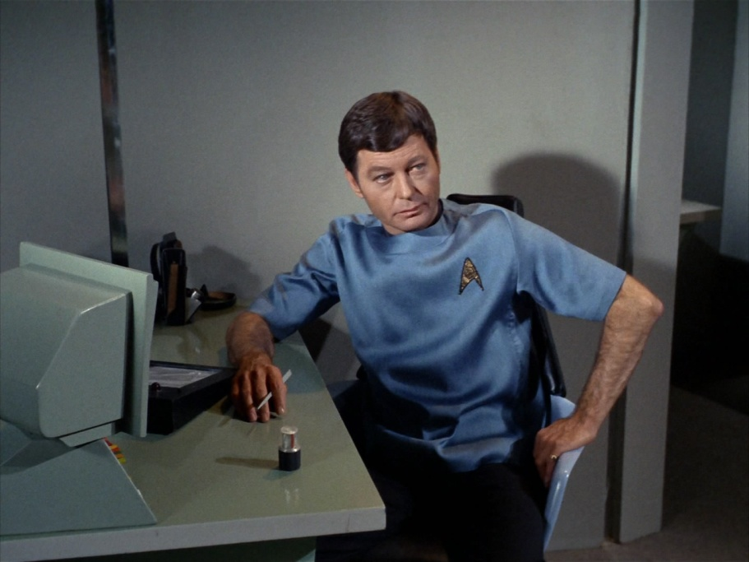
ITEC 715
Expert Perspective
Seeing the Solution in Different Ways
Captain Kirk has asked Dr. McCoy and Mr. Spock for advice. Each has a different perspective. Dr. McCoy offers a human, emotional point of view. Mr. Spock offers a logical, rational point of view.
Click each character to hear what he has to say. If you were in Captain Kirk’s position, who’s advice would you take?
Dr. McCoy’s Perspective
Dr. McCoy
Mr. Spock
Click each character to hear his perspective. Then click Next to continue.
Back
Menu
Next

Slide 63
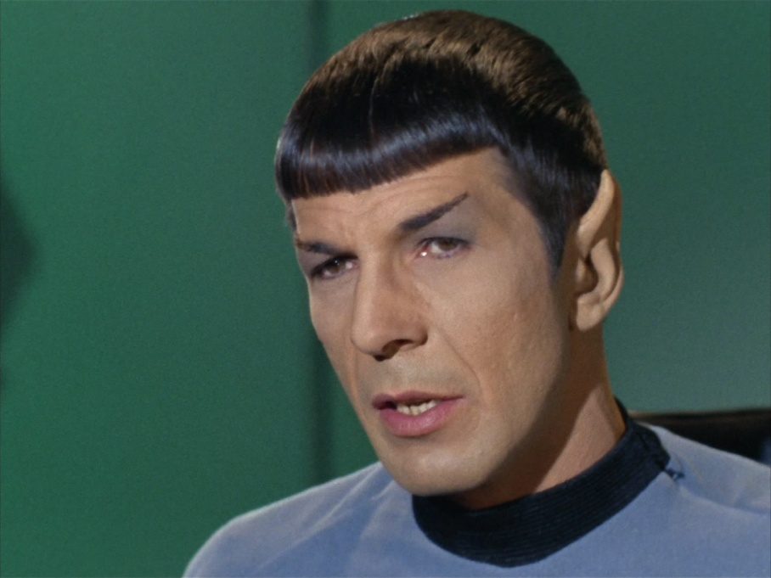
ITEC 715
Expert Perspective
Seeing the Solution in Different Ways
Captain Kirk has asked Dr. McCoy and Mr. Spock for advice. Each has a different perspective. Dr. McCoy offers a human, emotional point of view. Mr. Spock offers a logical, rational point of view.
Click each character to hear what he has to say. If you were in Captain Kirk’s position, who’s advice would you take?
Mr. Spock’s Perspective
Dr. McCoy
Mr. Spock
Click each character to hear his perspective. Then click Next to continue.
Back
Menu
Next

Slide 64


ITEC 715
What’s The Right Response?
Meet Joe and Anna Li
Emphasizing an Effect
ABC Sound Design has been hired to create the sound effects for an action movie, and mix them into the film’s soundtrack.
Anna Li created most of the sound effects, but she has asked her intern, Joe, to insert them into the film’s final audio mix.
In this activity, you will coach Anna Li as she answers Joe’s questions.
Click Start to begin the activity.
Joe is a new intern student at ABC Sound Design. He’s working under the supervision of Anna Li.
Anna Li is a new audio engineer at the sound effects department at ABC Sound. She’s helping Joe edit sound effects into an action movie.
Start
Click Start to begin the activity.
Back
Menu
Next
Note: Character images available for free at http://www.designcomics.com/

Slide 65


ITEC 715
What’s The Right Response?
Emphasizing an Effect
At the climax of the film, the heroes blow up the bad guys’ space station. I’ve put in the explosion sound effect, but it just doesn’t have the impact I want. Do you have any suggestions?
How should Ann Li respond? If you know, click the correct response below. If you’re not sure, you can call an expert for help.
Raise the gain on the explosion sound to make it louder.
Put a half-second or so of absolute silence right before the explosion.
Call an expert for a hint.
Click a response for Anna Li. Then click Next to continue.
Back
Menu
Next

Slide 66
ITEC 715
What’s The Right Response?
Emphasizing an Effect
Raising the Gain Probably Won’t Work
Turning up the volume on the explosion sound probably isn’t an option. The explosion sound effect is most likely already at maximum gain. Raising it any more would cause clipping, a kind of distortion that would make the sound effect even less satisfactory than it is now.
At the climax of the film, the heroes blow up the bad guys’ space station. I’ve put in the explosion sound effect, but it just doesn’t have the impact I want. Do you have any suggestions?
How should Ann Li respond? If you know, click the correct response below. If you’re not sure, you can call an expert for help.
Raise the gain on the explosion sound to make it louder.
Put a half-second or so of absolute silence right before the explosion.
Call an expert for a hint.
Click a response for Anna Li. Then click Next to continue.
Back
Menu
Next

Slide 67
ITEC 715
What’s The Right Response?
Emphasizing an Effect
Correct!
Legendary sound effects professional Ben Burtt calls the fractional second of absolute silence that precedes a loud sound effect an “audio black hole.” It increases the contrast in sound levels and makes the explosion that follows it seem much more intense.
At the climax of the film, the heroes blow up the bad guys’ space station. I’ve put in the explosion sound effect, but it just doesn’t have the impact I want. Do you have any suggestions?
How should Ann Li respond? If you know, click the correct response below. If you’re not sure, you can call an expert for help.
Raise the gain on the explosion sound to make it louder.
Put a half-second or so of absolute silence right before the explosion.
Call an expert for a hint.
Click a response for Anna Li. Then click Next to continue.
Back
Menu
Next

Slide 68
ITEC 715
What’s The Right Response?
Emphasizing an Effect
Hint
Remember that there are limits to how loud you can make a recorded sound. You want the effect to come through clearly and not be distorted. Only one of Anna Li’s possible responses avoids the risk of clipping. Can you figure out which one?
At the climax of the film, the heroes blow up the bad guys’ space station. I’ve put in the explosion sound effect, but it just doesn’t have the impact I want. Do you have any suggestions?
How should Ann Li respond? If you know, click the correct response below. If you’re not sure, you can call an expert for help.
Raise the gain on the explosion sound to make it louder.
Put a half-second or so of absolute silence right before the explosion.
Call an expert for a hint.
Click a response for Anna Li. Then click Next to continue.
Back
Menu
Next

Slide 69
ITEC 715
Multiple Choice Question
Conlon Nancarrow’s Studies for Player-Piano
Nancarrow composed his famous series of studies for player-piano in Mexico City starting in the 1940’s. Why did Nancarrow write so much music for player-piano?
  No humans could play the music he wanted to write.
  His father was a player-piano salesman.
  The early fame he achieved with his first player-piano compositions encouraged him to keep at it.
  He had a falling-out with his normal pianist and vowed never to write for pianists ever again.
Click a response. Then click Next to continue.
Back
Menu
Next

Slide 70

ITEC 715
Multiple Choice Question
Conlon Nancarrow’s Studies for Player-Piano
Nancarrow composed his famous series of studies for player-piano in Mexico City starting in the 1940’s. Why did Nancarrow write so much music for player-piano?
Correct!
Nancarrow was interested in exploring extremely complex cross-rhythmic counterpoint—way beyond human ability to count or perform.
Click the icon below to hear the intense final bars of Nancarrow’s Study No. 8:
  No humans could play the music he wanted to write.
  His father was a player-piano salesman.
  The early fame he achieved with his first player-piano compositions encouraged him to keep at it.
  He had a falling-out with his normal pianist and vowed never to write for pianists ever again.
Click a response. Then click Next to continue.
Back
Menu
Next

Slide 71
ITEC 715
Multiple Choice Question
Conlon Nancarrow’s Studies for Player-Piano
Nancarrow composed his famous series of studies for player-piano in Mexico City starting in the 1940’s. Why did Nancarrow write so much music for player-piano?
Incorrect.
Nancarrow’s father was not a player-piano salesman. Nancarrow wrote for player-piano because his music involved extremely complex cross-rhythms that human beings could not perform.
Click the icon below to hear the intense final bars of Nancarrow’s Study No. 8:
  No humans could play the music he wanted to write.
  His father was a player-piano salesman.
  The early fame he achieved with his first player-piano compositions encouraged him to keep at it.
  He had a falling-out with his normal pianist and vowed never to write for pianists ever again.
Click a response. Then click Next to continue.
Back
Menu
Next

Slide 72
ITEC 715
Multiple Choice Question
Conlon Nancarrow’s Studies for Player-Piano
Nancarrow composed his famous series of studies for player-piano in Mexico City starting in the 1940’s. Why did Nancarrow write so much music for player-piano?
Incorrect.
Nancarrow worked in relative obscurity for most of his career. His work only became known to the wider world in the when the first Columbia Records recording of a few of his Studies came out in 1969. Comprehensive recordings of his Studies weren’t released until 1977.
Click the icon below to hear the intense final bars of Nancarrow’s Study No. 8:
  No humans could play the music he wanted to write.
  His father was a player-piano salesman.
  The early fame he achieved with his first player-piano compositions encouraged him to keep at it.
  He had a falling-out with his normal pianist and vowed never to write for pianists ever again.
Click a response. Then click Next to continue.
Back
Menu
Next

Slide 73
ITEC 715
Multiple Choice Question
Conlon Nancarrow’s Studies for Player-Piano
Nancarrow composed his famous series of studies for player-piano in Mexico City starting in the 1940’s. Why did Nancarrow write so much music for player-piano?
Incorrect.
Nancarrow didn’t have a regular pianist he worked with. He pretty much gave up writing for humans for the majority of the time he worked as a composer, coming back to writing for human performers only near the end of his career.
Click the icon below to hear the intense final bars of Nancarrow’s Study No. 8:
  No humans could play the music he wanted to write.
  His father was a player-piano salesman.
  The early fame he achieved with his first player-piano compositions encouraged him to keep at it.
  He had a falling-out with his normal pianist and vowed never to write for pianists ever again.
Click a response. Then click Next to continue.
Back
Menu
Next

Slide 74
Page Types: Simple (Relatively)
Page types we looked at:
  Text with Graphic
  Text Explore
  Graphic Explore
  Two Character Dialog
  Expert Perspective
  What’s the Right Response?
Other common page types:
  True/False questions
  Multiple choice questions
  Drag and drop questions
  Fill in the blank questions
  Short answer questions
  Expert Answer

Slide 75
Page Types: More Complex
Software Simulation (e.g., Captivate-style sims)
Casual Games (concentration, crossword puzzles, hangman, gameshow-based interactions, etc.—these are usually of limited value)
Branched Conversations
Timed Challenges (“You have 3 minutes of Curt’s time, so make it count. When you are ready to begin your sales pitch, click Start.”)
Serious Games (basically, scored simulations relevant to the skills you are trying to teach, e.g., “flight simulator”-type games)

Slide 76
Interaction Design Considerations
Grouping and Navigation

Slide 77
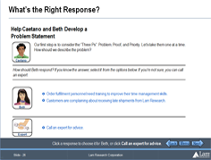
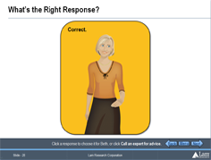
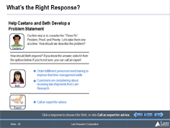
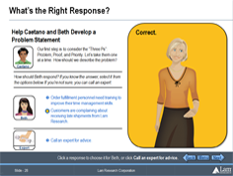
Design Considerations
Guideline: Don’t separate learner actions from feedback if you can avoid it.
Don’t do this:
Question asked on one page, but feedback given on the next page
Instead, do this:
Area reserved on question page, so feedback can appear there (on the same page)

Slide 78
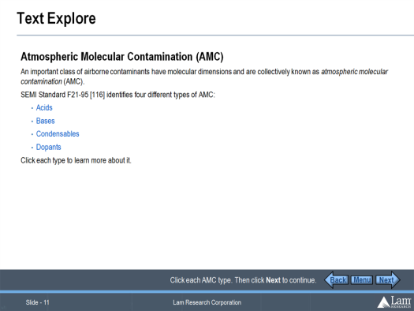
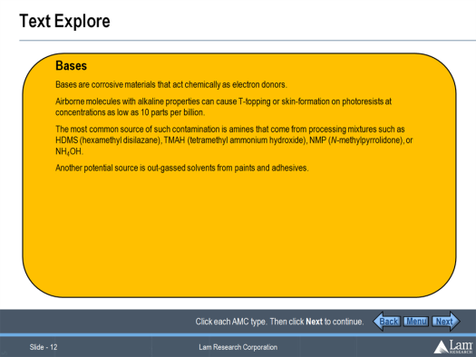
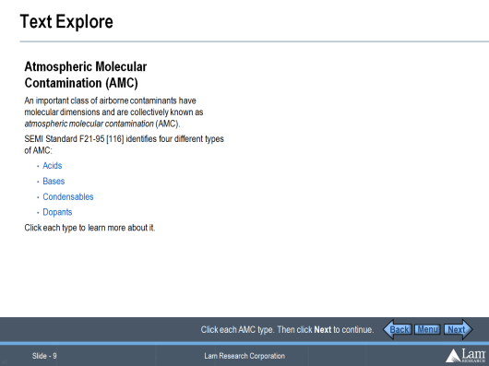
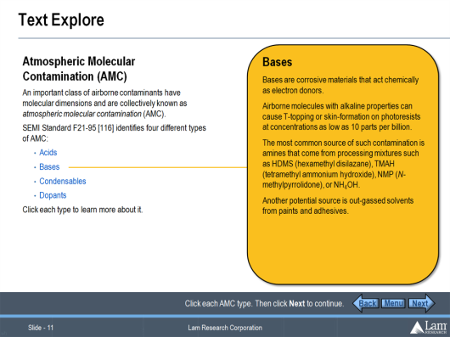
Design Considerations
Guideline: Avoid “hub and spoke” navigation schemes in your interactions.
Don’t do this:
Click on one page, view response on new page, then click Back to return to the first page…
Instead, do this:
Area reserved on first page, so response can appear there (on the same page)

Slide 79
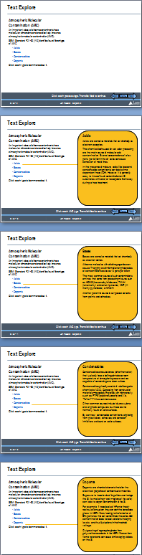
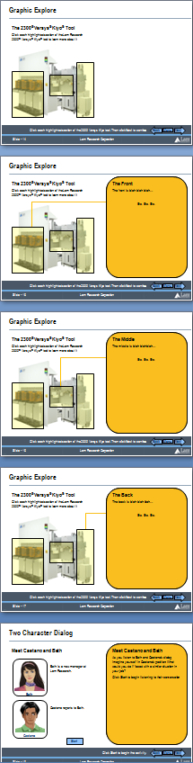
Design Considerations
Next and Back buttons never link to interior pages of compound page types!
Links in the course Menu never link to interior pages of compound page types!
Start of the page before
Back
Menu
Next
Back
Menu
Next
A compound page type
Interior pages
Back
Menu
Next
Back
Menu
Next
Start of the page after

Slide 80
Design Goals and Inspiration
Separating Good from Bad, and Drawing on Learning in Real Life

Slide 81
Designing Good Interactions
What makes an interaction “Good?”
Michael Allen says good interactions have four elements:
  Context
  Challenge
  Activity
  Feedback
  The Context is the setting in which the learner will perform the desired task.
  The Challenge is the problem the learners must learn to solve or the task they must perform.
  The Activity is the set of interactions the learner will perform in the course to solve the challenge.
  The Feedback is the information learners receive in response to actions they take in the activity.

Slide 82
Other Design Goals
Michael Allen also suggests the “Three Ms” are important attributes of good interactions. Are they:
Meaningful
Memorable
Motivational
In many instances, a 4th M could also be quite useful:
Measurable

Slide 83
Interaction Design Inspirations
Learning Models
Formal vs. Informal
Classroom vs. Lab
Trial and error (“learning by doing”)
Mentorship and Apprenticeship (“see one, do one, teach one”)
Dramas and Stories

Slide 84
Conclusion
Telling isn’t teaching
Designing in terms of learning interactions (as implemented as “page types”) will help you avoid creating boring “page-flipper” courses
When designing interactions (and even more so, when using them in a course), consider the CCAFs: when the CCAFs are meaningful, memorable, and motivational to learners, the course will be too
When designing new interactions, consider the way people learn in the real world

Slide 85
ITEC 715
For Next Week
In PowerPoint, create a sample interaction deck containing an example of at least 6 different page-types you will use in the design of your final e-learning project. At this stage, you can use place-holder (generic) content, rather than final text and images. The purpose is to establish your page-types, so that you can use them as building blocks for your design. You must include at least one assessment/quiz page.
Download and read the ITEC715-Week05.ppt slides and come to class ready to discuss
Next week: Design Documents!

