Slide 1
ITEC 715
The Design of Multimedia Learning
Week 5

Slide 2
Elements of
Good Screen Design
Recall from Last Week

Slide 3
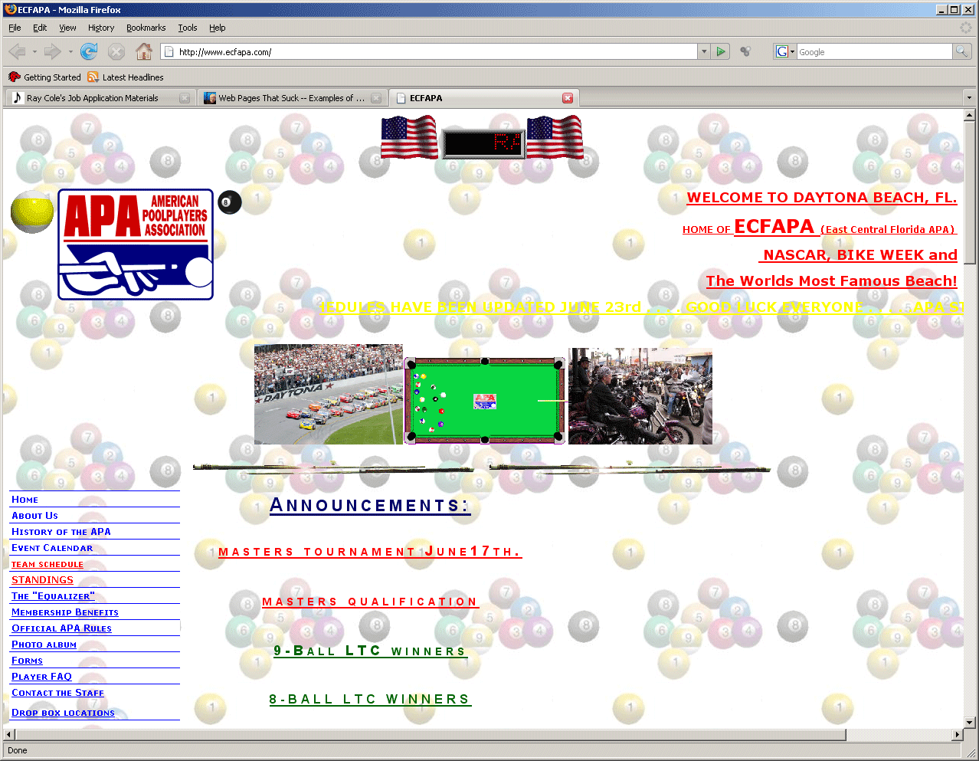
Bad Screen Design #1
What’s Wrong With This Screen?
Wasted space at top
Distracting background image
Insufficient contrast between yellow text and white background
What’s clickable?
What’s primary content?
Where is my eye supposed to start? How is it supposed to traverse this screen?
Etc…
_{Source: http://www.ecfapa.com/}

Slide 4
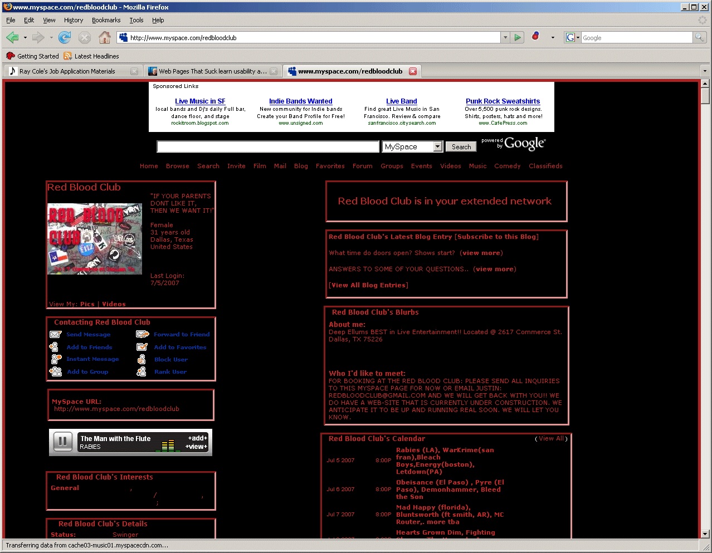
Bad Screen Design #2
What’s Wrong With This Screen?
Busy—too many links
Text-heavy—poor use of images/lack of images
Insufficient contrast between red text and black background
What’s primary content?
Etc…
Source: http://www.myspace.com/redbloodclub

Slide 5
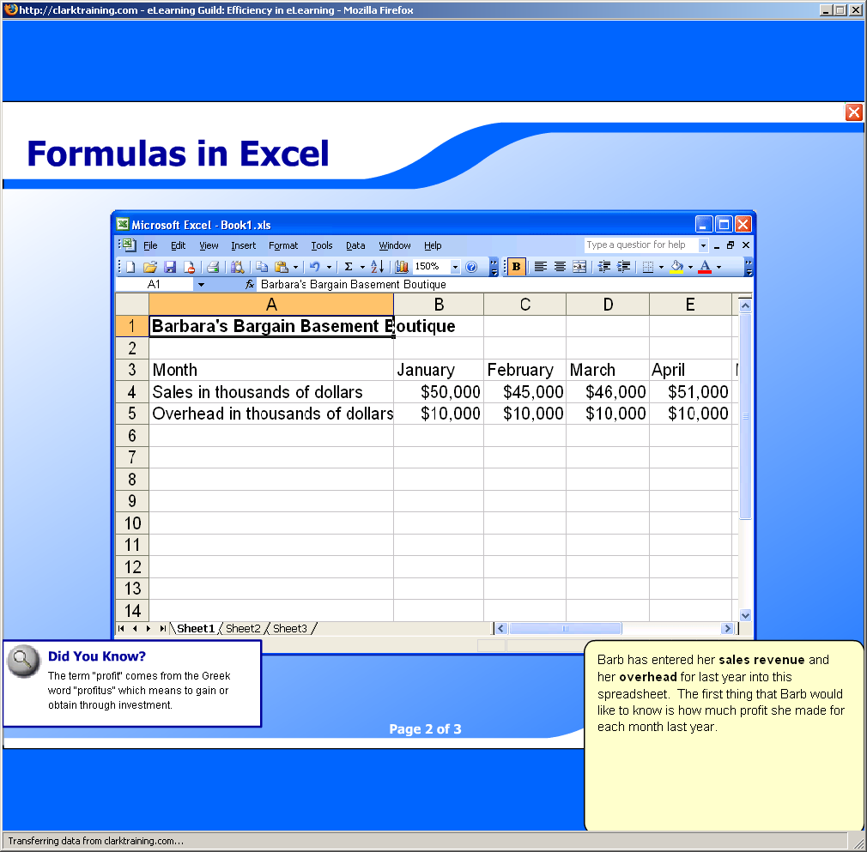
Multimedia Design Example
Is This Design Good or Bad? Why?
Music and voice compete for attention
The “Did You Know?” box and the yellow text box compete for attention with the main spreadsheet screen and the voice and music!
With so many things to focus on simultaneously, the learner is likely to retain none of it due to cognitive overload
Source: http://www.clarktraining.com/mtest

Slide 6
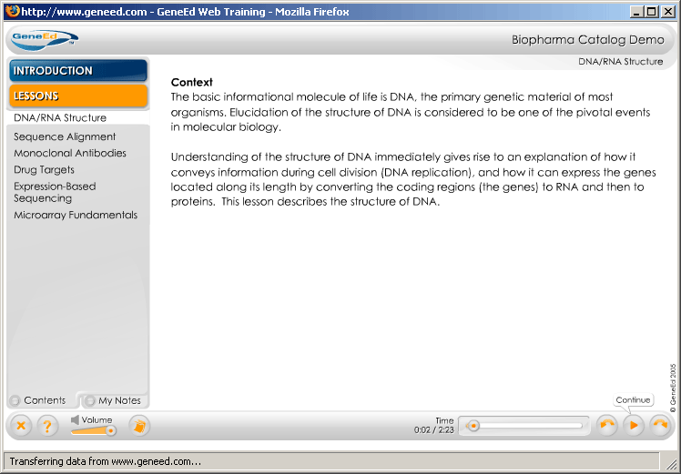
Better Screen Design #1
What’s Working Here?
Navigation (“Lessons”) links listed clearly in left column
Primary content is clear
Forward/Back buttons grouped together
Current location listed at top
Additional, less-often-used controls at the lower left
Clean look with good contrast between text and background
Source: http://www.geneed.com/g2/individual/demo.php

Slide 7
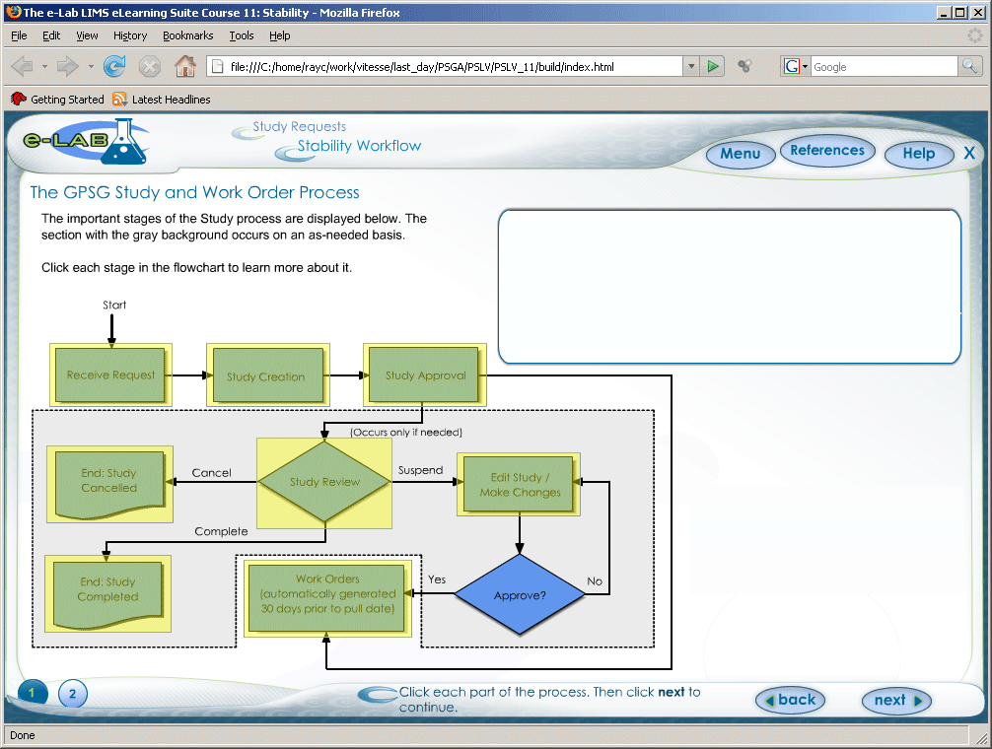
Better Screen Design #2
What’s Working Here?
Navigation recallable from “Menu” button at top; leaves more screen area available for content
Reasonable eye-path: Start at upper left. Read directions, then move to lower left to perform actions, then look to upper right for results
Forward/Back buttons grouped together
Current location listed at top

Slide 8
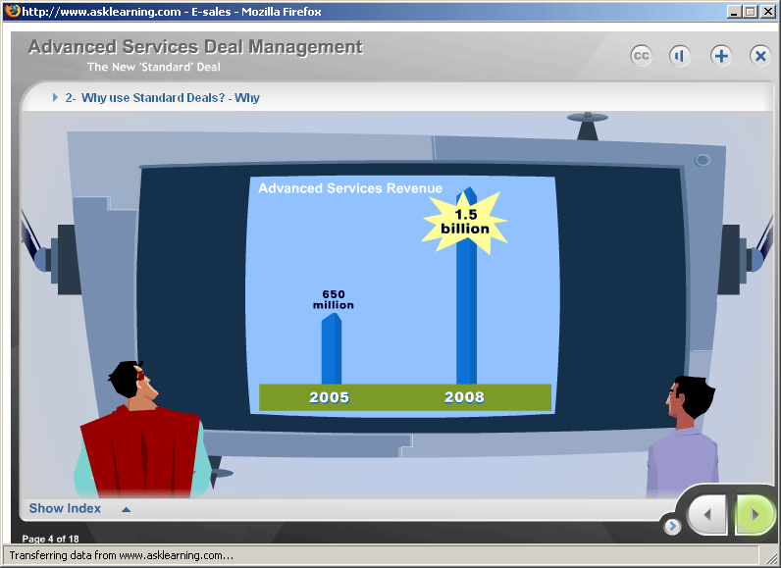
Better Screen Design #3
What’s Working Here?
Navigation recallable from “Show Index” button at lower left; leaves more screen area available for content
Eye is drawn directly to primary content
Forward/Back buttons grouped together
Current location listed at top
Progress indicator at lower left
Graphics support “story” context
Source: http://www.asklearning.com/web/defaultflash.cfm. → E-Learning Portfolio → The New Standard Deal

Slide 9
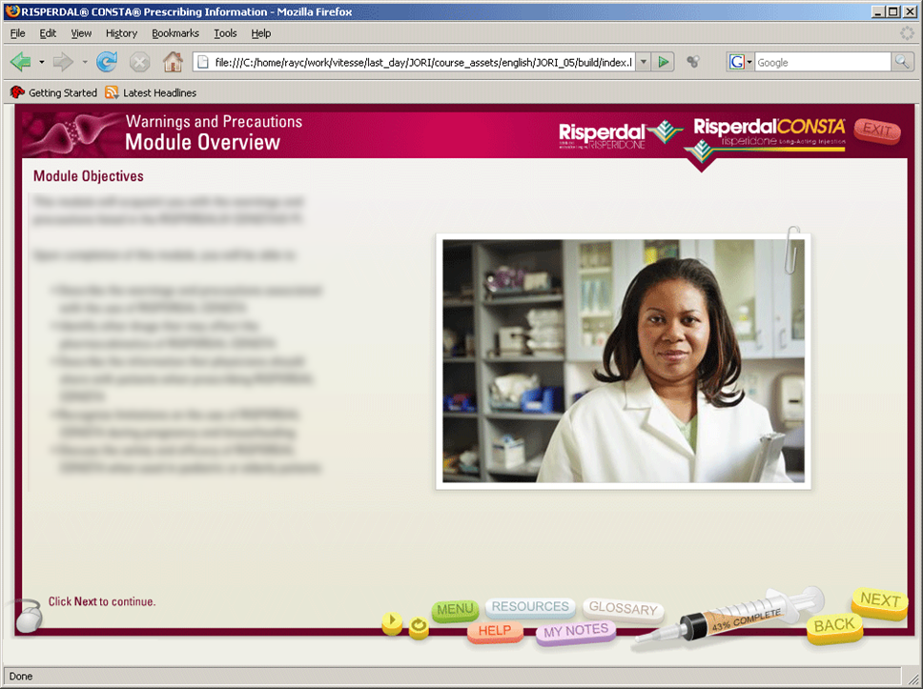
Better Screen Design #4
What’s Working Here?
Navigation recallable from “Menu” button at lower center; leaves more screen area available for content
Primary content is clear
Buttons grouped together
Current location listed at top
Syringe is progress indicator
Control graphics are thematically appropriate (a syringe and pills)

Slide 10
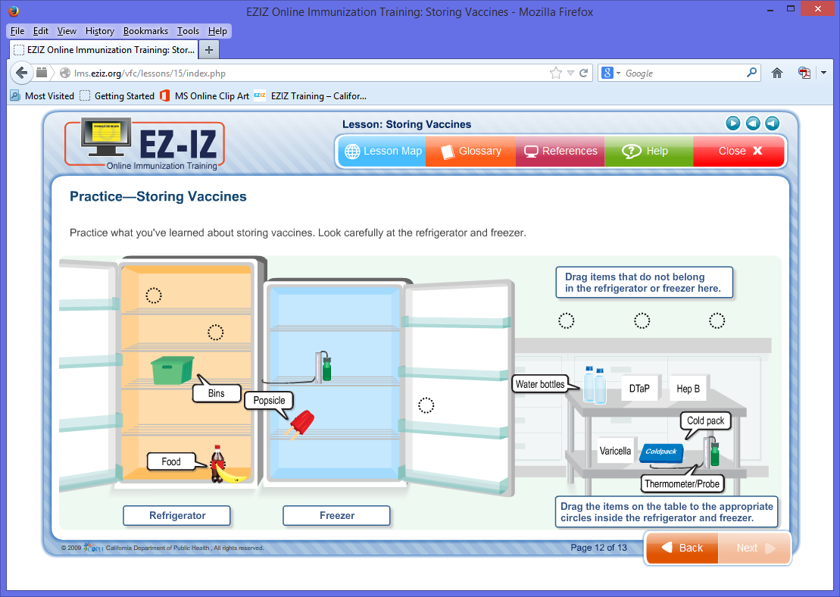
Better Screen Design #5
What’s Working Here?
Contrast: dark font on light background; objects the learner must manipulate are darker than background to draw the learner’s eye
Repetition of design elements such as button shapes, label boxes, callout shapes, and target circles
Clean alignment of elements
Elements with similar functions are in close proximity to each other
Source: http://lms.eziz.org/vfc/lessons/15/index.php

Slide 11
Screen Design Principles
Layout Principles
Controls and titling info at edges of screen; content in large middle area of screen
“CRAP”—Contrast, Repetition, Alignment, Proximity. See http://www.thinkvitamin.com/features/design/how-crap-is-your-site-design
Colors—If you’re not sure what colors go with each other, hunt down some online visual art, screen capture it, then use Photoshop’s Eye-dropper tool to select some colors from the artist’s pallete. Or, visit a paint store and get some color combination cards.
Navigation Principles
Learner should have a good idea of what will happen when clicking any button or link
Learner should be able to easily move around in the course—at least forward/back one page and to the start of any topic
If the learner receives feedback that he or she did something incorrectly, consider including a link to the portion of the course which explains how to do the task correctly
Place navigation controls in the same place on every screen; don’t let forward/back or other navigation buttons “jump” around from screen to screen

Slide 12
Navigation Review
This Week
(Break into groups and critique each other’s navigation mockups)

Slide 13
Image Sources

Slide 14
Royalty Free Image Sources
Stock Photography | Clipart
iStock Photo (http://www.istockphoto.com) | Microsoft Office Online (http://office.microsoft.com/en-us/images)
Getty Images (http://www.gettyimages.com) | Open Clip Art Library (http://www.openclipart.org)
Corbis Images (http://www.corbisimages.com) | Design Comics (http://designcomics.org)
And PowerPoint…

Slide 15
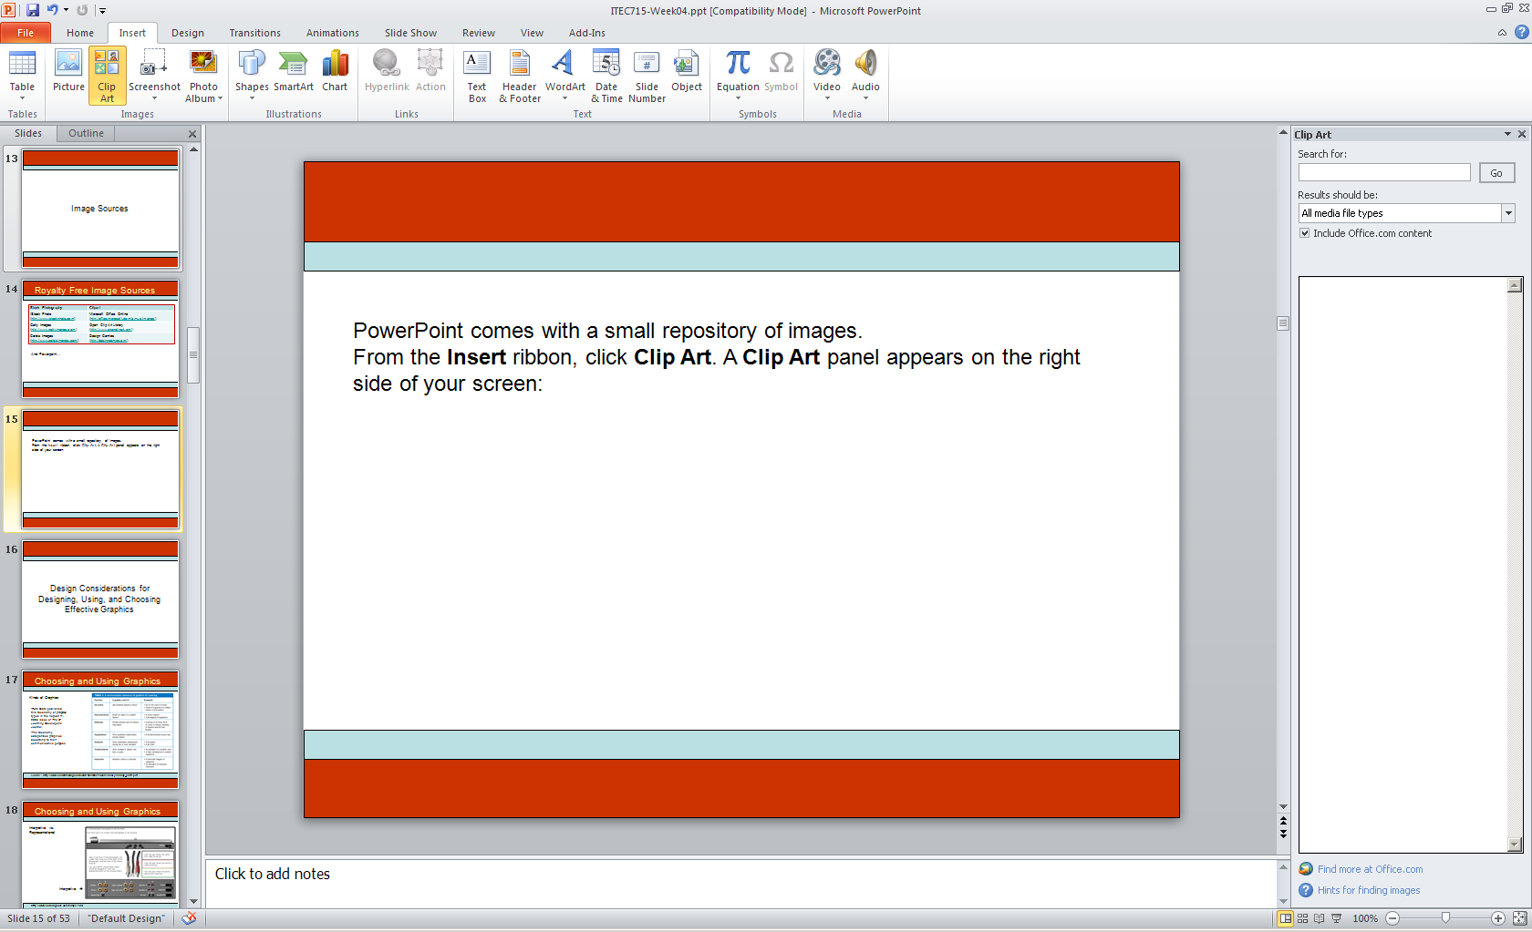
PowerPoint Clip Art
PowerPoint comes with a small repository of images.
From the Insert ribbon, click Clip Art. A Clip Art panel appears on the right side of your screen:

Slide 16
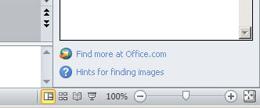
PowerPoint Clip Art
In the Windows version, there is also a link to the Microsoft Online clip art repository, which contains a lot more clip art (and stock photography) than the limited amount that comes bundled with PowerPoint itself:
Unfortunately, in late 2013, Microsoft destroyed the landing page for this MS Online repository, so the link in PowerPoint no longer works.

Slide 17
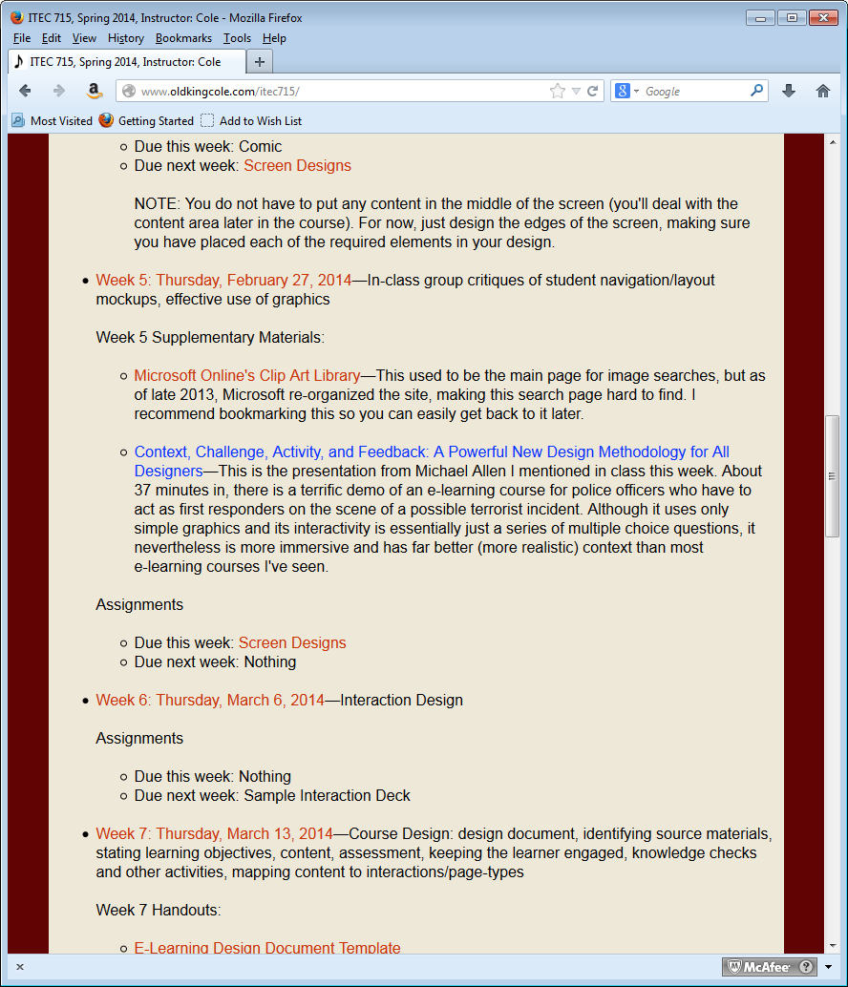
Reaching the MS Online Images

Slide 18
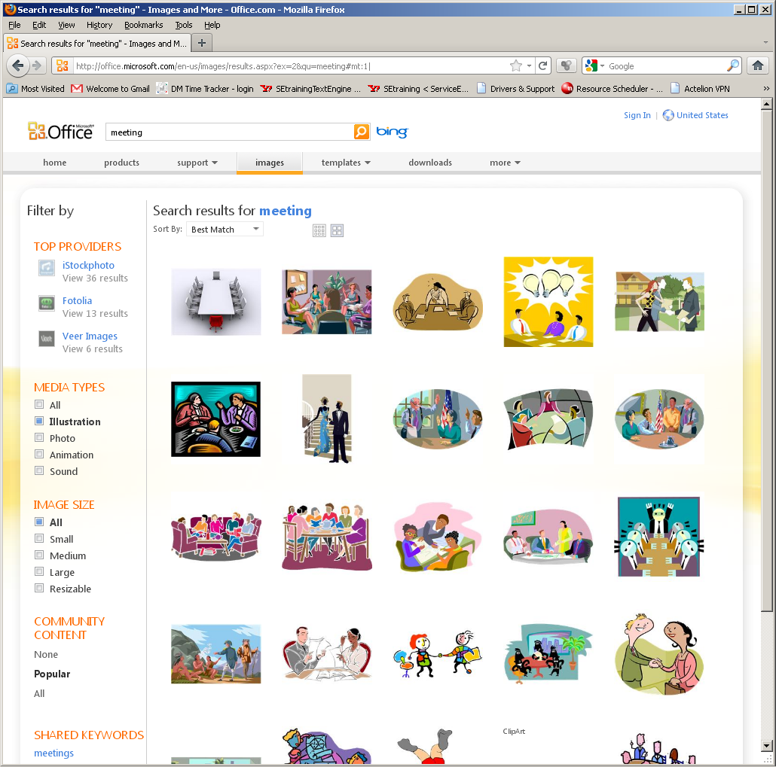
Searching
Enter your search term(s).
Use filters to restrict your search by media type or image size.

Slide 19
Style Numbers
Suppose you like this image. What other clip art is available that is drawn in this style?

Slide 20
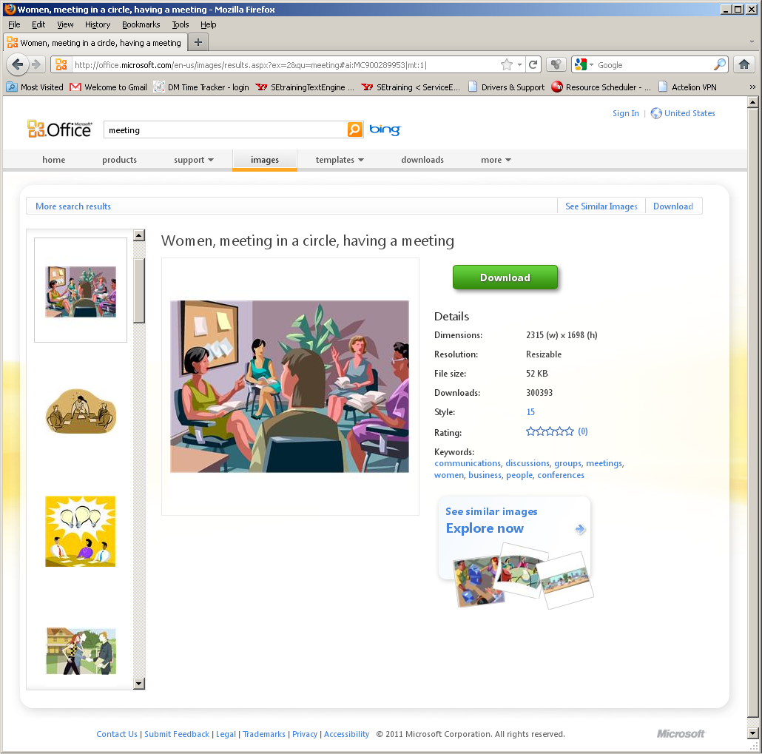
Style Numbers
Click the image you like
to view its details.
Many illustrated images have a Style number associated with them.
This number is an active link. Click it to reveal the other images in the repository that are drawn in the same style!

Slide 21
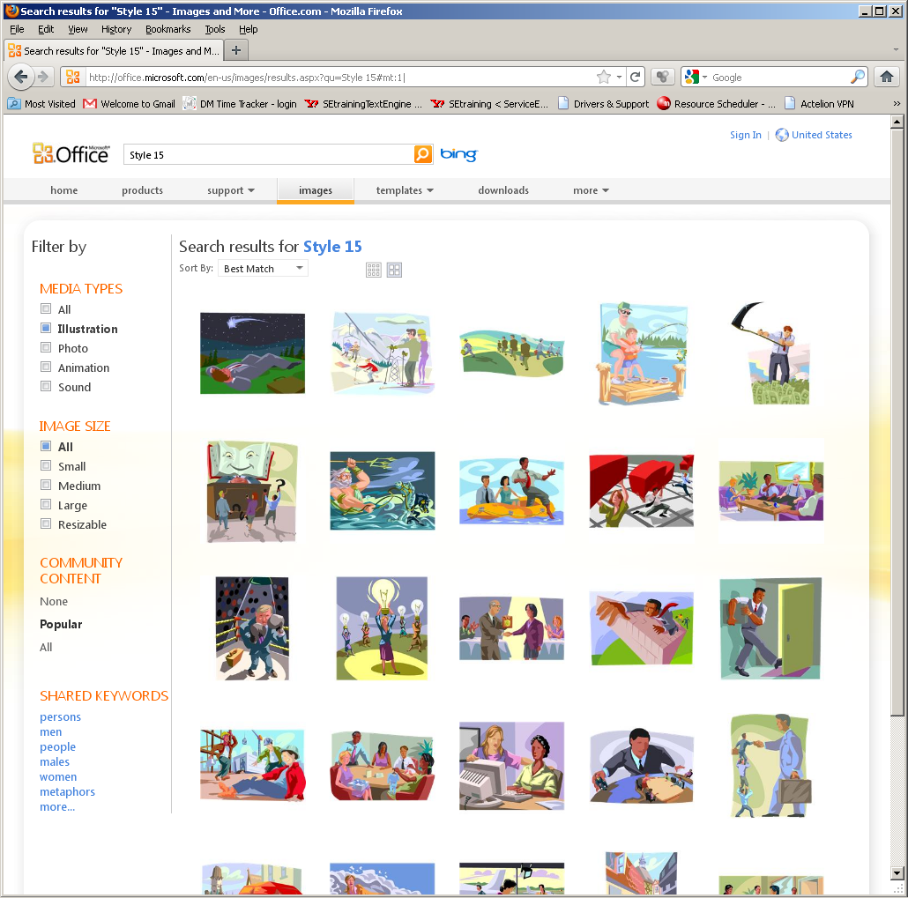
Like-Styled Images

Slide 22
Visual Unity

Slide 23
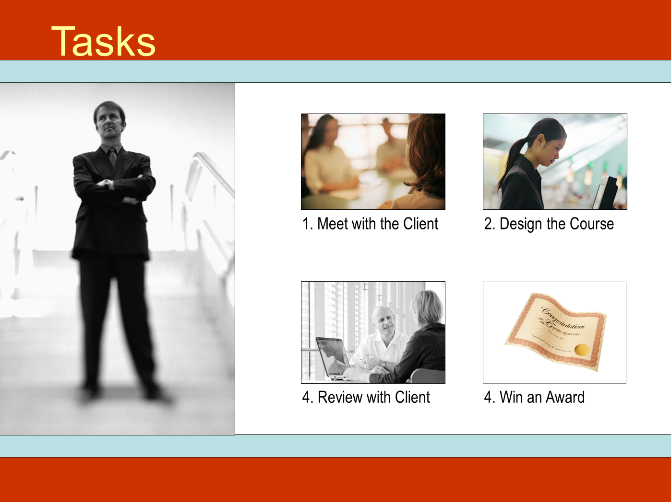
Hodge-Podge Look w/ Photos
Some images in color
Some images in B&W
Some images sharp
Some images blurred
VISUAL DISUNITY!

Slide 24
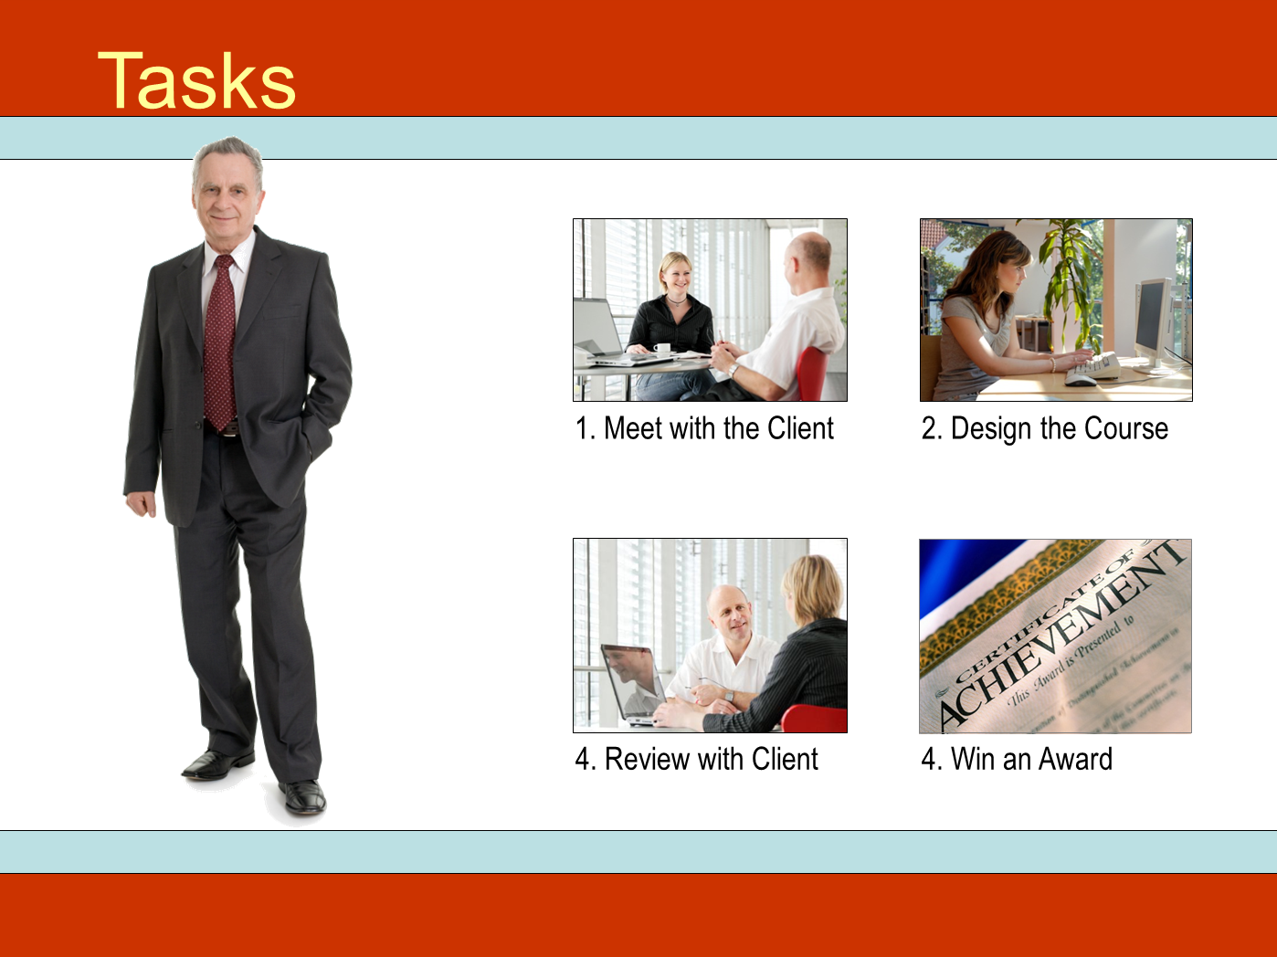
Visual Unity w/ Photos
All images in color
All images sharp
VISUAL UNITY!
Note: The slide now has good visual unity, but it has poor ethnic diversity.

Slide 25
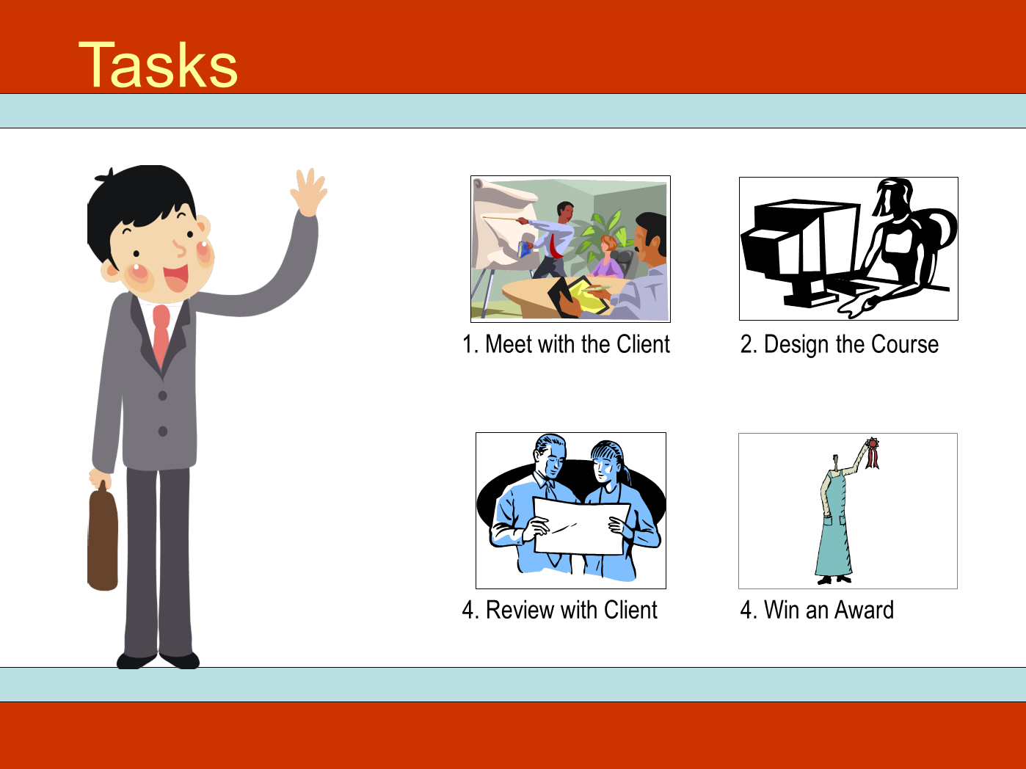
Visual Disunity w/ Illustrations
Some images in color
Some images in B&W
Some images in monotone
Every image in a different style
VISUAL DISUNITY!

Slide 26
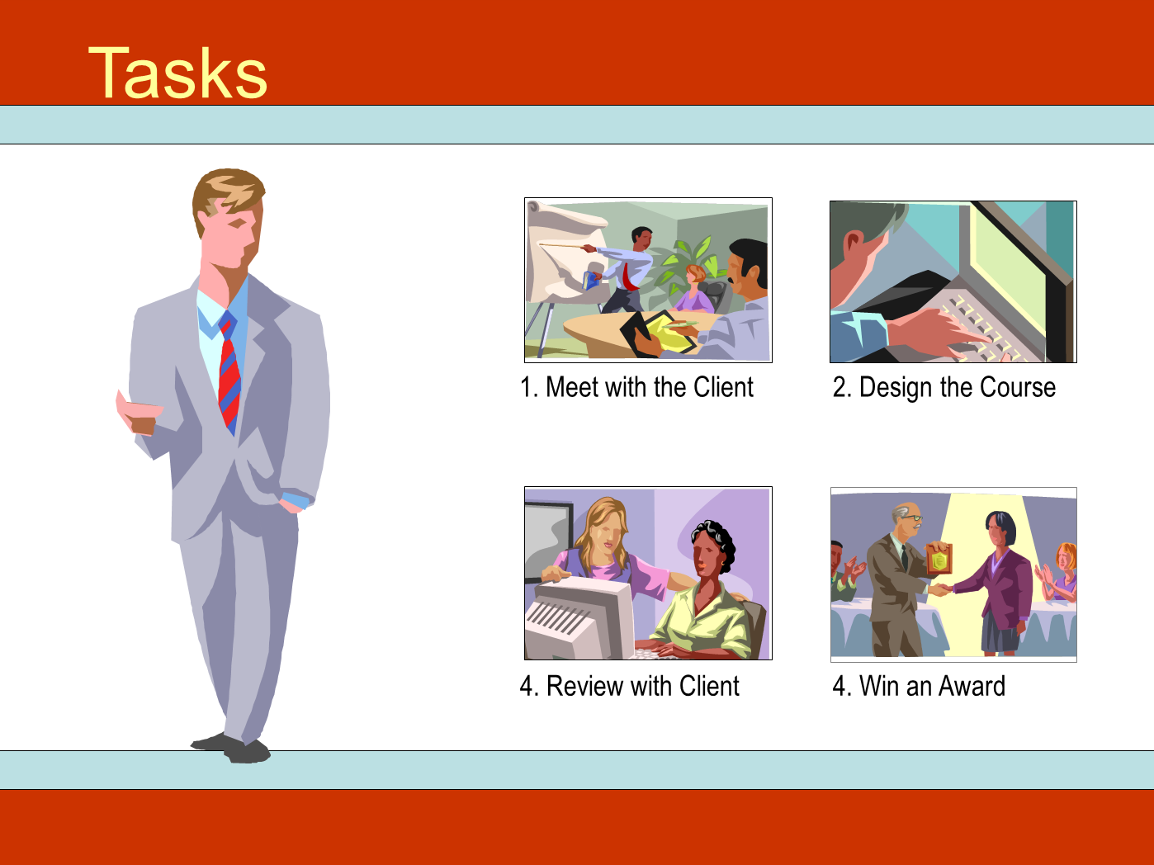
Visual Unity w/ Illustrations
All images in color
All images in same style (15)
VISUAL UNITY!

Slide 27
Working with Clip Art Illustrations

Slide 28
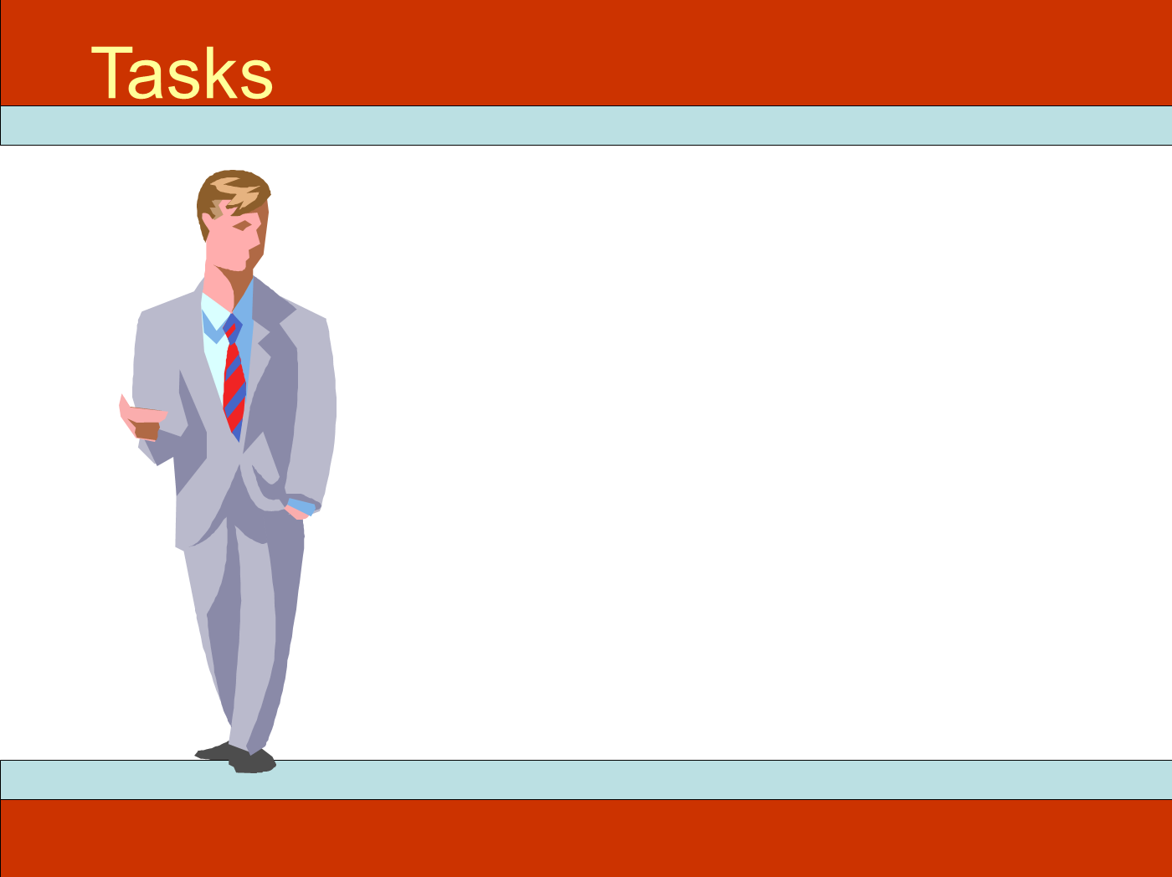
Deconstructing Clip Art
The image of the man originally came from this clip art image.

Slide 29
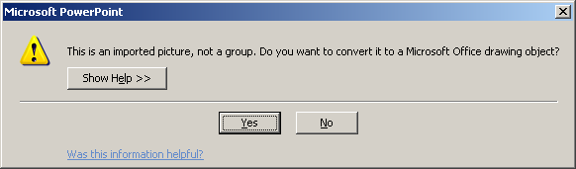
Deconstructing Clip Art
A lot of the illustrational clip art on the Microsoft Office Online image repository consists of many small shapes grouped together.
On a PC, right-click and choose Group→ Ungroup. You’ll be presented with this dialog. Click Yes.
Click Group→Ungroup a second time to complete the ungrouping process.

Slide 30
Deconstructing Clip Art
Unfortunately, the Mac versions of PowerPoint are unable to ungroup the WMF-formatted clip art.
On a Mac, you’ll have to load the WMF image into Adobe Illustrator, where you can gain access to its individual parts, deleting or modifying them as-needed, and then save the rest back out as a PNG image that you can then import into PowerPoint.

Slide 31
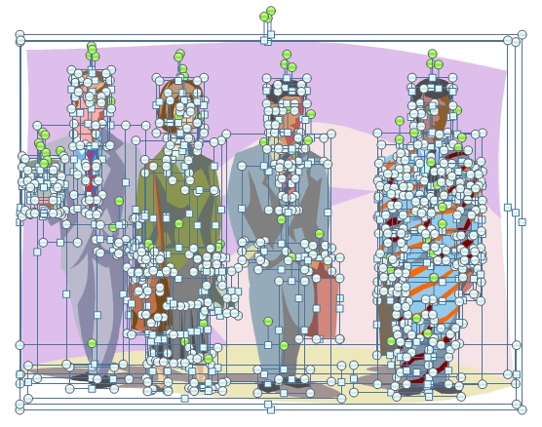
Deconstructing Clip Art
Back in the PC world, after you successfully ungroup the image, click somewhere neutral to clear the selections.
Then drag across the portions of the image you want to delete.

Slide 32
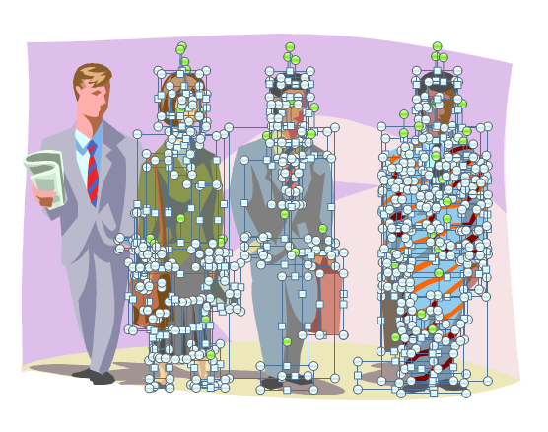
Deconstructing Clip Art
To delete the selected parts of the image, press the Delete key.
You may have to go back and re-select elements that didn’t get selected the first time, but eventually, you should be able to remove everything except the image of the man on the left.

Slide 33
Deconstructing Clip Art
The newspaper he’s holding is also constructed out of smaller shapes.
Click each part of the newspaper and press Delete. Continue until you have removed the newspaper completely.
But be careful not to delete his hand!

Slide 34
Deconstructing Clip Art
Finally, drag your mouse across the man to select all his parts, and then click Group→Group to group them all back together again.
After you’ve grouped the remaining parts, you can copy, paste, and resize the man as-needed and place him on your page.

Slide 35
Reconstructing Clip Art
Note that prior to regrouping, you could replace elements from this image with elements from other ungrouped clip art images.
For example, you could give the man a different tie or a different hair style.
You can also recolor elements to change skin tone, clothing color, or anything else.
Before
After

Slide 36
Combining Photographs

Slide 37

Background

Slide 38

Background + Foreground
Unfortunately, the foreground image of the man has its own (white) background that ruins the illusion that the man is in the office environment. What to do?

Slide 39
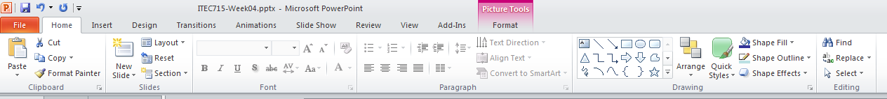
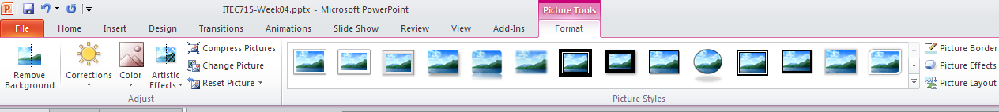
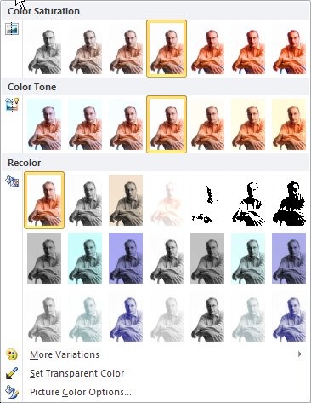
Remove the White Background
1. Click the photo of the man. Then, click Picture Tools in the ribbon.
2. Next, click Color → Set Transparent Color.
3. Finally, click the white background in the photo of the man to make it transparent.
Note: in PP2007, click Color→Recolor→Set Transparent Color

Slide 40
Background + Foreground
Now it looks like I’m in the office environment, ready to offer advice to your learners…
Unfortunately, the foreground image of the man has its own (white) background that ruins the illusion that the man is in the office environment. What to do?

Slide 41
Design Considerations for Designing, Using, and Choosing Effective Graphics

Slide 42
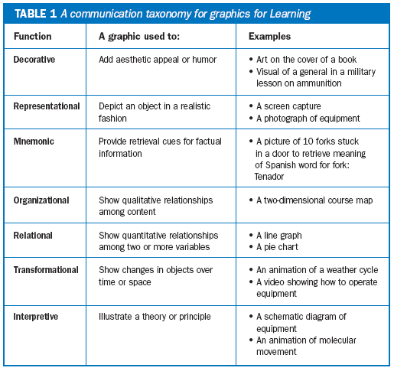
Choosing and Using Graphics
Kinds of Graphics
Ruth Clark published this taxonomy of graphics types in the August 11, 2003 issue of The E-Learning Developer’s Journal.
The taxonomy categorizes graphics according to their communicative purpose
Source: http://www.clarktraining.com/content/articles/MoreThanEyeCandy_part1.pdf

Slide 43
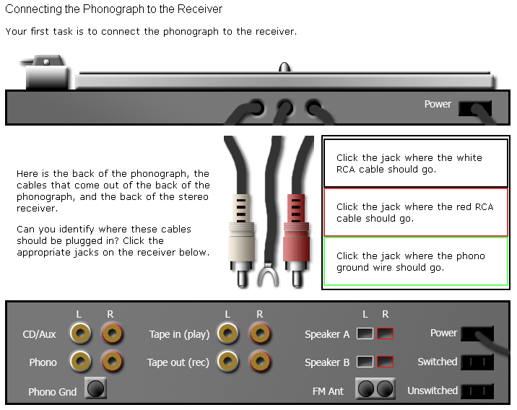
Choosing and Using Graphics
Interpretive vs. Representational
Interpretive →
http://www.oldkingcole.com/simple-sim/

Slide 44
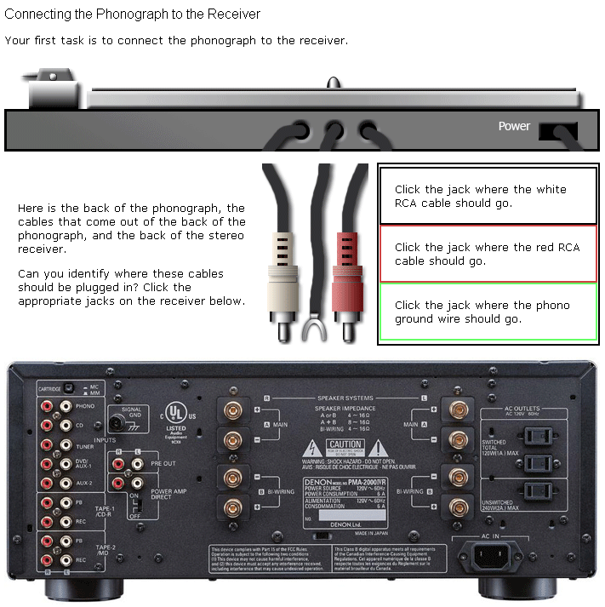
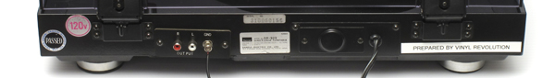
Choosing and Using Graphics
Interpretive vs. Representational
Is the representational image more effective or less?
Is there a theoretical basis for making a choice between representational and interpretive images?
Representational →
http://www.oldkingcole.com/simple-sim/photorealistic.html

Slide 45
Choosing and Using Graphics
Images with high visual fidelity represent a specific person or thing
As fidelity decreases, the images represent larger classes of people or things
Images with low visual fidelity can represent the fundamental essentials of people or things
This high visual fidelity image is a good choice when you want learners to understand how to connect cables to this specific audio receiver.
This low visual fidelity image is a good choice when you want learners to understand how to connect cables to any audio receiver, regardless of brand or specific model.

Slide 46
Choosing and Using Graphics
Perpendicular Continuums
Representational
Case Studies and Historical Accounts
Device and Application Emulations
In general, as things move from left to right across the scenario/simulation axis, they become more interactive
As things move from top to bottom on the realistic/abstract axis, they represent general concepts more than specific instances. Scott McCloud talks about this in his book, Understanding Comics. There, he points out that a photograph of a face represents one specific person. A drawing of a man’s face might represent any man. A genderless “smiley face” can represent any person, and so on
Text-based environments like “Zork”
Interpretive
Allegories and Fables
Scenario
Simulation
A similar, but slightly different take on these ideas is at Scott McCloud’s website here: http://www.scottmccloud.com/4-inventions/triangle/index.html
Notes:
Note: In Ruth Clark’s taxonomy, what I’ve called “Realistic” images, she would call “Representational.” What I’ve called “Abstract”, she calls “Interpretive.”

Slide 47
Images of People
Diversity, Attire, Setting, and Abstraction

Slide 48


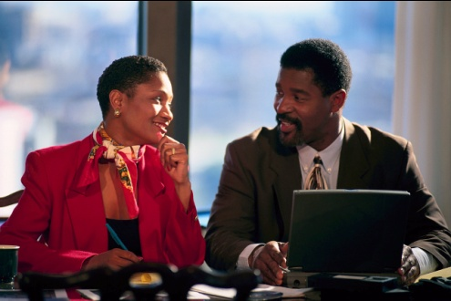

Diversity
How would you rate the diversity of these images?
Age diversity: Good
Gender diversity: Poor
Racial diversity: Poor
Age diversity: Fair (Poor?)
Gender diversity: Good
Racial diversity: Poor
Age diversity: Fair/Poor
Gender diversity: Good
Racial diversity: Poor
Age diversity: Fair (Poor?)
Gender diversity: Good
Racial diversity: Good

Slide 49

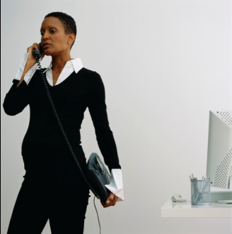

Diversity
Are age, gender, and race the only important diversity categories?
Not necessarily. If you want your images to signal an inclusive workplace, you may need to consciously choose images of people in other minority classes.
Disability status
Pregnancy status
Sexual orientation

Slide 50

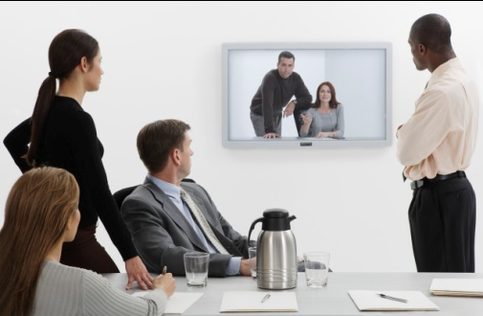


Attire & Setting
Do the people in your e-learning course look like the people in your school, company, or institution?
Attire:
Setting:

Slide 51
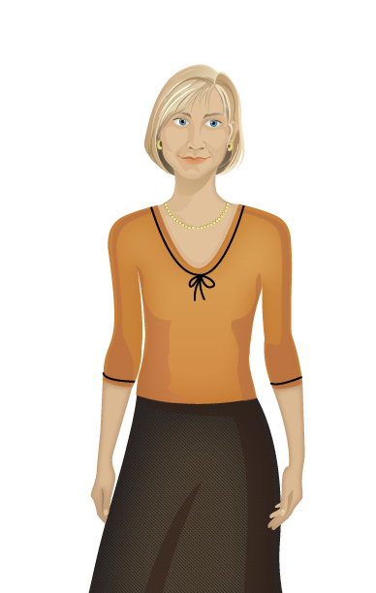


Abstraction
A specific woman
No specific woman
Representational
Interpretive

Slide 52





Which Is More Appropriate?
Scenario 1: Your audio narration is “Customers are another important stakeholder group.”
Customers
Customers

Slide 53
Which Is More Appropriate?
Scenario 2: Your audio narration is “Carol is an experienced manager; Joe is a new employee. Listen to their conversation, and then try to answer the following question: Is Carol making the right decision?”
Carol
Joe
Carol
Joe

Slide 54
ITEC 715
For Next Week
Nothing due next week

