Slide 1
ITEC 715
The Design of Multimedia Learning
Week 6

Slide 2
Image Sources
Recall from Last Week

Slide 3
Royalty Free Image Sources
Stock Photography | Clipart
iStock Photo (http://www.istockphoto.com) | Microsoft Office Online ($0) (http://office.microsoft.com/en-us/images)
Getty Images (http://www.gettyimages.com) | Open Clip Art Library (http://www.openclipart.org)
Corbis Images (http://www.corbisimages.com) | Design Comics ($0) (http://designcomics.org)
Stock.Xchng ($0) (http://www.sxc.hu)
And PowerPoint…

Slide 4
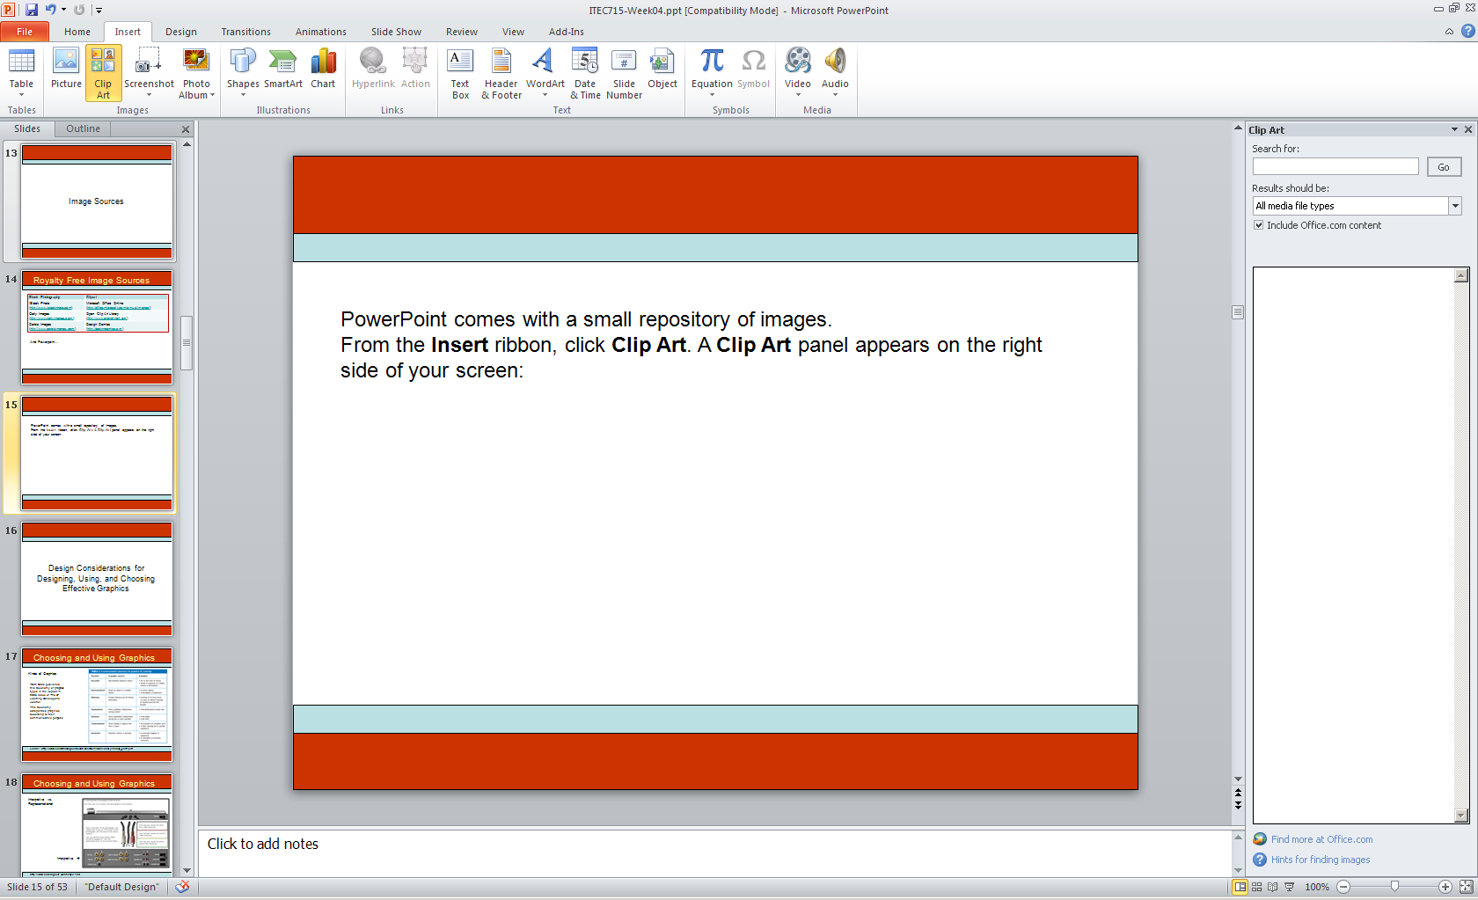
PowerPoint Clip Art
PowerPoint comes with a small repository of images.
From the Insert ribbon, click Clip Art. A Clip Art panel appears on the right side of your screen:

Slide 5
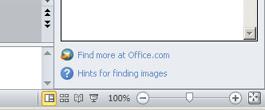
PowerPoint Clip Art
PowerPoint comes with a small repository of images.
From the Insert ribbon, click Clip Art. A Clip Art panel appears on the right side of your screen:

Slide 6
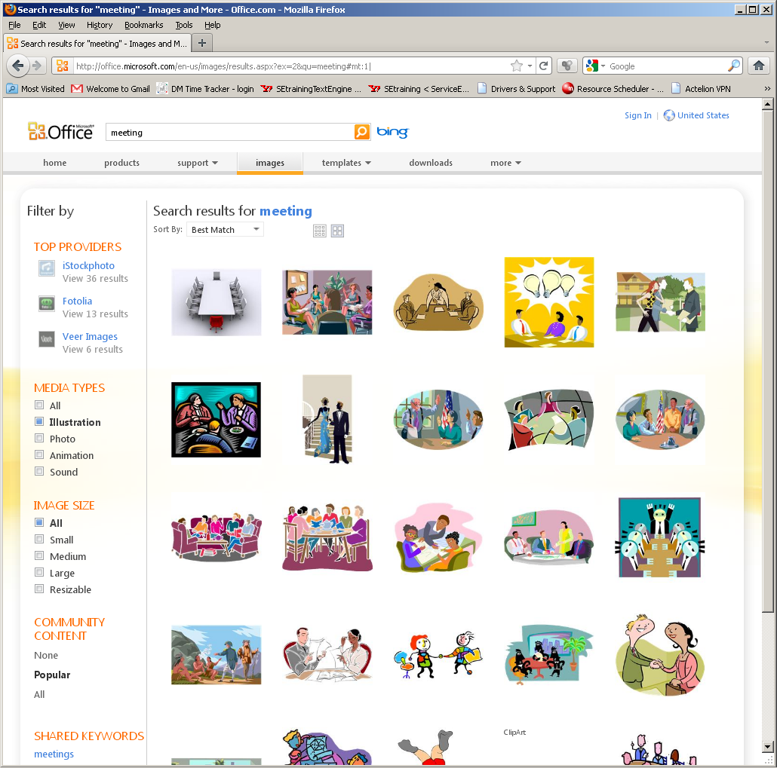
Searching
Enter your search term(s).
Use filters to restrict your search by media type or image size.

Slide 7
Style Numbers
Suppose you like this image. What other clip art is available that is drawn in this style?

Slide 8
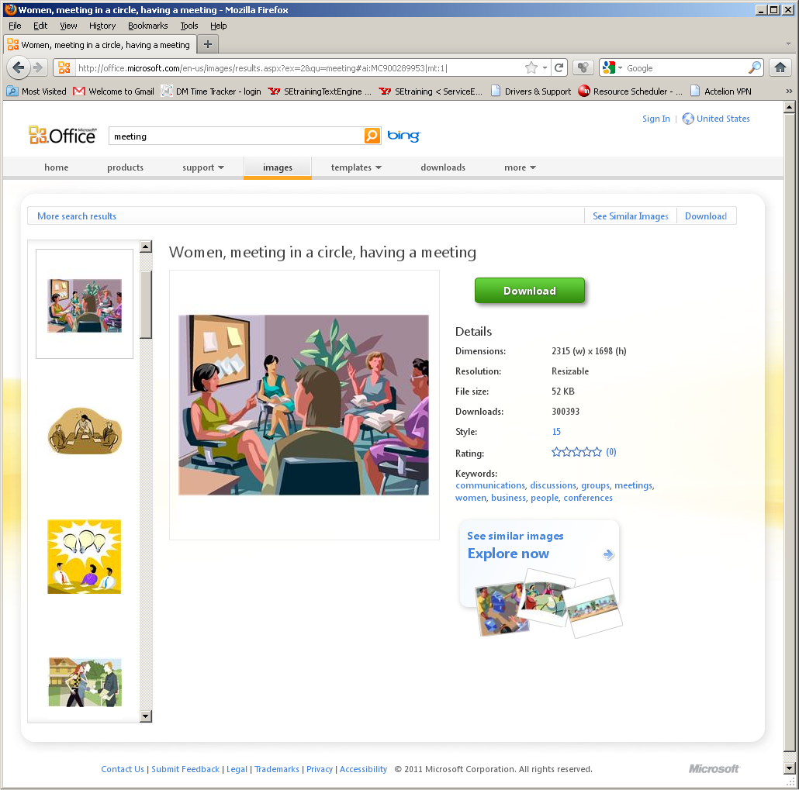
Style Numbers
Click the image you like
to view its details.
Many illustrated images have a Style number associated with them.
This number is an active link. Click it to reveal the other images in the repository that are drawn in the same style!

Slide 9
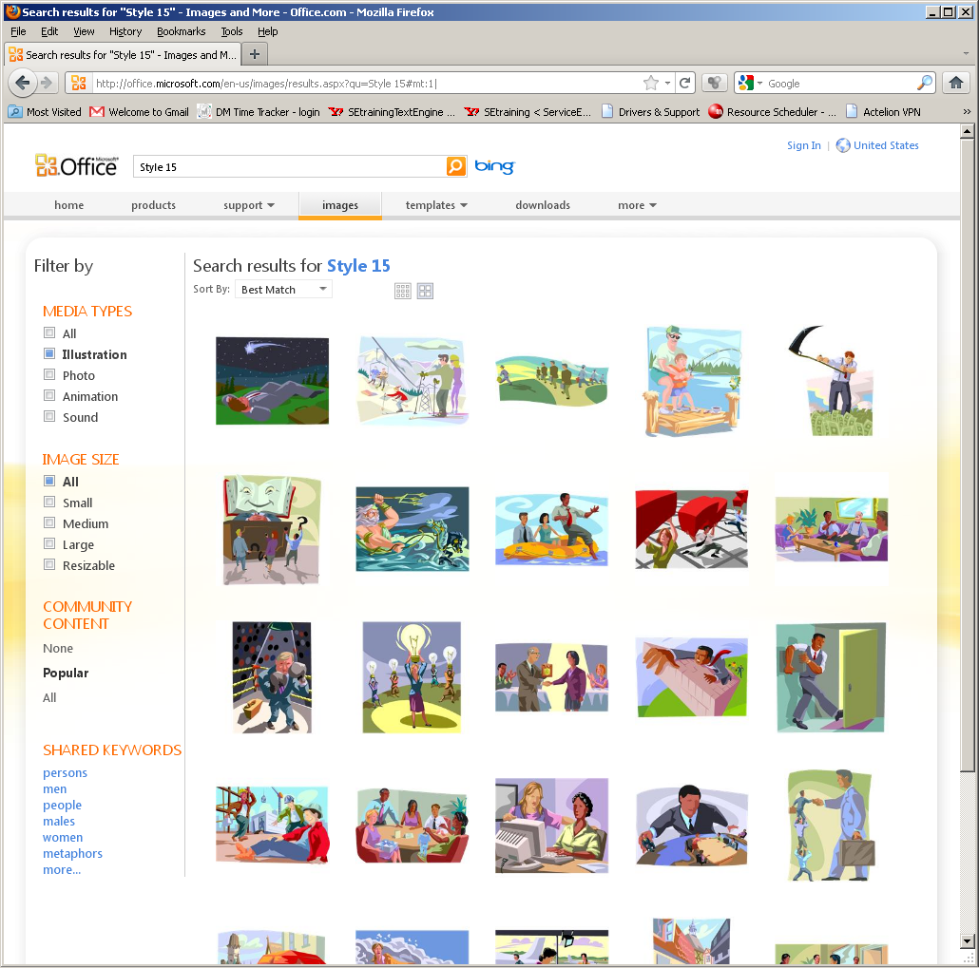
Like-Styled Images

Slide 10
Visual Unity

Slide 11

Hodge-Podge Look w/ Photos
Some images in color
Some images in B&W
Some images sharp
Some images blurred
VISUAL DISUNITY!

Slide 12

Visual Unity w/ Photos
All images in color
All images sharp
VISUAL UNITY!
Note: The slide now has good visual unity, but it has poor ethnic diversity.

Slide 13
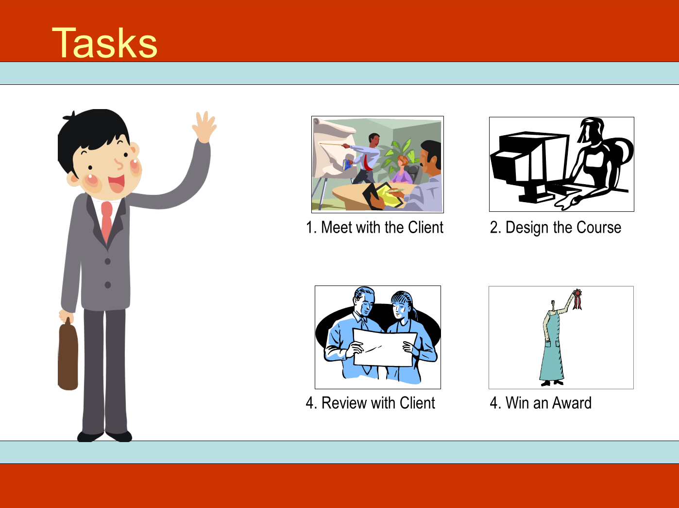
Visual Disunity w/ Illustrations
Some images in color
Some images in B&W
Some images in monotone
Every image in a different style
VISUAL DISUNITY!

Slide 14
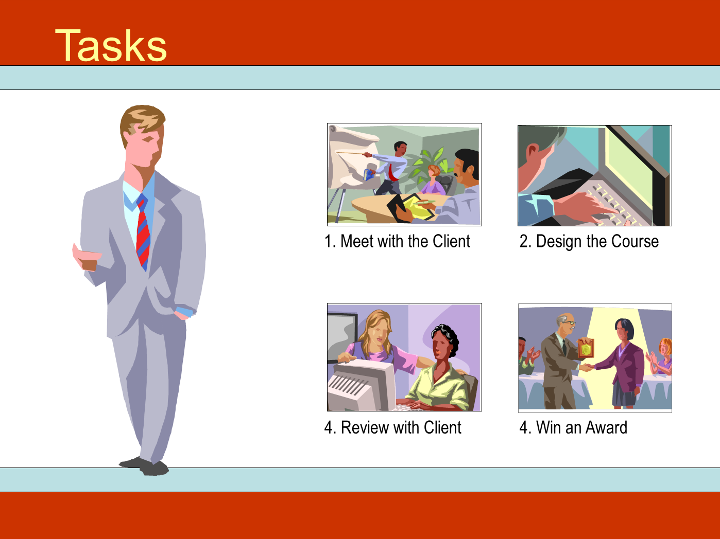
Visual Unity w/ Illustrations
All images in color
All images in same style (15)
VISUAL UNITY!

Slide 15
Working with Clip Art Illustrations

Slide 16

Deconstructing Clip Art
The image of the man originally came from this clip art image.

Slide 17
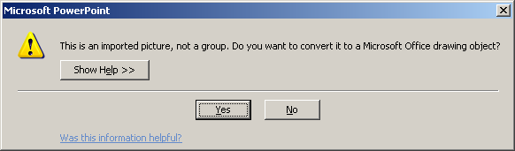
Deconstructing Clip Art
A lot of the illustrational clip art on the Microsoft Office Online image repository consists of many small shapes grouped together.
On a PC, right-click and choose Group→ Ungroup. You’ll be presented with this dialog. Click Yes.
Click Group→Ungroup a second time to complete the ungrouping process.

Slide 18
Deconstructing Clip Art
Unfortunately, the Mac versions of PowerPoint are unable to ungroup the WMF-formatted clip art.
On a Mac, you’ll have to load the WMF image into Adobe Illustrator, where you can gain access to its individual parts, deleting or modifying them as-needed, and then save the rest back out as a PNG image that you can then import into PowerPoint.

Slide 19
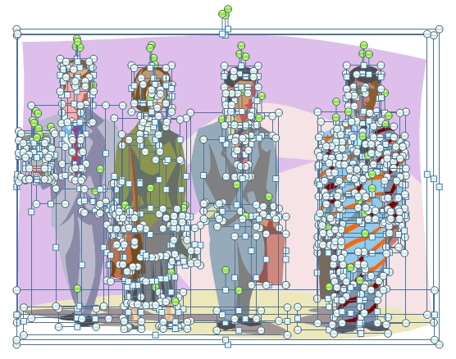
Deconstructing Clip Art
Back in the PC world, after you successfully ungroup the image, click somewhere neutral to clear the selections.
Then drag across the portions of the image you want to delete.

Slide 20

Deconstructing Clip Art
To delete the selected parts of the image, press the Delete key.
You may have to go back and re-select elements that didn’t get selected the first time, but eventually, you should be able to remove everything except the image of the man on the left.

Slide 21
Deconstructing Clip Art
The newspaper he’s holding is also constructed out of smaller shapes.
Click each part of the newspaper and press Delete. Continue until you have removed the newspaper completely.
But be careful not to delete his hand!

Slide 22
Deconstructing Clip Art
Finally, drag your mouse across the man to select all his parts, and then click Group→Group to group them all back together again.
After you’ve grouped the remaining parts, you can copy, paste, and resize the man as-needed and place him on your page.

Slide 23
Reconstructing Clip Art
Note that prior to regrouping, you could replace elements from this image with elements from other ungrouped clip art images.
For example, you could give the man a different tie, different hair style, etc.
You can also recolor elements to change skin tone, clothing color, etc.
Before
After

Slide 24
Combining Photographs

Slide 25

Background

Slide 26

Background + Foreground
Unfortunately, the foreground image of the man has its own (white) background that ruins the illusion that the man is in the office environment. What to do?

Slide 27
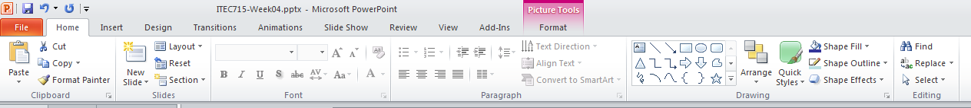
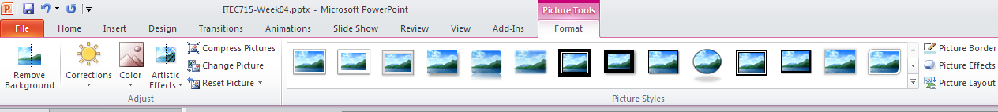
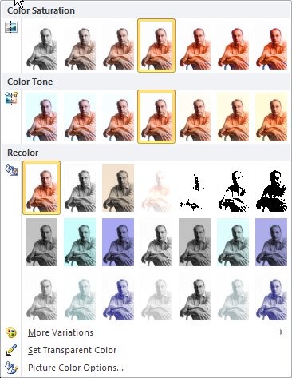
Remove the White Background
1. Click the photo of the man. Then, click Picture Tools in the ribbon.
2. Next, click Color → Set Transparent Color.
3. Finally, click the white background in the photo of the man to make it transparent.
Note: in PP2007, click Color→Recolor→Set Transparent Color

Slide 28
Background + Foreground
Now it looks like I’m in the office environment, ready to offer advice to your learners…
Unfortunately, the foreground image of the man has its own (white) background that ruins the illusion that the man is in the office environment. What to do?

Slide 29
Design Considerations for Designing, Using, and Choosing Effective Graphics

Slide 30
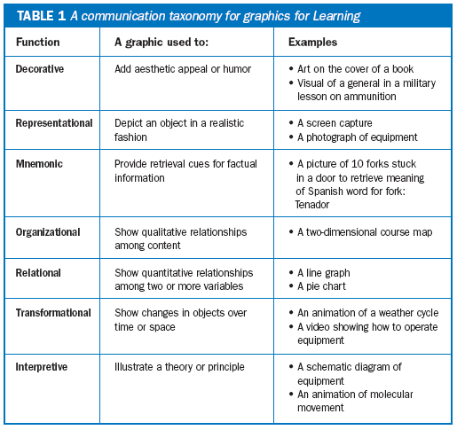
Choosing and Using Graphics
Kinds of Graphics
Ruth Clark published this taxonomy of graphics types in the August 11, 2003 issue of The E-Learning Developer’s Journal.
The taxonomy categorizes graphics according to their communicative purpose
Source: http://www.clarktraining.com/content/articles/MoreThanEyeCandy_part1.pdf

Slide 31
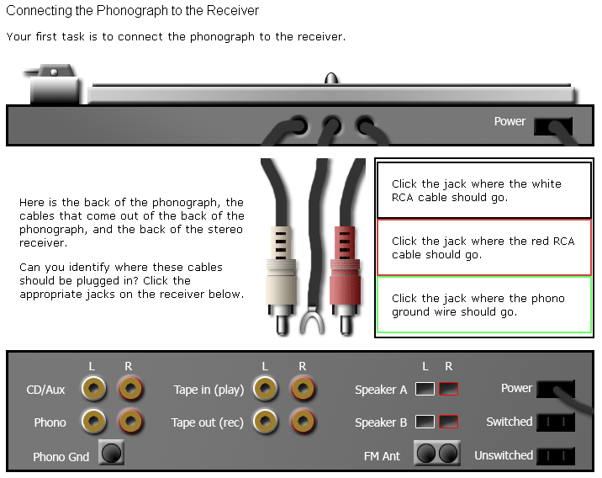
Choosing and Using Graphics
Interpretive vs. Representational
Interpretive →
http://www.oldkingcole.com/simple-sim/

Slide 32
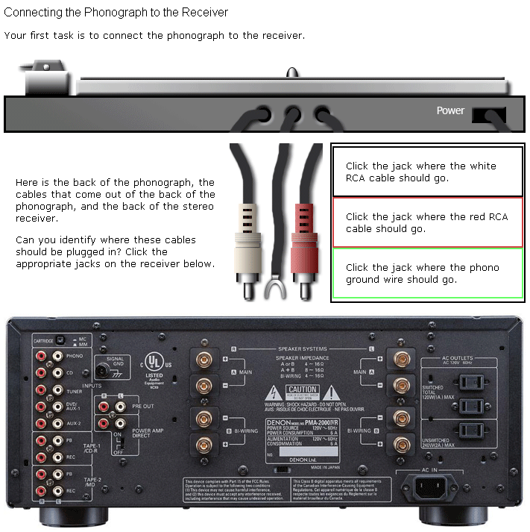
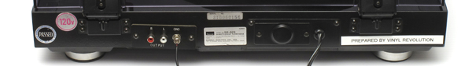
Choosing and Using Graphics
Interpretive vs. Representational
Is the representational image more effective or less?
Is there a theoretical basis for making a choice between representational and interpretive images?
Representational →
http://www.oldkingcole.com/simple-sim/photorealistic.html

Slide 33
Choosing and Using Graphics
Images with high visual fidelity represent a specific person or thing
As fidelity decreases, the images represent larger classes of people or things
Images with low visual fidelity can represent the fundamental essentials of people or things
This high visual fidelity image is a good choice when you want learners to understand how to connect cables to this specific audio receiver.
This low visual fidelity image is a good choice when you want learners to understand how to connect cables to any audio receiver, regardless of brand or specific model.

Slide 34
Choosing and Using Graphics
Perpendicular Continuums
In general, as things move from left to right across the scenario/simulation axis, they become more interactive
As things move from top to bottom on the realistic/abstract axis, they represent general concepts more than specific instances. Scott McCloud talks about this in his book, Understanding Comics. There, he points out that a photograph of a face represents one specific person. A drawing of a man’s face might represent any man. A genderless “smiley face” can represent any person, and so on
Representational
Case Studies and Historical Accounts
Device and Application Emulations
Text-based environments like “Zork”
Interpretive
Allegories and Fables
Scenario
Simulation
A similar, but slightly different take on these ideas is at Scott McCloud’s website here: http://www.scottmccloud.com/4-inventions/triangle/index.html
Notes:
Note: In Ruth Clark’s taxonomy, what I’ve called “Realistic” images, she would call “Representational.” What I’ve called “Abstract”, she calls “Interpretive.”

Slide 35
Images of People
Diversity, Attire, Setting, and Abstraction

Slide 36




Diversity
How would you rate the diversity of these images?
Age diversity: Good
Gender diversity: Poor
Racial diversity: Poor
Age diversity: Fair (Poor?)
Gender diversity: Good
Racial diversity: Poor
Age diversity: Fair/Poor
Gender diversity: Good
Racial diversity: Poor
Age diversity: Fair (Poor?)
Gender diversity: Good
Racial diversity: Good

Slide 37

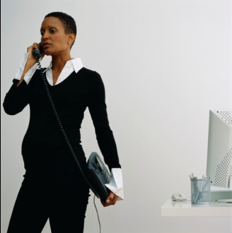

Diversity
Are age, gender, and race the only important diversity categories?
Not necessarily. If you want your images to signal an inclusive workplace, you may need to consciously choose images of people in other minority classes.
Disability status
Pregnancy status
Sexual orientation

Slide 38




Attire & Setting
Do the people in your e-learning course look like the people in your school, company, or institution?
Attire:
Setting:

Slide 39



Abstraction
A specific woman
No specific woman
Representational
Interpretive

Slide 40



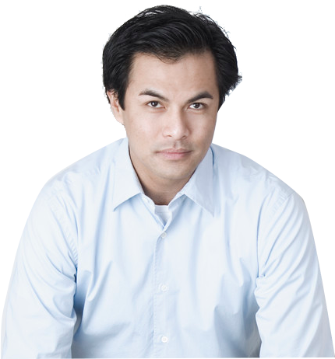

Which Is More Appropriate?
Scenario 1: Your audio narration is “Customers are another important stakeholder group.”
Customers
Customers

Slide 41
Which Is More Appropriate?
Scenario 2: Your audio narration is “Carol is an experienced manager; Joe is a new employee. Listen to their conversation, and then try to answer the following question: Is Carol making the right decision?”
Carol
Joe
Carol
Joe

Slide 42
This Week:
A Divide and Conquer Approach to E-learning Design and Production

Slide 43
A Challenge to E-learning Designers
A Challenge to E-learning Designers
Common reactions to e-learning:
“Overcoming my boredom is the hardest part of most e-learning I take.”
“I typically read e-mail or do other tasks while the voice of the e-learning narrator drones on.”
“At the quiz, I guess randomly until I get the right answer.”
“After taking a typical e-learning course, I haven’t learned much, and I retain even less.”
What can we do to avoid creating courses that generate responses like these?

Slide 44
Why Design Interactions?
Why Design Interactions?
Driving Principles (Instructional)
Improve learner engagement because bored learners tune out
Learners retain more when they work with the material
Driving Principles (Economic)
Don’t reinvent the wheel
Breaking a complex task into smaller chunks makes designing easier (and faster)
Time is money

Slide 45
Interaction Design
Interaction Design
Page Types
  Definition: A “page type” is a formalized templated combination of page layout and interactivity.
  Page layout = how elements are arranged on the page
  Interactivity = how the learner interacts with the page
  NOTE: Basic navigation doesn’t count as interactivity!

Slide 46
Page Type Examples
Tell-oriented Interactions

Slide 47

Text with Graphic
Text With Graphic
The Company Helpdesk
You can reach the company helpdesk at any time, day or night, by calling x1700. Please have the following information ready when you call the helpdesk:
Your employee number
Your location (campus and building)
Your computer’s asset number (located on a sticker the underside of most laptops)
Whether this is a new issue or an existing issue. If it’s an existing issue, please have the ticket number available.
Call x1700 to reach the helpdesk at any time
Click Next to continue.
Back
Menu
Next

Slide 48
Text Explore
Text Explore
The Company Business Process
There are four major steps to the company business process. Click each step to learn more about it:
Research the competitive landscape
Estimate costs required to “beat the best”
Estimate the return on investment (ROI)
Make a “build vs. buy” decision
Click each process step. Then click Next to continue.
Back
Menu
Next

Slide 49
Text Explore
Text Explore
The Company Business Process
There are four major steps to the company business process. Click each step to learn more about it:
Research the competitive landscape
Estimate costs required to “beat the best”
Estimate the return on investment (ROI)
Make a “build vs. buy” decision
Research the Competitive Landscape
In this step, you must determine if there are any competitors who are already engaged in the new business opportunity you see for your company. If so, you need to identify which competitor is doing the best in this market.
“Best” can be a tricky concept. Sometimes it means earning the largest gross margins. Sometimes is means capturing the largest share of the market. Be careful how you define “best” at this stage!
Click each process step. Then click Next to continue.
Back
Menu
Next

Slide 50
Text Explore
Text Explore
The Company Business Process
There are four major steps to the company business process. Click each step to learn more about it:
Research the competitive landscape
Estimate costs required to “beat the best”
Estimate the return on investment (ROI)
Make a “build vs. buy” decision
Estimate Costs Required to “Beat the Best”
Having identified the competitor who is doing best in this market, you next need to figure out how much it will cost your company to enter the market and beat the best player.
Some factors to consider:
Existing brand loyalties you may have to overcome
Marketing costs
Any import duties on parts or subcomponents
Taxes and other fees
Click each process step. Then click Next to continue.
Back
Menu
Next

Slide 51
Text Explore
Text Explore
The Company Business Process
There are four major steps to the company business process. Click each step to learn more about it:
Research the competitive landscape
Estimate costs required to “beat the best”
Estimate the return on investment (ROI)
Make a “build vs. buy” decision
Estimate the Return on Investment (ROI)
To compute the ROI, <blah blah blah etc. etc. etc.>
Click each process step. Then click Next to continue.
Back
Menu
Next

Slide 52
Text Explore
Text Explore
The Company Business Process
There are four major steps to the company business process. Click each step to learn more about it:
Research the competitive landscape
Estimate costs required to “beat the best”
Estimate the return on investment (ROI)
Make a “build vs. buy” decision
Make a “Build vs. Buy” Decision
Factors to consider in making this decision include:
Blah
Blah
Blah
Yadda
Yadda
Yadda
Click each process step. Then click Next to continue.
Back
Menu
Next

Slide 53
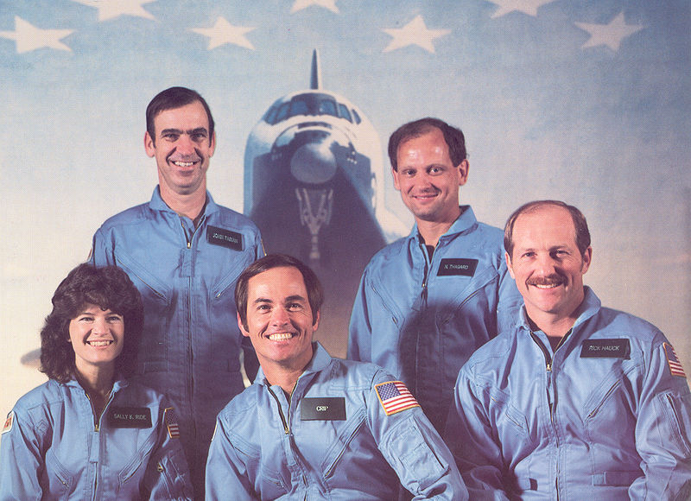
Graphic Explore: Ex. 1
Graphic Explore
Sally Ride’s Crewmates on STS-7
In 1983, Sally Ride became the first American woman to enter space when she flew on the space shuttle Challenger’s STS-7 mission. At the time, she was also the youngest American to enter space. Can you identify her crewmates? Click each astronaut to see if you are right.
Click each astronaut. Then click Next to continue.
Back
Menu
Next

Slide 54

Graphic Explore: Ex. 1
Graphic Explore
Sally Ride’s Crewmates on STS-7
In 1983, Sally Ride became the first American woman to enter space when she flew on the space shuttle Challenger’s STS-7 mission. At the time, she was also the youngest American to enter space. Can you identify her crewmates? Click each astronaut to see if you are right.
Sally K. Ride
(Mission Specialist)
Dr. Sally Kristen Ride (born May 26, 1951) from Los Angeles, California, is an American physicist and a former NASA astronaut. She studied at Portola Middle School, Westlake School for Girls, Swarthmore College and Stanford University, and earned a master's degree and PhD. Ride joined NASA in 1978, and in 1983, became the first American woman, and then-youngest American, to enter space. In 1987 she left NASA to work at Stanford University Center for International Security and Arms Control.
Click each astronaut. Then click Next to continue.
Back
Menu
Next

Slide 55

Graphic Explore: Ex. 1
Graphic Explore
Sally Ride’s Crewmates on STS-7
In 1983, Sally Ride became the first American woman to enter space when she flew on the space shuttle Challenger’s STS-7 mission. At the time, she was also the youngest American to enter space. Can you identify her crewmates? Click each astronaut to see if you are right.
Robert L. Crippen
(Mission Commander)
Robert Laurel Crippen (born September 11, 1937 in Beaumont, Texas) is an engineer, retired United States Navy Captain and a former NASA astronaut. He flew on four Space Shuttle missions, including three as commander.[1] Crippen is a recipient of the Congressional Space Medal of Honor.
Click each astronaut. Then click Next to continue.
Back
Menu
Next

Slide 56

Graphic Explore: Ex. 1
Graphic Explore
Sally Ride’s Crewmates on STS-7
In 1983, Sally Ride became the first American woman to enter space when she flew on the space shuttle Challenger’s STS-7 mission. At the time, she was also the youngest American to enter space. Can you identify her crewmates? Click each astronaut to see if you are right.
Frederick H. Hauck
(Pilot)
Frederick H. Hauck was born April 11, 1941 in Long Beach, California, but considers Winchester, Massachusetts and Washington, D.C. to be his hometowns. NASA selected Hauck as an astronaut candidate in January 1978. He was pilot for STS-7, the seventh flight of the Space Shuttle, which launched from Kennedy Space Center, Florida, on June 18, 1983. This was the second flight for the orbiter Challenger and the first mission with a 5-person crew.
Click each astronaut. Then click Next to continue.
Back
Menu
Next

Slide 57

Graphic Explore: Ex. 1
Graphic Explore
Sally Ride’s Crewmates on STS-7
In 1983, Sally Ride became the first American woman to enter space when she flew on the space shuttle Challenger’s STS-7 mission. At the time, she was also the youngest American to enter space. Can you identify her crewmates? Click each astronaut to see if you are right.
John M. Fabian
(Mission Specialist)
John McCreary Fabian (born January 28, 1939, in Goose Creek, Texas) is a former NASA Astronaut and Air Force officer who flew two space shuttle missions and worked on the development of the shuttle's robotic arm. He later led the Air Force's space operations.
Click each astronaut. Then click Next to continue.
Back
Menu
Next

Slide 58

Graphic Explore: Ex. 1
Graphic Explore
Sally Ride’s Crewmates on STS-7
In 1983, Sally Ride became the first American woman to enter space when she flew on the space shuttle Challenger’s STS-7 mission. At the time, she was also the youngest American to enter space. Can you identify her crewmates? Click each astronaut to see if you are right.
Norman E. Thagard
(Mission Specialist)
Dr. Norman Earl Thagard first flew on STS-7, which launched from Kennedy Space Center, Florida, on June 18, 1983. During the flight Dr. Thagard conducted various medical tests and collected data on physiological changes associated with astronaut adaptation to space. He also retrieved the rotating SPAS-01 using the RMS. Mission duration was 147 hours before landing at Edwards Air Force Base, California, on June 24, 1983.
Click each astronaut. Then click Next to continue.
Back
Menu
Next

Slide 59
GE Ex2
Graphic Explore
Photocopier: Key Components
To use a photocopy machine effectively, you must be able to recognize its key components. Click each highlighted area on the photocopy machine pictured below to learn its function.
Click each highlighted component. Then click Next to continue.
Back
Menu
Next

Slide 60
GE Ex2
Graphic Explore
Photocopier: Key Components
To use a photocopy machine effectively, you must be able to recognize its key components. Click each highlighted area on the photocopy machine pictured below to learn its function.
Collection Tray
As the photocopy machine completes each set of copies, it sends the completed copies to this collection tray.
This is where you will retrieve your finished copies.
Click each highlighted component. Then click Next to continue.
Back
Menu
Next

Slide 61
GE Ex2
Graphic Explore
Photocopier: Key Components
To use a photocopy machine effectively, you must be able to recognize its key components. Click each highlighted area on the photocopy machine pictured below to learn its function.
Copy Surface
Whenever you need to copy a single page (or a small number of pages), you can use the glass copy surface.
Place each page that you want to copy face-down on the glass, and then lower the lid. When you press Copy, the machine will copy the page.
To specify the number of copies you’d like, use the copier’s control panel.
Click each highlighted component. Then click Next to continue.
Back
Menu
Next

Slide 62
GE Ex2
Graphic Explore
Photocopier: Key Components
To use a photocopy machine effectively, you must be able to recognize its key components. Click each highlighted area on the photocopy machine pictured below to learn its function.
Control Panel
Use the control panel to adjust the darkness of your copies, the number of copies you’d like, and any changes in size that you want the copier to make in your copies.
Click each highlighted component. Then click Next to continue.
Back
Menu
Next

Slide 63
2CD Ex1
Two Character Dialog
Preparing for Launch
Meet Sally and Norman
As you listen to Sally and Norman’s dialog, see if you can find the answers to the following questions:
What is Sally’s chief concern about the mission?
What is Norman’s chief concern?
Click Start to begin listening to their conversation.
Sally is a Mission Specialist on STS-7.
Sally
Norman is a physician on the STS-7 flight.
Norman
Start
Click Start to begin the activity.
Back
Menu
Next

Slide 64
2CD Ex1
Two Character Dialog
Sally Ride’s Crewmates on STS-7
Blah blah blah etc etc etc yadda yadda yadda.
Norman
Sally
Click the dialog controls to view the conversation.
Then click Next to continue.
Back
Menu
Next

Slide 65
2CD Ex1
Two Character Dialog
Sally Ride’s Crewmates on STS-7
Yadda yadda yadda etc etc etc blah blah blah.
Sally
Norman
Click the dialog controls to view the conversation.
Then click Next to continue.
Back
Menu
Next

Slide 66
2CD Ex1
Two Character Dialog
Sally Ride’s Crewmates on STS-7
Blah blah blah etc etc etc yadda yadda yadda.
Norman
Sally
Click the dialog controls to view the conversation.
Then click Next to continue.
Back
Menu
Next

Slide 67
2CD Ex1
Two Character Dialog
Sally Ride’s Crewmates on STS-7
Yadda yadda yadda etc etc etc blah blah blah.
Sally
Norman
Click the dialog controls to view the conversation.
Then click Next to continue.
Back
Menu
Next

Slide 68

2CD Ex2
Two Character Dialog
Two-Key Cryptography
Leon is confused about two-key cryptography. Jennifer is the local expert on this form of codemaking, so when Leon runs into Jennifer in the hallway, he takes the opportunity to ask her some questions.
As you observe their dialog, see if you can find the answer to the following question:
What is the risk Leon will face if he downloads Jennifer’s public key from the Internet?
When you’re ready to begin, click Start.
Click Start to begin the activity.
Back
Menu
Next

Slide 69


2CD Ex2
Two Character Dialog
Jennifer, I want to practice sending you cryptographically-encoded messages using two-key cryptography. Can I just download your public key and use it?
Two-Key Cryptography
Leon is confused about two-key cryptography. Jennifer is the local expert on this form of codemaking, so when Leon runs into Jennifer in the hallway, he takes the opportunity to ask her some questions.
As you observe their dialog, see if you can find the answer to the following question:
What is the risk Leon will face if he downloads Jennifer’s public key from the Internet?
When you’re ready to begin, click Start.
Click the dialog controls to view the conversation.
Then click Next to continue.
Back
Menu
Next

Slide 70
2CD Ex2
Two Character Dialog
You could, but how can you be certain that you actually downloaded my public key, and not someone else’s public key masquerading as mine?
Click the dialog controls to view the conversation.
Then click Next to continue.
Back
Menu
Next

Slide 71
2CD Ex2
Two Character Dialog
You’re talking about the need for a circle of trust, aren’t you?
I’ve read about that, but I don’t understand how it works.
Click the dialog controls to view the conversation.
Then click Next to continue.
Back
Menu
Next

Slide 72
2CD Ex2
Two Character Dialog
Well, blah blah blah, yadda yadda yadda, explain, explain, explain, etc., etc., etc. as the dialog continues…
Click the dialog controls to view the conversation.
Then click Next to continue.
Back
Menu
Next

Slide 73


Expert Perspective
Expert Perspective
Seeing the Solution in Different Ways
Captain Kirk has asked Dr. McCoy and Mr. Spock for advice. Each has a different perspective. Dr. McCoy offers a human, emotional point of view. Mr. Spock offers a logical, rational point of view.
Click each character to hear what he has to say. If you were in Captain Kirk’s position, whose advice would you take?
Dr. McCoy
Mr. Spock
Click each character to hear his perspective.
Then click Next to continue.
Back
Menu
Next

Slide 74
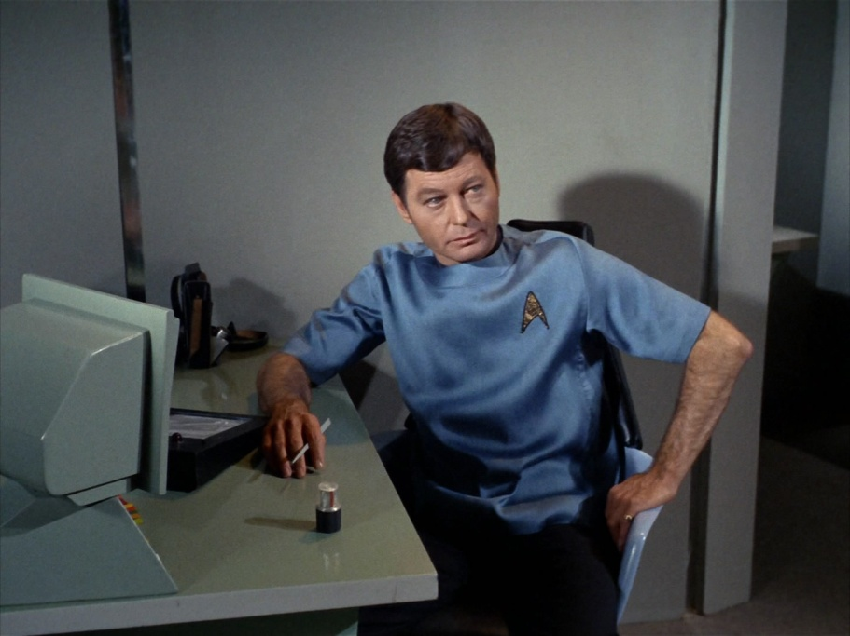
Expert Perspective
Expert Perspective
Seeing the Solution in Different Ways
Captain Kirk has asked Dr. McCoy and Mr. Spock for advice. Each has a different perspective. Dr. McCoy offers a human, emotional point of view. Mr. Spock offers a logical, rational point of view.
Click each character to hear what he has to say. If you were in Captain Kirk’s position, whose advice would you take?
Dr. McCoy’s Perspective
Dr. McCoy
Mr. Spock
Click each character to hear his perspective.
Then click Next to continue.
Back
Menu
Next

Slide 75

Expert Perspective
Expert Perspective
Seeing the Solution in Different Ways
Captain Kirk has asked Dr. McCoy and Mr. Spock for advice. Each has a different perspective. Dr. McCoy offers a human, emotional point of view. Mr. Spock offers a logical, rational point of view.
Click each character to hear what he has to say. If you were in Captain Kirk’s position, whose advice would you take?
Mr. Spock’s Perspective
Dr. McCoy
Mr. Spock
Click each character to hear his perspective.
Then click Next to continue.
Back
Menu
Next

Slide 76
Page Type Examples
Simple Do-oriented Interactions

Slide 77


What’s the Right Response?
What’s The Right Response?
Meet Joe and Anna Li
Emphasizing an Effect
ABC Sound Design has been hired to create the sound effects for an action movie, and mix them into the film’s soundtrack.
Anna Li created most of the sound effects, but she has asked her intern, Joe, to insert them into the film’s final audio mix.
In this activity, you will coach Anna Li as she answers Joe’s questions.
Click Start to begin the activity.
Joe is a new intern student at ABC Sound Design. He’s working under the supervision of Anna Li.
Anna Li is a new audio engineer at the sound effects department at ABC Sound. She’s helping Joe edit sound effects into an action movie.
Start
Note: Character images available for free at http://www.designcomics.com/
Click Start to begin the activity.
Back
Menu
Next

Slide 78


What’s the Right Response?
What’s The Right Response?
Emphasizing an Effect
At the climax of the film, the heroes blow up the bad guys’ space station. I’ve put in the explosion sound effect, but it just doesn’t have the impact I want. Do you have any suggestions?
How should Ann Li respond? If you know, click the correct response below. If you’re not sure, you can call an expert for help.
Raise the gain on the explosion sound to make it louder.
Put a half-second or so of absolute silence right before the explosion.
Call an expert for a hint.
Click a response for Anna Li. The click Next to continue.
Back
Menu
Next

Slide 79
What’s the Right Response?
What’s The Right Response?
Emphasizing an Effect
Raising the Gain Probably Won’t Work
Turning up the volume on the explosion sound probably isn’t an option. The explosion sound effect is most likely already at maximum gain. Raising it any more would cause clipping, a kind of distortion that would make the sound effect even less satisfactory than it is now.
At the climax of the film, the heroes blow up the bad guys’ space station. I’ve put in the explosion sound effect, but it just doesn’t have the impact I want. Do you have any suggestions?
How should Ann Li respond? If you know, click the correct response below. If you’re not sure, you can call an expert for help.
Raise the gain on the explosion sound to make it louder.
Put a half-second or so of absolute silence right before the explosion.
Call an expert for a hint.
Click a response for Anna Li. The click Next to continue.
Back
Menu
Next

Slide 80
What’s the Right Response?
What’s The Right Response?
Emphasizing an Effect
Correct!
Legendary sound effects professional Ben Burtt calls the fractional second of absolute silence that precedes a loud sound effect an “audio black hole.” It increases the contrast in sound levels and makes the explosion that follows it seem much more intense.
At the climax of the film, the heroes blow up the bad guys’ space station. I’ve put in the explosion sound effect, but it just doesn’t have the impact I want. Do you have any suggestions?
How should Ann Li respond? If you know, click the correct response below. If you’re not sure, you can call an expert for help.
Raise the gain on the explosion sound to make it louder.
Put a half-second or so of absolute silence right before the explosion.
Call an expert for a hint.
Click a response for Anna Li. The click Next to continue.
Back
Menu
Next

Slide 81
What’s the Right Response?
What’s The Right Response?
Emphasizing an Effect
Hint
Remember that there are limits to how loud you can make a recorded sound. You want the effect to come through clearly and not be distorted. Only one of Anna Li’s possible responses avoids the risk of clipping. Can you figure out which one?
At the climax of the film, the heroes blow up the bad guys’ space station. I’ve put in the explosion sound effect, but it just doesn’t have the impact I want. Do you have any suggestions?
How should Ann Li respond? If you know, click the correct response below. If you’re not sure, you can call an expert for help.
Raise the gain on the explosion sound to make it louder.
Put a half-second or so of absolute silence right before the explosion.
Call an expert for a hint.
Click a response for Anna Li. The click Next to continue.
Back
Menu
Next

Slide 82
Multiple Choice Question
Multiple Choice Question
Conlon Nancarrow’s Studies for Player-Piano
Nancarrow composed his famous series of studies for player-piano in Mexico City starting in the 1940’s.
Select the best choice: Why did Nancarrow write so much music for player-piano?
  No humans could play the music he wanted to write.
  His father was a player-piano salesman.
  The early fame he achieved with his first player-piano compositions encouraged him to keep at it.
  He had a falling-out with his normal pianist and vowed never to write for pianists ever again.
Click an answer choice. Then click Next to continue.
Back
Menu
Next

Slide 83

Multiple Choice Question
Multiple Choice Question
Conlon Nancarrow’s Studies for Player-Piano
Nancarrow composed his famous series of studies for player-piano in Mexico City starting in the 1940’s.
Select the best choice: Why did Nancarrow write so much music for player-piano?
Correct!
Nancarrow was interested in exploring extremely complex cross-rhythmic counterpoint—way beyond human ability to count or perform.
Click the icon below to hear the intense final bars of Nancarrow’s Study No. 8:
  No humans could play the music he wanted to write.
  His father was a player-piano salesman.
  The early fame he achieved with his first player-piano compositions encouraged him to keep at it.
  He had a falling-out with his normal pianist and vowed never to write for pianists ever again.
Click an answer choice. Then click Next to continue.
Back
Menu
Next

Slide 84
Multiple Choice Question
Multiple Choice Question
Conlon Nancarrow’s Studies for Player-Piano
Nancarrow composed his famous series of studies for player-piano in Mexico City starting in the 1940’s.
Select the best choice: Why did Nancarrow write so much music for player-piano?
Incorrect.
Nancarrow’s father was not a player-piano salesman. Nancarrow wrote for player-piano because his music involved extremely complex cross-rhythms that human beings could not perform.
Click the icon below to hear the intense final bars of Nancarrow’s Study No. 8:
  No humans could play the music he wanted to write.
  His father was a player-piano salesman.
  The early fame he achieved with his first player-piano compositions encouraged him to keep at it.
  He had a falling-out with his normal pianist and vowed never to write for pianists ever again.
Click an answer choice. Then click Next to continue.
Back
Menu
Next

Slide 85
Multiple Choice Question
Multiple Choice Question
Conlon Nancarrow’s Studies for Player-Piano
Nancarrow composed his famous series of studies for player-piano in Mexico City starting in the 1940’s.
Select the best choice: Why did Nancarrow write so much music for player-piano?
Incorrect.
Nancarrow worked in relative obscurity for most of his career. His work only became known to the wider world in the when the first Columbia Records recording of a few of his Studies came out in 1969. Comprehensive recordings of his Studies weren’t released until 1977.
Click the icon below to hear the intense final bars of Nancarrow’s Study No. 8:
  No humans could play the music he wanted to write.
  His father was a player-piano salesman.
  The early fame he achieved with his first player-piano compositions encouraged him to keep at it.
  He had a falling-out with his normal pianist and vowed never to write for pianists ever again.
Click an answer choice. Then click Next to continue.
Back
Menu
Next

Slide 86
Multiple Choice Question
Multiple Choice Question
Conlon Nancarrow’s Studies for Player-Piano
Nancarrow composed his famous series of studies for player-piano in Mexico City starting in the 1940’s.
Select the best choice: Why did Nancarrow write so much music for player-piano?
Incorrect.
Nancarrow didn’t have a regular pianist he worked with. He pretty much gave up writing for humans for the majority of the time he worked as a composer, coming back to writing for human performers only near the end of his career.
Click the icon below to hear the intense final bars of Nancarrow’s Study No. 8:
  No humans could play the music he wanted to write.
  His father was a player-piano salesman.
  The early fame he achieved with his first player-piano compositions encouraged him to keep at it.
  He had a falling-out with his normal pianist and vowed never to write for pianists ever again.
Click an answer choice. Then click Next to continue.
Back
Menu
Next

Slide 87
Page Type Examples
More Complex Do-oriented Interactions

Slide 88
MCQ 2
Multiple Choice Question 2
32 slides to implement this interaction.

Slide 89
MCQ 2
Multiple Choice Question 2
Incorrect.
You can’t make a BLT sandwich with no ingredients!
Click one or more ingredients and then click Submit.
Submit

Slide 90
MCQ 2
Multiple Choice Question 2

Slide 91
MCQ 2
Multiple Choice Question 2
Incorrect.
Bacon is one ingredient, but you need to use more in a BLT sandwich.
Click one or more additional ingredients, and then click Submit.
Submit

Slide 92
MCQ 2
Multiple Choice Question 2

Slide 93
MCQ 2
Multiple Choice Question 2
Incorrect.
Lettuce is one ingredient, but you need to use more in a BLT sandwich.
Click one or more additional ingredients, and then click Submit.
Submit

Slide 94
MCQ 2
Multiple Choice Question 2

Slide 95
MCQ 2
Multiple Choice Question 2
Incorrect.
Bacon and lettuce are ingredients in a BLT, but they are not the only ingredients.
Click one or more additional ingredients, and then click Submit.
Submit

Slide 96
MCQ 2
Multiple Choice Question 2

Slide 97
MCQ 2
Multiple Choice Question 2
Incorrect.
Tofu is not usually an ingredient in a BLT sandwich.
Click Tofu to deselect it, and then choose one or more other ingredients and click Submit.
Submit

Slide 98
MCQ 2
Multiple Choice Question 2

Slide 99
MCQ 2
Multiple Choice Question 2
Incorrect.
Tofu is not usually an ingredient in a BLT sandwich.
Click Tofu to deselect it, choose one or more other ingredients, and then click Submit.
Submit

Slide 100
MCQ 2
Multiple Choice Question 2

Slide 101
MCQ 2
Multiple Choice Question 2
Incorrect.
Tofu is not usually an ingredient in a BLT sandwich.
Click Tofu to deselect it, choose one or more other ingredients, and then click Submit.
Submit

Slide 102
MCQ 2
Multiple Choice Question 2

Slide 103
MCQ 2
Multiple Choice Question 2
Incorrect.
Tofu is not usually an ingredient in a BLT sandwich.
Click Tofu to deselect it, choose one or more other ingredients, and then click Submit.
Submit

Slide 104
MCQ 2
Multiple Choice Question 2

Slide 105
MCQ 2
Multiple Choice Question 2
Incorrect.
Tomato is one ingredient, but you need to use more in a BLT sandwich.
Click one or more additional ingredients, and then click Submit.
Submit

Slide 106
MCQ 2
Multiple Choice Question 2

Slide 107
MCQ 2
Multiple Choice Question 2
Incorrect.
Bacon and tomato are two ingredients, but you need to use more in a BLT sandwich.
Click one or more additional ingredients, and then click Submit.
Submit

Slide 108
MCQ 2
Multiple Choice Question 2

Slide 109
MCQ 2
Multiple Choice Question 2
Incorrect.
Lettuce and tomato are two ingredients, but you need to use more in a BLT sandwich.
Click one or more additional ingredients, and then click Submit.
Submit

Slide 110
MCQ 2
Multiple Choice Question 2

Slide 111
MCQ 2
Multiple Choice Question 2
Correct!
“B” is for “Bacon.”
“L” is for “Lettuce.”
“T” is for “Tomato.”
Click Next to continue.
Submit
Click Next to continue.
Back
Menu
Next

Slide 112
MCQ 2
Multiple Choice Question 2

Slide 113
MCQ 2
Multiple Choice Question 2
Incorrect.
Tofu is not usually an ingredient in a BLT sandwich.
Click Tofu to deselect it, and then choose one or more other ingredients and click Submit.
Submit

Slide 114
MCQ 2
Multiple Choice Question 2

Slide 115
MCQ 2
Multiple Choice Question 2
Incorrect.
Tofu is not usually an ingredient in a BLT sandwich.
Click Tofu to deselect it, and then choose one or more other ingredients and click Submit.
Submit

Slide 116
MCQ 2
Multiple Choice Question 2

Slide 117
MCQ 2
Multiple Choice Question 2
Incorrect.
Tofu is not usually an ingredient in a BLT sandwich.
Click Tofu to deselect it, and then choose one or more other ingredients and click Submit.
Submit

Slide 118
MCQ 2
Multiple Choice Question 2

Slide 119
MCQ 2
Multiple Choice Question 2
Incorrect.
Tofu is not usually an ingredient in a BLT sandwich.
Click Tofu to deselect it, and then choose zero or more other ingredients and click Submit.
Submit

Slide 120
Ordering
Ordering
144 slides to implement this interaction.
Notes:
*1234 2134 3124 4123
1243 2143 3142 4132
1324 2314 3214 4213
1342 2341 3241 4231
1423 2413 3412 4312
1432 2431 3421 4321

Slide 121
Ordering
Ordering
Notes:
*1234 2134 3124 4123
1243 2143 3142 4132
1324 2314 3214 4213
1342 2341 3241 4231
1423 2413 3412 4312
1432 2431 3421 4321

Slide 122
Ordering
Ordering
Notes:
*1234 2134 3124 4123
1243 2143 3142 4132
1324 2314 3214 4213
1342 2341 3241 4231
1423 2413 3412 4312
1432 2431 3421 4321

Slide 123
Ordering
Ordering
Notes:
*1234 2134 3124 4123
1243 2143 3142 4132
1324 2314 3214 4213
1342 2341 3241 4231
1423 2413 3412 4312
1432 2431 3421 4321

Slide 124
Ordering
Ordering
Notes:
*1234 2134 3124 4123
1243 2143 3142 4132
1324 2314 3214 4213
1342 2341 3241 4231
1423 2413 3412 4312
1432 2431 3421 4321

Slide 125
Ordering
Ordering
That’s Right!
These are three-letter English words displayed in Morse Code. They translate to:
Bug
Cat
Dog
Emu
Click Next to continue.
Notes:
*1234 2134 3124 4123
1243 2143 3142 4132
1324 2314 3214 4213
1342 2341 3241 4231
1423 2413 3412 4312
1432 2431 3421 4321

Slide 126
Ordering
Ordering
Notes:
+1234 2134 3124 4123
*1243 2143 3142 4132
1324 2314 3214 4213
1342 2341 3241 4231
1423 2413 3412 4312
1432 2431 3421 4321

Slide 127
Ordering
Ordering
Notes:
+1234 2134 3124 4123
*1243 2143 3142 4132
1324 2314 3214 4213
1342 2341 3241 4231
1423 2413 3412 4312
1432 2431 3421 4321

Slide 128
Ordering
Ordering
Notes:
+1234 2134 3124 4123
*1243 2143 3142 4132
1324 2314 3214 4213
1342 2341 3241 4231
1423 2413 3412 4312
1432 2431 3421 4321

Slide 129
Ordering
Ordering
Notes:
+1234 2134 3124 4123
*1243 2143 3142 4132
1324 2314 3214 4213
1342 2341 3241 4231
1423 2413 3412 4312
1432 2431 3421 4321

Slide 130
Ordering
Ordering
Notes:
+1234 2134 3124 4123
*1243 2143 3142 4132
1324 2314 3214 4213
1342 2341 3241 4231
1423 2413 3412 4312
1432 2431 3421 4321

Slide 131

Ordering
Ordering
Notes:
+1234 2134 3124 4123
*1243 2143 3142 4132
1324 2314 3214 4213
1342 2341 3241 4231
1423 2413 3412 4312
1432 2431 3421 4321

Slide 132
Ordering
Ordering
Notes:
+1234 2134 3124 4123
+1243 2143 3142 4132
*1324 2314 3214 4213
1342 2341 3241 4231
1423 2413 3412 4312
1432 2431 3421 4321

Slide 133
Ordering
Ordering
Notes:
+1234 2134 3124 4123
+1243 2143 3142 4132
*1324 2314 3214 4213
1342 2341 3241 4231
1423 2413 3412 4312
1432 2431 3421 4321

Slide 134
Ordering
Ordering
Notes:
+1234 2134 3124 4123
+1243 2143 3142 4132
*1324 2314 3214 4213
1342 2341 3241 4231
1423 2413 3412 4312
1432 2431 3421 4321

Slide 135
Ordering
Ordering
Notes:
+1234 2134 3124 4123
+1243 2143 3142 4132
*1324 2314 3214 4213
1342 2341 3241 4231
1423 2413 3412 4312
1432 2431 3421 4321

Slide 136
Ordering
Ordering
Notes:
+1234 2134 3124 4123
+1243 2143 3142 4132
*1324 2314 3214 4213
1342 2341 3241 4231
1423 2413 3412 4312
1432 2431 3421 4321

Slide 137
Ordering
Ordering
Notes:
+1234 2134 3124 4123
+1243 2143 3142 4132
*1324 2314 3214 4213
1342 2341 3241 4231
1423 2413 3412 4312
1432 2431 3421 4321

Slide 138
Ordering
Ordering
Notes:
+1234 2134 3124 4123
+1243 2143 3142 4132
+1324 2314 3214 4213
*1342 2341 3241 4231
1423 2413 3412 4312
1432 2431 3421 4321

Slide 139
Ordering
Ordering
Notes:
+1234 2134 3124 4123
+1243 2143 3142 4132
+1324 2314 3214 4213
*1342 2341 3241 4231
1423 2413 3412 4312
1432 2431 3421 4321

Slide 140
Ordering
Ordering
Notes:
+1234 2134 3124 4123
+1243 2143 3142 4132
+1324 2314 3214 4213
*1342 2341 3241 4231
1423 2413 3412 4312
1432 2431 3421 4321

Slide 141
Ordering
Ordering
Notes:
+1234 2134 3124 4123
+1243 2143 3142 4132
+1324 2314 3214 4213
*1342 2341 3241 4231
1423 2413 3412 4312
1432 2431 3421 4321

Slide 142
Ordering
Ordering
Notes:
+1234 2134 3124 4123
+1243 2143 3142 4132
+1324 2314 3214 4213
*1342 2341 3241 4231
1423 2413 3412 4312
1432 2431 3421 4321

Slide 143
Ordering
Ordering
Notes:
+1234 2134 3124 4123
+1243 2143 3142 4132
+1324 2314 3214 4213
*1342 2341 3241 4231
1423 2413 3412 4312
1432 2431 3421 4321

Slide 144
Ordering
Ordering
Notes:
+1234 2134 3124 4123
+1243 2143 3142 4132
+1324 2314 3214 4213
+1342 2341 3241 4231
*1423 2413 3412 4312
1432 2431 3421 4321

Slide 145
Ordering
Ordering
Notes:
+1234 2134 3124 4123
+1243 2143 3142 4132
+1324 2314 3214 4213
+1342 2341 3241 4231
*1423 2413 3412 4312
1432 2431 3421 4321

Slide 146
Ordering
Ordering
Notes:
+1234 2134 3124 4123
+1243 2143 3142 4132
+1324 2314 3214 4213
+1342 2341 3241 4231
*1423 2413 3412 4312
1432 2431 3421 4321

Slide 147
Ordering
Ordering
Notes:
+1234 2134 3124 4123
+1243 2143 3142 4132
+1324 2314 3214 4213
+1342 2341 3241 4231
*1423 2413 3412 4312
1432 2431 3421 4321

Slide 148
Ordering
Ordering
Notes:
+1234 2134 3124 4123
+1243 2143 3142 4132
+1324 2314 3214 4213
+1342 2341 3241 4231
*1423 2413 3412 4312
1432 2431 3421 4321

Slide 149
Ordering
Ordering
Notes:
+1234 2134 3124 4123
+1243 2143 3142 4132
+1324 2314 3214 4213
+1342 2341 3241 4231
*1423 2413 3412 4312
1432 2431 3421 4321

Slide 150
Ordering
Ordering
Notes:
+1234 2134 3124 4123
+1243 2143 3142 4132
+1324 2314 3214 4213
+1342 2341 3241 4231
+1423 2413 3412 4312
*1432 2431 3421 4321

Slide 151
Ordering
Ordering
Notes:
+1234 2134 3124 4123
+1243 2143 3142 4132
+1324 2314 3214 4213
+1342 2341 3241 4231
+1423 2413 3412 4312
*1432 2431 3421 4321

Slide 152
Ordering
Ordering
Notes:
+1234 2134 3124 4123
+1243 2143 3142 4132
+1324 2314 3214 4213
+1342 2341 3241 4231
+1423 2413 3412 4312
*1432 2431 3421 4321

Slide 153
Ordering
Ordering
Notes:
+1234 2134 3124 4123
+1243 2143 3142 4132
+1324 2314 3214 4213
+1342 2341 3241 4231
+1423 2413 3412 4312
*1432 2431 3421 4321

Slide 154
Ordering
Ordering
Notes:
+1234 2134 3124 4123
+1243 2143 3142 4132
+1324 2314 3214 4213
+1342 2341 3241 4231
+1423 2413 3412 4312
*1432 2431 3421 4321

Slide 155
Ordering
Ordering
Incorrect.
Words in the correct position are marked with a checkmark; those in the wrong position are marked with an “x”.
Please try again.
Submit
Notes:
+1234 2134 3124 4123
+1243 2143 3142 4132
+1324 2314 3214 4213
+1342 2341 3241 4231
+1423 2413 3412 4312
*1432 2431 3421 4321

Slide 156
Ordering
Ordering
Notes:
+1234 *2134 3124 4123
+1243 2143 3142 4132
+1324 2314 3214 4213
+1342 2341 3241 4231
+1423 2413 3412 4312
+1432 2431 3421 4321

Slide 157
Ordering
Ordering
Notes:
+1234 *2134 3124 4123
+1243 2143 3142 4132
+1324 2314 3214 4213
+1342 2341 3241 4231
+1423 2413 3412 4312
+1432 2431 3421 4321

Slide 158
Ordering
Ordering
Notes:
+1234 *2134 3124 4123
+1243 2143 3142 4132
+1324 2314 3214 4213
+1342 2341 3241 4231
+1423 2413 3412 4312
+1432 2431 3421 4321

Slide 159
Ordering
Ordering
Notes:
+1234 *2134 3124 4123
+1243 2143 3142 4132
+1324 2314 3214 4213
+1342 2341 3241 4231
+1423 2413 3412 4312
+1432 2431 3421 4321

Slide 160
Ordering
Ordering
Notes:
+1234 *2134 3124 4123
+1243 2143 3142 4132
+1324 2314 3214 4213
+1342 2341 3241 4231
+1423 2413 3412 4312
+1432 2431 3421 4321

Slide 161
Ordering
Ordering
Incorrect.
Words in the correct position are marked with a checkmark; those in the wrong position are marked with an “x”.
Please try again.
Submit
Notes:
+1234 *2134 3124 4123
+1243 2143 3142 4132
+1324 2314 3214 4213
+1342 2341 3241 4231
+1423 2413 3412 4312
+1432 2431 3421 4321

Slide 162
Ordering
Ordering
Notes:
+1234 +2134 3124 4123
+1243 *2143 3142 4132
+1324 2314 3214 4213
+1342 2341 3241 4231
+1423 2413 3412 4312
+1432 2431 3421 4321

Slide 163
Ordering
Ordering
Notes:
+1234 +2134 3124 4123
+1243 *2143 3142 4132
+1324 2314 3214 4213
+1342 2341 3241 4231
+1423 2413 3412 4312
+1432 2431 3421 4321

Slide 164
Ordering
Ordering
Notes:
+1234 +2134 3124 4123
+1243 *2143 3142 4132
+1324 2314 3214 4213
+1342 2341 3241 4231
+1423 2413 3412 4312
+1432 2431 3421 4321

Slide 165
Ordering
Ordering
Notes:
+1234 +2134 3124 4123
+1243 *2143 3142 4132
+1324 2314 3214 4213
+1342 2341 3241 4231
+1423 2413 3412 4312
+1432 2431 3421 4321

Slide 166
Ordering
Ordering
Notes:
+1234 +2134 3124 4123
+1243 *2143 3142 4132
+1324 2314 3214 4213
+1342 2341 3241 4231
+1423 2413 3412 4312
+1432 2431 3421 4321

Slide 167
Ordering
Ordering
Incorrect.
Words in the correct position are marked with a checkmark; those in the wrong position are marked with an “x”.
Please try again.
Notes:
+1234 +2134 3124 4123
+1243 *2143 3142 4132
+1324 2314 3214 4213
+1342 2341 3241 4231
+1423 2413 3412 4312
+1432 2431 3421 4321

Slide 168
Ordering
Ordering
Notes:
+1234 +2134 3124 4123
+1243 +2143 3142 4132
+1324 *2314 3214 4213
+1342 2341 3241 4231
+1423 2413 3412 4312
+1432 2431 3421 4321

Slide 169
Ordering
Ordering
Notes:
+1234 +2134 3124 4123
+1243 +2143 3142 4132
+1324 *2314 3214 4213
+1342 2341 3241 4231
+1423 2413 3412 4312
+1432 2431 3421 4321

Slide 170
Ordering
Ordering
Notes:
+1234 +2134 3124 4123
+1243 +2143 3142 4132
+1324 *2314 3214 4213
+1342 2341 3241 4231
+1423 2413 3412 4312
+1432 2431 3421 4321

Slide 171
Ordering
Ordering
Notes:
+1234 +2134 3124 4123
+1243 +2143 3142 4132
+1324 *2314 3214 4213
+1342 2341 3241 4231
+1423 2413 3412 4312
+1432 2431 3421 4321

Slide 172
Ordering
Ordering
Notes:
+1234 +2134 3124 4123
+1243 +2143 3142 4132
+1324 *2314 3214 4213
+1342 2341 3241 4231
+1423 2413 3412 4312
+1432 2431 3421 4321

Slide 173
Ordering
Ordering
Incorrect.
Words in the correct position are marked with a checkmark; those in the wrong position are marked with an “x”.
Please try again.
Notes:
+1234 +2134 3124 4123
+1243 +2143 3142 4132
+1324 *2314 3214 4213
+1342 2341 3241 4231
+1423 2413 3412 4312
+1432 2431 3421 4321

Slide 174
Ordering
Ordering
Notes:
+1234 +2134 3124 4123
+1243 +2143 3142 4132
+1324 +2314 3214 4213
+1342 *2341 3241 4231
+1423 2413 3412 4312
+1432 2431 3421 4321

Slide 175
Ordering
Ordering
Notes:
+1234 +2134 3124 4123
+1243 +2143 3142 4132
+1324 +2314 3214 4213
+1342 *2341 3241 4231
+1423 2413 3412 4312
+1432 2431 3421 4321

Slide 176
Ordering
Ordering
Notes:
+1234 +2134 3124 4123
+1243 +2143 3142 4132
+1324 +2314 3214 4213
+1342 *2341 3241 4231
+1423 2413 3412 4312
+1432 2431 3421 4321

Slide 177
Ordering
Ordering
Notes:
+1234 +2134 3124 4123
+1243 +2143 3142 4132
+1324 +2314 3214 4213
+1342 *2341 3241 4231
+1423 2413 3412 4312
+1432 2431 3421 4321

Slide 178
Ordering
Ordering
Notes:
+1234 +2134 3124 4123
+1243 +2143 3142 4132
+1324 +2314 3214 4213
+1342 *2341 3241 4231
+1423 2413 3412 4312
+1432 2431 3421 4321

Slide 179
Ordering
Ordering
Incorrect.
Words in the correct position are marked with a checkmark; those in the wrong position are marked with an “x”.
Please try again.
Notes:
+1234 +2134 3124 4123
+1243 +2143 3142 4132
+1324 +2314 3214 4213
+1342 *2341 3241 4231
+1423 2413 3412 4312
+1432 2431 3421 4321

Slide 180
Ordering
Ordering
Notes:
+1234 +2134 3124 4123
+1243 +2143 3142 4132
+1324 +2314 3214 4213
+1342 +2341 3241 4231
+1423 *2413 3412 4312
+1432 2431 3421 4321

Slide 181
Ordering
Ordering
Notes:
+1234 +2134 3124 4123
+1243 +2143 3142 4132
+1324 +2314 3214 4213
+1342 +2341 3241 4231
+1423 *2413 3412 4312
+1432 2431 3421 4321

Slide 182
Ordering
Ordering
Notes:
+1234 +2134 3124 4123
+1243 +2143 3142 4132
+1324 +2314 3214 4213
+1342 +2341 3241 4231
+1423 *2413 3412 4312
+1432 2431 3421 4321

Slide 183
Ordering
Ordering
Notes:
+1234 +2134 3124 4123
+1243 +2143 3142 4132
+1324 +2314 3214 4213
+1342 +2341 3241 4231
+1423 *2413 3412 4312
+1432 2431 3421 4321

Slide 184
Ordering
Ordering
Notes:
+1234 +2134 3124 4123
+1243 +2143 3142 4132
+1324 +2314 3214 4213
+1342 +2341 3241 4231
+1423 *2413 3412 4312
+1432 2431 3421 4321

Slide 185
Ordering
Ordering
Incorrect.
Words in the correct position are marked with a checkmark; those in the wrong position are marked with an “x”.
Please try again.
Notes:
+1234 +2134 3124 4123
+1243 +2143 3142 4132
+1324 +2314 3214 4213
+1342 +2341 3241 4231
+1423 *2413 3412 4312
+1432 2431 3421 4321

Slide 186
Ordering
Ordering
Notes:
+1234 +2134 3124 4123
+1243 +2143 3142 4132
+1324 +2314 3214 4213
+1342 +2341 3241 4231
+1423 +2413 3412 4312
+1432 *2431 3421 4321

Slide 187
Ordering
Ordering
Notes:
+1234 +2134 3124 4123
+1243 +2143 3142 4132
+1324 +2314 3214 4213
+1342 +2341 3241 4231
+1423 +2413 3412 4312
+1432 *2431 3421 4321

Slide 188
Ordering
Ordering
Notes:
+1234 +2134 3124 4123
+1243 +2143 3142 4132
+1324 +2314 3214 4213
+1342 +2341 3241 4231
+1423 +2413 3412 4312
+1432 *2431 3421 4321

Slide 189
Ordering
Ordering
Notes:
+1234 +2134 3124 4123
+1243 +2143 3142 4132
+1324 +2314 3214 4213
+1342 +2341 3241 4231
+1423 +2413 3412 4312
+1432 *2431 3421 4321

Slide 190
Ordering
Ordering
Notes:
+1234 +2134 3124 4123
+1243 +2143 3142 4132
+1324 +2314 3214 4213
+1342 +2341 3241 4231
+1423 +2413 3412 4312
+1432 *2431 3421 4321

Slide 191
Ordering
Ordering
Incorrect.
Words in the correct position are marked with a checkmark; those in the wrong position are marked with an “x”.
Please try again.
Notes:
+1234 +2134 3124 4123
+1243 +2143 3142 4132
+1324 +2314 3214 4213
+1342 +2341 3241 4231
+1423 +2413 3412 4312
+1432 *2431 3421 4321

Slide 192
Ordering
Ordering
Notes:
+1234 +2134 *3124 4123
+1243 +2143 3142 4132
+1324 +2314 3214 4213
+1342 +2341 3241 4231
+1423 +2413 3412 4312
+1432 +2431 3421 4321

Slide 193
Ordering
Ordering
Notes:
+1234 +2134 *3124 4123
+1243 +2143 3142 4132
+1324 +2314 3214 4213
+1342 +2341 3241 4231
+1423 +2413 3412 4312
+1432 +2431 3421 4321

Slide 194
Ordering
Ordering
Notes:
+1234 +2134 *3124 4123
+1243 +2143 3142 4132
+1324 +2314 3214 4213
+1342 +2341 3241 4231
+1423 +2413 3412 4312
+1432 +2431 3421 4321

Slide 195
Ordering
Ordering
Notes:
+1234 +2134 *3124 4123
+1243 +2143 3142 4132
+1324 +2314 3214 4213
+1342 +2341 3241 4231
+1423 +2413 3412 4312
+1432 +2431 3421 4321

Slide 196
Ordering
Ordering
Notes:
+1234 +2134 *3124 4123
+1243 +2143 3142 4132
+1324 +2314 3214 4213
+1342 +2341 3241 4231
+1423 +2413 3412 4312
+1432 +2431 3421 4321

Slide 197
Ordering
Ordering
Incorrect.
Words in the correct position are marked with a checkmark; those in the wrong position are marked with an “x”.
Please try again.
Notes:
+1234 +2134 *3124 4123
+1243 +2143 3142 4132
+1324 +2314 3214 4213
+1342 +2341 3241 4231
+1423 +2413 3412 4312
+1432 +2431 3421 4321

Slide 198
Ordering
Ordering
Notes:
+1234 +2134 +3124 4123
+1243 +2143 *3142 4132
+1324 +2314 3214 4213
+1342 +2341 3241 4231
+1423 +2413 3412 4312
+1432 +2431 3421 4321

Slide 199
Ordering
Ordering
Notes:
+1234 +2134 +3124 4123
+1243 +2143 *3142 4132
+1324 +2314 3214 4213
+1342 +2341 3241 4231
+1423 +2413 3412 4312
+1432 +2431 3421 4321

Slide 200
Ordering
Ordering
Notes:
+1234 +2134 +3124 4123
+1243 +2143 *3142 4132
+1324 +2314 3214 4213
+1342 +2341 3241 4231
+1423 +2413 3412 4312
+1432 +2431 3421 4321

Slide 201
Ordering
Ordering
Notes:
+1234 +2134 +3124 4123
+1243 +2143 *3142 4132
+1324 +2314 3214 4213
+1342 +2341 3241 4231
+1423 +2413 3412 4312
+1432 +2431 3421 4321

Slide 202
Ordering
Ordering
Notes:
+1234 +2134 +3124 4123
+1243 +2143 *3142 4132
+1324 +2314 3214 4213
+1342 +2341 3241 4231
+1423 +2413 3412 4312
+1432 +2431 3421 4321

Slide 203
Ordering
Ordering
Incorrect.
Words in the correct position are marked with a checkmark; those in the wrong position are marked with an “x”.
Please try again.
Notes:
+1234 +2134 +3124 4123
+1243 +2143 *3142 4132
+1324 +2314 3214 4213
+1342 +2341 3241 4231
+1423 +2413 3412 4312
+1432 +2431 3421 4321

Slide 204
Ordering
Ordering
Notes:
+1234 +2134 +3124 4123
+1243 +2143 +3142 4132
+1324 +2314 *3214 4213
+1342 +2341 3241 4231
+1423 +2413 3412 4312
+1432 +2431 3421 4321

Slide 205
Ordering
Ordering
Notes:
+1234 +2134 +3124 4123
+1243 +2143 +3142 4132
+1324 +2314 *3214 4213
+1342 +2341 3241 4231
+1423 +2413 3412 4312
+1432 +2431 3421 4321

Slide 206
Ordering
Ordering
Notes:
+1234 +2134 +3124 4123
+1243 +2143 +3142 4132
+1324 +2314 *3214 4213
+1342 +2341 3241 4231
+1423 +2413 3412 4312
+1432 +2431 3421 4321

Slide 207
Ordering
Ordering
Notes:
+1234 +2134 +3124 4123
+1243 +2143 +3142 4132
+1324 +2314 *3214 4213
+1342 +2341 3241 4231
+1423 +2413 3412 4312
+1432 +2431 3421 4321

Slide 208
Ordering
Ordering
Notes:
+1234 +2134 +3124 4123
+1243 +2143 +3142 4132
+1324 +2314 *3214 4213
+1342 +2341 3241 4231
+1423 +2413 3412 4312
+1432 +2431 3421 4321

Slide 209
Ordering
Ordering
Incorrect.
Words in the correct position are marked with a checkmark; those in the wrong position are marked with an “x”.
Please try again.
Notes:
+1234 +2134 +3124 4123
+1243 +2143 +3142 4132
+1324 +2314 *3214 4213
+1342 +2341 3241 4231
+1423 +2413 3412 4312
+1432 +2431 3421 4321

Slide 210
Ordering
Ordering
Notes:
+1234 +2134 +3124 4123
+1243 +2143 +3142 4132
+1324 +2314 +3214 4213
+1342 +2341 *3241 4231
+1423 +2413 3412 4312
+1432 +2431 3421 4321

Slide 211
Ordering
Ordering
Notes:
+1234 +2134 +3124 4123
+1243 +2143 +3142 4132
+1324 +2314 +3214 4213
+1342 +2341 *3241 4231
+1423 +2413 3412 4312
+1432 +2431 3421 4321

Slide 212
Ordering
Ordering
Notes:
+1234 +2134 +3124 4123
+1243 +2143 +3142 4132
+1324 +2314 +3214 4213
+1342 +2341 *3241 4231
+1423 +2413 3412 4312
+1432 +2431 3421 4321

Slide 213
Ordering
Ordering
Notes:
+1234 +2134 +3124 4123
+1243 +2143 +3142 4132
+1324 +2314 +3214 4213
+1342 +2341 *3241 4231
+1423 +2413 3412 4312
+1432 +2431 3421 4321

Slide 214
Ordering
Ordering
Notes:
+1234 +2134 +3124 4123
+1243 +2143 +3142 4132
+1324 +2314 +3214 4213
+1342 +2341 *3241 4231
+1423 +2413 3412 4312
+1432 +2431 3421 4321

Slide 215
Ordering
Ordering
Incorrect.
Words in the correct position are marked with a checkmark; those in the wrong position are marked with an “x”.
Please try again.
Notes:
+1234 +2134 +3124 4123
+1243 +2143 +3142 4132
+1324 +2314 +3214 4213
+1342 +2341 *3241 4231
+1423 +2413 3412 4312
+1432 +2431 3421 4321

Slide 216
Ordering
Ordering
Notes:
+1234 +2134 +3124 4123
+1243 +2143 +3142 4132
+1324 +2314 +3214 4213
+1342 +2341 +3241 4231
+1423 +2413 *3412 4312
+1432 +2431 3421 4321

Slide 217
Ordering
Ordering
Notes:
+1234 +2134 +3124 4123
+1243 +2143 +3142 4132
+1324 +2314 +3214 4213
+1342 +2341 +3241 4231
+1423 +2413 *3412 4312
+1432 +2431 3421 4321

Slide 218
Ordering
Ordering
Notes:
+1234 +2134 +3124 4123
+1243 +2143 +3142 4132
+1324 +2314 +3214 4213
+1342 +2341 +3241 4231
+1423 +2413 *3412 4312
+1432 +2431 3421 4321

Slide 219
Ordering
Ordering
Notes:
+1234 +2134 +3124 4123
+1243 +2143 +3142 4132
+1324 +2314 +3214 4213
+1342 +2341 +3241 4231
+1423 +2413 *3412 4312
+1432 +2431 3421 4321

Slide 220
Ordering
Ordering
Notes:
+1234 +2134 +3124 4123
+1243 +2143 +3142 4132
+1324 +2314 +3214 4213
+1342 +2341 +3241 4231
+1423 +2413 *3412 4312
+1432 +2431 3421 4321

Slide 221
Ordering
Ordering
Incorrect.
Words in the correct position are marked with a checkmark; those in the wrong position are marked with an “x”.
Please try again.
Notes:
+1234 +2134 +3124 4123
+1243 +2143 +3142 4132
+1324 +2314 +3214 4213
+1342 +2341 +3241 4231
+1423 +2413 *3412 4312
+1432 +2431 3421 4321

Slide 222
Ordering
Ordering
Notes:
+1234 +2134 +3124 4123
+1243 +2143 +3142 4132
+1324 +2314 +3214 4213
+1342 +2341 +3241 4231
+1423 +2413 +3412 4312
+1432 +2431 *3421 4321

Slide 223
Ordering
Ordering
Notes:
+1234 +2134 +3124 4123
+1243 +2143 +3142 4132
+1324 +2314 +3214 4213
+1342 +2341 +3241 4231
+1423 +2413 +3412 4312
+1432 +2431 *3421 4321

Slide 224
Ordering
Ordering
Notes:
+1234 +2134 +3124 4123
+1243 +2143 +3142 4132
+1324 +2314 +3214 4213
+1342 +2341 +3241 4231
+1423 +2413 +3412 4312
+1432 +2431 *3421 4321

Slide 225
Ordering
Ordering
Notes:
+1234 +2134 +3124 4123
+1243 +2143 +3142 4132
+1324 +2314 +3214 4213
+1342 +2341 +3241 4231
+1423 +2413 +3412 4312
+1432 +2431 *3421 4321

Slide 226
Ordering
Ordering
Notes:
+1234 +2134 +3124 4123
+1243 +2143 +3142 4132
+1324 +2314 +3214 4213
+1342 +2341 +3241 4231
+1423 +2413 +3412 4312
+1432 +2431 *3421 4321

Slide 227
Ordering
Ordering
Incorrect.
Words in the correct position are marked with a checkmark; those in the wrong position are marked with an “x”.
Please try again.
Notes:
+1234 +2134 +3124 4123
+1243 +2143 +3142 4132
+1324 +2314 +3214 4213
+1342 +2341 +3241 4231
+1423 +2413 +3412 4312
+1432 +2431 *3421 4321

Slide 228
Ordering
Ordering
Notes:
+1234 +2134 +3124 *4123
+1243 +2143 +3142 4132
+1324 +2314 +3214 4213
+1342 +2341 +3241 4231
+1423 +2413 +3412 4312
+1432 +2431 +3421 4321

Slide 229
Ordering
Ordering
Notes:
+1234 +2134 +3124 *4123
+1243 +2143 +3142 4132
+1324 +2314 +3214 4213
+1342 +2341 +3241 4231
+1423 +2413 +3412 4312
+1432 +2431 +3421 4321

Slide 230
Ordering
Ordering
Notes:
+1234 +2134 +3124 *4123
+1243 +2143 +3142 4132
+1324 +2314 +3214 4213
+1342 +2341 +3241 4231
+1423 +2413 +3412 4312
+1432 +2431 +3421 4321

Slide 231
Ordering
Ordering
Notes:
+1234 +2134 +3124 *4123
+1243 +2143 +3142 4132
+1324 +2314 +3214 4213
+1342 +2341 +3241 4231
+1423 +2413 +3412 4312
+1432 +2431 +3421 4321

Slide 232
Ordering
Ordering
Notes:
+1234 +2134 +3124 *4123
+1243 +2143 +3142 4132
+1324 +2314 +3214 4213
+1342 +2341 +3241 4231
+1423 +2413 +3412 4312
+1432 +2431 +3421 4321

Slide 233
Ordering
Ordering
Incorrect.
Words in the correct position are marked with a checkmark; those in the wrong position are marked with an “x”.
Please try again.
Notes:
+1234 +2134 +3124 *4123
+1243 +2143 +3142 4132
+1324 +2314 +3214 4213
+1342 +2341 +3241 4231
+1423 +2413 +3412 4312
+1432 +2431 +3421 4321

Slide 234
Ordering
Ordering
Notes:
+1234 +2134 +3124 +4123
+1243 +2143 +3142 *4132
+1324 +2314 +3214 4213
+1342 +2341 +3241 4231
+1423 +2413 +3412 4312
+1432 +2431 +3421 4321

Slide 235
Ordering
Ordering
Notes:
+1234 +2134 +3124 +4123
+1243 +2143 +3142 *4132
+1324 +2314 +3214 4213
+1342 +2341 +3241 4231
+1423 +2413 +3412 4312
+1432 +2431 +3421 4321

Slide 236
Ordering
Ordering
Notes:
+1234 +2134 +3124 +4123
+1243 +2143 +3142 *4132
+1324 +2314 +3214 4213
+1342 +2341 +3241 4231
+1423 +2413 +3412 4312
+1432 +2431 +3421 4321

Slide 237
Ordering
Ordering
Notes:
+1234 +2134 +3124 +4123
+1243 +2143 +3142 *4132
+1324 +2314 +3214 4213
+1342 +2341 +3241 4231
+1423 +2413 +3412 4312
+1432 +2431 +3421 4321

Slide 238
Ordering
Ordering
Notes:
+1234 +2134 +3124 +4123
+1243 +2143 +3142 *4132
+1324 +2314 +3214 4213
+1342 +2341 +3241 4231
+1423 +2413 +3412 4312
+1432 +2431 +3421 4321

Slide 239
Ordering
Ordering
Incorrect.
Words in the correct position are marked with a checkmark; those in the wrong position are marked with an “x”.
Please try again.
Notes:
+1234 +2134 +3124 +4123
+1243 +2143 +3142 *4132
+1324 +2314 +3214 4213
+1342 +2341 +3241 4231
+1423 +2413 +3412 4312
+1432 +2431 +3421 4321

Slide 240
Ordering
Ordering
Notes:
+1234 +2134 +3124 +4123
+1243 +2143 +3142 +4132
+1324 +2314 +3214 *4213
+1342 +2341 +3241 4231
+1423 +2413 +3412 4312
+1432 +2431 +3421 4321

Slide 241
Ordering
Ordering
Notes:
+1234 +2134 +3124 +4123
+1243 +2143 +3142 +4132
+1324 +2314 +3214 *4213
+1342 +2341 +3241 4231
+1423 +2413 +3412 4312
+1432 +2431 +3421 4321

Slide 242
Ordering
Ordering
Notes:
+1234 +2134 +3124 +4123
+1243 +2143 +3142 +4132
+1324 +2314 +3214 *4213
+1342 +2341 +3241 4231
+1423 +2413 +3412 4312
+1432 +2431 +3421 4321

Slide 243
Ordering
Ordering
Notes:
+1234 +2134 +3124 +4123
+1243 +2143 +3142 +4132
+1324 +2314 +3214 *4213
+1342 +2341 +3241 4231
+1423 +2413 +3412 4312
+1432 +2431 +3421 4321

Slide 244
Ordering
Ordering
Notes:
+1234 +2134 +3124 +4123
+1243 +2143 +3142 +4132
+1324 +2314 +3214 *4213
+1342 +2341 +3241 4231
+1423 +2413 +3412 4312
+1432 +2431 +3421 4321

Slide 245
Ordering
Ordering
Incorrect.
Words in the correct position are marked with a checkmark; those in the wrong position are marked with an “x”.
Please try again.
Notes:
+1234 +2134 +3124 +4123
+1243 +2143 +3142 +4132
+1324 +2314 +3214 *4213
+1342 +2341 +3241 4231
+1423 +2413 +3412 4312
+1432 +2431 +3421 4321

Slide 246
Ordering
Ordering
Notes:
+1234 +2134 +3124 +4123
+1243 +2143 +3142 +4132
+1324 +2314 +3214 +4213
+1342 +2341 +3241 *4231
+1423 +2413 +3412 4312
+1432 +2431 +3421 4321

Slide 247
Ordering
Ordering
Notes:
+1234 +2134 +3124 +4123
+1243 +2143 +3142 +4132
+1324 +2314 +3214 +4213
+1342 +2341 +3241 *4231
+1423 +2413 +3412 4312
+1432 +2431 +3421 4321

Slide 248
Ordering
Ordering
Notes:
+1234 +2134 +3124 +4123
+1243 +2143 +3142 +4132
+1324 +2314 +3214 +4213
+1342 +2341 +3241 *4231
+1423 +2413 +3412 4312
+1432 +2431 +3421 4321

Slide 249
Ordering
Ordering
Notes:
+1234 +2134 +3124 +4123
+1243 +2143 +3142 +4132
+1324 +2314 +3214 +4213
+1342 +2341 +3241 *4231
+1423 +2413 +3412 4312
+1432 +2431 +3421 4321

Slide 250
Ordering
Ordering
Notes:
+1234 +2134 +3124 +4123
+1243 +2143 +3142 +4132
+1324 +2314 +3214 +4213
+1342 +2341 +3241 *4231
+1423 +2413 +3412 4312
+1432 +2431 +3421 4321

Slide 251
Ordering
Ordering
Incorrect.
Words in the correct position are marked with a checkmark; those in the wrong position are marked with an “x”.
Please try again.
Notes:
+1234 +2134 +3124 +4123
+1243 +2143 +3142 +4132
+1324 +2314 +3214 +4213
+1342 +2341 +3241 *4231
+1423 +2413 +3412 4312
+1432 +2431 +3421 4321

Slide 252
Ordering
Ordering
Notes:
+1234 +2134 +3124 +4123
+1243 +2143 +3142 +4132
+1324 +2314 +3214 +4213
+1342 +2341 +3241 +4231
+1423 +2413 +3412 *4312
+1432 +2431 +3421 4321

Slide 253
Ordering
Ordering
Notes:
+1234 +2134 +3124 +4123
+1243 +2143 +3142 +4132
+1324 +2314 +3214 +4213
+1342 +2341 +3241 +4231
+1423 +2413 +3412 *4312
+1432 +2431 +3421 4321

Slide 254
Ordering
Ordering
Notes:
+1234 +2134 +3124 +4123
+1243 +2143 +3142 +4132
+1324 +2314 +3214 +4213
+1342 +2341 +3241 +4231
+1423 +2413 +3412 *4312
+1432 +2431 +3421 4321

Slide 255
Ordering
Ordering
Notes:
+1234 +2134 +3124 +4123
+1243 +2143 +3142 +4132
+1324 +2314 +3214 +4213
+1342 +2341 +3241 +4231
+1423 +2413 +3412 *4312
+1432 +2431 +3421 4321

Slide 256
Ordering
Ordering
Notes:
+1234 +2134 +3124 +4123
+1243 +2143 +3142 +4132
+1324 +2314 +3214 +4213
+1342 +2341 +3241 +4231
+1423 +2413 +3412 *4312
+1432 +2431 +3421 4321

Slide 257
Ordering
Ordering
Incorrect.
Words in the correct position are marked with a checkmark; those in the wrong position are marked with an “x”.
Please try again.
Notes:
+1234 +2134 +3124 +4123
+1243 +2143 +3142 +4132
+1324 +2314 +3214 +4213
+1342 +2341 +3241 +4231
+1423 +2413 +3412 *4312
+1432 +2431 +3421 4321

Slide 258
Ordering
Ordering
Notes:
+1234 +2134 +3124 +4123
+1243 +2143 +3142 +4132
+1324 +2314 +3214 +4213
+1342 +2341 +3241 +4231
+1423 +2413 +3412 +4312
+1432 +2431 +3421 *4321

Slide 259
Ordering
Ordering
Notes:
+1234 +2134 +3124 +4123
+1243 +2143 +3142 +4132
+1324 +2314 +3214 +4213
+1342 +2341 +3241 +4231
+1423 +2413 +3412 +4312
+1432 +2431 +3421 *4321

Slide 260
Ordering
Ordering
Notes:
+1234 +2134 +3124 +4123
+1243 +2143 +3142 +4132
+1324 +2314 +3214 +4213
+1342 +2341 +3241 +4231
+1423 +2413 +3412 +4312
+1432 +2431 +3421 *4321

Slide 261
Ordering
Ordering
Notes:
+1234 +2134 +3124 +4123
+1243 +2143 +3142 +4132
+1324 +2314 +3214 +4213
+1342 +2341 +3241 +4231
+1423 +2413 +3412 +4312
+1432 +2431 +3421 *4321

Slide 262
Ordering
Ordering
Notes:
+1234 +2134 +3124 +4123
+1243 +2143 +3142 +4132
+1324 +2314 +3214 +4213
+1342 +2341 +3241 +4231
+1423 +2413 +3412 +4312
+1432 +2431 +3421 *4321

Slide 263
Ordering
Ordering
Incorrect.
Words in the correct position are marked with a checkmark; those in the wrong position are marked with an “x”.
Please try again.
Notes:
+1234 +2134 +3124 +4123
+1243 +2143 +3142 +4132
+1324 +2314 +3214 +4213
+1342 +2341 +3241 +4231
+1423 +2413 +3412 +4312
+1432 +2431 +3421 *4321

Slide 264
Page Type Examples
Do-oriented Simulations

Slide 265


Branched Conversation
Chuck enters your office and says…
If I hire your orchestra for my recording, does the price include the conductor?
How do you respond?
Yes, the per-hour price includes the conductor’s time.
No, we can supply a conductor for an extra charge, or you can conduct the orchestra yourself.
Notes:
Does the price include the conductor?

Slide 266
Branched Conversation
Great! What about the recording engineer?
How do you respond?
Yes, the per-hour price also includes the recording engineer and use of our facility’s mixing console.
No, but we can supply an excellent engineer for an additional charge.
Notes:
Does the price include the conductor? YES
Does the price include the recording engineer?

Slide 267
Branched Conversation
How much more would it cost me to add the engineer’s services to my recording package?
How do you respond?
Oh, I’m sorry. I made a mistake. We don’t charge extra for the engineer; that cost is included
Notes:
Does the price include the conductor? YES
Does the price include the recording engineer? NO

Slide 268
Branched Conversation
How much would it cost me to add the conductor’s services to my recording package?
How do you respond?
Oh, I’m sorry. I made a mistake. We don’t charge extra for the conductor; that cost is included.
Notes:
Does the price include the conductor? NO
How much more would it cost to add the conductor? Oops!

Slide 269
Branched Conversation
If I don’t find the engineer’s sample recordings acceptable, or if he’s booked already for my recording date, can you recommend other engineers?
How do you respond?
Yes, I will send you a list of engineers we’ve used successfully in the past.
No, we just have the one engineer.

Slide 270
Branched Conversation
If I don’t find the engineer’s sample recordings acceptable, or if he’s booked already for my recording date, can you recommend other engineers?
How do you respond?
Yes, I will send you a list of engineers we’ve used successfully in the past.
No, we just have the one engineer.
Notes:
Does the price include the conductor? YES
Does the price include the recording engineer? NO
How much extra for the engineer? Oops! Engineer is included!
If I don’t like the engineer, or he or she is booked, can you recommend an alternate engineer?

Slide 271
Branched Conversation
If I supply you with my complete conductor’s score, can you extract the orchestral parts for the individual musicians?
How do you respond?
Yes, part-extraction is included in the cost
No, you need to extract the parts yourself. The orchestra needs these at least one week prior to your recording session
Notes:
Does the price include the conductor? YES
Does the price include the recording engineer? NO
How much extra for the engineer? OOPS! Engineer is included!
If I don’t like the engineer, or he or she is booked, can you recommend an alternate engineer? YES
Can you extract parts?

Slide 272
Branched Conversation
If I supply you with my complete conductor’s score, can you extract the orchestral parts for the individual musicians?
How do you respond?
Yes, part-extraction is included in the cost
No, you need to extract the parts yourself. The orchestra needs these at least one week prior to your recording session
Notes:
Does the price include the conductor? YES
Does the price include the recording engineer? NO
How much extra for the engineer? Oops! Engineer is included!
If I don’t like the engineer, or he or she is booked, can you recommend an alternate engineer?

Slide 273
Branched Conversation
Great! I think I’m ready to book a recording date.
Notes:
Does the price include the conductor? YES
Does the price include the recording engineer? NO
How much extra for the engineer? OOPS! Engineer is included!
If I don’t like the engineer, or he or she is booked, can you recommend an alternate engineer? YES
Can you extract parts? YES

Slide 274


Branched Conversation
How Did You Do?
Customer’s Question |  | Your Answer
Does the price include the conductor? |  | Yes
Does the price include the recording engineer? |  | No
How much extra for the engineer? |  | Oops!
Can your recommend an alternate engineer? |  | Yes
Can you extract parts? |  | Yes
Notes:
Does the price include the conductor? YES
Does the price include the recording engineer? NO
How much extra for the engineer? OOPS! Engineer is included!
If I don’t like the engineer, or he or she is booked, can you recommend an alternate engineer? YES
Can you extract parts? YES

Slide 275
Branched Conversation
How Did You Do?
Customer’s Question |  | Your Answer
Does the price include the conductor? |  | No
Does the price include the recording engineer? |  | No
How much extra for the engineer? |  | Oops!
Can your recommend an alternate engineer? |  | No
Can you extract parts? |  | Yes
Notes:
Does the price include the conductor? YES
Does the price include the recording engineer? NO
How much extra for the engineer? OOPS! Engineer is included!
If I don’t like the engineer, or he or she is booked, can you recommend an alternate engineer? YES
Can you extract parts? YES

Slide 276
Branched Conversation
OK, I can extract the parts myself.
I think I’d like to book a recording date now.

Slide 277
Branched Conversation
Can I hire my own conductor?
How do you respond?
Yes.
No, our insurance allows only for our pre-approved conductors or the composer (that is, you) to conduct the orchestra.

Slide 278
Branched Conversation
OK, that’s good to know. Do you have a list of conductors you’ve used on past projects?
How do you respond?
Yes. I will email you our list of recommended conductors.
No, most of our clients prefer to conduct the orchestra themselves.

Slide 279
Branched Conversation
What if I purchase my own insurance policy?
How do you respond?
That would be acceptable.
I would have to check with my legal department and get back to you.

Slide 280
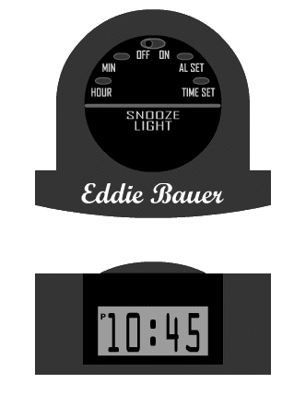
Device Simulation
Device Simulation
Setting Your Alarm
You’ve got an 8:30 AM meeting tomorrow and you don’t want to be late. As you climb into your hotel bed the night before, you decide to set your alarm for 6:30 AM so that you won’t be rushed the next morning.
Click the buttons on the top of your alarm clock to set the alarm for 6:30 AM. When you are done, click Submit to find out if you set the alarm correctly.
Submit

Slide 281
Page Types: Simple
Page Types: Simple (Relatively)
Page types we looked at:
  Text with Graphic (presentation only)
  Text Explore
  Graphic Explore
  Two Character Dialog
  Expert Perspective
  What’s the Right Response?
  Multiple Choice: One Correct
  Multiple Choice: Multiple Correct
  Ordering
  Branched Conversation
  Device Simulation
Other common page types:
  Audio-narrated animation (presentation only)
  Text with Video (presentation only)
  True/False questions
  Fill in the blank questions
  Short answer questions
  Expert Answer
  Matching

Slide 282
Page Types: More Complex
Page Types: More Complex
Software Simulation (e.g., Captivate-style sims)
Casual Games (concentration, crossword puzzles, hangman, gameshow-based interactions, etc.—these are usually of limited value)
Timed Challenges (“You have 3 minutes of Curt’s time, so make it count. When you are ready to begin your sales pitch, click Start.”)
Serious Games (basically, scored simulations relevant to the skills you are trying to teach, e.g., “flight simulator”-type games)

Slide 283
Interaction Design Considerations
Grouping and Navigation

Slide 284
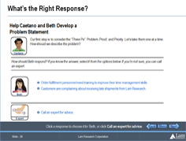

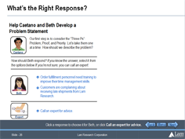

Design Considerations
Guideline: Don’t separate learner actions from feedback if you can avoid it.
Don’t do this:
Question asked on one page, but feedback given on the next page
Instead, do this:
Area reserved on question page, so feedback can appear there (on the same page)

Slide 285
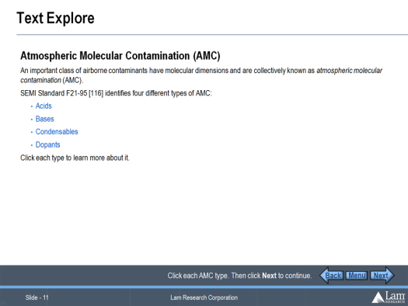
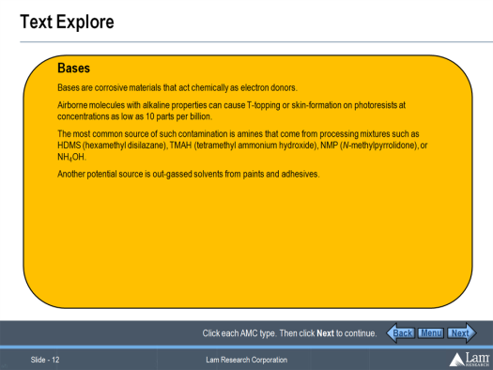
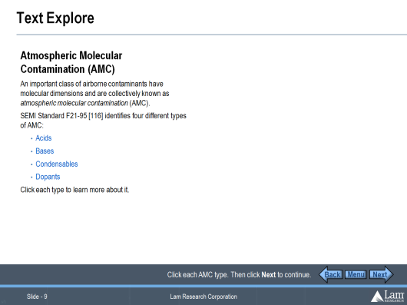
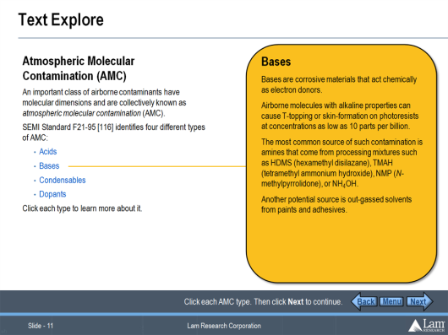
Design Considerations
Guideline: Avoid “hub and spoke” navigation schemes in your interactions.
Don’t do this:
Click on one page, view response on new page, then click Back to return to the first page…
Instead, do this:
Area reserved on first page, so response can appear there (on the same page)

Slide 286
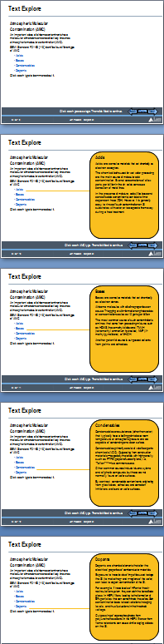
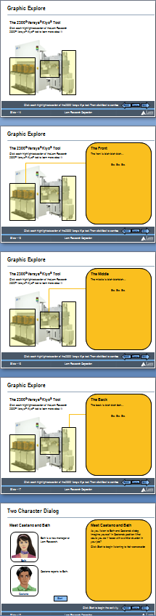
Design Considerations
Next and Back buttons never link to interior pages of compound page types!
Links in the course Menu never link to interior pages of compound page types!
Start of the page before
Back
Menu
Next
Back
Menu
Next
A compound page type
Interior pages
Back
Menu
Next
Back
Menu
Next
Start of the page after

Slide 287
Design Goals and Inspiration
Separating Good from Bad, and Drawing on Learning in Real Life

Slide 288
Designing Good Interactions
What makes an interaction “Good?”
Michael Allen says good interactions have four elements:
  Context
  Challenge
  Activity
  Feedback
  The Context is the setting in which the learner will perform the desired task.
  The Challenge is the problem the learners must learn to solve or the task they must perform.
  The Activity is the set of interactions the learner will perform in the course to solve the challenge.
  The Feedback is the information learners receive in response to actions they take in the activity.

Slide 289
Other Design Goals
Michael Allen also suggests the “Three Ms” are important attributes of good interactions. Are they:
Meaningful
Memorable
Motivational
In many instances, a 4th M could also be quite useful:
Measurable

Slide 290
Interaction Design Inspirations
Learning Models
Formal vs. Informal
Classroom vs. Lab
Trial and error (“learning by doing”)
Mentorship and Apprenticeship (“see one, do one, teach one”)
Dramas and Stories

Slide 291
Conclusion
Telling isn’t teaching
Designing in terms of learning interactions (implemented as “page types”) will help you avoid creating boring “page-flipper” courses
When designing interactions (and even more so, when using them in a course), consider the CCAFs: when the CCAFs are meaningful, memorable, and motivational to learners, the course will be too
When designing new interactions, consider the way people learn in the real world

Slide 292
Practice
Safety refresher
Red flags

Slide 293
ITEC 715
For Next Week
In PowerPoint, create a sample interaction deck containing an example of at least 6 different page-types you will use in the design of your final e-learning project. At this stage, you can use place-holder (generic) content, rather than final text and images. The purpose is to establish your page-types, so that you can use them as building blocks for your design. You must include at least one assessment/quiz page.
Download and read the Week 7 slides and come to class ready to discuss
Next week: Design Documents!

