Slide 1
ITEC 715
The Design of Multimedia Learning
Week 7

Slide 2
Page Types
Recall from Last Week

Slide 3
Why Design Interactions?
Why Design Interactions?
Driving Principles (Instructional)
Improve learner engagement because bored learners tune out
Learners retain more when they work with the material
Driving Principles (Economic)
Don’t reinvent the wheel
Breaking a complex task into smaller chunks makes designing easier (and faster)
Time is money

Slide 4
Interaction Design
Interaction Design
Page Types
Definition: A “page type” is a formalized templated combination of page layout and interactivity.
Page layout = how elements are arranged on the page
Interactivity = how the learner interacts with the page
NOTE: Basic navigation doesn’t count as interactivity!

Slide 5
Page Type Examples Tell-oriented Interactions

Slide 6
Text with Graphic
Text With Graphic
The Company Helpdesk
You can reach the company helpdesk at any time, day or night, by calling x1700. Please have the following information ready when you call the helpdesk:
Your employee number
Your location (campus and building)
Your computer’s asset number (located on a sticker the underside of most laptops)
Whether this is a new issue or an existing issue. If it’s an existing issue, please have the ticket number available.
Call x1700 to reach the helpdesk at any time
Click Next to continue.
Back
Menu
Next

Slide 7
Text Explore
Text Explore
The Company Business Process
There are four major steps to the company business process. Click each step to learn more about it:
Research the competitive landscape
Estimate costs required to “beat the best”
Estimate the return on investment (ROI)
Make a “build vs. buy” decision
Click each process step. Then click Next to continue.
Back
Menu
Next

Slide 8
Text Explore
Text Explore
The Company Business Process
There are four major steps to the company business process. Click each step to learn more about it:
Research the competitive landscape
Estimate costs required to “beat the best”
Estimate the return on investment (ROI)
Make a “build vs. buy” decision
Research the Competitive Landscape
In this step, you must determine if there are any competitors who are already engaged in the new business opportunity you see for your company. If so, you need to identify which competitor is doing the best in this market.
“Best” can be a tricky concept. Sometimes it means earning the largest gross margins. Sometimes is means capturing the largest share of the market. Be careful how you define “best” at this stage!
Click each process step. Then click Next to continue.
Back
Menu
Next

Slide 9
Text Explore
Text Explore
The Company Business Process
There are four major steps to the company business process. Click each step to learn more about it:
Research the competitive landscape
Estimate costs required to “beat the best”
Estimate the return on investment (ROI)
Make a “build vs. buy” decision
Estimate Costs Required to “Beat the Best”
Having identified the competitor who is doing best in this market, you next need to figure out how much it will cost your company to enter the market and beat the best player.
Some factors to consider:
Existing brand loyalties you may have to overcome
Marketing costs
Any import duties on parts or subcomponents
Taxes and other fees
Click each process step. Then click Next to continue.
Back
Menu
Next

Slide 10
Text Explore
Text Explore
The Company Business Process
There are four major steps to the company business process. Click each step to learn more about it:
Research the competitive landscape
Estimate costs required to “beat the best”
Estimate the return on investment (ROI)
Make a “build vs. buy” decision
Estimate the Return on Investment (ROI)
To compute the ROI, <blah blah blah etc. etc. etc.>
Click each process step. Then click Next to continue.
Back
Menu
Next

Slide 11
Text Explore
Text Explore
The Company Business Process
There are four major steps to the company business process. Click each step to learn more about it:
Research the competitive landscape
Estimate costs required to “beat the best”
Estimate the return on investment (ROI)
Make a “build vs. buy” decision
Make a “Build vs. Buy” Decision
Factors to consider in making this decision include:
Blah
Blah
Blah
Yadda
Yadda
Yadda
Click each process step. Then click Next to continue.
Back
Menu
Next

Slide 12
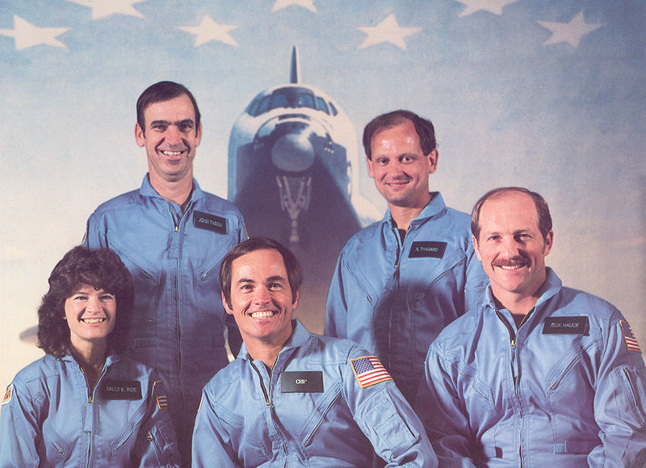
Graphic Explore: Ex. 1
Graphic Explore
Sally Ride’s Crewmates on STS-7
In 1983, Sally Ride became the first American woman to enter space when she flew on the space shuttle Challenger’s STS-7 mission. At the time, she was also the youngest American to enter space. Can you identify her crewmates? Click each astronaut to see if you are right.
Click each astronaut. Then click Next to continue.
Back
Menu
Next

Slide 13
Graphic Explore: Ex. 1
Graphic Explore
Sally Ride’s Crewmates on STS-7
In 1983, Sally Ride became the first American woman to enter space when she flew on the space shuttle Challenger’s STS-7 mission. At the time, she was also the youngest American to enter space. Can you identify her crewmates? Click each astronaut to see if you are right.
Sally K. Ride (Mission Specialist)
Dr. Sally Kristen Ride (born May 26, 1951) from Los Angeles, California, is an American physicist and a former NASA astronaut. She studied at Portola Middle School, Westlake School for Girls, Swarthmore College and Stanford University, and earned a master's degree and PhD. Ride joined NASA in 1978, and in 1983, became the first American woman, and then-youngest American, to enter space. In 1987 she left NASA to work at Stanford University Center for International Security and Arms Control.
Click each astronaut. Then click Next to continue.
Back
Menu
Next

Slide 14
Graphic Explore: Ex. 1
Graphic Explore
Sally Ride’s Crewmates on STS-7
In 1983, Sally Ride became the first American woman to enter space when she flew on the space shuttle Challenger’s STS-7 mission. At the time, she was also the youngest American to enter space. Can you identify her crewmates? Click each astronaut to see if you are right.
Robert L. Crippen (Mission Commander)
Robert Laurel Crippen (born September 11, 1937 in Beaumont, Texas) is an engineer, retired United States Navy Captain and a former NASA astronaut. He flew on four Space Shuttle missions, including three as commander.[1] Crippen is a recipient of the Congressional Space Medal of Honor.
Click each astronaut. Then click Next to continue.
Back
Menu
Next

Slide 15
Graphic Explore: Ex. 1
Graphic Explore
Sally Ride’s Crewmates on STS-7
In 1983, Sally Ride became the first American woman to enter space when she flew on the space shuttle Challenger’s STS-7 mission. At the time, she was also the youngest American to enter space. Can you identify her crewmates? Click each astronaut to see if you are right.
Frederick H. Hauck (Pilot)
Frederick H. Hauck was born April 11, 1941 in Long Beach, California, but considers Winchester, Massachusetts and Washington, D.C. to be his hometowns. NASA selected Hauck as an astronaut candidate in January 1978. He was pilot for STS-7, the seventh flight of the Space Shuttle, which launched from Kennedy Space Center, Florida, on June 18, 1983. This was the second flight for the orbiter Challenger and the first mission with a 5-person crew.
Click each astronaut. Then click Next to continue.
Back
Menu
Next

Slide 16
Graphic Explore: Ex. 1
Graphic Explore
Sally Ride’s Crewmates on STS-7
In 1983, Sally Ride became the first American woman to enter space when she flew on the space shuttle Challenger’s STS-7 mission. At the time, she was also the youngest American to enter space. Can you identify her crewmates? Click each astronaut to see if you are right.
John M. Fabian (Mission Specialist)
John McCreary Fabian (born January 28, 1939, in Goose Creek, Texas) is a former NASA Astronaut and Air Force officer who flew two space shuttle missions and worked on the development of the shuttle's robotic arm. He later led the Air Force's space operations.
Click each astronaut. Then click Next to continue.
Back
Menu
Next

Slide 17
Graphic Explore: Ex. 1
Graphic Explore
Sally Ride’s Crewmates on STS-7
In 1983, Sally Ride became the first American woman to enter space when she flew on the space shuttle Challenger’s STS-7 mission. At the time, she was also the youngest American to enter space. Can you identify her crewmates? Click each astronaut to see if you are right.
Norman E. Thagard (Mission Specialist)
Dr. Norman Earl Thagard first flew on STS-7, which launched from Kennedy Space Center, Florida, on June 18, 1983. During the flight Dr. Thagard conducted various medical tests and collected data on physiological changes associated with astronaut adaptation to space. He also retrieved the rotating SPAS-01 using the RMS. Mission duration was 147 hours before landing at Edwards Air Force Base, California, on June 24, 1983.
Click each astronaut. Then click Next to continue.
Back
Menu
Next

Slide 18
GE Ex2
Graphic Explore
Photocopier: Key Components
To use a photocopy machine effectively, you must be able to recognize its key components. Click each highlighted area on the photocopy machine pictured below to learn its function.
Click each highlighted component. Then click Next to continue.
Back
Menu
Next

Slide 19
GE Ex2
Graphic Explore
Photocopier: Key Components
To use a photocopy machine effectively, you must be able to recognize its key components. Click each highlighted area on the photocopy machine pictured below to learn its function.
Collection Tray
As the photocopy machine completes each set of copies, it sends the completed copies to this collection tray.
This is where you will retrieve your finished copies.
Click each highlighted component. Then click Next to continue.
Back
Menu
Next

Slide 20
GE Ex2
Graphic Explore
Photocopier: Key Components
To use a photocopy machine effectively, you must be able to recognize its key components. Click each highlighted area on the photocopy machine pictured below to learn its function.
Copy Surface
Whenever you need to copy a single page (or a small number of pages), you can use the glass copy surface.
Place each page that you want to copy face-down on the glass, and then lower the lid. When you press Copy, the machine will copy the page.
To specify the number of copies you’d like, use the copier’s control panel.
Click each highlighted component. Then click Next to continue.
Back
Menu
Next

Slide 21
GE Ex2
Graphic Explore
Photocopier: Key Components
To use a photocopy machine effectively, you must be able to recognize its key components. Click each highlighted area on the photocopy machine pictured below to learn its function.
Control Panel
Use the control panel to adjust the darkness of your copies, the number of copies you’d like, and any changes in size that you want the copier to make in your copies.
Click each highlighted component. Then click Next to continue.
Back
Menu
Next

Slide 22
2CD Ex1
Two Character Dialog
Preparing for Launch
Meet Sally and Norman
As you listen to Sally and Norman’s dialog, see if you can find the answers to the following questions:
What is Sally’s chief concern about the mission?
What is Norman’s chief concern?
Click Start to begin listening to their conversation.
Sally is a Mission Specialist on STS-7.
Sally
Norman is a physician on the STS-7 flight.
Norman
Start
Click Start to begin the activity.
Back
Menu
Next

Slide 23
2CD Ex1
Two Character Dialog
Sally Ride’s Crewmates on STS-7
Blah blah blah etc etc etc yadda yadda yadda.
Norman
Sally
Click the dialog controls to view the conversation. Then click Next to continue.
Back
Menu
Next

Slide 24
2CD Ex1
Two Character Dialog
Sally Ride’s Crewmates on STS-7
Yadda yadda yadda etc etc etc blah blah blah.
Sally
Norman
Click the dialog controls to view the conversation. Then click Next to continue.
Back
Menu
Next

Slide 25
2CD Ex1
Two Character Dialog
Sally Ride’s Crewmates on STS-7
Blah blah blah etc etc etc yadda yadda yadda.
Norman
Sally
Click the dialog controls to view the conversation. Then click Next to continue.
Back
Menu
Next

Slide 26
2CD Ex1
Two Character Dialog
Sally Ride’s Crewmates on STS-7
Yadda yadda yadda etc etc etc blah blah blah.
Sally
Norman
Click the dialog controls to view the conversation. Then click Next to continue.
Back
Menu
Next

Slide 27
2CD Ex2
Two Character Dialog
Two-Key Cryptography
Leon is confused about two-key cryptography. Jennifer is the local expert on this form of codemaking, so when Leon runs into Jennifer in the hallway, he takes the opportunity to ask her some questions.
As you observe their dialog, see if you can find the answer to the following question:
What is the risk Leon will face if he downloads Jennifer’s public key from the Internet?
When you’re ready to begin, click Start.
Click Start to begin the activity.
Back
Menu
Next

Slide 28
2CD Ex2
Two Character Dialog
Jennifer, I want to practice sending you cryptographically-encoded messages using two-key cryptography. Can I just download your public key and use it?
Two-Key Cryptography
Leon is confused about two-key cryptography. Jennifer is the local expert on this form of codemaking, so when Leon runs into Jennifer in the hallway, he takes the opportunity to ask her some questions.
As you observe their dialog, see if you can find the answer to the following question:
What is the risk Leon will face if he downloads Jennifer’s public key from the Internet?
When you’re ready to begin, click Start.
Click the dialog controls to view the conversation. Then click Next to continue.
Back
Menu
Next

Slide 29
2CD Ex2
Two Character Dialog
You could, but how can you be certain that you actually downloaded my public key, and not someone else’s public key masquerading as mine?
Click the dialog controls to view the conversation. Then click Next to continue.
Back
Menu
Next

Slide 30
2CD Ex2
Two Character Dialog
You’re talking about the need for a circle of trust, aren’t you?
I’ve read about that, but I don’t understand how it works.
Click the dialog controls to view the conversation. Then click Next to continue.
Back
Menu
Next

Slide 31
2CD Ex2
Two Character Dialog
Well, blah blah blah, yadda yadda yadda, explain, explain, explain, etc., etc., etc. as the dialog continues…
Click the dialog controls to view the conversation. Then click Next to continue.
Back
Menu
Next

Slide 32
Expert Perspective
Expert Perspective
Seeing the Solution in Different Ways
Captain Kirk has asked Dr. McCoy and Mr. Spock for advice. Each has a different perspective. Dr. McCoy offers a human, emotional point of view. Mr. Spock offers a logical, rational point of view.
Click each character to hear what he has to say. If you were in Captain Kirk’s position, whose advice would you take?
Dr. McCoy
Mr. Spock
Click each character to hear his perspective. Then click Next to continue.
Back
Menu
Next

Slide 33
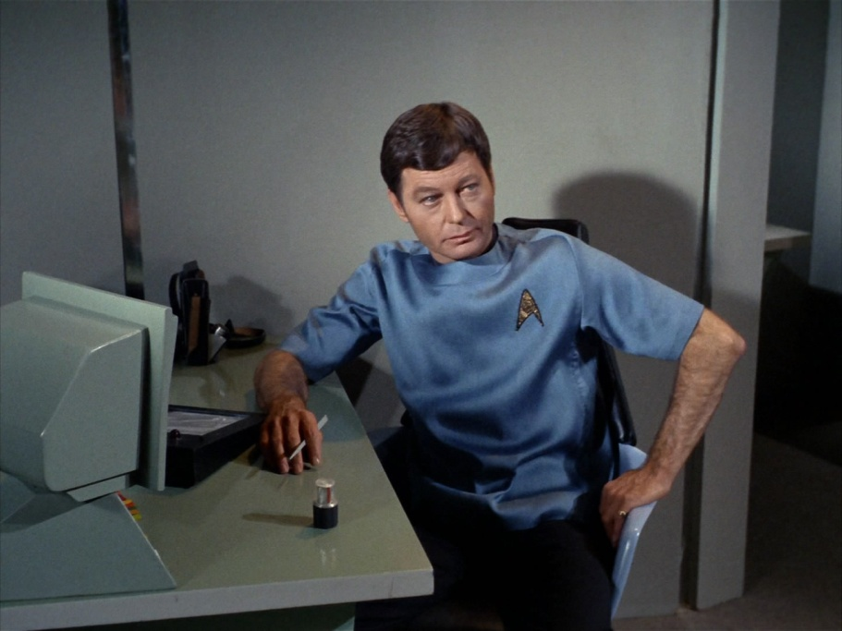
Expert Perspective
Expert Perspective
Seeing the Solution in Different Ways
Captain Kirk has asked Dr. McCoy and Mr. Spock for advice. Each has a different perspective. Dr. McCoy offers a human, emotional point of view. Mr. Spock offers a logical, rational point of view.
Click each character to hear what he has to say. If you were in Captain Kirk’s position, whose advice would you take?
Dr. McCoy’s Perspective
Dr. McCoy
Mr. Spock
Click each character to hear his perspective. Then click Next to continue.
Back
Menu
Next

Slide 34
Expert Perspective
Expert Perspective
Seeing the Solution in Different Ways
Captain Kirk has asked Dr. McCoy and Mr. Spock for advice. Each has a different perspective. Dr. McCoy offers a human, emotional point of view. Mr. Spock offers a logical, rational point of view.
Click each character to hear what he has to say. If you were in Captain Kirk’s position, whose advice would you take?
Mr. Spock’s Perspective
Dr. McCoy
Mr. Spock
Click each character to hear his perspective. Then click Next to continue.
Back
Menu
Next

Slide 35
Page Type Examples Simple Do-oriented Interactions

Slide 36
What’s the Right Response?
What’s The Right Response?
Meet Joe and Anna Li
Emphasizing an Effect
ABC Sound Design has been hired to create the sound effects for an action movie, and mix them into the film’s soundtrack.
Anna Li created most of the sound effects, but she has asked her intern, Joe, to insert them into the film’s final audio mix.
In this activity, you will coach Anna Li as she answers Joe’s questions.
Click Start to begin the activity.
Joe is a new intern student at ABC Sound Design. He’s working under the supervision of Anna Li.
Anna Li is a new audio engineer at the sound effects department at ABC Sound. She’s helping Joe edit sound effects into an action movie.
Start
Note: Character images available for free at http://www.designcomics.com/
Click Start to begin the activity.
Back
Menu
Next

Slide 37
What’s the Right Response?
What’s The Right Response?
Emphasizing an Effect
At the climax of the film, the heroes blow up the bad guys’ space station. I’ve put in the explosion sound effect, but it just doesn’t have the impact I want. Do you have any suggestions?
How should Ann Li respond? If you know, click the correct response below. If you’re not sure, you can call an expert for help.
Raise the gain on the explosion sound to make it louder.
Put a half-second or so of absolute silence right before the explosion.
Call an expert for a hint.
Click a response for Anna Li. The click Next to continue.
Back
Menu
Next

Slide 38
What’s the Right Response?
What’s The Right Response?
Emphasizing an Effect
Raising the Gain Probably Won’t Work
Turning up the volume on the explosion sound probably isn’t an option. The explosion sound effect is most likely already at maximum gain. Raising it any more would cause clipping, a kind of distortion that would make the sound effect even less satisfactory than it is now.
At the climax of the film, the heroes blow up the bad guys’ space station. I’ve put in the explosion sound effect, but it just doesn’t have the impact I want. Do you have any suggestions?
How should Ann Li respond? If you know, click the correct response below. If you’re not sure, you can call an expert for help.
Raise the gain on the explosion sound to make it louder.
Put a half-second or so of absolute silence right before the explosion.
Call an expert for a hint.
Click a response for Anna Li. The click Next to continue.
Back
Menu
Next

Slide 39
What’s the Right Response?
What’s The Right Response?
Emphasizing an Effect
Correct!
Legendary sound effects professional Ben Burtt calls the fractional second of absolute silence that precedes a loud sound effect an “audio black hole.” It increases the contrast in sound levels and makes the explosion that follows it seem much more intense.
At the climax of the film, the heroes blow up the bad guys’ space station. I’ve put in the explosion sound effect, but it just doesn’t have the impact I want. Do you have any suggestions?
How should Ann Li respond? If you know, click the correct response below. If you’re not sure, you can call an expert for help.
Raise the gain on the explosion sound to make it louder.
Put a half-second or so of absolute silence right before the explosion.
Call an expert for a hint.
Click a response for Anna Li. The click Next to continue.
Back
Menu
Next

Slide 40
What’s the Right Response?
What’s The Right Response?
Emphasizing an Effect
Hint
Remember that there are limits to how loud you can make a recorded sound. You want the effect to come through clearly and not be distorted. Only one of Anna Li’s possible responses avoids the risk of clipping. Can you figure out which one?
At the climax of the film, the heroes blow up the bad guys’ space station. I’ve put in the explosion sound effect, but it just doesn’t have the impact I want. Do you have any suggestions?
How should Ann Li respond? If you know, click the correct response below. If you’re not sure, you can call an expert for help.
Raise the gain on the explosion sound to make it louder.
Put a half-second or so of absolute silence right before the explosion.
Call an expert for a hint.
Click a response for Anna Li. The click Next to continue.
Back
Menu
Next

Slide 41
Multiple Choice Question
Multiple Choice Question
Conlon Nancarrow’s Studies for Player-Piano
Nancarrow composed his famous series of studies for player-piano in Mexico City starting in the 1940’s.
Select the best choice: Why did Nancarrow write so much music for player-piano?
No humans could play the music he wanted to write.
His father was a player-piano salesman.
The early fame he achieved with his first player-piano compositions encouraged him to keep at it.
He had a falling-out with his normal pianist and vowed never to write for pianists ever again.
Click an answer choice. Then click Next to continue.
Back
Menu
Next

Slide 42
Multiple Choice Question
Multiple Choice Question
Conlon Nancarrow’s Studies for Player-Piano
Nancarrow composed his famous series of studies for player-piano in Mexico City starting in the 1940’s.
Select the best choice: Why did Nancarrow write so much music for player-piano?
Correct!
Nancarrow was interested in exploring extremely complex cross-rhythmic counterpoint—way beyond human ability to count or perform.
Click the icon below to hear the intense final bars of Nancarrow’s Study No. 8:
No humans could play the music he wanted to write.
His father was a player-piano salesman.
The early fame he achieved with his first player-piano compositions encouraged him to keep at it.
He had a falling-out with his normal pianist and vowed never to write for pianists ever again.
Click an answer choice. Then click Next to continue.
Back
Menu
Next

Slide 43
Multiple Choice Question
Multiple Choice Question
Conlon Nancarrow’s Studies for Player-Piano
Nancarrow composed his famous series of studies for player-piano in Mexico City starting in the 1940’s.
Select the best choice: Why did Nancarrow write so much music for player-piano?
Incorrect.
Nancarrow’s father was not a player-piano salesman. Nancarrow wrote for player-piano because his music involved extremely complex cross-rhythms that human beings could not perform.
Click the icon below to hear the intense final bars of Nancarrow’s Study No. 8:
No humans could play the music he wanted to write.
His father was a player-piano salesman.
The early fame he achieved with his first player-piano compositions encouraged him to keep at it.
He had a falling-out with his normal pianist and vowed never to write for pianists ever again.
Click an answer choice. Then click Next to continue.
Back
Menu
Next

Slide 44
Multiple Choice Question
Multiple Choice Question
Conlon Nancarrow’s Studies for Player-Piano
Nancarrow composed his famous series of studies for player-piano in Mexico City starting in the 1940’s.
Select the best choice: Why did Nancarrow write so much music for player-piano?
Incorrect.
Nancarrow worked in relative obscurity for most of his career. His work only became known to the wider world in the when the first Columbia Records recording of a few of his Studies came out in 1969. Comprehensive recordings of his Studies weren’t released until 1977.
Click the icon below to hear the intense final bars of Nancarrow’s Study No. 8:
No humans could play the music he wanted to write.
His father was a player-piano salesman.
The early fame he achieved with his first player-piano compositions encouraged him to keep at it.
He had a falling-out with his normal pianist and vowed never to write for pianists ever again.
Click an answer choice. Then click Next to continue.
Back
Menu
Next

Slide 45
Multiple Choice Question
Multiple Choice Question
Conlon Nancarrow’s Studies for Player-Piano
Nancarrow composed his famous series of studies for player-piano in Mexico City starting in the 1940’s.
Select the best choice: Why did Nancarrow write so much music for player-piano?
Incorrect.
Nancarrow didn’t have a regular pianist he worked with. He pretty much gave up writing for humans for the majority of the time he worked as a composer, coming back to writing for human performers only near the end of his career.
Click the icon below to hear the intense final bars of Nancarrow’s Study No. 8:
No humans could play the music he wanted to write.
His father was a player-piano salesman.
The early fame he achieved with his first player-piano compositions encouraged him to keep at it.
He had a falling-out with his normal pianist and vowed never to write for pianists ever again.
Click an answer choice. Then click Next to continue.
Back
Menu
Next

Slide 46
Page Type Examples More Complex Do-oriented Interactions

Slide 47
MCQ 2
Multiple Choice Question 2
32 slides to implement this interaction.

Slide 48
MCQ 2
Multiple Choice Question 2
Incorrect.
You can’t make a BLT sandwich with no ingredients!
Click one or more ingredients and then click Submit.
Submit

Slide 49
MCQ 2
Multiple Choice Question 2

Slide 50
MCQ 2
Multiple Choice Question 2
Incorrect.
Bacon is one ingredient, but you need to use more in a BLT sandwich.
Click one or more additional ingredients, and then click Submit.
Submit

Slide 51
MCQ 2
Multiple Choice Question 2

Slide 52
MCQ 2
Multiple Choice Question 2
Incorrect.
Lettuce is one ingredient, but you need to use more in a BLT sandwich.
Click one or more additional ingredients, and then click Submit.
Submit

Slide 53
MCQ 2
Multiple Choice Question 2

Slide 54
MCQ 2
Multiple Choice Question 2
Incorrect.
Bacon and lettuce are ingredients in a BLT, but they are not the only ingredients.
Click one or more additional ingredients, and then click Submit.
Submit

Slide 55
MCQ 2
Multiple Choice Question 2

Slide 56
MCQ 2
Multiple Choice Question 2
Incorrect.
Tofu is not usually an ingredient in a BLT sandwich.
Click Tofu to deselect it, and then choose one or more other ingredients and click Submit.
Submit

Slide 57
MCQ 2
Multiple Choice Question 2

Slide 58
MCQ 2
Multiple Choice Question 2
Incorrect.
Tofu is not usually an ingredient in a BLT sandwich.
Click Tofu to deselect it, choose one or more other ingredients, and then click Submit.
Submit

Slide 59
MCQ 2
Multiple Choice Question 2

Slide 60
MCQ 2
Multiple Choice Question 2
Incorrect.
Tofu is not usually an ingredient in a BLT sandwich.
Click Tofu to deselect it, choose one or more other ingredients, and then click Submit.
Submit

Slide 61
MCQ 2
Multiple Choice Question 2

Slide 62
MCQ 2
Multiple Choice Question 2
Incorrect.
Tofu is not usually an ingredient in a BLT sandwich.
Click Tofu to deselect it, choose one or more other ingredients, and then click Submit.
Submit

Slide 63
MCQ 2
Multiple Choice Question 2

Slide 64
MCQ 2
Multiple Choice Question 2
Incorrect.
Tomato is one ingredient, but you need to use more in a BLT sandwich.
Click one or more additional ingredients, and then click Submit.
Submit

Slide 65
MCQ 2
Multiple Choice Question 2

Slide 66
MCQ 2
Multiple Choice Question 2
Incorrect.
Bacon and tomato are two ingredients, but you need to use more in a BLT sandwich.
Click one or more additional ingredients, and then click Submit.
Submit

Slide 67
MCQ 2
Multiple Choice Question 2

Slide 68
MCQ 2
Multiple Choice Question 2
Incorrect.
Lettuce and tomato are two ingredients, but you need to use more in a BLT sandwich.
Click one or more additional ingredients, and then click Submit.
Submit

Slide 69
MCQ 2
Multiple Choice Question 2

Slide 70
MCQ 2
Multiple Choice Question 2
Correct!
“B” is for “Bacon.”
“L” is for “Lettuce.”
“T” is for “Tomato.”
Click Next to continue.
Submit
Click Next to continue.
Back
Menu
Next

Slide 71
MCQ 2
Multiple Choice Question 2

Slide 72
MCQ 2
Multiple Choice Question 2
Incorrect.
Tofu is not usually an ingredient in a BLT sandwich.
Click Tofu to deselect it, and then choose one or more other ingredients and click Submit.
Submit

Slide 73
MCQ 2
Multiple Choice Question 2

Slide 74
MCQ 2
Multiple Choice Question 2
Incorrect.
Tofu is not usually an ingredient in a BLT sandwich.
Click Tofu to deselect it, and then choose one or more other ingredients and click Submit.
Submit

Slide 75
MCQ 2
Multiple Choice Question 2

Slide 76
MCQ 2
Multiple Choice Question 2
Incorrect.
Tofu is not usually an ingredient in a BLT sandwich.
Click Tofu to deselect it, and then choose one or more other ingredients and click Submit.
Submit

Slide 77
MCQ 2
Multiple Choice Question 2

Slide 78
MCQ 2
Multiple Choice Question 2
Incorrect.
Tofu is not usually an ingredient in a BLT sandwich.
Click Tofu to deselect it, and then choose zero or more other ingredients and click Submit.
Submit

Slide 79
Ordering
Ordering
144 slides to implement this interaction.
Notes:
*1234 2134 3124 4123
1243 2143 3142 4132
1324 2314 3214 4213
1342 2341 3241 4231
1423 2413 3412 4312
1432 2431 3421 4321

Slide 80
Ordering
Ordering
Notes:
*1234 2134 3124 4123
1243 2143 3142 4132
1324 2314 3214 4213
1342 2341 3241 4231
1423 2413 3412 4312
1432 2431 3421 4321

Slide 81
Ordering
Ordering
Notes:
*1234 2134 3124 4123
1243 2143 3142 4132
1324 2314 3214 4213
1342 2341 3241 4231
1423 2413 3412 4312
1432 2431 3421 4321

Slide 82
Ordering
Ordering
Notes:
*1234 2134 3124 4123
1243 2143 3142 4132
1324 2314 3214 4213
1342 2341 3241 4231
1423 2413 3412 4312
1432 2431 3421 4321

Slide 83
Ordering
Ordering
Notes:
*1234 2134 3124 4123
1243 2143 3142 4132
1324 2314 3214 4213
1342 2341 3241 4231
1423 2413 3412 4312
1432 2431 3421 4321

Slide 84
Ordering
Ordering
That’s Right!
These are three-letter English words displayed in Morse Code. They translate to:
Bug
Cat
Dog
Emu
Click Next to continue.
Notes:
*1234 2134 3124 4123
1243 2143 3142 4132
1324 2314 3214 4213
1342 2341 3241 4231
1423 2413 3412 4312
1432 2431 3421 4321

Slide 85
Ordering
Ordering
Notes:
+1234 2134 3124 4123
*1243 2143 3142 4132
1324 2314 3214 4213
1342 2341 3241 4231
1423 2413 3412 4312
1432 2431 3421 4321

Slide 86
Ordering
Ordering
Notes:
+1234 2134 3124 4123
*1243 2143 3142 4132
1324 2314 3214 4213
1342 2341 3241 4231
1423 2413 3412 4312
1432 2431 3421 4321

Slide 87
Ordering
Ordering
Notes:
+1234 2134 3124 4123
*1243 2143 3142 4132
1324 2314 3214 4213
1342 2341 3241 4231
1423 2413 3412 4312
1432 2431 3421 4321

Slide 88
Ordering
Ordering
Notes:
+1234 2134 3124 4123
*1243 2143 3142 4132
1324 2314 3214 4213
1342 2341 3241 4231
1423 2413 3412 4312
1432 2431 3421 4321

Slide 89
Ordering
Ordering
Notes:
+1234 2134 3124 4123
*1243 2143 3142 4132
1324 2314 3214 4213
1342 2341 3241 4231
1423 2413 3412 4312
1432 2431 3421 4321

Slide 90
Ordering
Ordering
Notes:
+1234 2134 3124 4123
*1243 2143 3142 4132
1324 2314 3214 4213
1342 2341 3241 4231
1423 2413 3412 4312
1432 2431 3421 4321

Slide 91
Ordering
Ordering
Notes:
+1234 2134 3124 4123
+1243 2143 3142 4132
*1324 2314 3214 4213
1342 2341 3241 4231
1423 2413 3412 4312
1432 2431 3421 4321

Slide 92
Ordering
Ordering
Notes:
+1234 2134 3124 4123
+1243 2143 3142 4132
*1324 2314 3214 4213
1342 2341 3241 4231
1423 2413 3412 4312
1432 2431 3421 4321

Slide 93
Ordering
Ordering
Notes:
+1234 2134 3124 4123
+1243 2143 3142 4132
*1324 2314 3214 4213
1342 2341 3241 4231
1423 2413 3412 4312
1432 2431 3421 4321

Slide 94
Ordering
Ordering
Notes:
+1234 2134 3124 4123
+1243 2143 3142 4132
*1324 2314 3214 4213
1342 2341 3241 4231
1423 2413 3412 4312
1432 2431 3421 4321

Slide 95
Ordering
Ordering
Notes:
+1234 2134 3124 4123
+1243 2143 3142 4132
*1324 2314 3214 4213
1342 2341 3241 4231
1423 2413 3412 4312
1432 2431 3421 4321

Slide 96
Ordering
Ordering
Notes:
+1234 2134 3124 4123
+1243 2143 3142 4132
*1324 2314 3214 4213
1342 2341 3241 4231
1423 2413 3412 4312
1432 2431 3421 4321

Slide 97
Ordering
Ordering
Notes:
+1234 2134 3124 4123
+1243 2143 3142 4132
+1324 2314 3214 4213
*1342 2341 3241 4231
1423 2413 3412 4312
1432 2431 3421 4321

Slide 98
Ordering
Ordering
Notes:
+1234 2134 3124 4123
+1243 2143 3142 4132
+1324 2314 3214 4213
*1342 2341 3241 4231
1423 2413 3412 4312
1432 2431 3421 4321

Slide 99
Ordering
Ordering
Notes:
+1234 2134 3124 4123
+1243 2143 3142 4132
+1324 2314 3214 4213
*1342 2341 3241 4231
1423 2413 3412 4312
1432 2431 3421 4321

Slide 100
Ordering
Ordering
Notes:
+1234 2134 3124 4123
+1243 2143 3142 4132
+1324 2314 3214 4213
*1342 2341 3241 4231
1423 2413 3412 4312
1432 2431 3421 4321

Slide 101
Ordering
Ordering
Notes:
+1234 2134 3124 4123
+1243 2143 3142 4132
+1324 2314 3214 4213
*1342 2341 3241 4231
1423 2413 3412 4312
1432 2431 3421 4321

Slide 102
Ordering
Ordering
Notes:
+1234 2134 3124 4123
+1243 2143 3142 4132
+1324 2314 3214 4213
*1342 2341 3241 4231
1423 2413 3412 4312
1432 2431 3421 4321

Slide 103
Ordering
Ordering
Notes:
+1234 2134 3124 4123
+1243 2143 3142 4132
+1324 2314 3214 4213
+1342 2341 3241 4231
*1423 2413 3412 4312
1432 2431 3421 4321

Slide 104
Ordering
Ordering
Notes:
+1234 2134 3124 4123
+1243 2143 3142 4132
+1324 2314 3214 4213
+1342 2341 3241 4231
*1423 2413 3412 4312
1432 2431 3421 4321

Slide 105
Ordering
Ordering
Notes:
+1234 2134 3124 4123
+1243 2143 3142 4132
+1324 2314 3214 4213
+1342 2341 3241 4231
*1423 2413 3412 4312
1432 2431 3421 4321

Slide 106
Ordering
Ordering
Notes:
+1234 2134 3124 4123
+1243 2143 3142 4132
+1324 2314 3214 4213
+1342 2341 3241 4231
*1423 2413 3412 4312
1432 2431 3421 4321

Slide 107
Ordering
Ordering
Notes:
+1234 2134 3124 4123
+1243 2143 3142 4132
+1324 2314 3214 4213
+1342 2341 3241 4231
*1423 2413 3412 4312
1432 2431 3421 4321

Slide 108
Ordering
Ordering
Notes:
+1234 2134 3124 4123
+1243 2143 3142 4132
+1324 2314 3214 4213
+1342 2341 3241 4231
*1423 2413 3412 4312
1432 2431 3421 4321

Slide 109
Ordering
Ordering
Notes:
+1234 2134 3124 4123
+1243 2143 3142 4132
+1324 2314 3214 4213
+1342 2341 3241 4231
+1423 2413 3412 4312
*1432 2431 3421 4321

Slide 110
Ordering
Ordering
Notes:
+1234 2134 3124 4123
+1243 2143 3142 4132
+1324 2314 3214 4213
+1342 2341 3241 4231
+1423 2413 3412 4312
*1432 2431 3421 4321

Slide 111
Ordering
Ordering
Notes:
+1234 2134 3124 4123
+1243 2143 3142 4132
+1324 2314 3214 4213
+1342 2341 3241 4231
+1423 2413 3412 4312
*1432 2431 3421 4321

Slide 112
Ordering
Ordering
Notes:
+1234 2134 3124 4123
+1243 2143 3142 4132
+1324 2314 3214 4213
+1342 2341 3241 4231
+1423 2413 3412 4312
*1432 2431 3421 4321

Slide 113
Ordering
Ordering
Notes:
+1234 2134 3124 4123
+1243 2143 3142 4132
+1324 2314 3214 4213
+1342 2341 3241 4231
+1423 2413 3412 4312
*1432 2431 3421 4321

Slide 114
Ordering
Ordering
Incorrect.
Words in the correct position are marked with a checkmark; those in the wrong position are marked with an “x”.
Please try again.
Submit
Notes:
+1234 2134 3124 4123
+1243 2143 3142 4132
+1324 2314 3214 4213
+1342 2341 3241 4231
+1423 2413 3412 4312
*1432 2431 3421 4321

Slide 115
Ordering
Ordering
Notes:
+1234 *2134 3124 4123
+1243 2143 3142 4132
+1324 2314 3214 4213
+1342 2341 3241 4231
+1423 2413 3412 4312
+1432 2431 3421 4321

Slide 116
Ordering
Ordering
Notes:
+1234 *2134 3124 4123
+1243 2143 3142 4132
+1324 2314 3214 4213
+1342 2341 3241 4231
+1423 2413 3412 4312
+1432 2431 3421 4321

Slide 117
Ordering
Ordering
Notes:
+1234 *2134 3124 4123
+1243 2143 3142 4132
+1324 2314 3214 4213
+1342 2341 3241 4231
+1423 2413 3412 4312
+1432 2431 3421 4321

Slide 118
Ordering
Ordering
Notes:
+1234 *2134 3124 4123
+1243 2143 3142 4132
+1324 2314 3214 4213
+1342 2341 3241 4231
+1423 2413 3412 4312
+1432 2431 3421 4321

Slide 119
Ordering
Ordering
Notes:
+1234 *2134 3124 4123
+1243 2143 3142 4132
+1324 2314 3214 4213
+1342 2341 3241 4231
+1423 2413 3412 4312
+1432 2431 3421 4321

Slide 120
Ordering
Ordering
Incorrect.
Words in the correct position are marked with a checkmark; those in the wrong position are marked with an “x”.
Please try again.
Submit
Notes:
+1234 *2134 3124 4123
+1243 2143 3142 4132
+1324 2314 3214 4213
+1342 2341 3241 4231
+1423 2413 3412 4312
+1432 2431 3421 4321

Slide 121
Ordering
Ordering
Notes:
+1234 +2134 3124 4123
+1243 *2143 3142 4132
+1324 2314 3214 4213
+1342 2341 3241 4231
+1423 2413 3412 4312
+1432 2431 3421 4321

Slide 122
Ordering
Ordering
Notes:
+1234 +2134 3124 4123
+1243 *2143 3142 4132
+1324 2314 3214 4213
+1342 2341 3241 4231
+1423 2413 3412 4312
+1432 2431 3421 4321

Slide 123
Ordering
Ordering
Notes:
+1234 +2134 3124 4123
+1243 *2143 3142 4132
+1324 2314 3214 4213
+1342 2341 3241 4231
+1423 2413 3412 4312
+1432 2431 3421 4321

Slide 124
Ordering
Ordering
Notes:
+1234 +2134 3124 4123
+1243 *2143 3142 4132
+1324 2314 3214 4213
+1342 2341 3241 4231
+1423 2413 3412 4312
+1432 2431 3421 4321

Slide 125
Ordering
Ordering
Notes:
+1234 +2134 3124 4123
+1243 *2143 3142 4132
+1324 2314 3214 4213
+1342 2341 3241 4231
+1423 2413 3412 4312
+1432 2431 3421 4321

Slide 126
Ordering
Ordering
Incorrect.
Words in the correct position are marked with a checkmark; those in the wrong position are marked with an “x”.
Please try again.
Notes:
+1234 +2134 3124 4123
+1243 *2143 3142 4132
+1324 2314 3214 4213
+1342 2341 3241 4231
+1423 2413 3412 4312
+1432 2431 3421 4321

Slide 127
Ordering
Ordering
Notes:
+1234 +2134 3124 4123
+1243 +2143 3142 4132
+1324 *2314 3214 4213
+1342 2341 3241 4231
+1423 2413 3412 4312
+1432 2431 3421 4321

Slide 128
Ordering
Ordering
Notes:
+1234 +2134 3124 4123
+1243 +2143 3142 4132
+1324 *2314 3214 4213
+1342 2341 3241 4231
+1423 2413 3412 4312
+1432 2431 3421 4321

Slide 129
Ordering
Ordering
Notes:
+1234 +2134 3124 4123
+1243 +2143 3142 4132
+1324 *2314 3214 4213
+1342 2341 3241 4231
+1423 2413 3412 4312
+1432 2431 3421 4321

Slide 130
Ordering
Ordering
Notes:
+1234 +2134 3124 4123
+1243 +2143 3142 4132
+1324 *2314 3214 4213
+1342 2341 3241 4231
+1423 2413 3412 4312
+1432 2431 3421 4321

Slide 131
Ordering
Ordering
Notes:
+1234 +2134 3124 4123
+1243 +2143 3142 4132
+1324 *2314 3214 4213
+1342 2341 3241 4231
+1423 2413 3412 4312
+1432 2431 3421 4321

Slide 132
Ordering
Ordering
Incorrect.
Words in the correct position are marked with a checkmark; those in the wrong position are marked with an “x”.
Please try again.
Notes:
+1234 +2134 3124 4123
+1243 +2143 3142 4132
+1324 *2314 3214 4213
+1342 2341 3241 4231
+1423 2413 3412 4312
+1432 2431 3421 4321

Slide 133
Ordering
Ordering
Notes:
+1234 +2134 3124 4123
+1243 +2143 3142 4132
+1324 +2314 3214 4213
+1342 *2341 3241 4231
+1423 2413 3412 4312
+1432 2431 3421 4321

Slide 134
Ordering
Ordering
Notes:
+1234 +2134 3124 4123
+1243 +2143 3142 4132
+1324 +2314 3214 4213
+1342 *2341 3241 4231
+1423 2413 3412 4312
+1432 2431 3421 4321

Slide 135
Ordering
Ordering
Notes:
+1234 +2134 3124 4123
+1243 +2143 3142 4132
+1324 +2314 3214 4213
+1342 *2341 3241 4231
+1423 2413 3412 4312
+1432 2431 3421 4321

Slide 136
Ordering
Ordering
Notes:
+1234 +2134 3124 4123
+1243 +2143 3142 4132
+1324 +2314 3214 4213
+1342 *2341 3241 4231
+1423 2413 3412 4312
+1432 2431 3421 4321

Slide 137
Ordering
Ordering
Notes:
+1234 +2134 3124 4123
+1243 +2143 3142 4132
+1324 +2314 3214 4213
+1342 *2341 3241 4231
+1423 2413 3412 4312
+1432 2431 3421 4321

Slide 138
Ordering
Ordering
Incorrect.
Words in the correct position are marked with a checkmark; those in the wrong position are marked with an “x”.
Please try again.
Notes:
+1234 +2134 3124 4123
+1243 +2143 3142 4132
+1324 +2314 3214 4213
+1342 *2341 3241 4231
+1423 2413 3412 4312
+1432 2431 3421 4321

Slide 139
Ordering
Ordering
Notes:
+1234 +2134 3124 4123
+1243 +2143 3142 4132
+1324 +2314 3214 4213
+1342 +2341 3241 4231
+1423 *2413 3412 4312
+1432 2431 3421 4321

Slide 140
Ordering
Ordering
Notes:
+1234 +2134 3124 4123
+1243 +2143 3142 4132
+1324 +2314 3214 4213
+1342 +2341 3241 4231
+1423 *2413 3412 4312
+1432 2431 3421 4321

Slide 141
Ordering
Ordering
Notes:
+1234 +2134 3124 4123
+1243 +2143 3142 4132
+1324 +2314 3214 4213
+1342 +2341 3241 4231
+1423 *2413 3412 4312
+1432 2431 3421 4321

Slide 142
Ordering
Ordering
Notes:
+1234 +2134 3124 4123
+1243 +2143 3142 4132
+1324 +2314 3214 4213
+1342 +2341 3241 4231
+1423 *2413 3412 4312
+1432 2431 3421 4321

Slide 143
Ordering
Ordering
Notes:
+1234 +2134 3124 4123
+1243 +2143 3142 4132
+1324 +2314 3214 4213
+1342 +2341 3241 4231
+1423 *2413 3412 4312
+1432 2431 3421 4321

Slide 144
Ordering
Ordering
Incorrect.
Words in the correct position are marked with a checkmark; those in the wrong position are marked with an “x”.
Please try again.
Notes:
+1234 +2134 3124 4123
+1243 +2143 3142 4132
+1324 +2314 3214 4213
+1342 +2341 3241 4231
+1423 *2413 3412 4312
+1432 2431 3421 4321

Slide 145
Ordering
Ordering
Notes:
+1234 +2134 3124 4123
+1243 +2143 3142 4132
+1324 +2314 3214 4213
+1342 +2341 3241 4231
+1423 +2413 3412 4312
+1432 *2431 3421 4321

Slide 146
Ordering
Ordering
Notes:
+1234 +2134 3124 4123
+1243 +2143 3142 4132
+1324 +2314 3214 4213
+1342 +2341 3241 4231
+1423 +2413 3412 4312
+1432 *2431 3421 4321

Slide 147
Ordering
Ordering
Notes:
+1234 +2134 3124 4123
+1243 +2143 3142 4132
+1324 +2314 3214 4213
+1342 +2341 3241 4231
+1423 +2413 3412 4312
+1432 *2431 3421 4321

Slide 148
Ordering
Ordering
Notes:
+1234 +2134 3124 4123
+1243 +2143 3142 4132
+1324 +2314 3214 4213
+1342 +2341 3241 4231
+1423 +2413 3412 4312
+1432 *2431 3421 4321

Slide 149
Ordering
Ordering
Notes:
+1234 +2134 3124 4123
+1243 +2143 3142 4132
+1324 +2314 3214 4213
+1342 +2341 3241 4231
+1423 +2413 3412 4312
+1432 *2431 3421 4321

Slide 150
Ordering
Ordering
Incorrect.
Words in the correct position are marked with a checkmark; those in the wrong position are marked with an “x”.
Please try again.
Notes:
+1234 +2134 3124 4123
+1243 +2143 3142 4132
+1324 +2314 3214 4213
+1342 +2341 3241 4231
+1423 +2413 3412 4312
+1432 *2431 3421 4321

Slide 151
Ordering
Ordering
Notes:
+1234 +2134 *3124 4123
+1243 +2143 3142 4132
+1324 +2314 3214 4213
+1342 +2341 3241 4231
+1423 +2413 3412 4312
+1432 +2431 3421 4321

Slide 152
Ordering
Ordering
Notes:
+1234 +2134 *3124 4123
+1243 +2143 3142 4132
+1324 +2314 3214 4213
+1342 +2341 3241 4231
+1423 +2413 3412 4312
+1432 +2431 3421 4321

Slide 153
Ordering
Ordering
Notes:
+1234 +2134 *3124 4123
+1243 +2143 3142 4132
+1324 +2314 3214 4213
+1342 +2341 3241 4231
+1423 +2413 3412 4312
+1432 +2431 3421 4321

Slide 154
Ordering
Ordering
Notes:
+1234 +2134 *3124 4123
+1243 +2143 3142 4132
+1324 +2314 3214 4213
+1342 +2341 3241 4231
+1423 +2413 3412 4312
+1432 +2431 3421 4321

Slide 155
Ordering
Ordering
Notes:
+1234 +2134 *3124 4123
+1243 +2143 3142 4132
+1324 +2314 3214 4213
+1342 +2341 3241 4231
+1423 +2413 3412 4312
+1432 +2431 3421 4321

Slide 156
Ordering
Ordering
Incorrect.
Words in the correct position are marked with a checkmark; those in the wrong position are marked with an “x”.
Please try again.
Notes:
+1234 +2134 *3124 4123
+1243 +2143 3142 4132
+1324 +2314 3214 4213
+1342 +2341 3241 4231
+1423 +2413 3412 4312
+1432 +2431 3421 4321

Slide 157
Ordering
Ordering
Notes:
+1234 +2134 +3124 4123
+1243 +2143 *3142 4132
+1324 +2314 3214 4213
+1342 +2341 3241 4231
+1423 +2413 3412 4312
+1432 +2431 3421 4321

Slide 158
Ordering
Ordering
Notes:
+1234 +2134 +3124 4123
+1243 +2143 *3142 4132
+1324 +2314 3214 4213
+1342 +2341 3241 4231
+1423 +2413 3412 4312
+1432 +2431 3421 4321

Slide 159
Ordering
Ordering
Notes:
+1234 +2134 +3124 4123
+1243 +2143 *3142 4132
+1324 +2314 3214 4213
+1342 +2341 3241 4231
+1423 +2413 3412 4312
+1432 +2431 3421 4321

Slide 160
Ordering
Ordering
Notes:
+1234 +2134 +3124 4123
+1243 +2143 *3142 4132
+1324 +2314 3214 4213
+1342 +2341 3241 4231
+1423 +2413 3412 4312
+1432 +2431 3421 4321

Slide 161
Ordering
Ordering
Notes:
+1234 +2134 +3124 4123
+1243 +2143 *3142 4132
+1324 +2314 3214 4213
+1342 +2341 3241 4231
+1423 +2413 3412 4312
+1432 +2431 3421 4321

Slide 162
Ordering
Ordering
Incorrect.
Words in the correct position are marked with a checkmark; those in the wrong position are marked with an “x”.
Please try again.
Notes:
+1234 +2134 +3124 4123
+1243 +2143 *3142 4132
+1324 +2314 3214 4213
+1342 +2341 3241 4231
+1423 +2413 3412 4312
+1432 +2431 3421 4321

Slide 163
Ordering
Ordering
Notes:
+1234 +2134 +3124 4123
+1243 +2143 +3142 4132
+1324 +2314 *3214 4213
+1342 +2341 3241 4231
+1423 +2413 3412 4312
+1432 +2431 3421 4321

Slide 164
Ordering
Ordering
Notes:
+1234 +2134 +3124 4123
+1243 +2143 +3142 4132
+1324 +2314 *3214 4213
+1342 +2341 3241 4231
+1423 +2413 3412 4312
+1432 +2431 3421 4321

Slide 165
Ordering
Ordering
Notes:
+1234 +2134 +3124 4123
+1243 +2143 +3142 4132
+1324 +2314 *3214 4213
+1342 +2341 3241 4231
+1423 +2413 3412 4312
+1432 +2431 3421 4321

Slide 166
Ordering
Ordering
Notes:
+1234 +2134 +3124 4123
+1243 +2143 +3142 4132
+1324 +2314 *3214 4213
+1342 +2341 3241 4231
+1423 +2413 3412 4312
+1432 +2431 3421 4321

Slide 167
Ordering
Ordering
Notes:
+1234 +2134 +3124 4123
+1243 +2143 +3142 4132
+1324 +2314 *3214 4213
+1342 +2341 3241 4231
+1423 +2413 3412 4312
+1432 +2431 3421 4321

Slide 168
Ordering
Ordering
Incorrect.
Words in the correct position are marked with a checkmark; those in the wrong position are marked with an “x”.
Please try again.
Notes:
+1234 +2134 +3124 4123
+1243 +2143 +3142 4132
+1324 +2314 *3214 4213
+1342 +2341 3241 4231
+1423 +2413 3412 4312
+1432 +2431 3421 4321

Slide 169
Ordering
Ordering
Notes:
+1234 +2134 +3124 4123
+1243 +2143 +3142 4132
+1324 +2314 +3214 4213
+1342 +2341 *3241 4231
+1423 +2413 3412 4312
+1432 +2431 3421 4321

Slide 170
Ordering
Ordering
Notes:
+1234 +2134 +3124 4123
+1243 +2143 +3142 4132
+1324 +2314 +3214 4213
+1342 +2341 *3241 4231
+1423 +2413 3412 4312
+1432 +2431 3421 4321

Slide 171
Ordering
Ordering
Notes:
+1234 +2134 +3124 4123
+1243 +2143 +3142 4132
+1324 +2314 +3214 4213
+1342 +2341 *3241 4231
+1423 +2413 3412 4312
+1432 +2431 3421 4321

Slide 172
Ordering
Ordering
Notes:
+1234 +2134 +3124 4123
+1243 +2143 +3142 4132
+1324 +2314 +3214 4213
+1342 +2341 *3241 4231
+1423 +2413 3412 4312
+1432 +2431 3421 4321

Slide 173
Ordering
Ordering
Notes:
+1234 +2134 +3124 4123
+1243 +2143 +3142 4132
+1324 +2314 +3214 4213
+1342 +2341 *3241 4231
+1423 +2413 3412 4312
+1432 +2431 3421 4321

Slide 174
Ordering
Ordering
Incorrect.
Words in the correct position are marked with a checkmark; those in the wrong position are marked with an “x”.
Please try again.
Notes:
+1234 +2134 +3124 4123
+1243 +2143 +3142 4132
+1324 +2314 +3214 4213
+1342 +2341 *3241 4231
+1423 +2413 3412 4312
+1432 +2431 3421 4321

Slide 175
Ordering
Ordering
Notes:
+1234 +2134 +3124 4123
+1243 +2143 +3142 4132
+1324 +2314 +3214 4213
+1342 +2341 +3241 4231
+1423 +2413 *3412 4312
+1432 +2431 3421 4321

Slide 176
Ordering
Ordering
Notes:
+1234 +2134 +3124 4123
+1243 +2143 +3142 4132
+1324 +2314 +3214 4213
+1342 +2341 +3241 4231
+1423 +2413 *3412 4312
+1432 +2431 3421 4321

Slide 177
Ordering
Ordering
Notes:
+1234 +2134 +3124 4123
+1243 +2143 +3142 4132
+1324 +2314 +3214 4213
+1342 +2341 +3241 4231
+1423 +2413 *3412 4312
+1432 +2431 3421 4321

Slide 178
Ordering
Ordering
Notes:
+1234 +2134 +3124 4123
+1243 +2143 +3142 4132
+1324 +2314 +3214 4213
+1342 +2341 +3241 4231
+1423 +2413 *3412 4312
+1432 +2431 3421 4321

Slide 179
Ordering
Ordering
Notes:
+1234 +2134 +3124 4123
+1243 +2143 +3142 4132
+1324 +2314 +3214 4213
+1342 +2341 +3241 4231
+1423 +2413 *3412 4312
+1432 +2431 3421 4321

Slide 180
Ordering
Ordering
Incorrect.
Words in the correct position are marked with a checkmark; those in the wrong position are marked with an “x”.
Please try again.
Notes:
+1234 +2134 +3124 4123
+1243 +2143 +3142 4132
+1324 +2314 +3214 4213
+1342 +2341 +3241 4231
+1423 +2413 *3412 4312
+1432 +2431 3421 4321

Slide 181
Ordering
Ordering
Notes:
+1234 +2134 +3124 4123
+1243 +2143 +3142 4132
+1324 +2314 +3214 4213
+1342 +2341 +3241 4231
+1423 +2413 +3412 4312
+1432 +2431 *3421 4321

Slide 182
Ordering
Ordering
Notes:
+1234 +2134 +3124 4123
+1243 +2143 +3142 4132
+1324 +2314 +3214 4213
+1342 +2341 +3241 4231
+1423 +2413 +3412 4312
+1432 +2431 *3421 4321

Slide 183
Ordering
Ordering
Notes:
+1234 +2134 +3124 4123
+1243 +2143 +3142 4132
+1324 +2314 +3214 4213
+1342 +2341 +3241 4231
+1423 +2413 +3412 4312
+1432 +2431 *3421 4321

Slide 184
Ordering
Ordering
Notes:
+1234 +2134 +3124 4123
+1243 +2143 +3142 4132
+1324 +2314 +3214 4213
+1342 +2341 +3241 4231
+1423 +2413 +3412 4312
+1432 +2431 *3421 4321

Slide 185
Ordering
Ordering
Notes:
+1234 +2134 +3124 4123
+1243 +2143 +3142 4132
+1324 +2314 +3214 4213
+1342 +2341 +3241 4231
+1423 +2413 +3412 4312
+1432 +2431 *3421 4321

Slide 186
Ordering
Ordering
Incorrect.
Words in the correct position are marked with a checkmark; those in the wrong position are marked with an “x”.
Please try again.
Notes:
+1234 +2134 +3124 4123
+1243 +2143 +3142 4132
+1324 +2314 +3214 4213
+1342 +2341 +3241 4231
+1423 +2413 +3412 4312
+1432 +2431 *3421 4321

Slide 187
Ordering
Ordering
Notes:
+1234 +2134 +3124 *4123
+1243 +2143 +3142 4132
+1324 +2314 +3214 4213
+1342 +2341 +3241 4231
+1423 +2413 +3412 4312
+1432 +2431 +3421 4321

Slide 188
Ordering
Ordering
Notes:
+1234 +2134 +3124 *4123
+1243 +2143 +3142 4132
+1324 +2314 +3214 4213
+1342 +2341 +3241 4231
+1423 +2413 +3412 4312
+1432 +2431 +3421 4321

Slide 189
Ordering
Ordering
Notes:
+1234 +2134 +3124 *4123
+1243 +2143 +3142 4132
+1324 +2314 +3214 4213
+1342 +2341 +3241 4231
+1423 +2413 +3412 4312
+1432 +2431 +3421 4321

Slide 190
Ordering
Ordering
Notes:
+1234 +2134 +3124 *4123
+1243 +2143 +3142 4132
+1324 +2314 +3214 4213
+1342 +2341 +3241 4231
+1423 +2413 +3412 4312
+1432 +2431 +3421 4321

Slide 191
Ordering
Ordering
Notes:
+1234 +2134 +3124 *4123
+1243 +2143 +3142 4132
+1324 +2314 +3214 4213
+1342 +2341 +3241 4231
+1423 +2413 +3412 4312
+1432 +2431 +3421 4321

Slide 192
Ordering
Ordering
Incorrect.
Words in the correct position are marked with a checkmark; those in the wrong position are marked with an “x”.
Please try again.
Notes:
+1234 +2134 +3124 *4123
+1243 +2143 +3142 4132
+1324 +2314 +3214 4213
+1342 +2341 +3241 4231
+1423 +2413 +3412 4312
+1432 +2431 +3421 4321

Slide 193
Ordering
Ordering
Notes:
+1234 +2134 +3124 +4123
+1243 +2143 +3142 *4132
+1324 +2314 +3214 4213
+1342 +2341 +3241 4231
+1423 +2413 +3412 4312
+1432 +2431 +3421 4321

Slide 194
Ordering
Ordering
Notes:
+1234 +2134 +3124 +4123
+1243 +2143 +3142 *4132
+1324 +2314 +3214 4213
+1342 +2341 +3241 4231
+1423 +2413 +3412 4312
+1432 +2431 +3421 4321

Slide 195
Ordering
Ordering
Notes:
+1234 +2134 +3124 +4123
+1243 +2143 +3142 *4132
+1324 +2314 +3214 4213
+1342 +2341 +3241 4231
+1423 +2413 +3412 4312
+1432 +2431 +3421 4321

Slide 196
Ordering
Ordering
Notes:
+1234 +2134 +3124 +4123
+1243 +2143 +3142 *4132
+1324 +2314 +3214 4213
+1342 +2341 +3241 4231
+1423 +2413 +3412 4312
+1432 +2431 +3421 4321

Slide 197
Ordering
Ordering
Notes:
+1234 +2134 +3124 +4123
+1243 +2143 +3142 *4132
+1324 +2314 +3214 4213
+1342 +2341 +3241 4231
+1423 +2413 +3412 4312
+1432 +2431 +3421 4321

Slide 198
Ordering
Ordering
Incorrect.
Words in the correct position are marked with a checkmark; those in the wrong position are marked with an “x”.
Please try again.
Notes:
+1234 +2134 +3124 +4123
+1243 +2143 +3142 *4132
+1324 +2314 +3214 4213
+1342 +2341 +3241 4231
+1423 +2413 +3412 4312
+1432 +2431 +3421 4321

Slide 199
Ordering
Ordering
Notes:
+1234 +2134 +3124 +4123
+1243 +2143 +3142 +4132
+1324 +2314 +3214 *4213
+1342 +2341 +3241 4231
+1423 +2413 +3412 4312
+1432 +2431 +3421 4321

Slide 200
Ordering
Ordering
Notes:
+1234 +2134 +3124 +4123
+1243 +2143 +3142 +4132
+1324 +2314 +3214 *4213
+1342 +2341 +3241 4231
+1423 +2413 +3412 4312
+1432 +2431 +3421 4321

Slide 201
Ordering
Ordering
Notes:
+1234 +2134 +3124 +4123
+1243 +2143 +3142 +4132
+1324 +2314 +3214 *4213
+1342 +2341 +3241 4231
+1423 +2413 +3412 4312
+1432 +2431 +3421 4321

Slide 202
Ordering
Ordering
Notes:
+1234 +2134 +3124 +4123
+1243 +2143 +3142 +4132
+1324 +2314 +3214 *4213
+1342 +2341 +3241 4231
+1423 +2413 +3412 4312
+1432 +2431 +3421 4321

Slide 203
Ordering
Ordering
Notes:
+1234 +2134 +3124 +4123
+1243 +2143 +3142 +4132
+1324 +2314 +3214 *4213
+1342 +2341 +3241 4231
+1423 +2413 +3412 4312
+1432 +2431 +3421 4321

Slide 204
Ordering
Ordering
Incorrect.
Words in the correct position are marked with a checkmark; those in the wrong position are marked with an “x”.
Please try again.
Notes:
+1234 +2134 +3124 +4123
+1243 +2143 +3142 +4132
+1324 +2314 +3214 *4213
+1342 +2341 +3241 4231
+1423 +2413 +3412 4312
+1432 +2431 +3421 4321

Slide 205
Ordering
Ordering
Notes:
+1234 +2134 +3124 +4123
+1243 +2143 +3142 +4132
+1324 +2314 +3214 +4213
+1342 +2341 +3241 *4231
+1423 +2413 +3412 4312
+1432 +2431 +3421 4321

Slide 206
Ordering
Ordering
Notes:
+1234 +2134 +3124 +4123
+1243 +2143 +3142 +4132
+1324 +2314 +3214 +4213
+1342 +2341 +3241 *4231
+1423 +2413 +3412 4312
+1432 +2431 +3421 4321

Slide 207
Ordering
Ordering
Notes:
+1234 +2134 +3124 +4123
+1243 +2143 +3142 +4132
+1324 +2314 +3214 +4213
+1342 +2341 +3241 *4231
+1423 +2413 +3412 4312
+1432 +2431 +3421 4321

Slide 208
Ordering
Ordering
Notes:
+1234 +2134 +3124 +4123
+1243 +2143 +3142 +4132
+1324 +2314 +3214 +4213
+1342 +2341 +3241 *4231
+1423 +2413 +3412 4312
+1432 +2431 +3421 4321

Slide 209
Ordering
Ordering
Notes:
+1234 +2134 +3124 +4123
+1243 +2143 +3142 +4132
+1324 +2314 +3214 +4213
+1342 +2341 +3241 *4231
+1423 +2413 +3412 4312
+1432 +2431 +3421 4321

Slide 210
Ordering
Ordering
Incorrect.
Words in the correct position are marked with a checkmark; those in the wrong position are marked with an “x”.
Please try again.
Notes:
+1234 +2134 +3124 +4123
+1243 +2143 +3142 +4132
+1324 +2314 +3214 +4213
+1342 +2341 +3241 *4231
+1423 +2413 +3412 4312
+1432 +2431 +3421 4321

Slide 211
Ordering
Ordering
Notes:
+1234 +2134 +3124 +4123
+1243 +2143 +3142 +4132
+1324 +2314 +3214 +4213
+1342 +2341 +3241 +4231
+1423 +2413 +3412 *4312
+1432 +2431 +3421 4321

Slide 212
Ordering
Ordering
Notes:
+1234 +2134 +3124 +4123
+1243 +2143 +3142 +4132
+1324 +2314 +3214 +4213
+1342 +2341 +3241 +4231
+1423 +2413 +3412 *4312
+1432 +2431 +3421 4321

Slide 213
Ordering
Ordering
Notes:
+1234 +2134 +3124 +4123
+1243 +2143 +3142 +4132
+1324 +2314 +3214 +4213
+1342 +2341 +3241 +4231
+1423 +2413 +3412 *4312
+1432 +2431 +3421 4321

Slide 214
Ordering
Ordering
Notes:
+1234 +2134 +3124 +4123
+1243 +2143 +3142 +4132
+1324 +2314 +3214 +4213
+1342 +2341 +3241 +4231
+1423 +2413 +3412 *4312
+1432 +2431 +3421 4321

Slide 215
Ordering
Ordering
Notes:
+1234 +2134 +3124 +4123
+1243 +2143 +3142 +4132
+1324 +2314 +3214 +4213
+1342 +2341 +3241 +4231
+1423 +2413 +3412 *4312
+1432 +2431 +3421 4321

Slide 216
Ordering
Ordering
Incorrect.
Words in the correct position are marked with a checkmark; those in the wrong position are marked with an “x”.
Please try again.
Notes:
+1234 +2134 +3124 +4123
+1243 +2143 +3142 +4132
+1324 +2314 +3214 +4213
+1342 +2341 +3241 +4231
+1423 +2413 +3412 *4312
+1432 +2431 +3421 4321

Slide 217
Ordering
Ordering
Notes:
+1234 +2134 +3124 +4123
+1243 +2143 +3142 +4132
+1324 +2314 +3214 +4213
+1342 +2341 +3241 +4231
+1423 +2413 +3412 +4312
+1432 +2431 +3421 *4321

Slide 218
Ordering
Ordering
Notes:
+1234 +2134 +3124 +4123
+1243 +2143 +3142 +4132
+1324 +2314 +3214 +4213
+1342 +2341 +3241 +4231
+1423 +2413 +3412 +4312
+1432 +2431 +3421 *4321

Slide 219
Ordering
Ordering
Notes:
+1234 +2134 +3124 +4123
+1243 +2143 +3142 +4132
+1324 +2314 +3214 +4213
+1342 +2341 +3241 +4231
+1423 +2413 +3412 +4312
+1432 +2431 +3421 *4321

Slide 220
Ordering
Ordering
Notes:
+1234 +2134 +3124 +4123
+1243 +2143 +3142 +4132
+1324 +2314 +3214 +4213
+1342 +2341 +3241 +4231
+1423 +2413 +3412 +4312
+1432 +2431 +3421 *4321

Slide 221
Ordering
Ordering
Notes:
+1234 +2134 +3124 +4123
+1243 +2143 +3142 +4132
+1324 +2314 +3214 +4213
+1342 +2341 +3241 +4231
+1423 +2413 +3412 +4312
+1432 +2431 +3421 *4321

Slide 222
Ordering
Ordering
Incorrect.
Words in the correct position are marked with a checkmark; those in the wrong position are marked with an “x”.
Please try again.
Notes:
+1234 +2134 +3124 +4123
+1243 +2143 +3142 +4132
+1324 +2314 +3214 +4213
+1342 +2341 +3241 +4231
+1423 +2413 +3412 +4312
+1432 +2431 +3421 *4321

Slide 223
Page Type Examples Do-oriented Simulations

Slide 224
Branched Conversation
Chuck enters your office and says…
If I hire your orchestra for my recording, does the price include the conductor?
How do you respond?
Yes, the per-hour price includes the conductor’s time.
No, we can supply a conductor for an extra charge, or you can conduct the orchestra yourself.
Notes:
Does the price include the conductor?

Slide 225
Branched Conversation
Great! What about the recording engineer?
How do you respond?
Yes, the per-hour price also includes the recording engineer and use of our facility’s mixing console.
No, but we can supply an excellent engineer for an additional charge.
Notes:
Does the price include the conductor? YES
Does the price include the recording engineer?

Slide 226
Branched Conversation
How much more would it cost me to add the engineer’s services to my recording package?
How do you respond?
Oh, I’m sorry. I made a mistake. We don’t charge extra for the engineer; that cost is included
Notes:
Does the price include the conductor? YES
Does the price include the recording engineer? NO

Slide 227
Branched Conversation
How much would it cost me to add the conductor’s services to my recording package?
How do you respond?
Oh, I’m sorry. I made a mistake. We don’t charge extra for the conductor; that cost is included.
Notes:
Does the price include the conductor? NO
How much more would it cost to add the conductor? Oops!

Slide 228
Branched Conversation
If I don’t find the engineer’s sample recordings acceptable, or if he’s booked already for my recording date, can you recommend other engineers?
How do you respond?
Yes, I will send you a list of engineers we’ve used successfully in the past.
No, we just have the one engineer.

Slide 229
Branched Conversation
If I don’t find the engineer’s sample recordings acceptable, or if he’s booked already for my recording date, can you recommend other engineers?
How do you respond?
Yes, I will send you a list of engineers we’ve used successfully in the past.
No, we just have the one engineer.
Notes:
Does the price include the conductor? YES
Does the price include the recording engineer? NO
How much extra for the engineer? Oops! Engineer is included!
If I don’t like the engineer, or he or she is booked, can you recommend an alternate engineer?

Slide 230
Branched Conversation
If I supply you with my complete conductor’s score, can you extract the orchestral parts for the individual musicians?
How do you respond?
Yes, part-extraction is included in the cost
No, you need to extract the parts yourself. The orchestra needs these at least one week prior to your recording session
Notes:
Does the price include the conductor? YES
Does the price include the recording engineer? NO
How much extra for the engineer? OOPS! Engineer is included!
If I don’t like the engineer, or he or she is booked, can you recommend an alternate engineer? YES
Can you extract parts?

Slide 231
Branched Conversation
If I supply you with my complete conductor’s score, can you extract the orchestral parts for the individual musicians?
How do you respond?
Yes, part-extraction is included in the cost
No, you need to extract the parts yourself. The orchestra needs these at least one week prior to your recording session
Notes:
Does the price include the conductor? YES
Does the price include the recording engineer? NO
How much extra for the engineer? Oops! Engineer is included!
If I don’t like the engineer, or he or she is booked, can you recommend an alternate engineer?

Slide 232
Branched Conversation
Great! I think I’m ready to book a recording date.
Notes:
Does the price include the conductor? YES
Does the price include the recording engineer? NO
How much extra for the engineer? OOPS! Engineer is included!
If I don’t like the engineer, or he or she is booked, can you recommend an alternate engineer? YES
Can you extract parts? YES

Slide 233
Branched Conversation
How Did You Do?
Customer’s Question |  | Your Answer
Does the price include the conductor? |  | Yes
Does the price include the recording engineer? |  | No
How much extra for the engineer? |  | Oops!
Can your recommend an alternate engineer? |  | Yes
Can you extract parts? |  | Yes
Notes:
Does the price include the conductor? YES
Does the price include the recording engineer? NO
How much extra for the engineer? OOPS! Engineer is included!
If I don’t like the engineer, or he or she is booked, can you recommend an alternate engineer? YES
Can you extract parts? YES

Slide 234
Branched Conversation
How Did You Do?
Customer’s Question |  | Your Answer
Does the price include the conductor? |  | No
Does the price include the recording engineer? |  | No
How much extra for the engineer? |  | Oops!
Can your recommend an alternate engineer? |  | No
Can you extract parts? |  | Yes
Notes:
Does the price include the conductor? YES
Does the price include the recording engineer? NO
How much extra for the engineer? OOPS! Engineer is included!
If I don’t like the engineer, or he or she is booked, can you recommend an alternate engineer? YES
Can you extract parts? YES

Slide 235
Branched Conversation
OK, I can extract the parts myself.
I think I’d like to book a recording date now.

Slide 236
Branched Conversation
Can I hire my own conductor?
How do you respond?
Yes.
No, our insurance allows only for our pre-approved conductors or the composer (that is, you) to conduct the orchestra.

Slide 237
Branched Conversation
OK, that’s good to know. Do you have a list of conductors you’ve used on past projects?
How do you respond?
Yes. I will email you our list of recommended conductors.
No, most of our clients prefer to conduct the orchestra themselves.

Slide 238
Branched Conversation
What if I purchase my own insurance policy?
How do you respond?
That would be acceptable.
I would have to check with my legal department and get back to you.

Slide 239
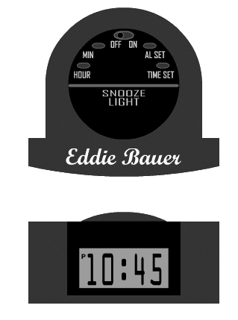
Device Simulation
Device Simulation
Setting Your Alarm
You’ve got an 8:30 AM meeting tomorrow and you don’t want to be late. As you climb into your hotel bed the night before, you decide to set your alarm for 6:30 AM so that you won’t be rushed the next morning.
Click the buttons on the top of your alarm clock to set the alarm for 6:30 AM. When you are done, click Submit to find out if you set the alarm correctly.
Submit

Slide 240
Page Types: Simple
Page Types: Simple (Relatively)
Page types we looked at:
Text with Graphic (presentation only)
Text Explore
Graphic Explore
Two Character Dialog
Expert Perspective
What’s the Right Response?
Multiple Choice: One Correct
Multiple Choice: Multiple Correct
Ordering
Branched Conversation
Device Simulation
Other common page types:
Audio-narrated animation (presentation only)
Text with Video (presentation only)
True/False questions
Fill in the blank questions
Short answer questions
Expert Answer
Matching

Slide 241
Page Types: More Complex
Page Types: More Complex
Software Simulation (e.g., Captivate-style sims)
Casual Games (concentration, crossword puzzles, hangman, gameshow-based interactions, etc.—these are usually of limited value)
Timed Challenges (“You have 3 minutes of Curt’s time, so make it count. When you are ready to begin your sales pitch, click Start.”)
Serious Games (basically, scored simulations relevant to the skills you are trying to teach, e.g., “flight simulator”-type games)

Slide 242
Interaction Design Considerations Grouping and Navigation

Slide 243
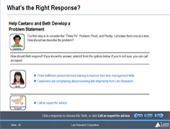
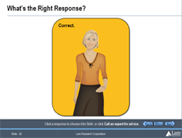
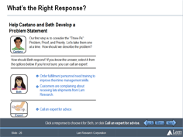
Design Considerations
Guideline: Don’t separate learner actions from feedback if you can avoid it.
Don’t do this:
Question asked on one page, but feedback given on the next page
Instead, do this:
Area reserved on question page, so feedback can appear there (on the same page)

Slide 244
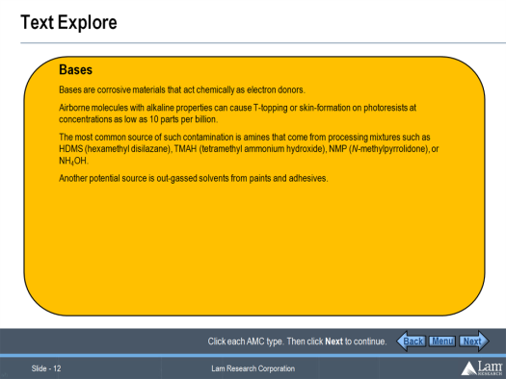
Design Considerations
Guideline: Avoid “hub and spoke” navigation schemes in your interactions.
Don’t do this:
Click on one page, view response on new page, then click Back to return to the first page…
Instead, do this:
Area reserved on first page, so response can appear there (on the same page)

Slide 245
Design Considerations
Next and Back buttons never link to interior pages of compound page types!
Links in the course Menu never link to interior pages of compound page types!
Start of the page before
Back
Menu
Next
Back
Menu
Next
A compound page type
Interior pages
Back
Menu
Next
Back
Menu
Next
Start of the page after

Slide 246
Design Goals and Inspiration Separating Good from Bad, and Drawing on Learning in Real Life

Slide 247
Designing Good Interactions
What makes an interaction “Good?”
Michael Allen says good interactions have four elements:
Context
Challenge
Activity
Feedback
The Context is the setting in which the learner will perform the desired task.
The Challenge is the problem the learners must learn to solve or the task they must perform.
The Activity is the set of interactions the learner will perform in the course to solve the challenge.
The Feedback is the information learners receive in response to actions they take in the activity.

Slide 248
Other Design Goals
Michael Allen also suggests the “Three Ms” are important attributes of good interactions. Are they:
Meaningful
Memorable
Motivational
In many instances, a 4th M could also be quite useful:
Measurable

Slide 249
Interaction Design Inspirations
Learning Models
Formal vs. Informal
Classroom vs. Lab
Trial and error (“learning by doing”)
Mentorship and Apprenticeship (“see one, do one, teach one”)
Dramas and Stories

Slide 250
Conclusion
Telling isn’t teaching
Designing in terms of learning interactions (implemented as “page types”) will help you avoid creating boring “page-flipper” courses
When designing interactions (and even more so, when using them in a course), consider the CCAFs: when the CCAFs are meaningful, memorable, and motivational to learners, the course will be too
When designing new interactions, consider the way people learn in the real world

Slide 251
Class Review and Critique of Student Page Types
This Week
Notes:
Consider: Look & Feel; Functionality; Instructional Usefulness

Slide 252
The ADDIE Model

Slide 253
ITEC 715
The ADDIE Model
What is the ADDIE Model?

Slide 254
ITEC 715
The ADDIE Model
What is the ADDIE Model?
ADDIE is an acronym. Each letter stands for one phase of a 5-phase process:
Analyze
Design
Develop
Implement
Evaluate
(Personally, I’ve always felt the “I” step (for “Implement”) was a bit misnamed → “Rollout” or “Deploy” would more accurately name this step, but that would mess up the acronym)

Slide 255
ITEC 715
The ADDIE Model
What is the ADDIE Model?
ADDIE is an acronym. Each letter stands for one phase of a 5-phase process:
Analyze → Discover the gaps between current and desired learner behaviors
Design → Specify learning objectives, organize and sequence content, choose implementation method (e.g., online or classroom), choose assessment options
Develop → Write the script, choose specific graphics and other media, write assessment questions, and if e-learning is part of the solution then actually build the course (e.g., write the programming code, etc.)
Implement → Roll out the built course to learners
Evaluate → Did students like the course? Did they learn anything? Did they put what they learned to use on the job? Did doing so make any difference to the business’s “bottom line”?

Slide 256
A Design D I E

Slide 257
Learning Objectives

Slide 258
ITEC 715
What is a Learning Objective?
Learning objectives are:
Short statements about specific capabilities learners will have after completing a course that they do not have before.
Examples:
After successfully completing this course, you will be able to:
Explain how a refrigerator works
Identify the major steps in the Carnot cycle
Define the terms adiabatic, isothermal, entropy, and work
List common failure modes of older refrigerators and suggest design improvements to correct them

Slide 259
ITEC 715
Why State Learning Objectives?
The purpose of a course is to help the learner achieve the learning objectives.
The learning objectives tell you what content to cover in the course.
The course and the learner are successful when the learning objectives have been achieved.
Each learning objective suggests how to write one or more quiz questions. Then you know the objectives are met if the learner answers the questions correctly.
Example:
Learning Objective: Use appropriate terminology while participating in problem-solving meetings with co-workers.
Quiz Question: Mary suggests initiating a root cause analysis. How do you respond?
Page Type: What’s the Right Response?

Slide 260
ITEC 715
Why State Learning Objectives?
Learning objectives tell you what to include/exclude from the course: if content you are considering doesn’t support one or more of your learning objectives, then leave it out!
Researchers at UC Santa Barbara* found that interesting but irrelevant content:
Significantly interfered with learners’ ability to recall the main points of the lesson
Reduced learners’ problem solving ability compared with learners who learned from the same lesson without the extraneous content
*Mayer, Richard E. and Shannon F. Harp, “How Seductive Details Do Their Damage: A Theory of Cognitive Interest in Science Learning”; Journal of Educational Psychology, 1998, Vol. 90, No. 3, 414-434; http://visuallearningresearch.wiki.educ.msu.edu/file/view/Harp+%26+Mayer+(1998).pdf

Slide 261
ITEC 715
Good Learning Objectives…
Learning objectives should specify observable behaviors such as categorizing, identifying, describing, etc.
Note that “knowing” is not an observable behavior (you can’t observe someone “knowing” something)!
Since only actions (not thoughts) are observable, state your learning objectives in terms of “action verbs”
Bloom’s Taxonomy is a convenient source of action verbs and a way of thinking about different levels of learning objectives

Slide 262
ITEC 715
Bloom’s Taxonomy
Benjamin Bloom suggested three “domains” of learning: Affective, Psychomotor, and Cognitive.
Affective: Learning objectives aimed at changing the learner’s attitudes and feelings
Examples: Courses designed to encourage people to recycle, or to adhere to core values
Psychomotor: Learning objectives aimed at physical skills
Examples: How to ride a bike, throw a baseball, or play the piano
Cognitive: Learning objectives aimed at changing what people know, or how they think
Examples: How to read a statistical process control chart, how to diagnose an etch problem, or how to create a financial portfolio with an optimum mix of investments

Slide 263
ITEC 715
Bloom’s Taxonomy
A great deal of the e-learning we create is focused on the Cognitive domain, which, in 1956, Bloom divided into 6 levels, shown below with the simplest at the bottom
Cognitive Domain Level | Action Verbs
Evaluation | Appraise, Argue, Assess, Choose, Conclude, Critique, Decide, Evaluate, Judge, Justify, Predict, Prioritize, Prove, Rank, Rate, Select
Synthesis | Compose, Construct, Create, Design, Develop, Integrate, Invent, Make, Organize, Perform, Plan, Produce, Propose, Rewrite
Analysis | Analyze, Characterize, Classify, Compare, Contrast, Debate, Deduce, Diagram, Differentiate, Discriminate, Distinguish, Examine, Outline, Relate, Research, Separate
Application | Apply, Change, Choose, Compute, Dramatize, Interview, Prepare, Produce, Role-play, Select, Show, Transfer, Use
Comprehension | Conclude, Demonstrate, Discuss, Explain, Generalize, Identify, Illustrate, Interpret, Paraphrase, Predict, Report, Restate, Review, Summarize, Tell
Knowledge | Count, Define, Describe, Draw, Find, Identify, Label, List, Match, Name, Quote, Recall, Recite, Sequence, Tell, Write
Source for these action verbs: http://www.teach-nology.com/worksheets/time_savers/bloom/

Slide 264
ITEC 715
Bloom’s Taxonomy
In 2001, Bloom’s original 1956 taxonomy was revised to use verbs rather than nouns to label the categories. Also, Synthesis (now Creating) swapped positions with Evaluation (now Evaluating):
Cognitive Domain Level | Action Verbs
Creating | Compose, Construct, Create, Design, Develop, Integrate, Invent, Make, Organize, Perform, Plan, Produce, Propose, Rewrite
Evaluating | Appraise, Argue, Assess, Choose, Conclude, Critique, Decide, Evaluate, Judge, Justify, Predict, Prioritize, Prove, Rank, Rate, Select
Analyzing | Analyze, Characterize, Classify, Compare, Contrast, Debate, Deduce, Diagram, Differentiate, Discriminate, Distinguish, Examine, Outline, Relate, Research, Separate
Applying | Apply, Change, Choose, Compute, Dramatize, Interview, Prepare, Produce, Role-play, Select, Show, Transfer, Use
Understanding | Conclude, Demonstrate, Discuss, Explain, Generalize, Identify, Illustrate, Interpret, Paraphrase, Predict, Report, Restate, Review, Summarize, Tell
Remembering | Count, Define, Describe, Draw, Find, Identify, Label, List, Match, Name, Quote, Recall, Recite, Sequence, Tell, Write
Source for these action verbs: http://www.teach-nology.com/worksheets/time_savers/bloom/

Slide 265
ITEC 715
Criterion Referenced Objectives
In Robert Mager’s “Criterion Referenced Objectives” model, learning objectives include three elements:
Performance → The observable task the learner will perform
Conditions → The conditions under which the learner will perform the task
Criteria → An explicit description of what constitutes acceptable performance
Example: Using any reference materials, correctly identify 85% of the copyedit errors on each supplied example document within 5 minutes.

Slide 266
Documenting Your Course Design

Slide 267
ITEC 715
The First “D” in “ADDIE”
Why Do We Need a Good, Simple Design Document Format?
Client review
Internal review
Design clarity
QUESTION: How can you document your design, without actually building the course, so that clients and your own internal management can understand your intent and make sure that everyone agrees that:
The learning objectives are good and are adequately addressed in your course design
The course has the right mix of content presentation and learning interactions
The content organization is right
Transitions and flow are good, especially at the boundaries between content sections
The assessment strategy is right
The graphics you intend to use are the right kind of graphics, used in an appropriate way
ANSWER:
You will write an E-learning Design Document (EDD for short)

Slide 268
ITEC 715
EDD Walkthrough
Template is available for download at: http://www.oldkingcole.com/itec715/ITEC715-EDD.doc
Four major sections:
Course Metadata
Course Outline/Sequence
Interaction Design
Detailed Course Sequence

Slide 269
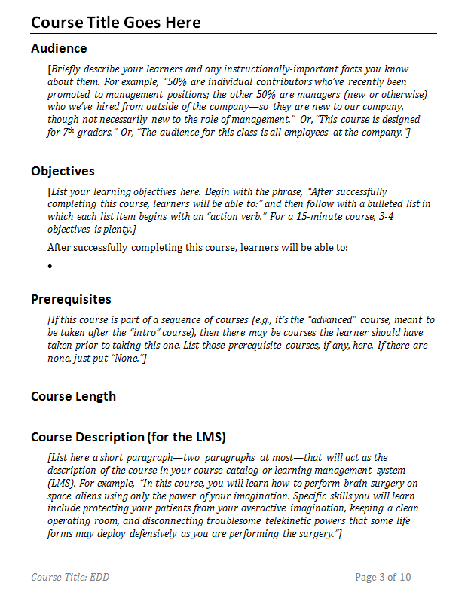
ITEC 715
EDD Walkthrough
The EDD template contains instructions throughout. These are printed in italics within square brackets (“[ ]”). After you’ve followed these instructions, you can remove them from your design document.
Course Length is an estimate of how long it will take the typical learner to complete the course, usually expressed in minutes for e-learning (e.g., 15 minutes). If you’re not sure, you can get a rough estimate by estimating how long each learning objective requires.

Slide 270
ITEC 715
EDD Walkthrough
Project Team: For the project you design for this class, you may not have a “Sponsoring Executive,” in which case you can delete that line (or, you could list me as the sponsoring executive, if you prefer).
Source Materials: List your source materials here. These may be client-supplied documents (e.g., Word or PowerPoint docs, PDFs, videos, existing classroom materials) or external resources (websites, textbooks, documentary films), or a combination of both.

Slide 271
ITEC 715
EDD Walkthrough
Course Outline/Sequence
In this class, you will be organizing your course content into modules, topics, and pages.
Modules are like book chapters: they divide your content into the largest logical chunks.
Each module consists of two or more topics, which are like subsections within a book chapter.
Each topic consists of two or more pages. A page is any collection of slides that the learner perceives as a single activity. You enter a page by clicking Next from the page before it, by clicking Back on the page after it, or by selecting it from the main menu.

Slide 272
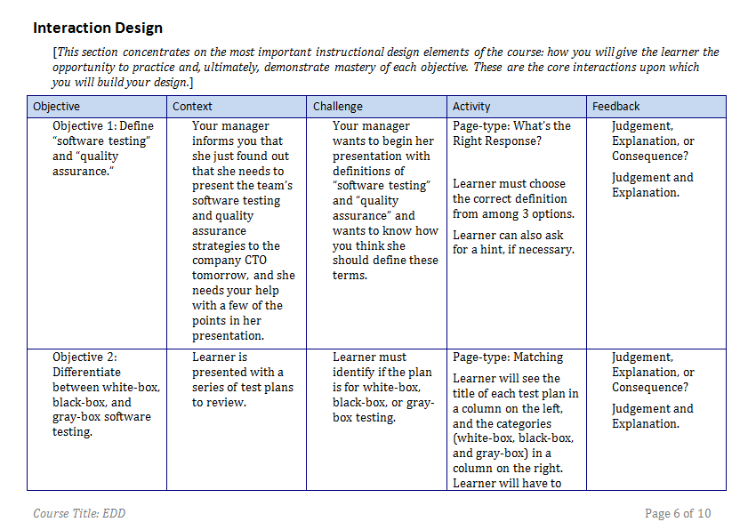
ITEC 715
EDD Walkthrough
This is where you identify the major CCAFs for each objective. There must be at least one for each objective. Sometimes you might want more than one for an objective, and that’s OK too.

Slide 273
ITEC 715
Assessment
Assessment questions should be tied to learning objectives (Don’t ask “trivia” questions!)
There are two (different) things to “test” for:
Retention: Do learners remember what you’ve taught them?
Example: Which of the following does ITAR forbid?
Transfer: Can learners apply what they’ve learned in your course to novel situations not specifically covered in the course?
Example: Given what you know about the design goals for Product X, which of the following cost cutting approaches would you recommend?
For learning, transfer is the more important.
Ask the learner to redesign a system to accomplish a new function
Ask the learner to troubleshoot a system
Ask the learner to uncover an underlying principle
Ask the learner to predict an outcome based on his or her understanding of the system

Slide 274
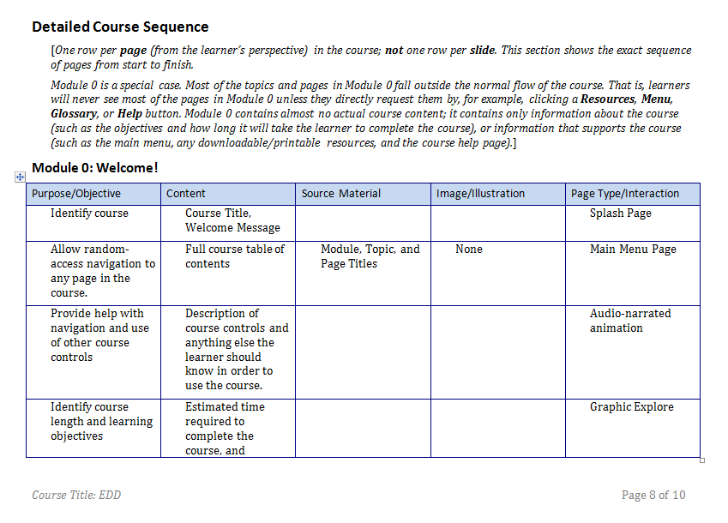
ITEC 715
EDD Walkthrough
Having identified the major interactions in the previous section, in this section, you show how you will support those interactions and how the course will flow from start to finish.

Slide 275
ITEC 715
EDD Walkthrough
Module 0 usually contains:
Splash page
Welcome message
OSD: “Click Start to begin.”
Start button
Help page
Resources page
Menu page (if applicable)
Glossary (if applicable)
Learning objectives
Course length

Slide 276
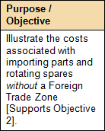
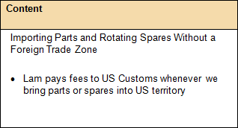
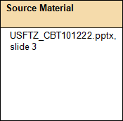
ITEC 715
EDD Walkthrough
In tables for Modules 1-n, in each row:
Purpose / Objective: List the purpose of this page here. Tie it to a learning objective.
Content: Describe the content you will present or assess on this page.
Source Material: Cite the document(s) and page number(s) from which you will pull the content.

Slide 277
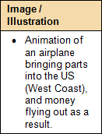
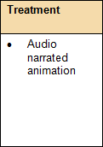
ITEC 715
EDD Walkthrough
For each row:
Image / Illustration: List the images you will use, or describe any animations or video you will use.
Page type/ Interaction
Page type/Interaction: What page type will you use?
Repeat until you’ve described the entire course this way.

Slide 278
Benefits of Using the EDD Quick to Write, Easy to Review
Notes:
Consider: Look & Feel; Functionality; Instructional Usefulness

Slide 279
ITEC 715
EDD Benefits
When combined with the Sample Interaction Deck (SID), the EDD gives a very good indication of your design, yet does not require you to:
Create any graphics
Lay out any pages
Animate anything
Record any audio
Shoot any video
Create any links or interactivity features
∴writing an EDD for a course can be done relatively quickly

Slide 280
ITEC 715
Tips for Using the EDD
Before sending out your EDD for review:
Enable “Tracked Changes”
Ask reviewers to make edits directly in the EDD itself
If you have questions for subject matter experts (SMEs) or reviewers, write them into the EDD and highlight them in yellow. Reviewers can type their answers directly into the EDD for you.

Slide 281
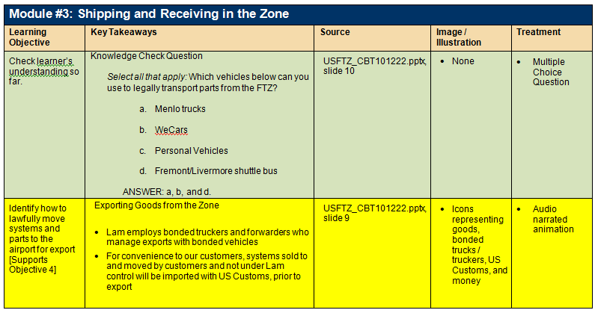
ITEC 715
Tips for Using the EDD
After your EDD is approved, you can work through it row by row during the scripting phase.
As I script each row, I like to track my progress by turning the background color to:
GREEN on rows I am able to script without questions
YELLOW for rows I need additional SME or client input to finish scripting
RED for rows that turn out to be impossible to script for one reason or another

Slide 282
Variety It’s the Spice of Life…
Notes:
Consider: Look & Feel; Functionality; Instructional Usefulness

Slide 283
ITEC 715
Variety
Why does so much e-learning end up being nothing more than a (boring) narrated PowerPoint presentation?
Source content → Often a linear PowerPoint deck or Word doc
Development tool → Often Adobe Presenter, an add-on to PowerPoint
If all we’re doing is creating narrated PowerPoint presentations (“page flipper” courses), we are squandering most of the power of interactivity that e-learning promises.

Slide 284
ITEC 715
Variety
How to avoid creating a page-flipper course:
Use a variety of interactions from your SID.
Remember, there’s more than one way to present content (narrated animation, 2-character dialog, expert perspective, etc.), and it’s often possible to have learners learn by doing (what’s the right response, interactive conversations, interactive software or hardware simulations, etc.)
Try not to use the same page type more than 2-3 times in a row
Break up long sequences of presentation-only pages with knowledge checks and other interactive exercises
Some page types are totally non-interactive, for example: Text with Graphic, or Audio Narrated Bullet Points. Use these page types sparingly; instead favor page types that require more learner engagement

Slide 285
Course Design Some Thoughts on Different Approaches
Notes:
Consider: Look & Feel; Functionality; Instructional Usefulness

Slide 286
ITEC 715
Components of Good Instruction
Good courses usually have:
Demonstrations
Examples
Context
Opportunities for practice
Expert tips, tricks, and advice
Comparisons
Instructional graphics
As you work out your design, consider:
Are these elements present?
Does your design make appropriate use of them?

Slide 287
ITEC 715
Design Considerations: Structure
Michael Allen* characterizes traditional e-learning as “Tell and Test”
Tell the learner some stuff (“tell”); then ask a multiple choice question or two (“test”)
Problems with “Tell and Test”
Content presentation usually starts with the simplest, most foundational skills and then builds up as the course progresses. Course topic not fully addressed until the end.
Learning to Drive a Car
What is a Car?
Getting Ready to Drive: Adjusting Seats and Mirrors
Safety / Recognizing Road Hazards
Driving
Starting Your Engine
Selecting a Gear
Understanding Pedals: Gas, Brake, and Clutch
Driving Around the Block
*Michael W. Allen, Michael Allen’s Guide to E-Learning, John Wiley & Sons, 2003, p. 181

Slide 288
ITEC 715
Design Considerations: Structure
Allen suggests:
Begin near the end:
Grandma just phoned. She’s fallen down and needs your help to get up. Trouble is, she lives three towns over (about 50 miles away). There’s no public transportation linking your two towns, and the taxi drivers throughout the state are currently on strike. So you will have to drive.
What would you like to do next?
Drive to Grandma’s
Tell me about cars
Read the Owner’s Manual entries on adjusting seats and mirrors
Interview a safety specialist for safety tips
Driving
What is a Car?
Getting Ready to Drive: Adjusting Seats and Mirrors
Safety / Recognizing Road Hazards
A demo: https://admin.adobe.acrobat.com/_a227210/p35706793/ (~37 min in)

Slide 289
ITEC 715
Design Considerations
INSTRUCTIONAL INTERACTIVITY:
Don’t let the learner sit passively while your course drones on with page after page of “lecture”
Break up content presentation with frequent knowledge checks, interactive challenges, and assessment questions
Most beginning instructional designers think that the learner learns most from the content presentation portions of the course, but in fact, learners need to work with the material to have any hope of retaining it. Instructional interactivity is at the core of successful e-learning

Slide 290
ITEC 715
Design Considerations
FEEDBACK:
Consider how you will let learners know if they have successfully met your interactive challenge. Broadly speaking, there are two ways:
Extrinsic feedback → An (often anonymous) authority says “That’s correct,” or “That’s incorrect, please try again.”
Intrinsic feedback → The learner sees the consequences of his or her choice and judges its correctness based upon the desirability of the consequences (e.g., after choosing to yell at his or her boss in a simulated interaction, the learner gets “fired.”)

Slide 291
ITEC 715
Design Considerations
FEEDBACK, continued:
Timing can also be important
Immediate feedback → There is a place for immediate feedback, but be careful when employing it. Telling the learner right away whether his or her answer is correct can lead to mindless guessing until the feedback reveals the correct answer. The learner, having done no real work to get the answer, gains nothing from this “interactive” experience
Delayed feedback → By not telling the learner if his or her answer choice is correct or not, you give the learner a chance to explore the possibility space, and to back up and try again if a particular set of choices doesn’t seem to be working. Often, the learner will arrive at the correct answer, without having to be told. By discovering it on his or her own, the accomplishment is more meaningful and the knowledge gained is more likely to be retained

Slide 292
ITEC 715
EDD Considerations
FEEDBACK, continued:
Other strategies
Ask “Why?” → Sometimes, after a learner chooses an answer (whether right or wrong), instead of saying if the answer is right or wrong, ask the learner to justify the answer. This makes the learner reflect on the underlying reasons, and reduces the chance that the learner is simply guessing
Ask for a free-form answer, then have the learner click a button to compare his or her answer with that of an expert. The assessment of whether the answers are sufficiently close is up to the learner, making him or her work with the material one extra step
Ask for a free-form answer, then show how other learners have answered the question in the past (requires saving answers from one learner so they can be displayed to another). This adds a useful social dimension to the learning

Slide 293
ITEC 715
For Next Week
Write your design document (EDD) for your course—Use as few “Text with Graphic” pages as possible in your design!
Make sure to include:
At least one page with video (~30 sec)
At least one page with animation (audio narrated)
Download and read the Week 8 slides and come prepared next week to discuss

