Slide 1
ITEC 715
The Design of Multimedia Learning
Week 8

Slide 2
Recall from Last Week
What is the ADDIE model?
Notes:
Consider: Look & Feel; Functionality; Instructional Usefulness

Slide 3
The ADDIE Model
The ADDIE Model
What is the ADDIE Model?
ADDIE is an acronym. Each letter stands for one phase of a 5-phase process:
  Analyze
  Design
  Develop
  Implement
  Evaluate
(Personally, I’ve always felt the “I” step (for “Implement”) was a bit misnamed → “Rollout” or “Deploy” would more accurately name this step, but that would mess up the acronym)

Slide 4
The ADDIE Model
The ADDIE Model
What is the ADDIE Model?
ADDIE is an acronym. Each letter stands for one phase of a 5-phase process:
  Analyze → Discover the gaps between current and desired learner behaviors
  Design → Specify learning objectives, organize and sequence content, choose implementation method (e.g., online or classroom), choose assessment options
  Develop → Write the script, choose specific graphics and other media, write assessment questions, and if e-learning is part of the solution then actually build the course (e.g., write the programming code, etc.)
  Implement → Roll out the built course to learners
  Evaluate → Did students like the course? Did they learn anything? Did they put what they learned to use on the job? Did doing so make any difference to the business’s “bottom line”?

Slide 5
The First “D” in “ADDIE”
The ADDIE Model
Clients will want to review a design and give approval before committing resources to the development effort
In many cases, your design will need to be approved internally (by a Lead Instructional Designer) before it is sent to the client
How can you document your design, without actually building the course, so that clients and your own internal management can understand your intent and make sure that everyone is “on the same page” (e.g., all learning objectives are adequately addressed, etc.)?

Slide 6
The First “D” in “ADDIE”
The ADDIE Model
Clients will want to review a design and give approval before committing resources to the development effort
In many cases, your design will need to be approved internally (by a Lead Instructional Designer) before it is sent to the client
How can you document your design, without actually building the course, so that clients and your own internal management can understand your intent and make sure that everyone is “on the same page” (e.g., all learning objectives are adequately addressed, etc.)?
ANSWER: You will write an E-learning Design Document (which we’ll call an EDD for short)

Slide 7
EDD Walkthrough
The ADDIE Model
I’ve provided you with a template for your EDD
It contains 4 main sections
  Notes & Bibilography → lists global notes (e.g., in the real world, you might still be missing content that the client has promised but not yet delivered to you), and file paths and/or bibliographic citations of source material
  Course Overview → Gives catalog description of course, lists prerequisites (if any), primary course-level learning objectives, and shows high-level view of your sequencing of the content, broken down by module and topic
  Assessment Strategy → Shows how many assessment questions you will ask in order to test mastery of each of the course’s stated learning objectives
  Course Breakdown by Module → Shows detailed breakdown of your content sequencing, down to the page level, with recommended implementation page-type selected from your prototype and a description of recommended graphics or other media to be used

Slide 8
EDD Considerations
The ADDIE Model
SOURCE MATERIALS: Normally, the client would provide you with at least some source materials. For this class, you will have to come up with your own materials. List them in Section I of your EDD

Slide 9
EDD Considerations
The ADDIE Model
LEARNING OBJECTIVES: For the EDD, list learning objectives as items in a bulleted list. Keep in mind the following:
  Learning objectives must specify observable behaviors such as categorizing, identifying, describing, etc. Note that “knowing” is not an observable behavior (you can’t observe if someone “knows” something)
  Good learning objectives are specific and measurable, as in Robert Mager’s “Criterion Referenced Objectives” model in which you state the:
    Performance → the observable task the learner will perform
    Conditions → the conditions under which the learner will perform the task
    Criteria → an explicit description of what constitutes acceptable performance
Example: Using any reference materials, correctly identify 85% of the copyedit errors on each supplied example document within 5 minutes.

Slide 10
EDD Considerations
The ADDIE Model
CHOOSING / SEQUENCING PAGE TYPES: Variety is the spice of life!
  Try not to place more than 2 or three presentation pages in a row without breaking them up with activity pages
  Even for short runs of presentation pages, try to vary the type. For example, if you start with a “Text with Graphic” page, try not to follow it with another “Text with Graphic” page. If you still need to present additional content before proceeding to an activity page, try to use a different page-type to do the additional presenting—maybe a “Text with Animation” or “Text with Video” or “Text- (or Graphic- ) Explore” page will do
  Later in the course, you’ll fill out a color-coded document that will identify at a glance how much page-type variety is in your design. Keep this in mind!

Slide 11
EDD Considerations
The ADDIE Model
CHOOSING / SEQUENCING PAGE TYPES, continued: “Tell and Test”
  Traditional e-learning begins by presenting content, then ends by asking the learner to answer questions about it. Michael Allen* calls this approach “Tell and Test” for obvious reasons
  Within the “Tell and Test” paradigm, content presentation is usually sequenced to start with the simplest, most foundational skills and then builds up as the course progresses to ever more sophisticated and complex tasks
  Allen suggests that this means the instruction tends to begin with the boring stuff and doesn’t get interesting or meaningful until the course is almost over. That’s not very motivating for the learner!

Slide 12
EDD Considerations
The ADDIE Model
INSTRUCTIONAL INTERACTIVITY:
  Don’t let the learner sit passively while your course drones on with page after page of “lecture”
  Break up content presentation with frequent knowledge checks, interactive challenges, and assessment questions
  Most beginning instructional designers think that the learner learns most from the content presentation portions of the course, but in fact, learners need to work with the material to have any hope of retaining it. Instructional interactivity is at the core of successful e-learning

Slide 13
EDD Considerations
The ADDIE Model
FEEDBACK:
  Consider how you will let learners know if they have successfully met your interactive challenge. Broadly speaking, there are two ways:
    Extrinsic feedback → An (often anonymous) authority says “That’s correct,” or “That’s incorrect, please try again.”
    Intrinsic feedback → The learner sees the consequences of his or her choice and judges its correctness based upon the desirability of the consequences (e.g., after choosing to yell at his or her boss in a simulated interaction, the learner gets “fired.”)

Slide 14
EDD Considerations
The ADDIE Model
FEEDBACK, continued:
  Timing can also be important
    Immediate feedback → There is a place for immediate feedback, but be careful when employing it. Telling the learner right away whether his or her answer is correct can lead to mindless guessing until the feedback reveals the correct answer. The learner, having done no real work to get the answer, gains nothing from this “interactive” experience
    Delayed feedback → By not telling the learner if his or her answer choice is correct or not, you give the learner a chance to explore the possibility space, and to back up and try again if a particular set of choices doesn’t seem to be working. Often, the learner will arrive at the correct answer, without having to be told. By discovering it on his or her own, the accomplishment is more meaningful and the knowledge gained is more likely to be retained

Slide 15
EDD Considerations
The ADDIE Model
FEEDBACK, continued:
  Other strategies
    Ask “Why?” → Sometimes, after a learner chooses an answer (whether right or wrong), instead of saying if the answer is right or wrong, ask the learner to justify the answer. This makes the learner reflect on the underlying reasons, and reduces the chance that the learner is simply guessing
    Ask for a free-form answer, then have the learner click a button to compare his or her answer with that of an expert. The assessment of whether the answers are sufficiently close is up to the learner, making him or her work with the material one extra step
    Ask for a free-form answer, then show how other learners have answered the question in the past (requires saving answers from one learner so they can be displayed to another). This adds a useful social dimension to the learning

Slide 16
This Week
The ADDIE Model
Design Document Review
(Break into groups of 4 and
critique each others’ design documents)

Slide 17
Design Document Critiques
The ADDIE Model
Remember to use good “Critiquing Etiquette”
Consider:
  Good learning objectives?
    Action verbs
    Condition, performance, criterion
  Number of assessment questions reflects importance of learning objective
  Logical organization into Modules, Topics, and Pages
  Reasonable mapping of content to page types

Slide 18
Scripting from Your Design Document
This Week
Notes:
Consider: Look & Feel; Functionality; Instructional Usefulness

Slide 19
ITEC 715
Scripting from Your EDD
After client sign-off, the next step in the e-learning production process is to script the course
Make any client-requested changes to the EDD, then use it as a blueprint for scripting the course:
  Go back to your prototype and copy out the page-types specified in your EDD
  Replace all place-holder/prototype content with actual content for the course

Slide 20
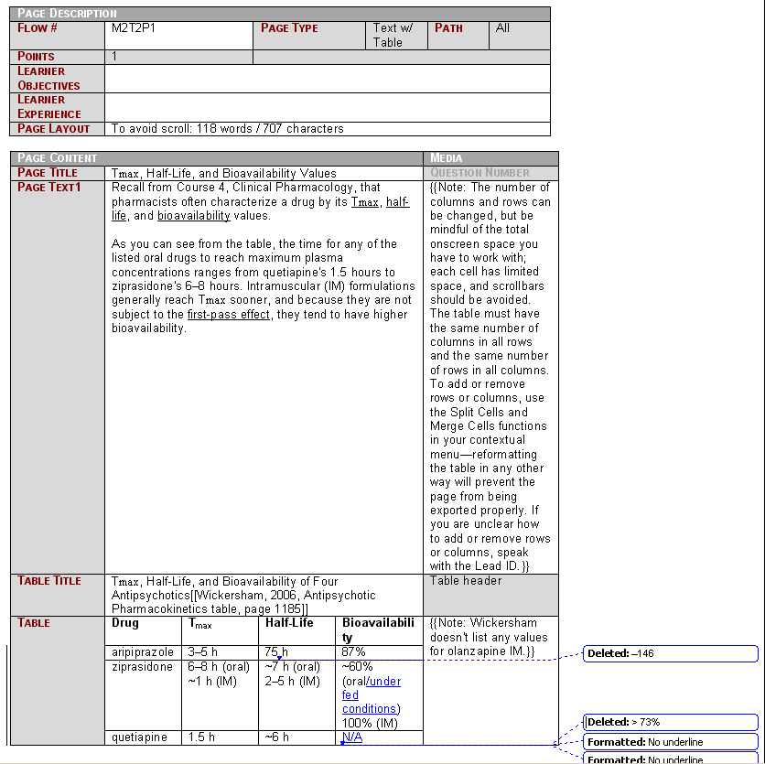
ITEC 715
Scripting from Your EDD
In many production environments, IDs write “structured” scripts. Typically, this means scripts are written inside multicolumn script tables, one table per page-type (possibly with a “header” table preceding each “content” table)

Slide 21
ITEC 715
Scripting from Your EDD
Advantages of structured scripts include:
  Structured content has a defined space for every piece of content and information that is required to build the page, and thus minimizes the chance that the ID will forget to put in something whose absence would slow down the production pipeline
  Structured content can be processed by computer programs to automate some or all of the build process

Slide 22
ITEC 715
Scripting from Your EDD
You won’t be using a structured script in the class, though
Instead, simply type your final copy directly into PowerPoint. Lay out your final graphics or place holders for your animations, videos, dialog controls, and other buttons
In other words, your script for this class will be a PowerPoint deck

Slide 23
Sound in Instructional Multimedia:
Some Examples for Class Discussion
This Week
Notes:
Consider: Look & Feel; Functionality; Instructional Usefulness

Slide 24
ITEC 715
Instructional Use of Audio
Instructional podcast (audio only): http://csulb.edu/lats/itss/design/xml-files/episode-005.mp3
Traditional e-learning with audio: Example 1: FTZ
Traditional e-learning with audio: Example 2: JONH_03

Slide 25
Intro to Audio Production
This Week
Notes:
Consider: Look & Feel; Functionality; Instructional Usefulness

Slide 26
Audio Fundamentals
What is Sound?

Slide 27
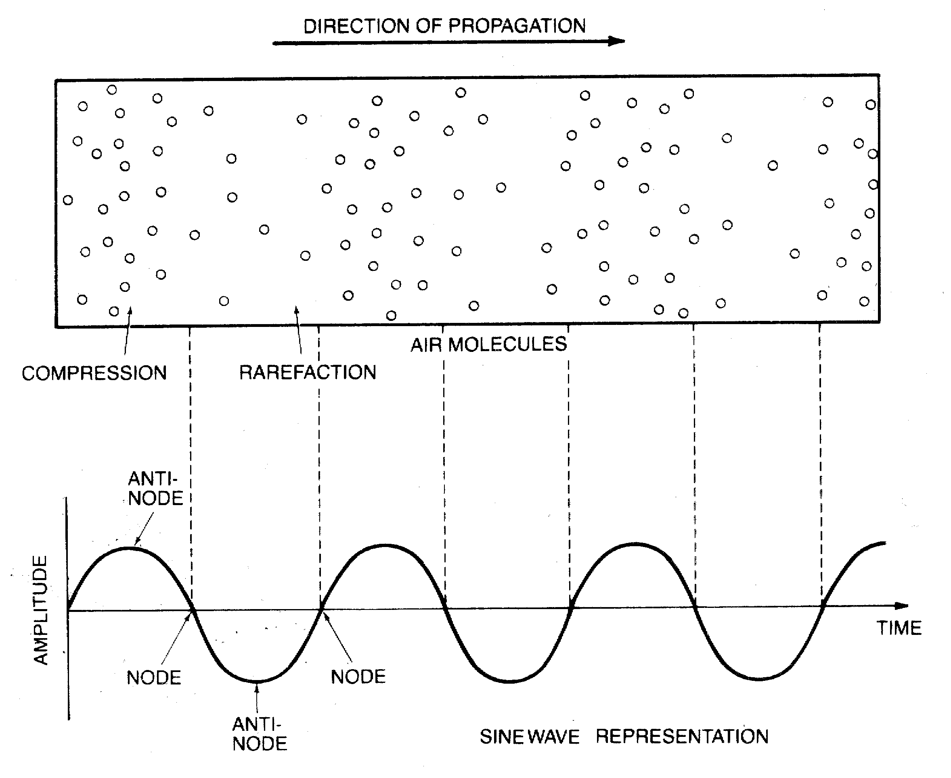
Sound
Sound is a compression wave in the air. You hear it because your ears convert the changing air densities into signals that your brain interprets as sound.
If you graph the compression and rarefaction cycles of a sound wave, you end up with something that looks like the picture at the lower right.
1 wavelength
Diagram source: Principles of Digital Audio, 2nd Edition by Ken C. Pohlmann (1989)

Slide 28
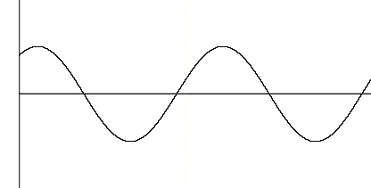
Visually Representing Sound
Usually, in a graph of a sound wave, the vertical direction represents amplitude and the horizontal direction represents time.
All sound requires time, so that axis is fairly self explanatory. But amplitude, which is a measure of the relative compaction or rarefaction of the air, is less familiar.
Amplitude (usually in dB) →
Time (usually in seconds) →

Slide 29
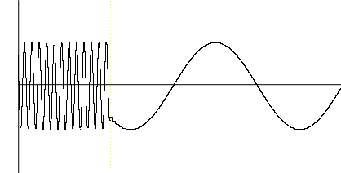
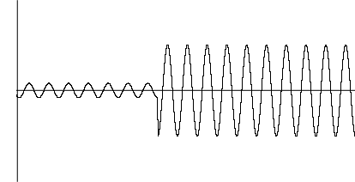
Frequency and Amplitude
Putting It Into Practice
Frequency → Pitch
Human hearing: 20 Hz – 20,000 Hz
High frequency Low frequency
Amplitude → Loudness
Human hearing: 0 dB – ~120 dB
Soft Loud

Slide 30
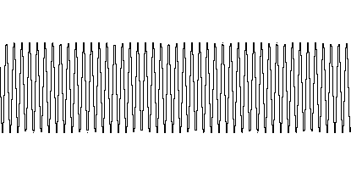
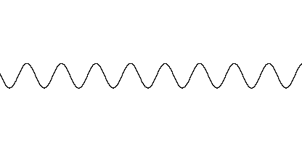
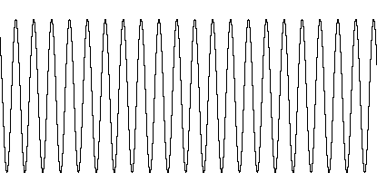
Frequency and Amplitude
Putting It Into Practice
At the right are graphs of three sound waves.
Which wave would sound the loudest?
Which would sound the highest?
Which would sound the lowest?
Which would sound the softest?

Slide 31
Frequency and Amplitude
Putting It Into Practice
Highest frequency = sounds the highest pitch
Medium amplitude = medium loudness
Lowest frequency = sounds the lowest pitch
Smallest amplitude = softest sound
Medium frequency = medium pitch
Biggest amplitude = loudest sound

Slide 32

Nyquist Theorem
Sample Rate → Freq. Range
= sample points
The Nyquist sampling theorem says you must use a sample rate that is twice as high as the highest frequency you wish to record.
Jon Faddis sampled at 44.1 KHz
9 8 6 3 1 0 2 5 7 8 8 7 5 2 0 1 4 5
Jon Faddis sampled at 2 KHz
Sample values
Sound source: “High Five” by Jon Faddis from Hornicopia (1991)

Slide 33
Applying the Nyquist Theorem
The Nyquist Frequency
QUESTION: If you want to be able to record frequencies within the entire range of human hearing, what is the minimum sample rate you must use?

Slide 34
Applying the Nyquist Theorem
The Nyquist Frequency (cont.)
QUESTION: If you want to be able to record frequencies within the entire range of human hearing, what is the minimum sample rate you must use?
HINT: The range of human hearing is 20 Hz to 20 KHz.

Slide 35
The Nyquist Frequency (cont.)
QUESTION: If you want to be able to record frequencies within the entire range of human hearing, what is the minimum sample rate you must use?
HINT: The range of human hearing is 20 Hz to 20 KHz.
ANSWER: According to Nyquist’s theorem, you must sample at twice the rate of the highest frequency. Hence, your minimum sample rate is 40 KHz.

Slide 36
Bit Depth → Dynamic Range
A recording’s dynamic range is the difference in volume between its loudest and softest sounds.
The more accurately you measure the amplitude of the sound wave at each sample point, more dynamic range you can capture in your digital recording.
In practice, bit depths are almost always multiples of 8 and rarely go over 32 bits. Since sounds louder than about 120 dB cause us pain, 24 bits is usually enough for playback purposes.
Bit Depth (n) | # of Levels (0 – (2^{n}-1)) | Dynamic Range
8 bits | 256 | 48 dB
16 bits | 65536 | 96 dB
24 bits | 16777216 | 144 dB
32 bits | 4294967296 | 192 dB
(Range of human hearing = ~120 dB)

Slide 37
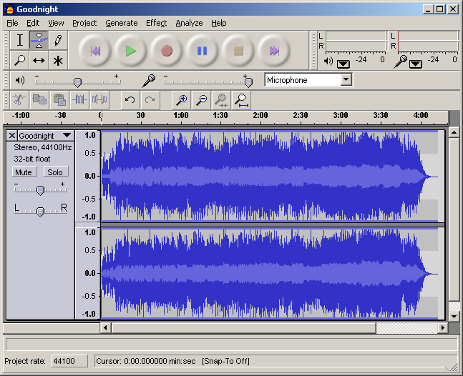
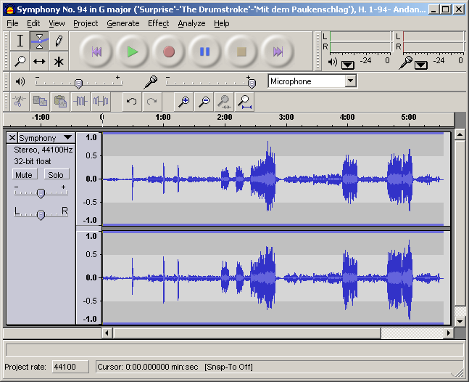
Loudness vs. Dynamic Range
Which recording below has more dynamic range?
Pop music example
Classical music example
Pop source: “Goodnight” by Matthew Stewart from No Stone Unturned (2000)
Classical source: “Andante” by Franz Joseph Haydn from Symphony No. 94 (“Surprise”) (1791)

Slide 38
Digital Sound Quality
The table at the right shows commonly used sample rate / bit depth combinations. Note that in the consumer press (and, particularly, in advertisements for consumer electronics), terms like “CD Quality” are used rather loosely. But true CD quality means 44.1 KHz / 16 bit uncompressed. (You’ll learn more about compression later in this workshop – stay tuned!)
These numbers are sometimes abbreviated by leaving out the units, e.g., you might say a soundcard supports 96/24 sound.
Sample Rate / Bit Depth | Used by
44.1 KHz / 16 bit | CD players
48 KHz / 16 bit | DVD players (uncompressed PCM)
48 KH / 24 bit | Some computer soundcards
96 KHz / 24 bit | DVD-Audio
192 KHz / 24 bit | DVD-Audio (2 channel only)

Slide 39
Review
Sound = compression waves in the air
Human Hearing = Frequency range: 20 Hz – 20 KHz; Dynamic range: 0 – 120 dB
Frequency → Pitch
Amplitude → Loudness/Volume
Sample Rate → Highest Freqency
Bit Depth → Dynamic Range
Nyquist Theorem → Must sample at 2x the sound’s highest frequency

Slide 40
Module 2: Recording with Audition

Slide 41
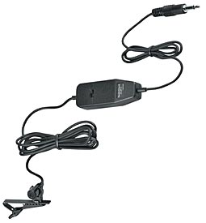
Microphone
Two things needed for digital audio recording:
Microphone
Digital audio recording software
A limited number of mics like this are available for checkout from SFSU’s Cahill Lab, Burk Hall 319
May still be available for purchase from Radio Shack for ~$30 (“Hands-Free Tie-Clip Omni-Directional Electret” part number 33-3013)
Pros: Pretty decent mic for cheap; small; easy to bring out into the field
Cons: Some computer soundcards don’t have the ability to get a strong signal from this kind of mic; requires an analog mic input jack
Analog lavalier (clip-on) mic

Slide 42
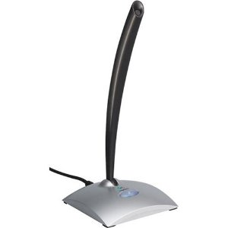
Microphone
Microphone
A cheaper, simpler option that will still work well for our purposes
Available from Amazon, Best Buy, etc. for ~$20-$30 (Logitech brand shown at left)
Pros: Inexpensive; doesn’t require batteries; somewhat portable; doesn’t require an analog mic jack on your computer; no problems with weak signal strength
Cons: just so-so sound quality (but plenty good enough for our basic voice recordings); odd-shaped tip won’t take traditionally-sized foam wind-socks
Digital tabletop USB mic

Slide 43
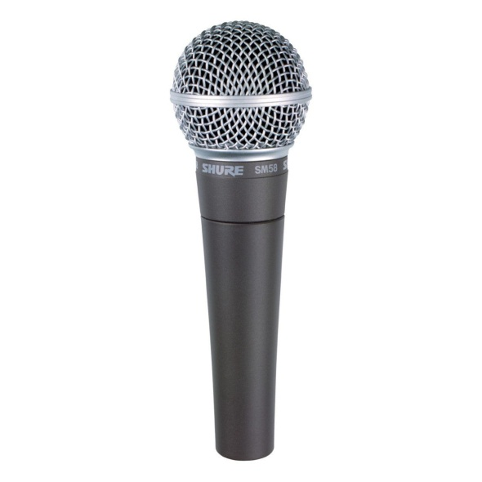
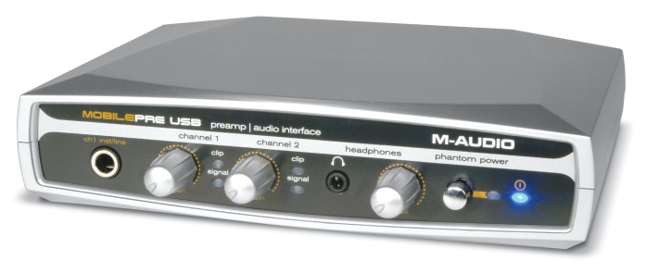
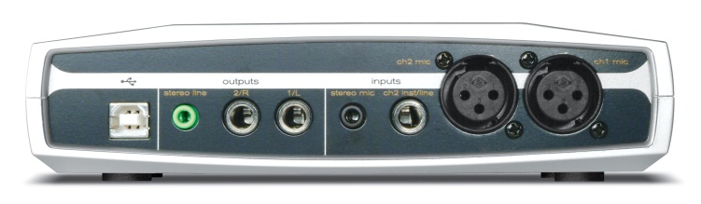
Microphone
Microphone
A classic mic, used on thousands of professional recordings
Relatively inexpensive (about $100)
Pros: Good sound quality
Cons: Requires a microphone pre-amp
Analog, professional vocal mic:
Shure SM58 (~$100)
Or: A knock-off that’s very similar: GLS ES-58 (~$35)

Slide 44
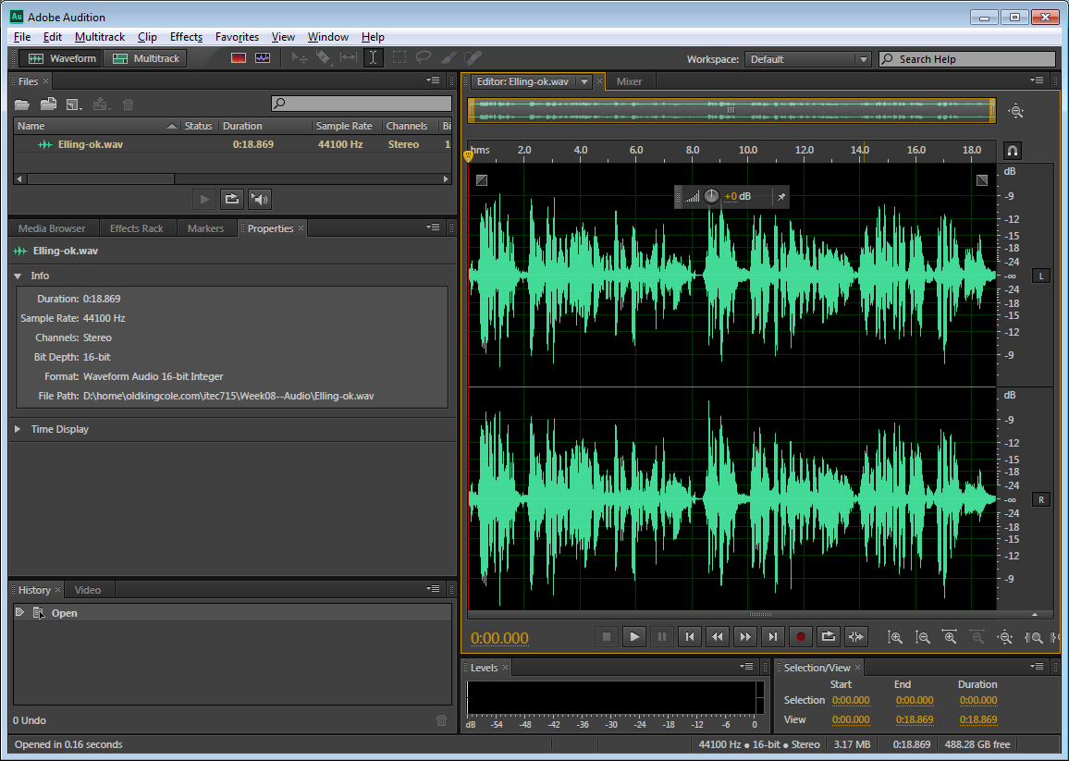
Adobe Audition

Slide 45

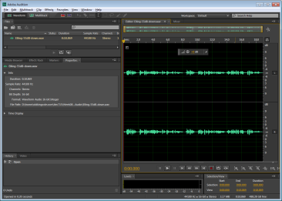
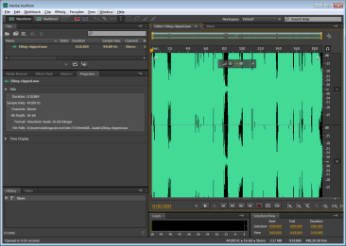
Making a Recording
Your goal is to record sound so that its loudest portion comes as close as possible to the top and bottom of your work window, but no farther.
Too Soft
Too Loud
OK
Sound source: “It’s Just A Thing” by Kurt Elling from The Messenger (1997)

Slide 46
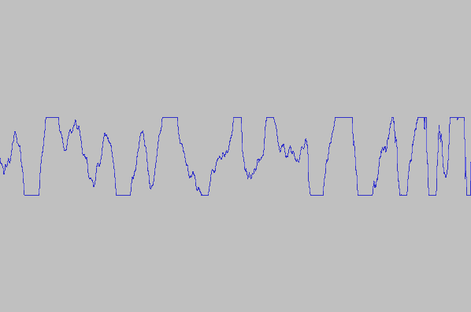
Clipping
Remember that amplitude values you can measure are directly related to how many bits you devote to each measurement. If your sound level is so high that you run out of bits trying to measure it, you get clipping.
Waveforms with clipped peaks sound distorted. Generally, this is something you want to avoid.
Clipping
Sound source: “It’s Just A Thing” by Kurt Elling from The Messenger (1997)

Slide 47
Unfortunately, if your microphone input levels are too low, you get a different kind of problem: excessive noise.
All recordings record both sound you want to hear and background noise you don’t want to hear. If you record some “silence,” what you’ll actually get is the sound of the air particles moving around in the room and colliding with the walls. Professionals call this room tone.
Room Tone

Slide 48
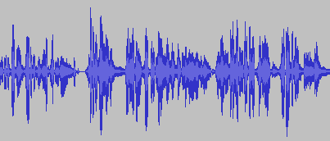
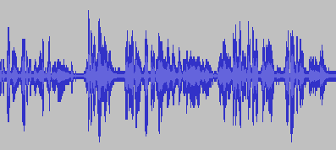
Room Tone
Rooms of differing volumes and differing configurations have different-sounding room tones, but since you can’t have sound without air (remember: sound is density changes in air), room tone will always be present when you make recordings indoors.
True silence
noise floor
noise
signal

Slide 49
Signal to Noise Ratio
Signal amplitude – noise amplitude
= the signal to noise ratio
The signal to noise ratio can be maximized by either
a. lowering the noise floor, or
b. raising the signal level
(or both).
Suppose we record a narrator twice – once with a strong signal (large amplitude), and once with a weak signal (small amplitude).
During playback, we’ll have to turn up the volume in order to hear the recording with the weak signal. But “turning up the volume” amplifies everything, including the noise. This will make our recording sound “hissy.”
For a clean recording, we want the ratio of the signal’s amplitude to that of the noise’s amplitude to be as high as possible.
:

Slide 50
Activity 1A
Activity 1A: Recording, Normalizing,
Noise Reduction, and Saving
I’ll record, then the class will normalize and noise reduce.

Slide 51
Voice Over Script
(Note – Add in some “Uhs” and “Umms”, so we’ll have something to edit later on)
Using this course is easy! To move forward one page, click Next. To move backward one page, click Back. You can go to any page in the course by clicking Menu, and then clicking the page you want to visit.
From time to time, you will be asked to interact with the course by clicking links or buttons.
To view the additional resources available to you, including job aids and checklists, click Resources.
You can return to this help page at any time by clicking Help from any page.
When you're ready, click Next to get started.

Slide 52

Making a Recording
Launch Audition
Click Record
Enter your desired sample rate and bit depth
Click OK
Set your levels by speaking into the microphone and then seeing how “hot” your signal is
When you’re done recording, click Stop
Stop
Play in loop
Play
Pause
Go to beginning
Go to end
Record

Slide 53
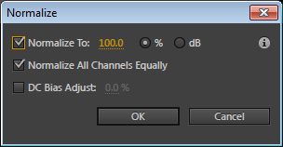
Normalizing
Click Effects ➔Amplitude and Compression ➔ Normalize (process)…
In the dialog, you can accept the defaults:
  Normalize to: 100%
  Normalize all channels equally
  No DC bias adjust (unless needed)
Click OK

Slide 54
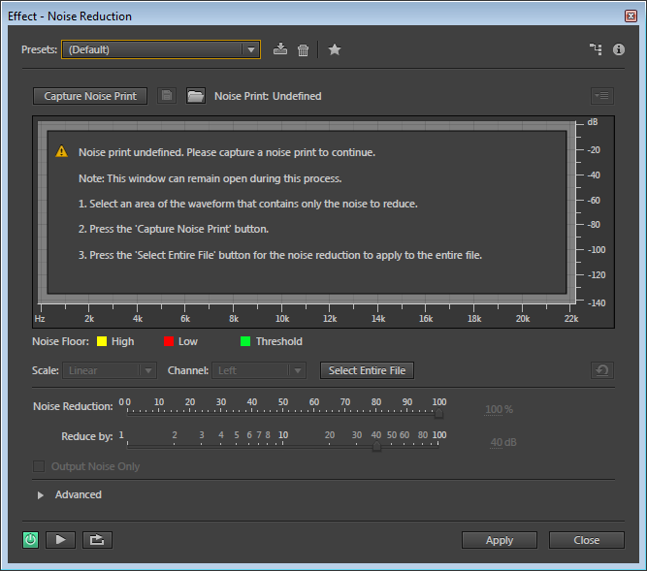
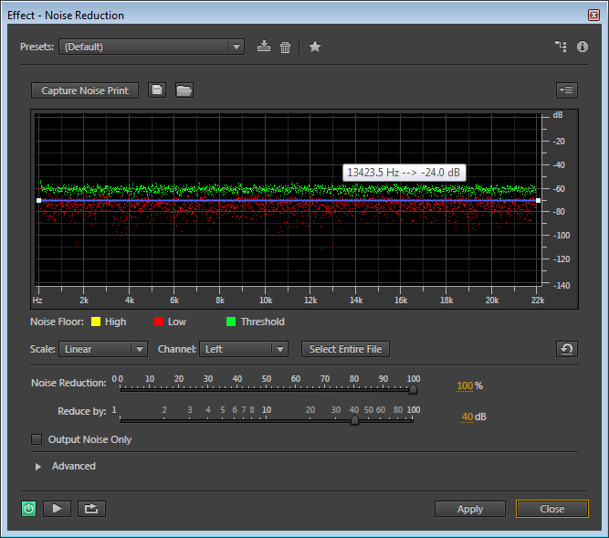
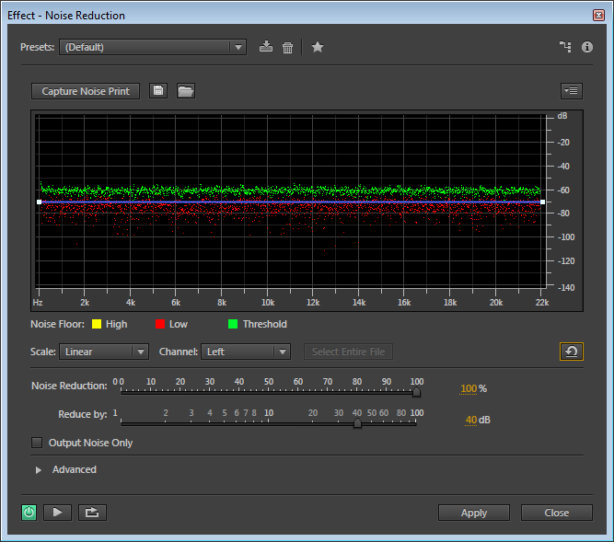
Digital Noise Reduction
Highlight a section of your recording that should be pure silence.
Click Effects ➔Noise Reduction / Restoration ➔ Noise Reduction (process…)
You’ll see the message at right: “Noise print undefined.”
Click Capture Noise Print
Click Select Entire File
You can adjust how much noise you want to remove by dragging the 100% default to the left to decrease it, or if it’s less than 100%, to the right to increase it.
Click Apply and then Close.
Noise Removal

Slide 55
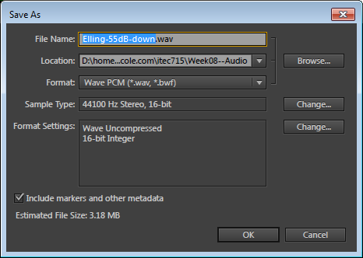
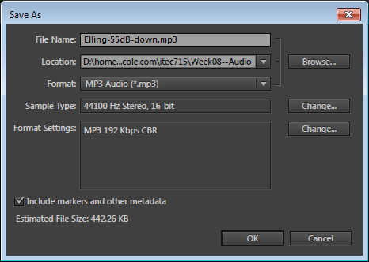
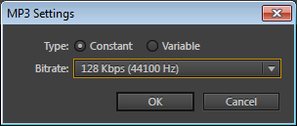
Saving
Save as a WAV file: File -> Save As…
Save as an mp3 file: File -> Save As…
Click Change
Select 128kbps (Constant)
Click OK
Click OK

Slide 56
Activity 1B
Noise Reduction, Normalizing, Saving
Your Turn!

Slide 57
Editing
Demo

Slide 58
Editing
Your Turn!

Slide 59
ITEC 715
For Next Week
Revise your EDD (make any changes identified during the group review meeting during today’s class session)
Start scripting your course—have at least 3 pages done by next week. Don’t worry about media types we haven’t covered yet (e.g., video, animation), just leave a still graphic on the page as a place-holder and use the Notes area to describe the functions of the various buttons and features. Place the script for the audio narration in the PowerPoint “Notes” section for each slide that has audio narration.
Record voice-over or other spoken audio (e.g., product testimonials, quote from an expert, etc.) for three scripted pages of your course. You will turn in these recordings as 44.1 KHz, 16-bit mono WAV or AIFF files
Download and read the Week 9 slides and come prepared next week to discuss

