Slide 1
ITEC 715
The Design of Multimedia Learning
Week 9

Slide 2
Video in E-learning
This Week
Notes:
Consider: Look & Feel; Functionality; Instructional Usefulness

Slide 3
Strengths and Weaknesses
Strengths
Conveying emotion
Establishing a human connection
Showing a visual demonstration
Weaknesses
Difficult to edit
Expensive to change or update
Expensive to shoot and edit

Slide 4
ITEC 715
Some Common Uses
Digital Coach/Feedback
Expert Perspective
Customer Testimonial
Demonstration
Lecture
Vignette
Branched Conversation/Virtual Interaction

Slide 5
ITEC 715
Digital Coach / Feedback
The Company Business Process
There are four major steps to the company business process. Click each step to learn more about it:
Research the competitive landscape
Estimate costs required to “beat the best”
Estimate the return on investment (ROI)
Make a “build vs. buy” decision
Click each process step. Then click Next to continue.
Back
Menu
Next

Slide 6
ITEC 715
Digital Coach / Feedback
The Company Business Process
There are four major steps to the company business process. Click each step to learn more about it:
Research the competitive landscape
Estimate costs required to “beat the best”
Estimate the return on investment (ROI)
Make a “build vs. buy” decision
Research the Competitive Landscape
In this step, you must determine if there are any competitors who are already engaged in the new business opportunity you see for your company. If so, you need to identify which competitor is doing the best in this market.
“Best” can be a tricky concept. Sometimes it means earning the largest gross margins. Sometimes is means capturing the largest share of the market. Be careful how you define “best” at this stage!
Click each process step. Then click Next to continue.
Back
Menu
Next

Slide 7
ITEC 715
Digital Coach / Feedback
The Company Business Process
There are four major steps to the company business process. Click each step to learn more about it:
Research the competitive landscape
Estimate costs required to “beat the best”
Estimate the return on investment (ROI)
Make a “build vs. buy” decision
Estimate Costs Required to “Beat the Best”
Having identified the competitor who is doing best in this market, you next need to figure out how much it will cost your company to enter the market and beat the best player.
Some factors to consider:
Existing brand loyalties you may have to overcome
Marketing costs
Any import duties on parts or subcomponents
Taxes and other fees
Click each process step. Then click Next to continue.
Back
Menu
Next

Slide 8
ITEC 715
Digital Coach / Feedback
The Company Business Process
There are four major steps to the company business process. Click each step to learn more about it:
Research the competitive landscape
Estimate costs required to “beat the best”
Estimate the return on investment (ROI)
Make a “build vs. buy” decision
Estimate the Return on Investment (ROI)
To compute the ROI, <blah blah blah etc. etc. etc.>
Click each process step. Then click Next to continue.
Back
Menu
Next

Slide 9
ITEC 715
Digital Coach / Feedback
The Company Business Process
There are four major steps to the company business process. Click each step to learn more about it:
Research the competitive landscape
Estimate costs required to “beat the best”
Estimate the return on investment (ROI)
Make a “build vs. buy” decision
Make a “Build vs. Buy” Decision
Factors to consider in making this decision include:
Blah
Blah
Blah
Yadda
Yadda
Yadda
Click each process step. Then click Next to continue.
Back
Menu
Next

Slide 10
ITEC 715
Digital Coach / Feedback
The Company Business Process
There are four major steps to the company business process. Click each step to learn more about it:
Research the competitive landscape
Estimate costs required to “beat the best”
Estimate the return on investment (ROI)
Make a “build vs. buy” decision
Click each process step. Then click Next to continue.
Back
Menu
Next

Slide 11

ITEC 715
Digital Coach / Feedback
In this step, you must determine if there are any competitors...
The Company Business Process
There are four major steps to the company business process. Click each step to learn more about it:
Research the competitive landscape
Estimate costs required to “beat the best”
Estimate the return on investment (ROI)
Make a “build vs. buy” decision
Click each process step. Then click Next to continue.
Back
Menu
Next

Slide 12
ITEC 715
Digital Coach / Feedback
Having identified the competitor who is doing best in this market, …
The Company Business Process
There are four major steps to the company business process. Click each step to learn more about it:
Research the competitive landscape
Estimate costs required to “beat the best”
Estimate the return on investment (ROI)
Make a “build vs. buy” decision
Click each process step. Then click Next to continue.
Back
Menu
Next

Slide 13
ITEC 715
Digital Coach / Feedback
To compute the ROI, <blah blah blah etc. etc. etc.>…
The Company Business Process
There are four major steps to the company business process. Click each step to learn more about it:
Research the competitive landscape
Estimate costs required to “beat the best”
Estimate the return on investment (ROI)
Make a “build vs. buy” decision
Click each process step. Then click Next to continue.
Back
Menu
Next

Slide 14
ITEC 715
Digital Coach / Feedback
The right way to make a build vs. buy decision is to…
The Company Business Process
There are four major steps to the company business process. Click each step to learn more about it:
Research the competitive landscape
Estimate costs required to “beat the best”
Estimate the return on investment (ROI)
Make a “build vs. buy” decision
Click each process step. Then click Next to continue.
Back
Menu
Next

Slide 15


ITEC 715
Expert Perspective
Seeing the Solution in Different Ways
Captain Kirk has asked Dr. McCoy and Mr. Spock for advice. Each has a different perspective. Dr. McCoy offers a human, emotional point of view. Mr. Spock offers a logical, rational point of view.
Click each character to hear what he has to say. If you were in Captain Kirk’s position, who’s advice would you take?
Dr. McCoy
Mr. Spock
Click each character to hear his perspective. Then click Next to continue.
Back
Menu
Next

Slide 16
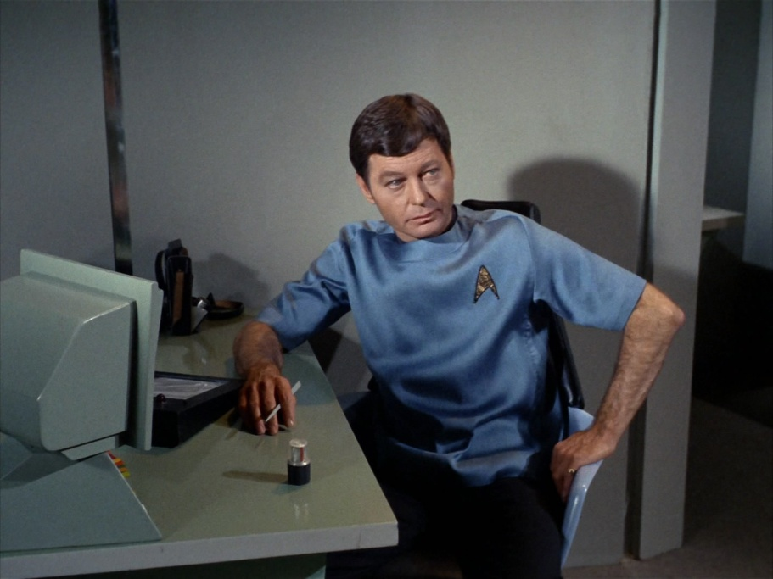
ITEC 715
Expert Perspective
Seeing the Solution in Different Ways
Captain Kirk has asked Dr. McCoy and Mr. Spock for advice. Each has a different perspective. Dr. McCoy offers a human, emotional point of view. Mr. Spock offers a logical, rational point of view.
Click each character to hear what he has to say. If you were in Captain Kirk’s position, who’s advice would you take?
Dr. McCoy’s Perspective
Dr. McCoy
Mr. Spock
Click each character to hear his perspective. Then click Next to continue.
Back
Menu
Next

Slide 17
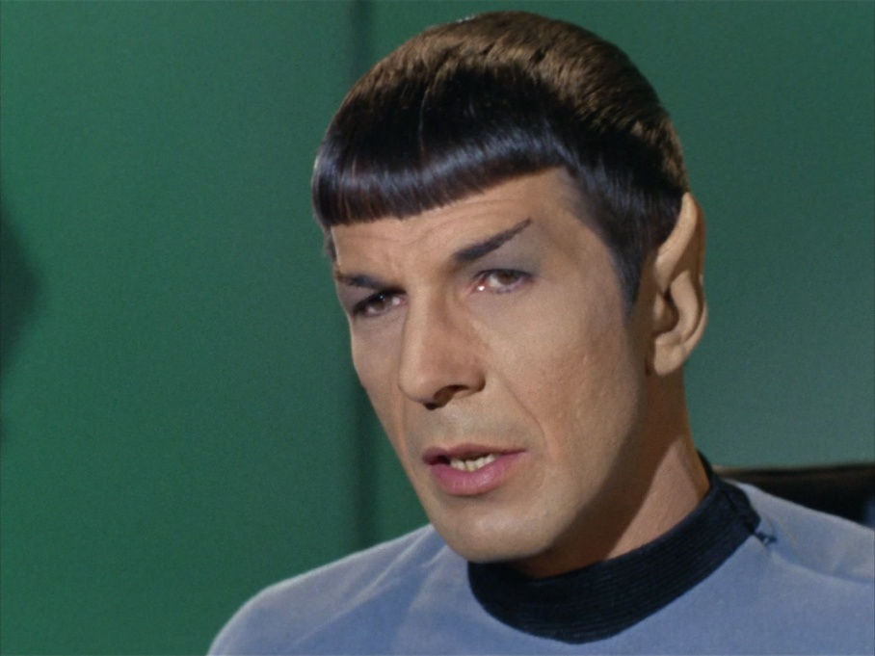
ITEC 715
Expert Perspective
Seeing the Solution in Different Ways
Captain Kirk has asked Dr. McCoy and Mr. Spock for advice. Each has a different perspective. Dr. McCoy offers a human, emotional point of view. Mr. Spock offers a logical, rational point of view.
Click each character to hear what he has to say. If you were in Captain Kirk’s position, who’s advice would you take?
Mr. Spock’s Perspective
Dr. McCoy
Mr. Spock
Click each character to hear his perspective. Then click Next to continue.
Back
Menu
Next

Slide 18
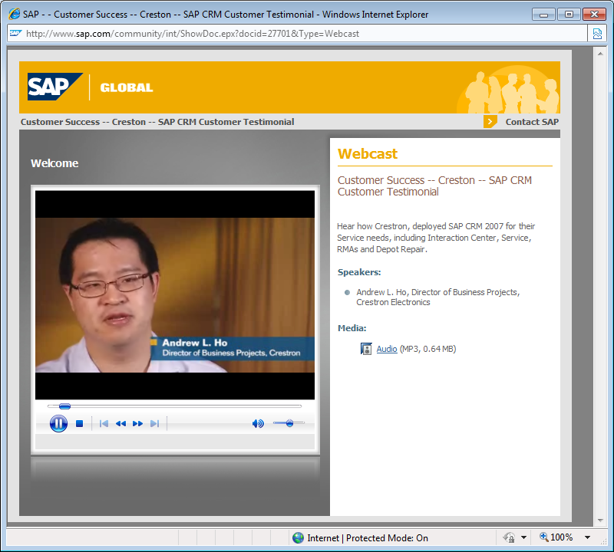
ITEC 715
Customer Testimonial

Slide 19
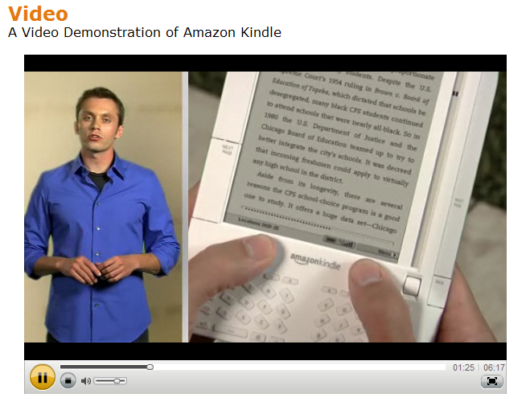
ITEC 715
Demonstration

Slide 20
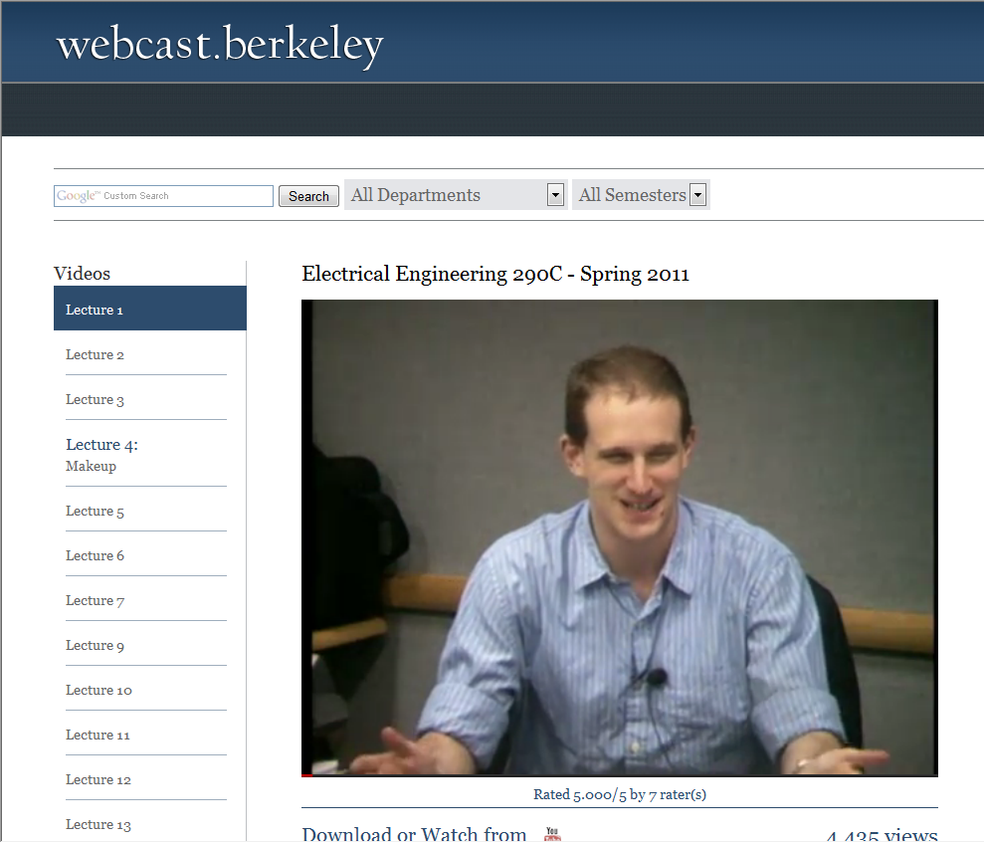
ITEC 715
Lecture

Slide 21
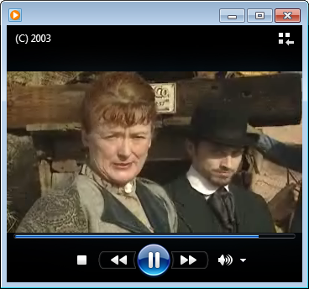
ITEC 715
Vignette

Slide 22

ITEC 715
Virtual Interaction/Branched Conversation
I can book your flight, accommodations, and rental car. Do you have a profile on file with us?
How do you respond to Hank?
Yes, I have a profile on file with you.
No, I do not have a profile on file with you.

Slide 23
Approaches
Notes:
Consider: Look & Feel; Functionality; Instructional Usefulness

Slide 24
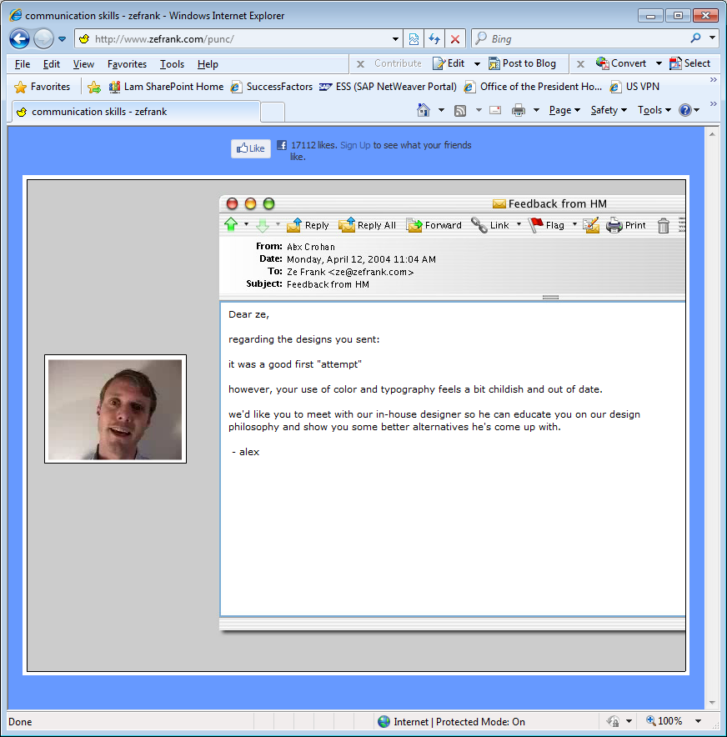
ITEC 715
Humor

Slide 25
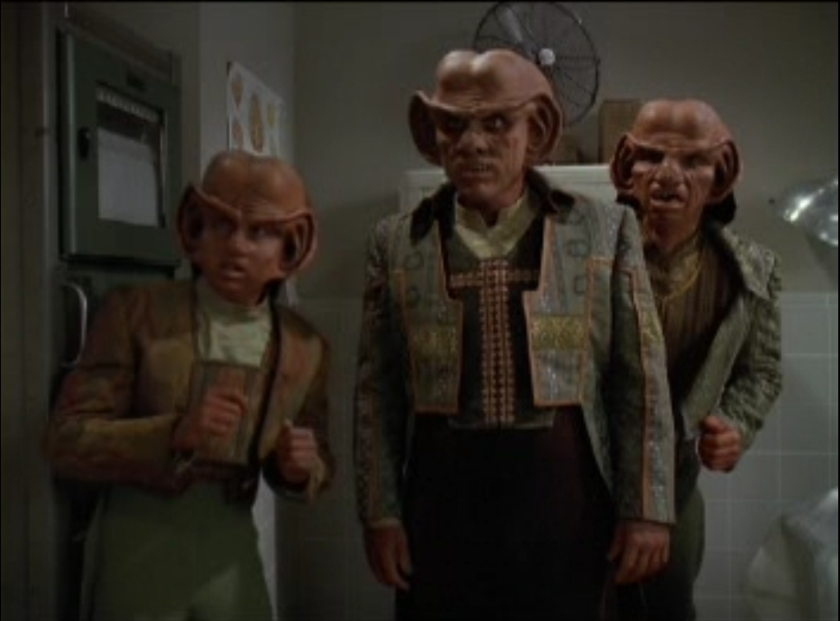
ITEC 715
The Genius and the Fool
Fool
Genius

Slide 26
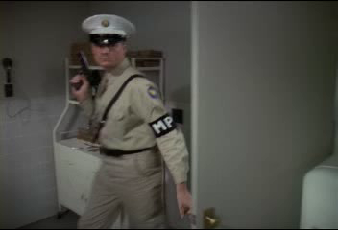
ITEC 715
The Genius and the Fool

Slide 27
Shooting Instructional Video
Top 10 Tips
Notes:
Consider: Look & Feel; Functionality; Instructional Usefulness

Slide 28
ITEC 715
Tips
Don’t use the built-in mic; use an external mic.
A few feet
A few inches
Microphone is far from subject
Microphone is near to subject

Slide 29
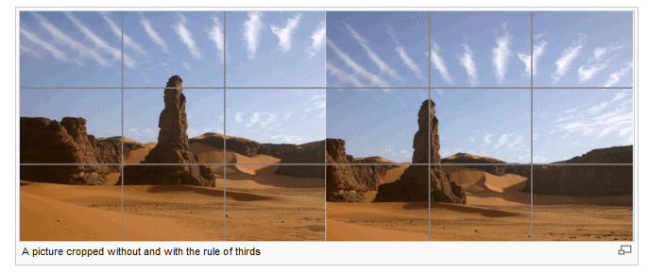
ITEC 715
Tips
Keep in mind the “rule of thirds” when framing your subjects.

Slide 30


ITEC 715
Tips
Don’t backlight your subject.
Backlit
Not backlit
NOTE: Using a back light (aka “hair and shoulder light”) in a three point lighting setup is fine; the “Don’t backlight” tip applies when the backlight is the only light source.

Slide 31
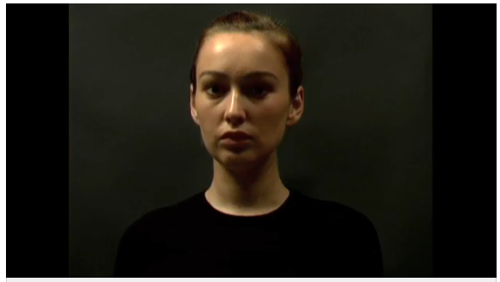
ITEC 715
Tips
Watch out for shadowy eye-sockets (a frequent problem when the only source of light is directly overhead).
Image source: http://video.about.com/desktopvideo/Lighting--Effect-of-Direction.htm

Slide 32
ITEC 715
Tips
You can use a cookie sheet, a windshield sun-screen, or a white posterboard to reflect light onto your subject.
Window: “Key” Light
Camera Operator
Subject
Assistant with reflective sheet: “Fill” Light

Slide 33


ITEC 715
Tips
Watch out for distracting backgrounds.
Are pine needles growing out of your subject’s head?

Slide 34
ITEC 715
Tips
Arrive at the shoot with a script and a plan.
  Depending on the complexity of the material you are shooting, you may need:
  A script
  A shot list
  A set of storyboards
  A scene-by-scene list of locations, actors, and props
  You may need to take continuity notes if you shoot scenes out of order or across multiple days.

Slide 35
ITEC 715
Tips
Use a teleprompter (if you have access to one) if your subject needs to read from the script.

Slide 36
ITEC 715
Tips
Use a tripod (unless you’re specifically aiming for a “raw news-footage” look)

Slide 37

ITEC 715
Tips
Keep a log during the shoot so that you will know which takes to keep and which to “leave on the cutting room floor.”
In this course, you will learn how to mow your lawn using only a nail clipper and a flashlight, open your garage door while trapped in interdimensional space, and carry 500 lbs of chicken feed in an empty Coca-cola can.
To aid you in your studies, this course will include loud, random noises and…

Slide 38
Editing
Notes:
Consider: Look & Feel; Functionality; Instructional Usefulness

Slide 39
ITEC 715
iMovie Demo
Overview
Editing clips
Adding titles
Exporting in the QuickTime MOV format

Slide 40
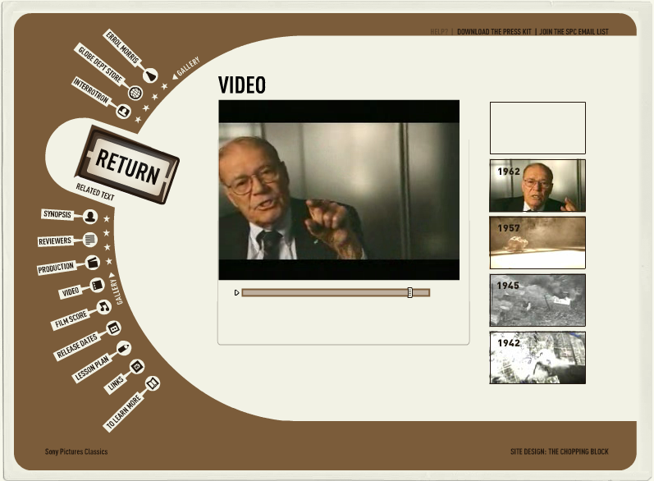
ITEC 715
Editing Strategies
Remove everything that’s not directly relevant to your instructional point.
Don’t worry about jumps or discontinuities in the video (see Fog of War)—you can do a short cross-fade between clips, or place a flash of light at the edit points if you want.

Slide 41
Context and Use
Notes:
Consider: Look & Feel; Functionality; Instructional Usefulness

Slide 42
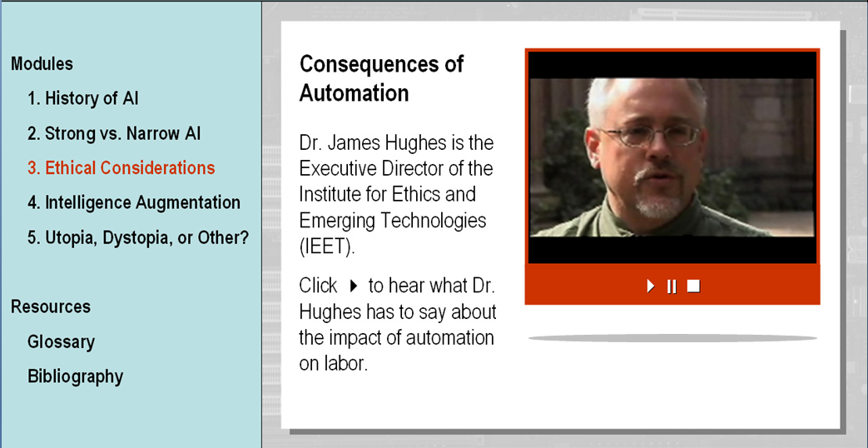
ITEC 715
What Else Should Be on the Page?
Dr. James Hughes is the executive director of the Institute for Emerging Ethics and Technologies (IEET). As you listen to Dr. Hughes, see if you can find the answers to the following question:
Why does Dr. Hughes think that advances in AI will require society to devise a new social contract with humanity?
When you’re ready, click the video to begin playing it.
Click 4 to begin the video.

Slide 43
ITEC 715
For Next Week
Shoot and edit a 30 second (or more) video of an expert speaking to a topic of relevance to your course.
Turn in the edited video in either the QuickTime MOV or Flash FLV format. Also turn in the scripted page of your course on which this video would be placed. You do not have to create any media controls or actually import the video clip onto the slide yet. Just turn in the video and the slide(s) as separate entities for next week.

